Slide 1
JavaScript
Notes:
30min intro
5min languages/web
5min walkthrough
15min callbacks
10min randomcircles
30min weatherbug

Slide 2
Python
JavaScript
Swift
HTML
Java
C
C++
Objective-C
Notes:
Each language is like a tool (hammer, wrench, Chris’s chainsaw, screwdriver) – they all help you build the same thing, but each specializes in something special

Slide 3
The Web!

Slide 4

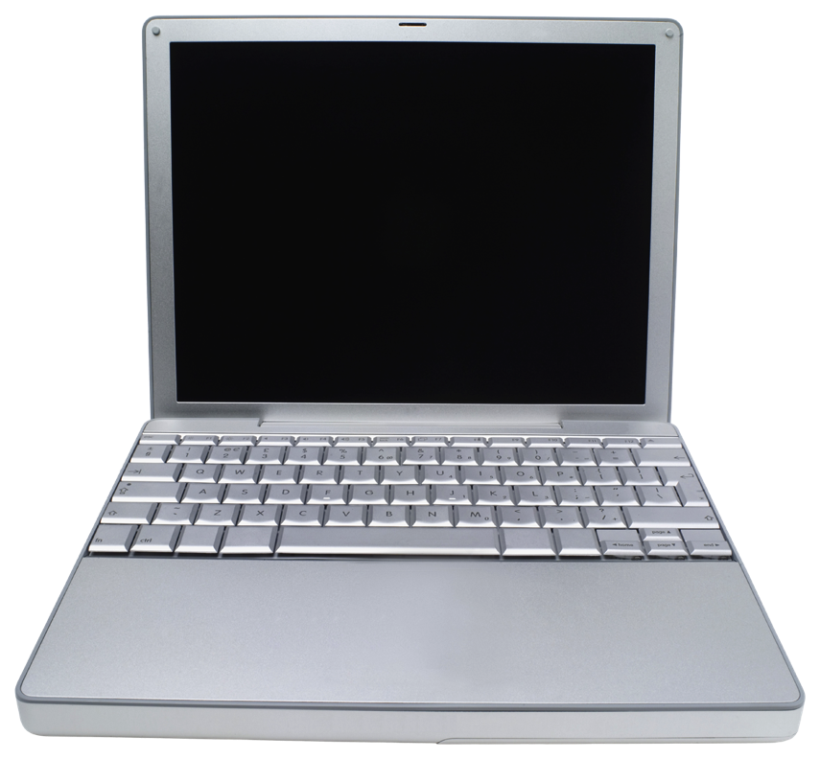
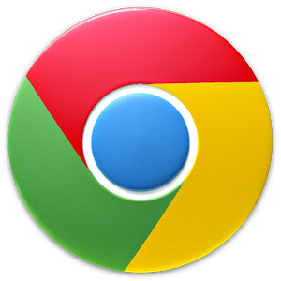
Notes:
If you download something, you have to constantly download updates
But on the web, all you have to do is refresh!

Slide 5
Cool! How do I write JS?
Notes:
Walkthrough:
Variables – no types!
Add 2 numbers – no int division!
Strings and concatenating numbers
Functions
Declaring – no return type
sum() example

Slide 6
Functions
Notes:
Walkthrough:
Variables – no types!
Add 2 numbers – no int division!
Strings and concatenating numbers
Functions
Declaring – no return type
sum() example

Slide 7


Slide 8
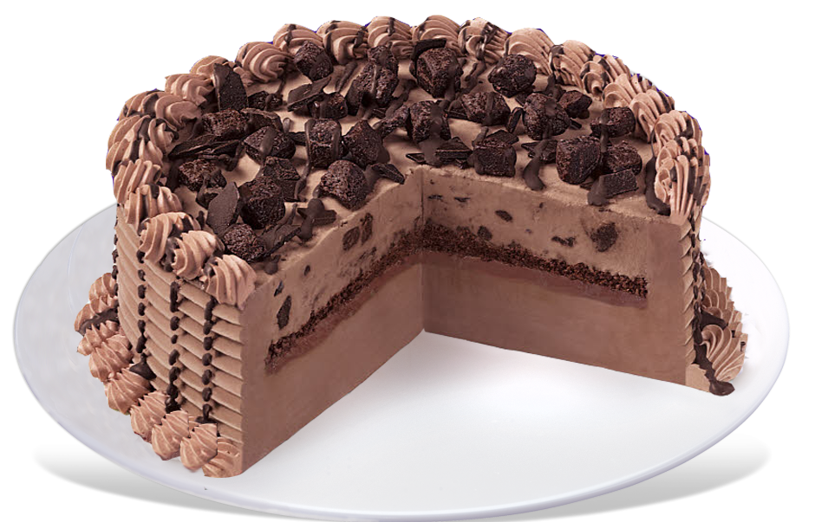

Slide 9
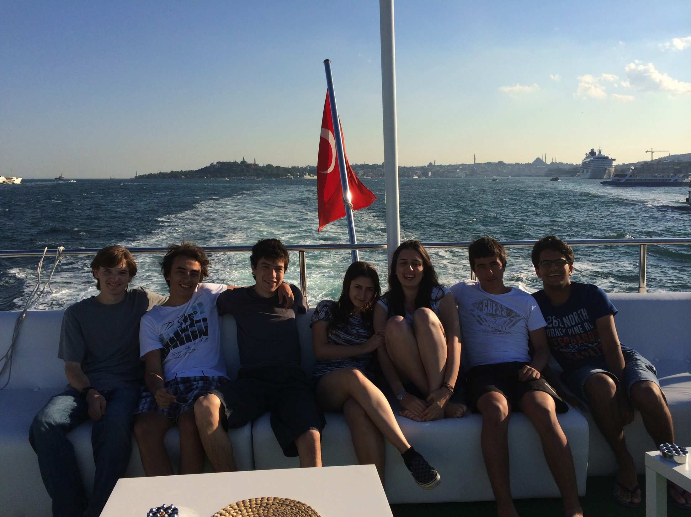

Slide 10

Done!

Slide 11
Done!
Notes:
Instead, callbacks let you continue surfing the page and get a notification when the photo is finished uploading.
This comes in handy for network calls and for interactors (mouse events, etc.)
randomCircles

Slide 12
Random Circles!

Slide 13
WeatherBug

Slide 14
displayStatusMessage(message)
displays message at the bottom of the screen.
fetchWeatherForQuery(place, numDays, successFn, errorFn)
fetches the weather for the next numDays days for place. If successful, the success callback is called and passed the weather data. If unsuccessful, the error callback is called.
fetchWeatherForCoordinates(lat, lon, numDays, successFn, errorFn)
fetches the weather for the next numDays days for place. If successful, the success callback is called and passed the weather data. If unsuccessful, the error callback is called.
getCurrentLocation(callback)
Fetches the user’s current location, and calls the callback. The callback should take 2 parameters – the user’s latitude and longitude.
addButton(buttonText, callback)
Adds a button that displays buttonText to the screen. Every time the button is clicked, the callback is executed.
Notes:
Show JS hack at the end

