Slide 1
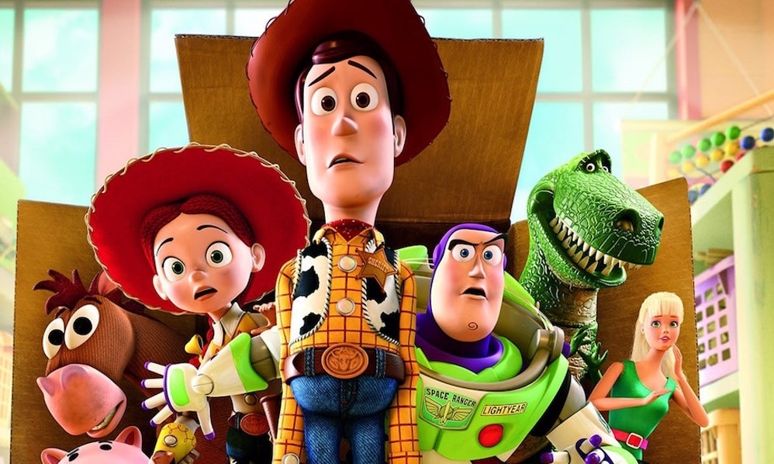

Graphics

Slide 2
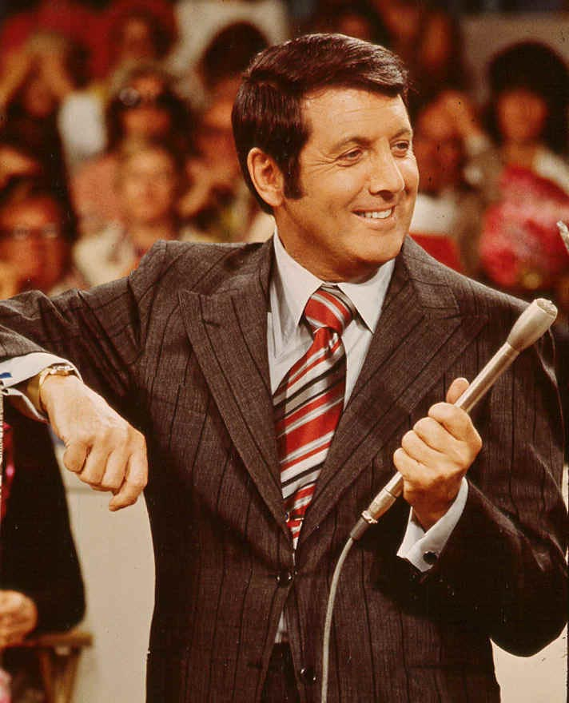
CSBridge Game Show

Slide 3
Or and And
// 1. Get a door number from the user
int doorChoice = readInt(”Choose a door: ");
while(doorChoice < 1 || doorChoice > 3) {
println(”Choose a door number between 1 and 3");
doorChoice = readInt(”Choose a door: ");
}
or
|| or
&& and

Slide 4
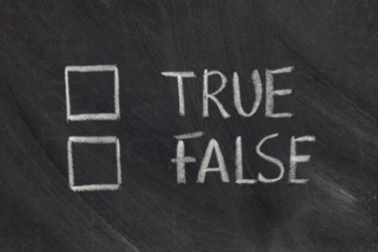
Boolean

Slide 5
Boolean Variable
boolean karelIsAwesome = true;
boolean myBool = 1 < 2;

Slide 6
Boolean Operations
boolean a = true;
boolean b = false;
//This is false
boolean a_and_b = a && b;
//This is true
boolean a_or_b = a || b;
//This is false
boolean not_a = !a;

Slide 7
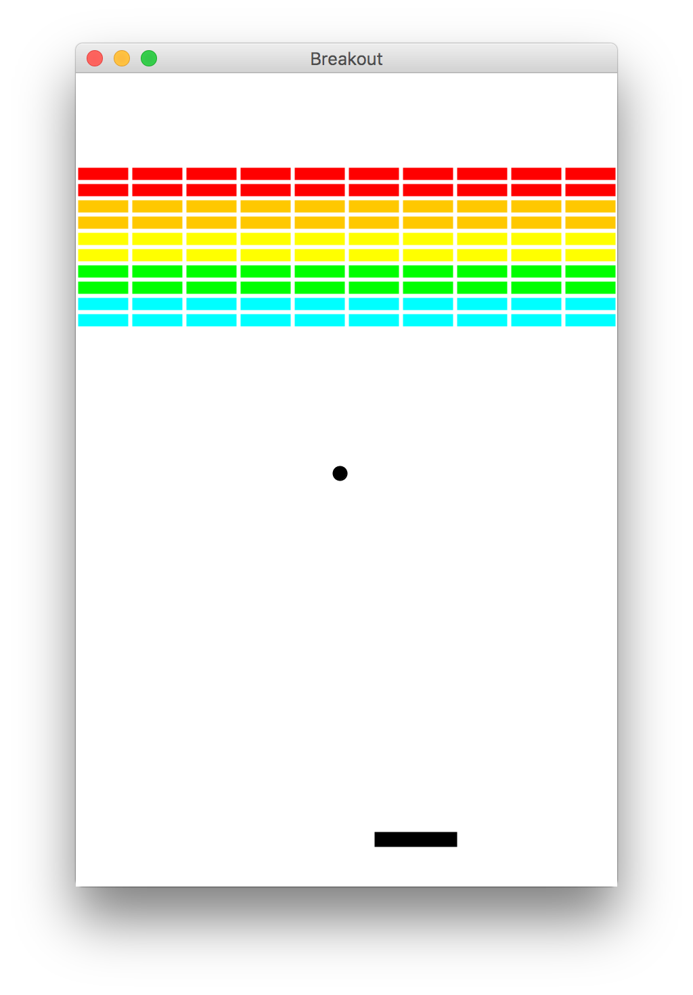
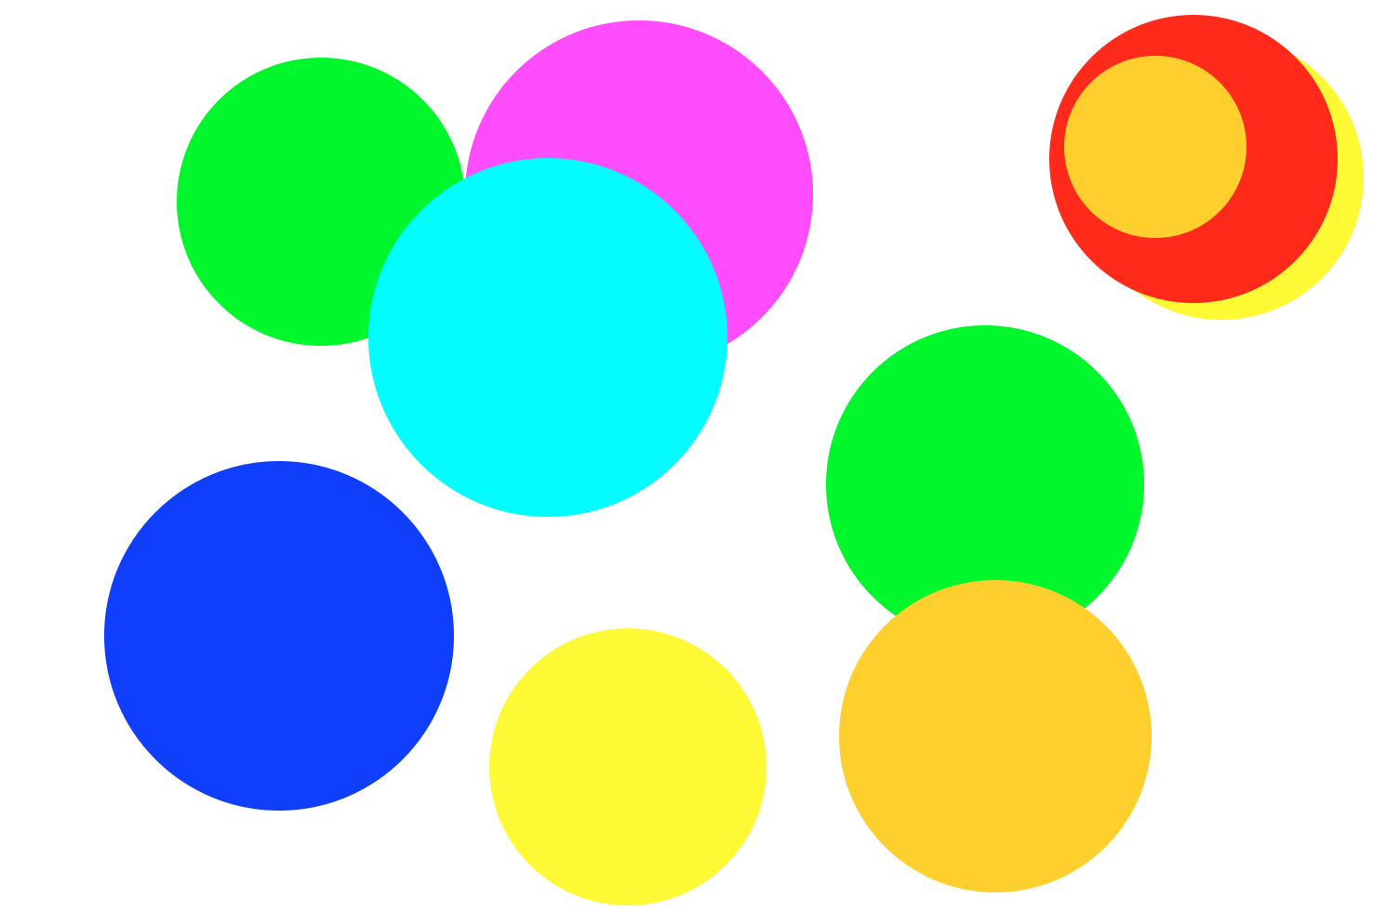
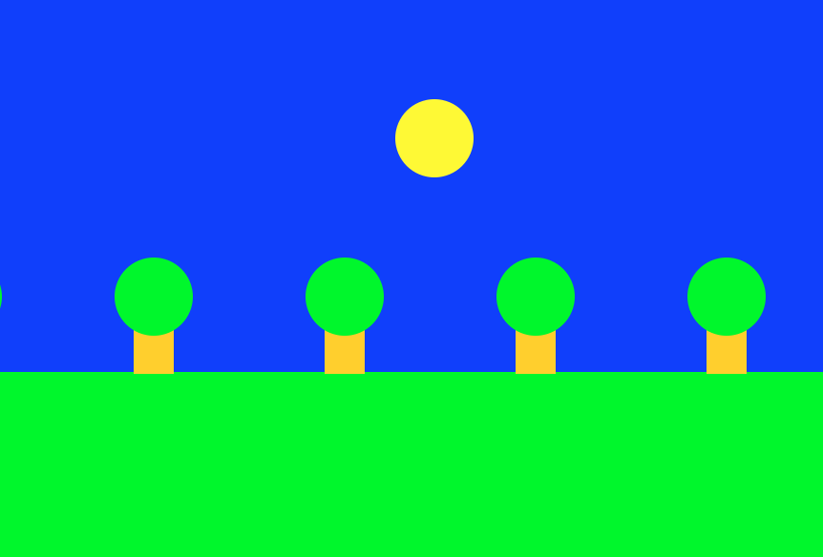
Beyond Console Programs

Slide 8
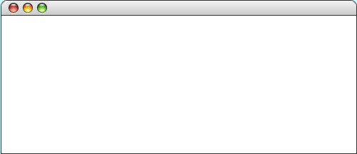
GRect
GRect is a variable that stores a rectangle.
As an example, the following run method displays a rectangle
public void run() {
GRect rect = new GRect(200, 200);
rect.setFilled(true);
rect.setColor(Color.BLUE);
add(rect, 50, 50);
}
LargestOval

Slide 9
GRect
GRect is a variable that stores a rectangle.
As an example, the following run method displays a rectangle
public void run() {
GRect rect = new GRect(200, 200);
rect.setFilled(true);
rect.setColor(Color.BLUE);
add(rect, 50, 50);
}
LargestOval
Coordinates for a rectangle are the top left corner.
50
50

Slide 10
Graphics Coordinates
0,0
40,20
120,40
getHeight();
40,120
getWidth();

Slide 11
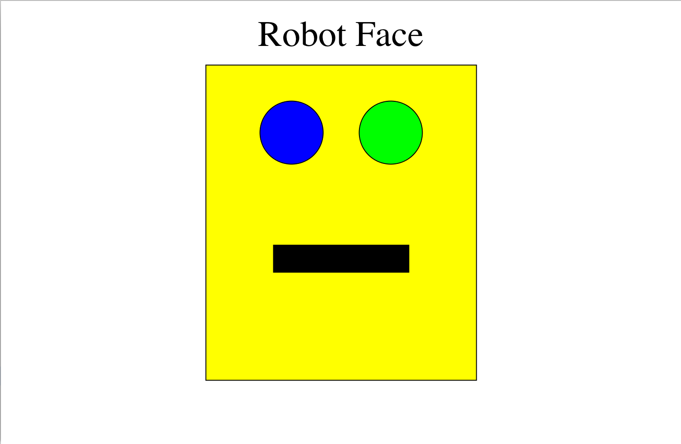
Karel’s Grandpa

Slide 12
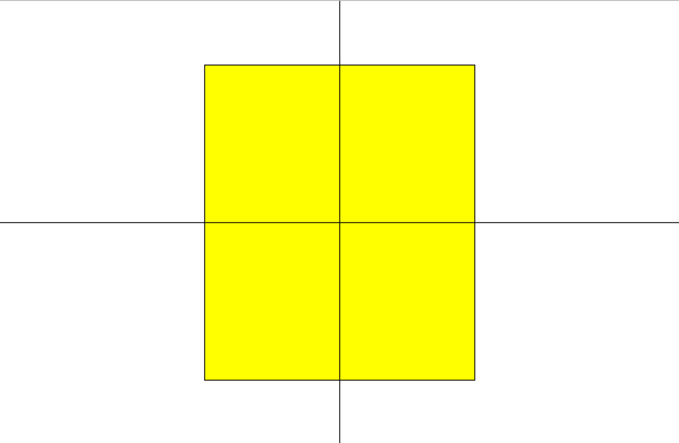
Karel’s Grandpa

Slide 13
Karel’s Grandpa
rect.getWidth() / 2
getWidth() / 2

Slide 14
Karel’s Grandpa
rect.getHeight() / 2
getHeight() / 2

Slide 15
Constants

Slide 16
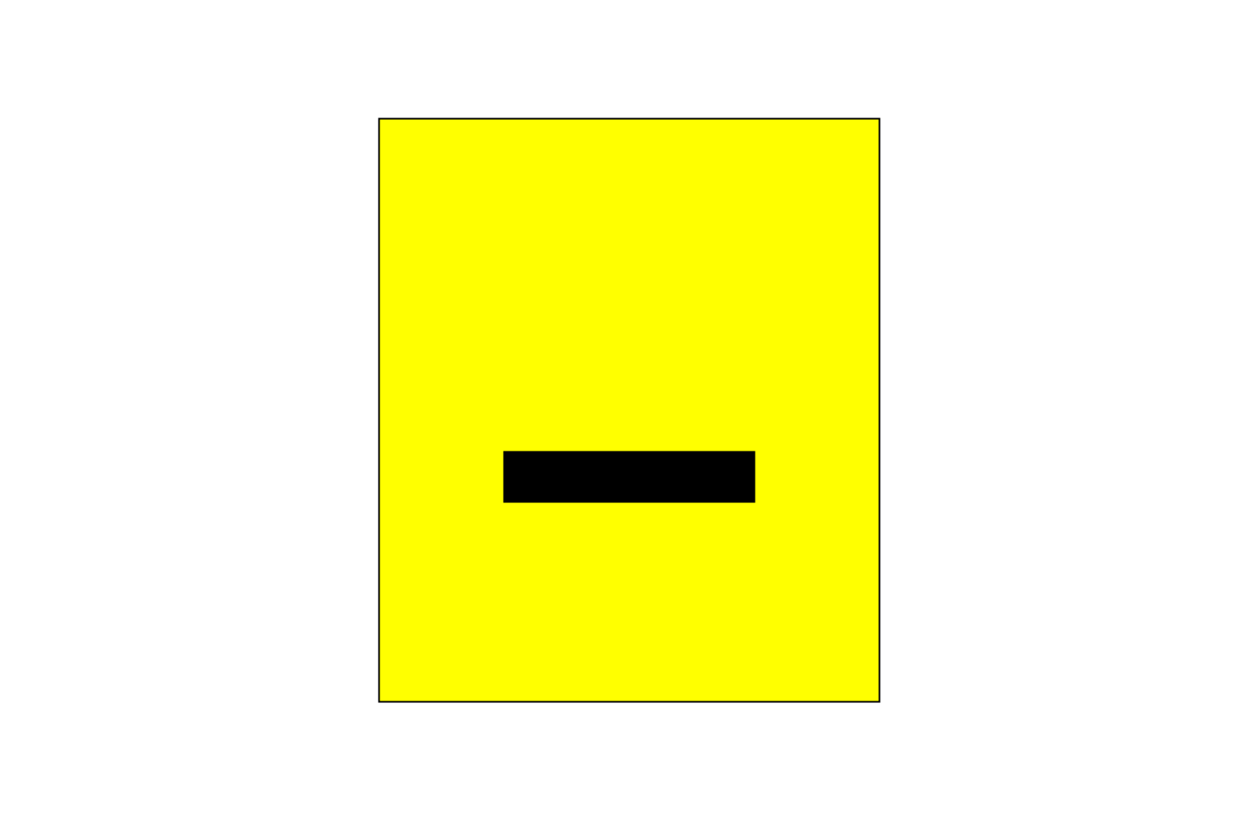
Karel’s Grandpa

Slide 17
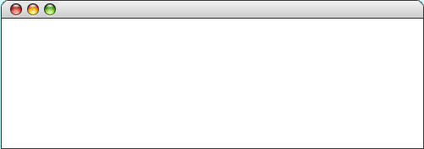
GLabel
A variable that represents text.
public class HelloProgram extends GraphicsProgram {
public void run() {
GLabel label = new GLabel(”hello, world”, 100, 75);
label.setFont(“SansSerif-36”);
label.setColor(Color.RED);
add(label);
}
}
HelloProgram
HelloProgram
hello, world

Slide 18
GLabel
A variable that represents text.
public class HelloProgram extends GraphicsProgram {
public void run() {
GLabel label = new GLabel(”hello, world”, 100, 75);
label.setFont(“SansSerif-36”);
label.setColor(Color.RED);
add(label);
}
}
HelloProgram
HelloProgram
75
hello, world
100

Slide 19
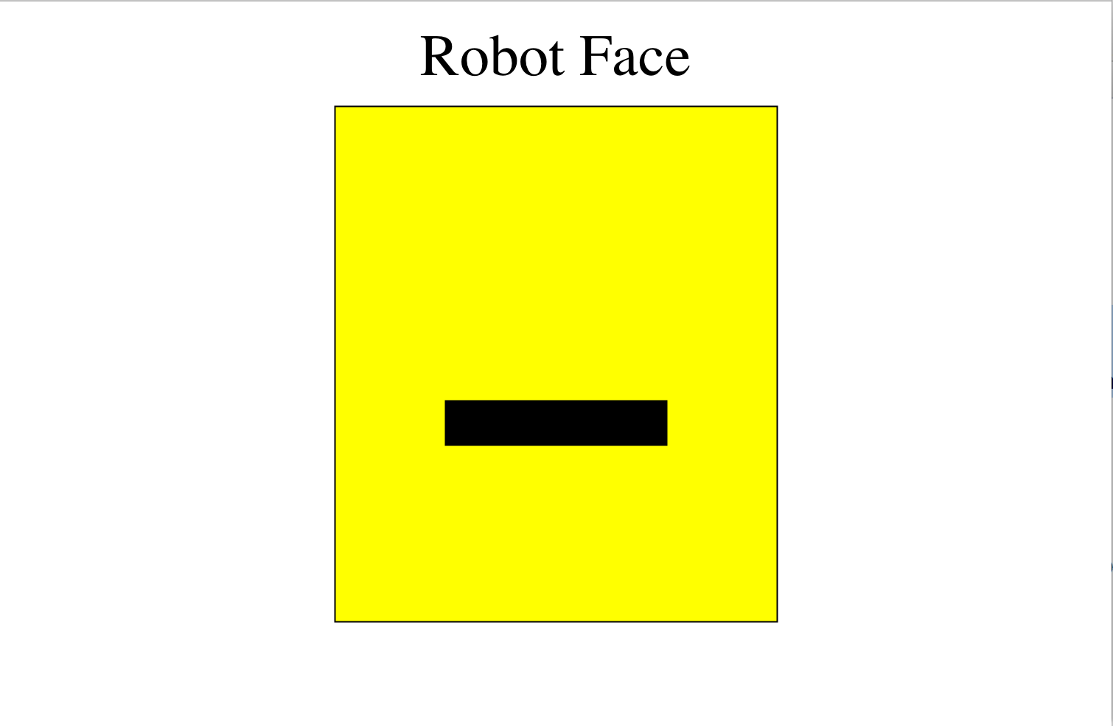
Karel’s Grandpa

Slide 20
GOval
The GOval class represents an elliptical shape defined by the boundaries of its enclosing rectangle.
As an example, the following run method creates the largest oval that fits within the canvas:
public void run() {
GOval oval = new GOval(getWidth(), getHeight());
oval.setFilled(true);
oval.setColor(Color.GREEN);
add(oval, 0, 0);
}
LargestOval

Slide 21

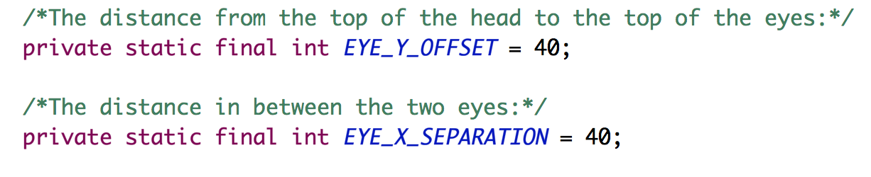
Karel’s Grandpa

Slide 22
Karel’s Grandpa

Slide 23
Graphics Methods
add(object)
Adds the object to the canvas at the front of the stack
add(object, x, y)
Moves the object to (x, y) and then adds it to the canvas
remove(object)
Removes the object from the canvas
removeAll()
Removes all objects from the canvas
getElementAt(x, y)
Returns the frontmost object at (x, y), or null if none
getWidth()
Returns the width in pixels of the entire canvas
getHeight()
Returns the height in pixels of the entire canvas
setBackground(c)
Sets the background color of the canvas to c.
pause(milliseconds)
Pauses the program for the specified time in milliseconds
waitForClick()
Suspends the program until the user clicks the mouse

Slide 24
Graphics Methods
add(object)
Adds the object to the canvas at the front of the stack
add(object, x, y)
Moves the object to (x, y) and then adds it to the canvas
remove(object)
Removes the object from the canvas
removeAll()
Removes all objects from the canvas
getElementAt(x, y)
Returns the frontmost object at (x, y), or null if none
getWidth()
Returns the width in pixels of the entire canvas
getHeight()
Returns the height in pixels of the entire canvas
setBackground(c)
Sets the background color of the canvas to c.
pause(milliseconds)
Pauses the program for the specified time in milliseconds
waitForClick()
Suspends the program until the user clicks the mouse

Slide 25
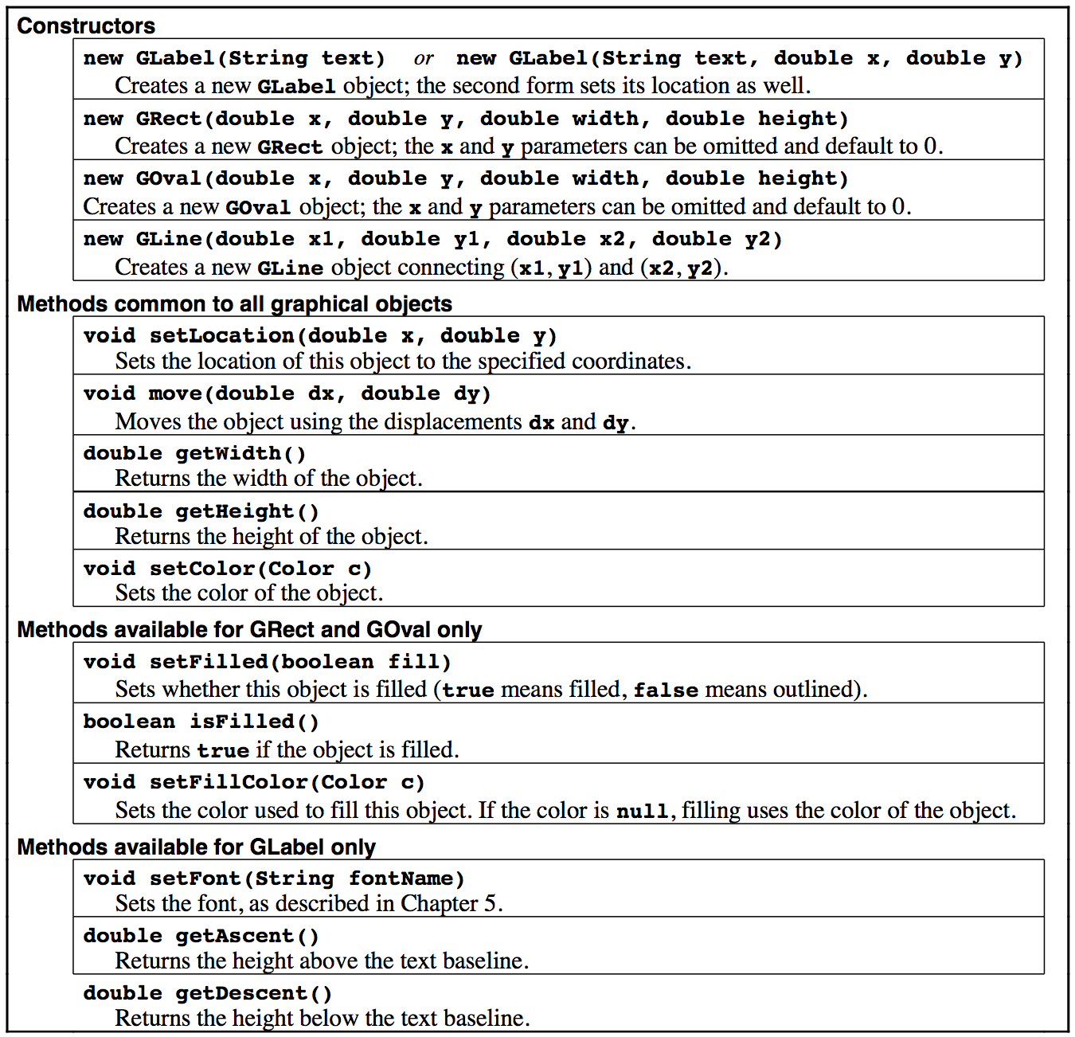
Reference Sheet

Slide 26
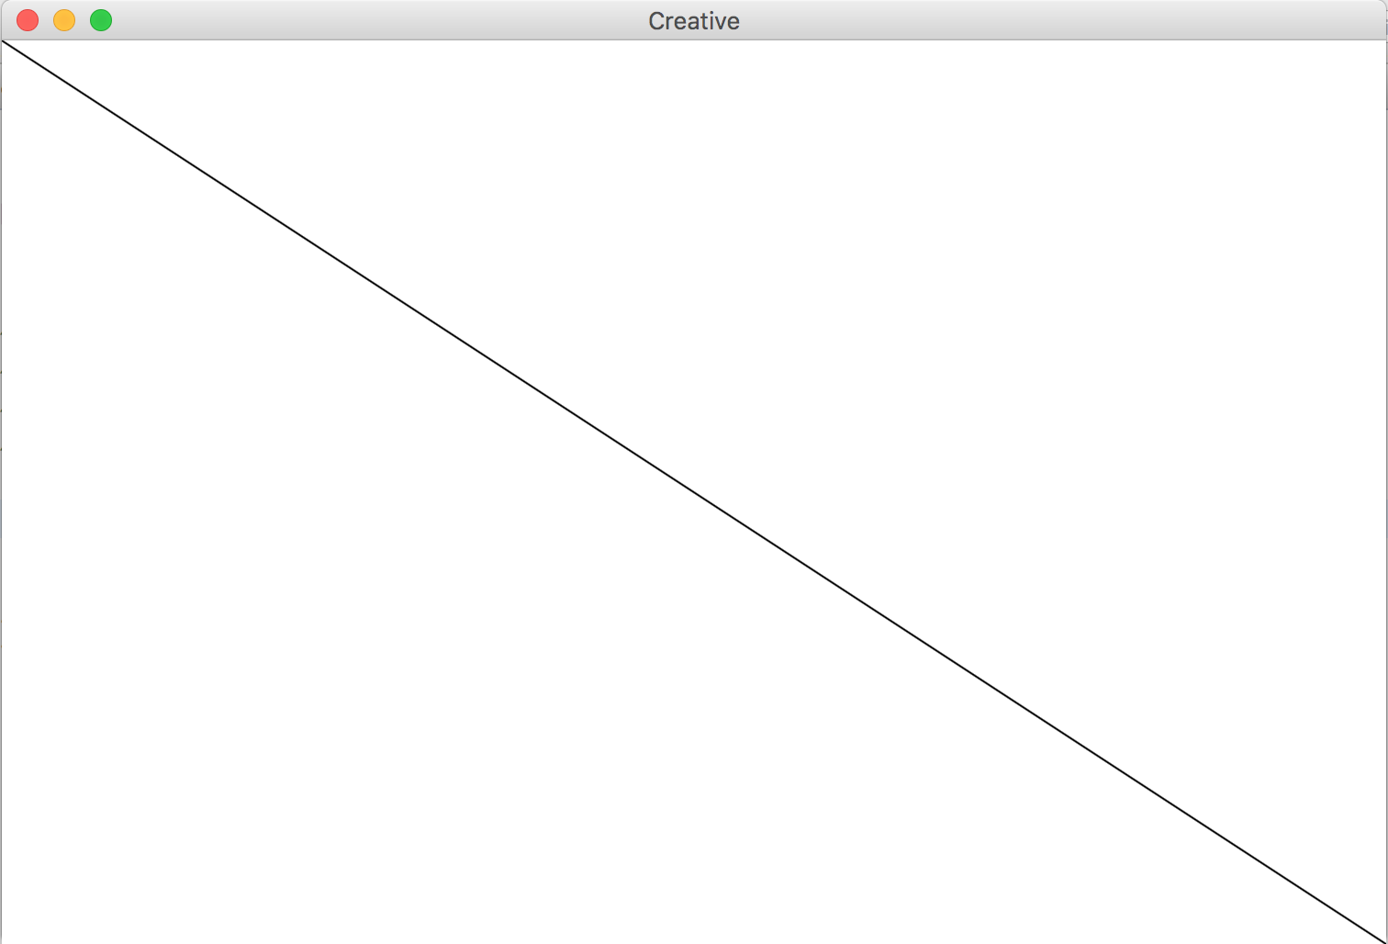
GLine
The GLine class represents a line defined by a start point and an end point.
As an example, the following run method creates a diagonal line across the canvas:
public void run() {
GLine line = new GLine(0,0, getWidth(), getHeight());
add(line);
}

Slide 27
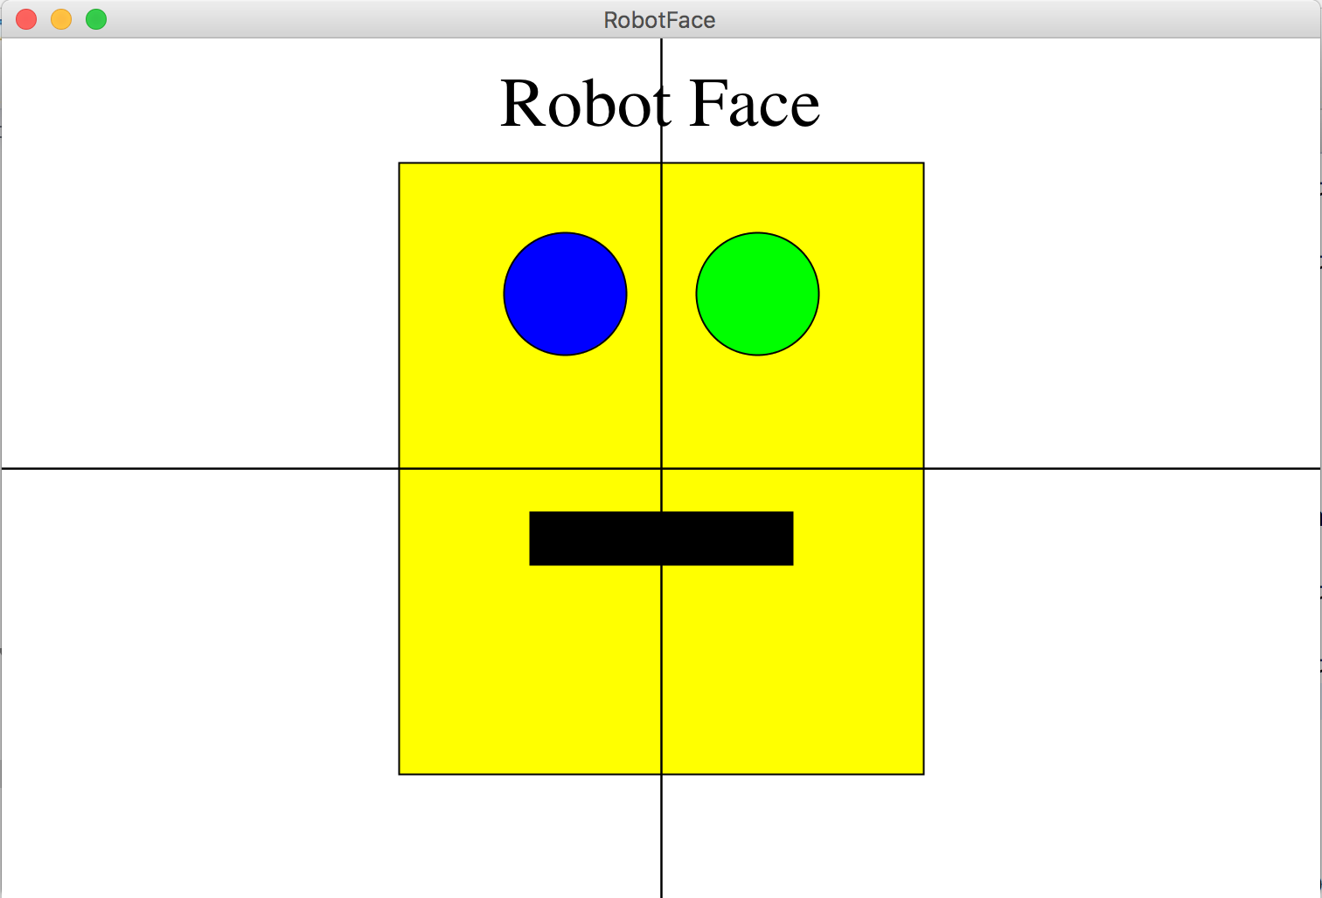
Karel’s Grandpa

