Slide 1

CSCI E-25 Computer Vision
Attention and Transformers
Steve Elston
Copyright 2023, Stephen F Elston. All rights reserved.

Slide 2
Transformers for Computer Vision
Transformers are seen as an alternative to CNNs
CNNs have revolutionized a several CV application
CNNs have inductive biases
Good localization
Translation invariance
CNNs are not robust to rotation
Transformers are seen as a possible alternative to CNNs

Slide 3
Transformers for Computer Vision
Transformers are seen as an alternative to CNNs
Transformers are seen as a possible alternative to CNNs
Transformers are rotationally invariant
But…………
Transformer architectures have yet to show superior performance to CNNs
Transformers have higher computational complexity when compared to CNNs

Slide 4
Transformers for Computer Vision
Transformer architecture
Multi-head attention
Recurrent architecture
Training on massive datasets
Unsupervised training
Transformer architectures use no convolutional layers

Slide 5
Attention for CV
Images of real-world scenes have a significant spatial extent
Non-local attention adds non-local behavior to model
Attention map weights which pixels are most important in scene
Attention map contains pixel specific activations

Slide 6
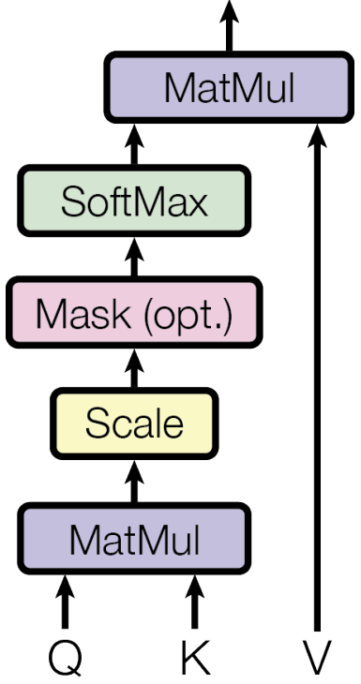
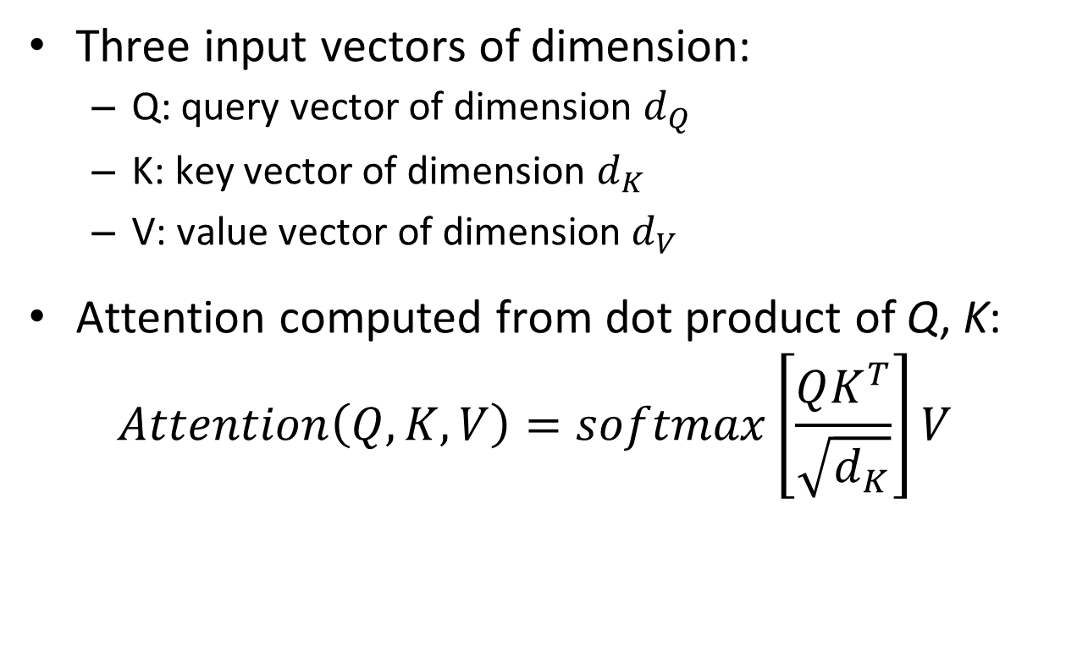
Attention for CV
Transformer architecture uses scalable dot product attention
Three input vectors of dimension:
Q: query vector of dimension $d_{Q}$
K: key vector of dimension $d_{K}$
V: value vector of dimension $d_{V}$
Attention computed from dot product of Q, K:
$$Attention\left(Q,K,V\right)=softmax\left[\frac{QK^{T}}{\sqrt{d_{K}}}\right]V$$
From Vaswani, et.al., 2016

Slide 7

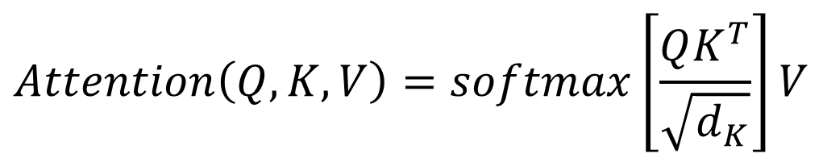
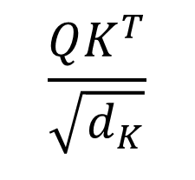
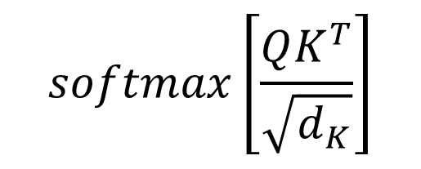
Attention for CV
Transformer architecture uses scalable dot product attention
$$Attention\left(Q,K,V\right)=softmax\left[\frac{QK^{T}}{\sqrt{d_{K}}}\right]V$$
$$softmax\left[\frac{QK^{T}}{\sqrt{d_{K}}}\right]$$
Mask prevents ‘backward’ information leakage in sequence
$$\frac{QK^{T}}{\sqrt{d_{K}}}$$
$$QK^{T}$$
From Vaswani, et.al., 2016

Slide 8

Attention for CV
Transformer architecture uses scaled dot-product self attention
For self attention $Q=K=V$
Where $Q, K, V=$ pixel values
In other words, self attention is dot product attention of the image with itself
From Vaswani, et.al., 2016

Slide 9
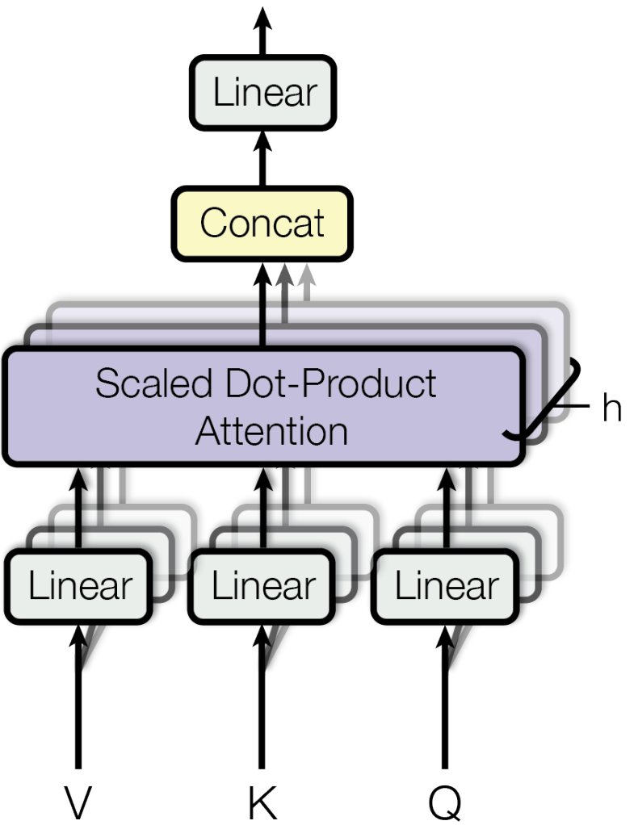
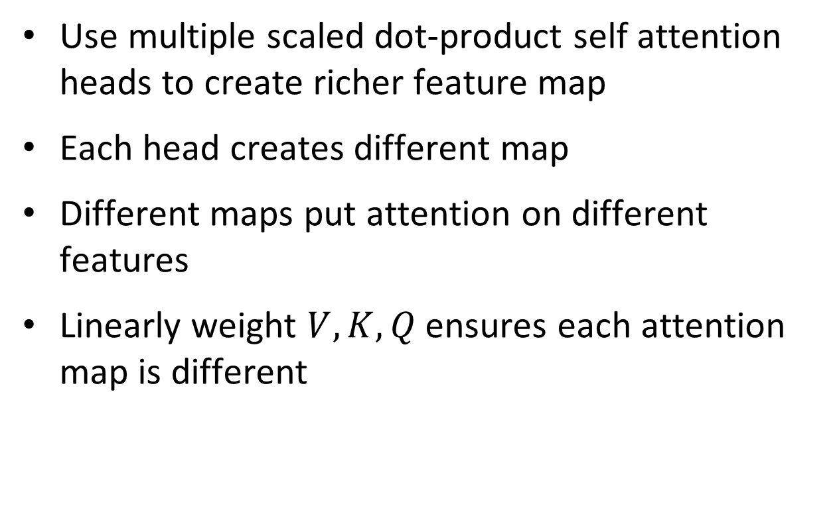
Attention for CV
Transformer architecture multi-headed self attention
Use multiple scaled dot-product self attention heads to create richer feature map
Each head creates different map
Different maps put attention on different features
Linearly weight $V,K,Q$ ensures each attention map is different
From Vaswani, et.al., 2016

Slide 10
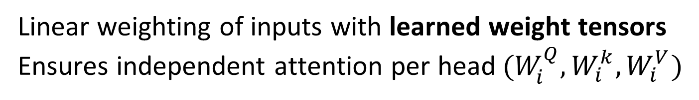
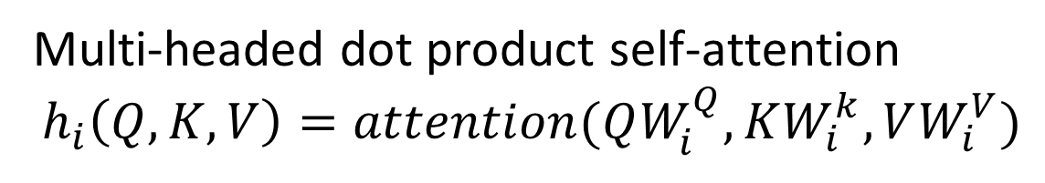
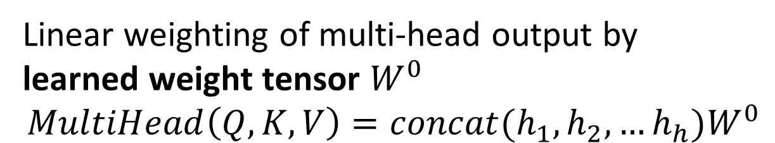

Attention for CV
Transformer architecture multi-headed self attention
Linear weighting of multi-head output by
learned weight tensor $W^{0}$
$$MultiHead\left(Q,K,V\right)=concat(h_{1},h_{2},…h_{h})W^{0}$$
Concatenate output of h attention heads
$$concat(h_{1},h_{2},…h_{h})$$
Multi-headed dot product self-attention
$$h_{i}\left(Q,K,V\right)=attention(QW_{i}^{Q},KW_{i}^{k},VW_{i}^{V})$$
Linear weighting of inputs with learned weight tensors
Ensures independent attention per head$(W_{i}^{Q},W_{i}^{k},W_{i}^{V})$
From Vaswani, et.al., 2016

Slide 11
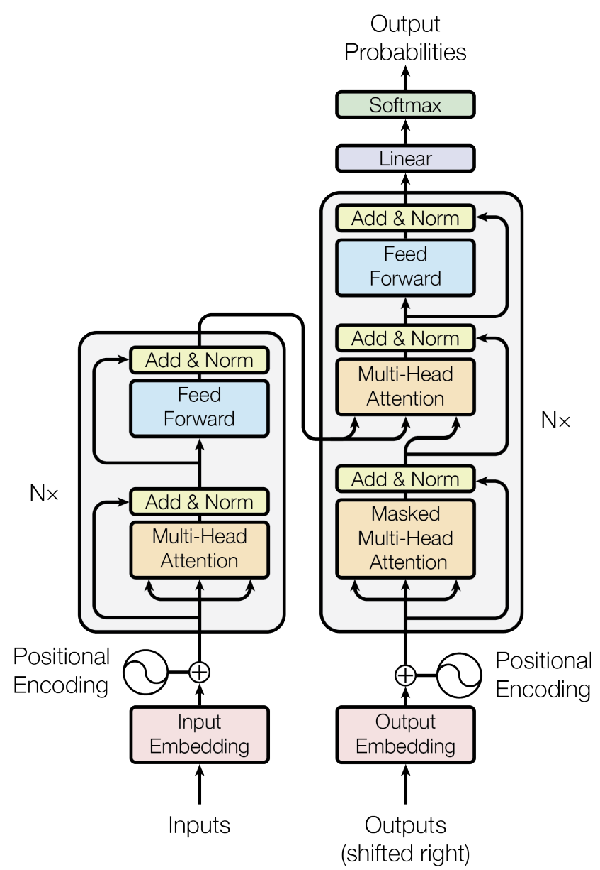
Transformer layer
Transformer architecture comprised of multiple transformer layers
Transformer architecture uses multiple transformer layers
Is an encoder-decoder architecture
Each transformer layer is composed of three units
Input encodes data values – image
Outputs encoded from previous layers
Output, decoder producing probabilities
From Vaswani, et.al., 2016

Slide 12
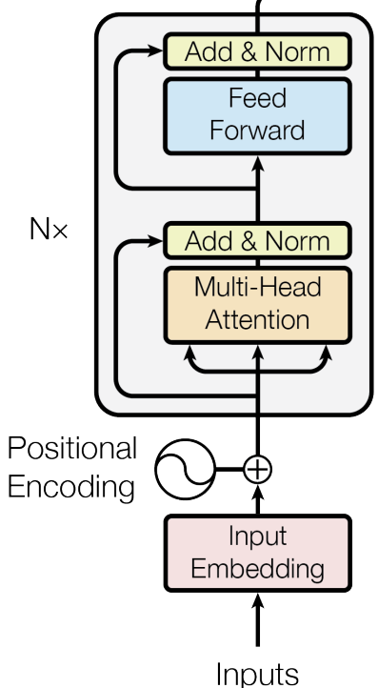
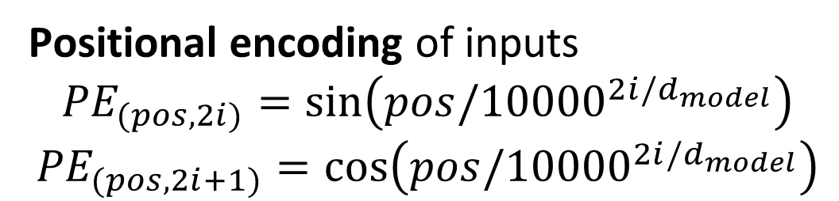
Attention for CV
Dot product self attention head for input encoder
Residual loops
Fully connected layer with learned weight tensor
Multi-head dot product self-attention
Positional encoding of inputs
$${PE}_{(pos,2i)}=\sin\left(pos/{10000}^{2i/d_{model}}\right)$$
$${PE}_{(pos,2i+1)}=cos⁡\left(pos/{10000}^{2i/d_{model}}\right)$$
Linear embedding with learned weight tensor
From Vaswani, et.al., 2016

Slide 13
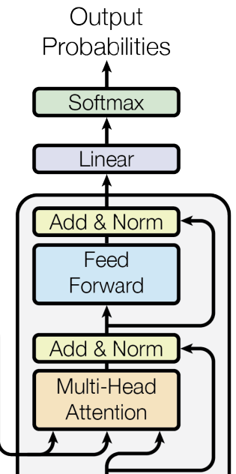
Attention for CV
Dot product multi-headed self attention output decoder
Softmax squashes output to probabilities
Linear weighting of multi-head output by learned weight tensor
Residual loop
Fully connected network with learned weight tensor
Residual loop of V from previous layer encoder
Multi-head self-attention with K, Q from input encoder and V from previous layer encoder
K, Q
V
From Vaswani, et.al., 2016

Slide 14
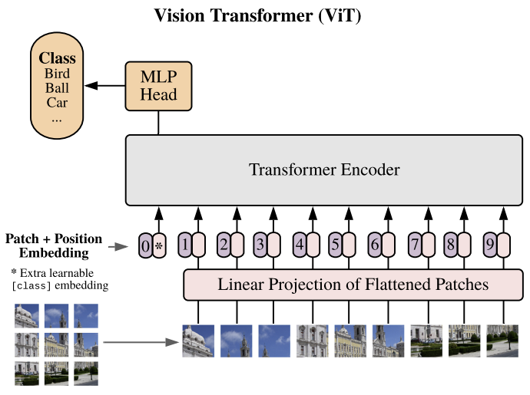
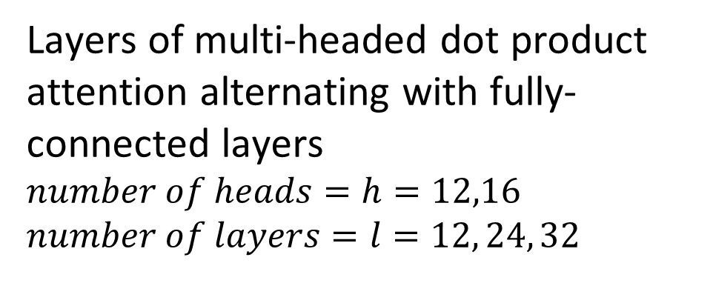
Vision Transformer (ViT) Architecture
We now have all the components to put the ViT model together
Fully connected multi-layer classifier uses attention feature map
Layers of multi-headed dot product attention alternating with fully-connected layers
$number of heads=h=12,16$
$number of layers=l=12, 24, 32$
Sequence of patch PCAs with position embedding
Partition input image into patches
Sequence of patches
From Dosoviskiy, et.al., 2021

Slide 15
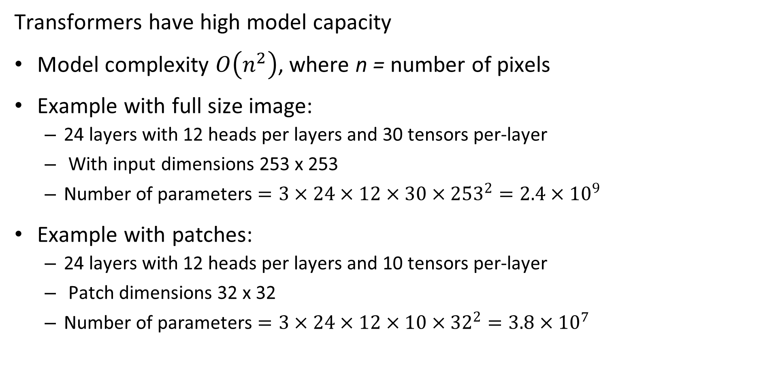
Why Use Patches?
Transformers have high model capacity
Model complexity $O\left(n^{2}\right)$, where n = number of pixels
Example with full size image:
24 layers with 12 heads per layers and 30 tensors per-layer
With input dimensions 253 x 253
Number of parameters $=3×24×12×30×{253}^{2}=2.4×{10}^{9}$
Example with patches:
24 layers with 12 heads per layers and 10 tensors per-layer
Patch dimensions 32 x 32
Number of parameters $=3×24×12×10×{32}^{2}=3.8×{10}^{7}$

Slide 16
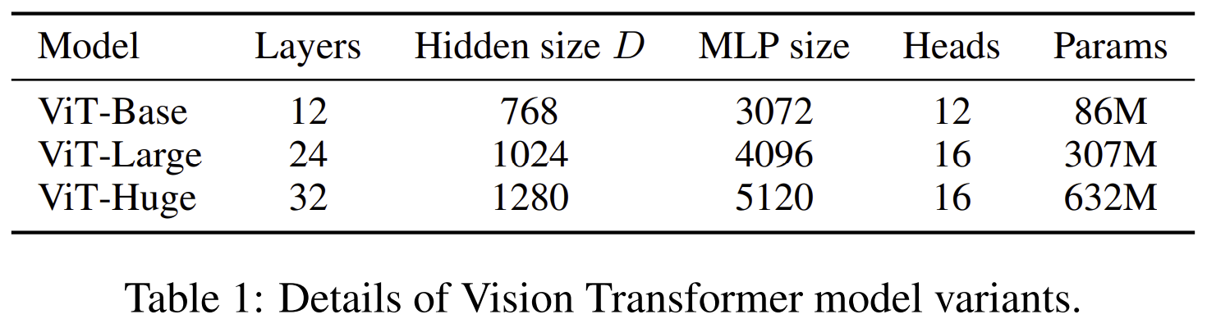
Family of ViT Architectures
Can trade-off model complexity for accuracy with ViT model

Slide 17
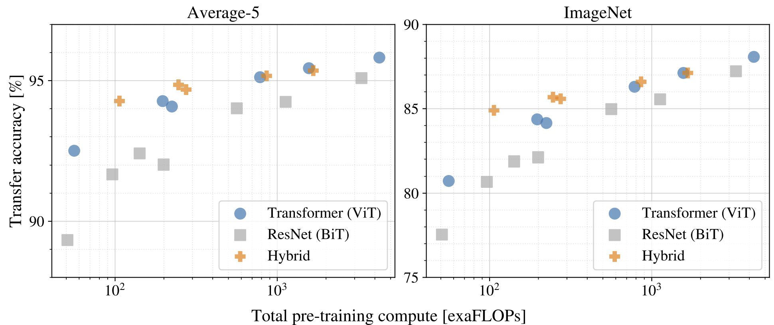
How Does the ViT Performance Compare?
Trade-off od complexity and accuracy comparable to CNN models

Slide 18
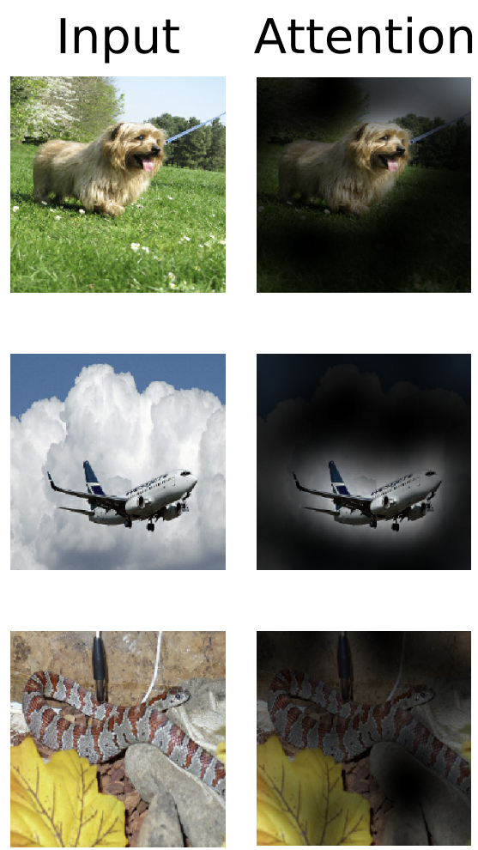
Attention Activations
What do the activations of the ViT model look like?
Compare input image to attention
Attention high for regions with objects of interest
From Dosoviskiy, et.al., 2021

Slide 19
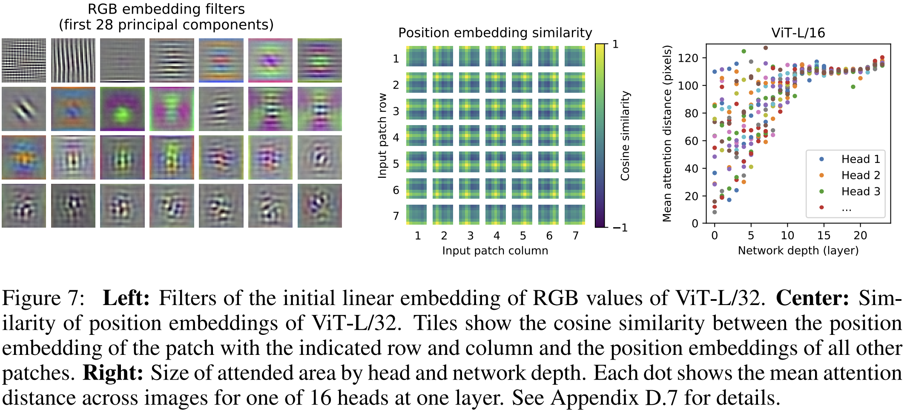
Attention Characteristics
What are the characteristics of the embedding and attention?
PCA embedding and distance in attended area
From Dosoviskiy, et.al., 2021

Slide 20
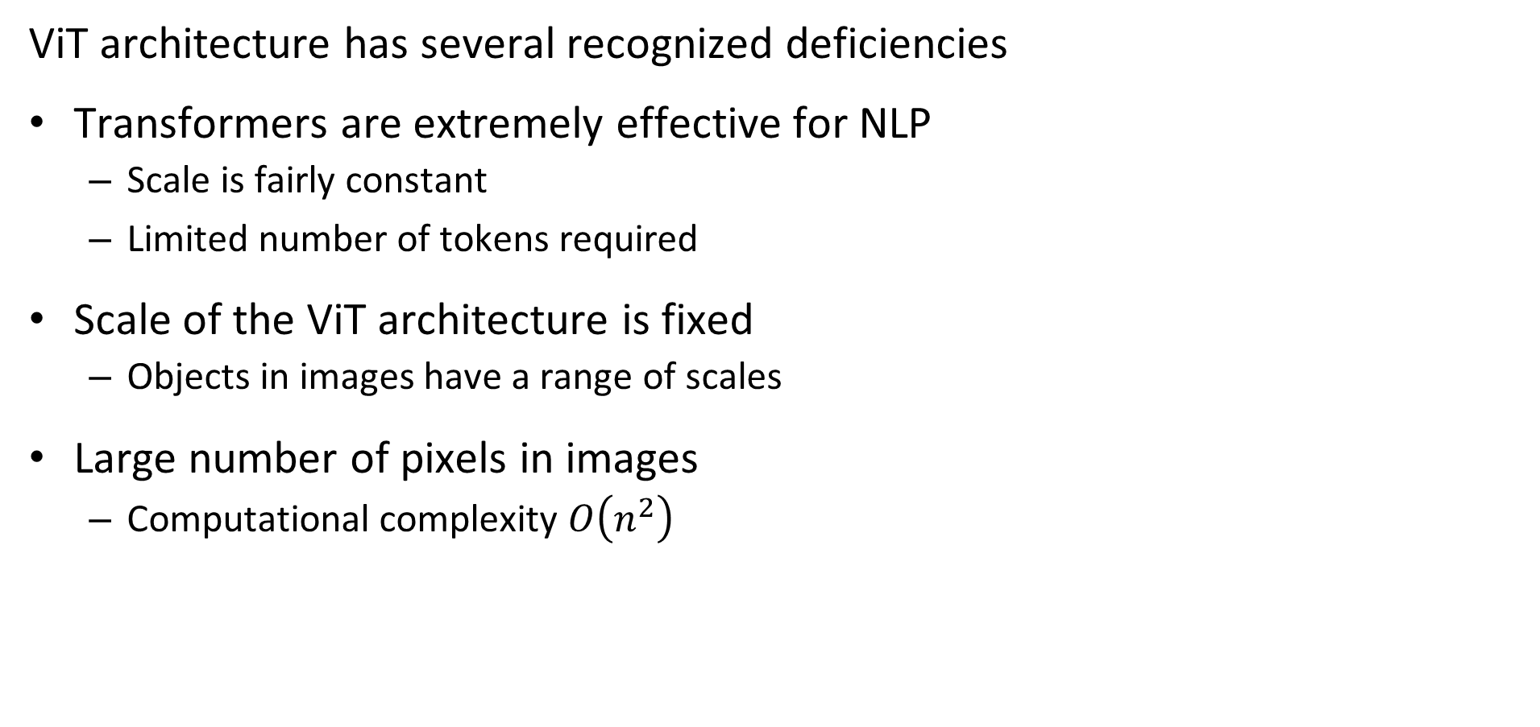
Deficiencies of ViT Architecture
ViT architecture has several recognized deficiencies
Transformers are extremely effective for NLP
Scale is fairly constant
Limited number of tokens required
Scale of the ViT architecture is fixed
Objects in images have a range of scales
Large number of pixels in images
Computational complexity $O\left(n^{2}\right)$

Slide 21
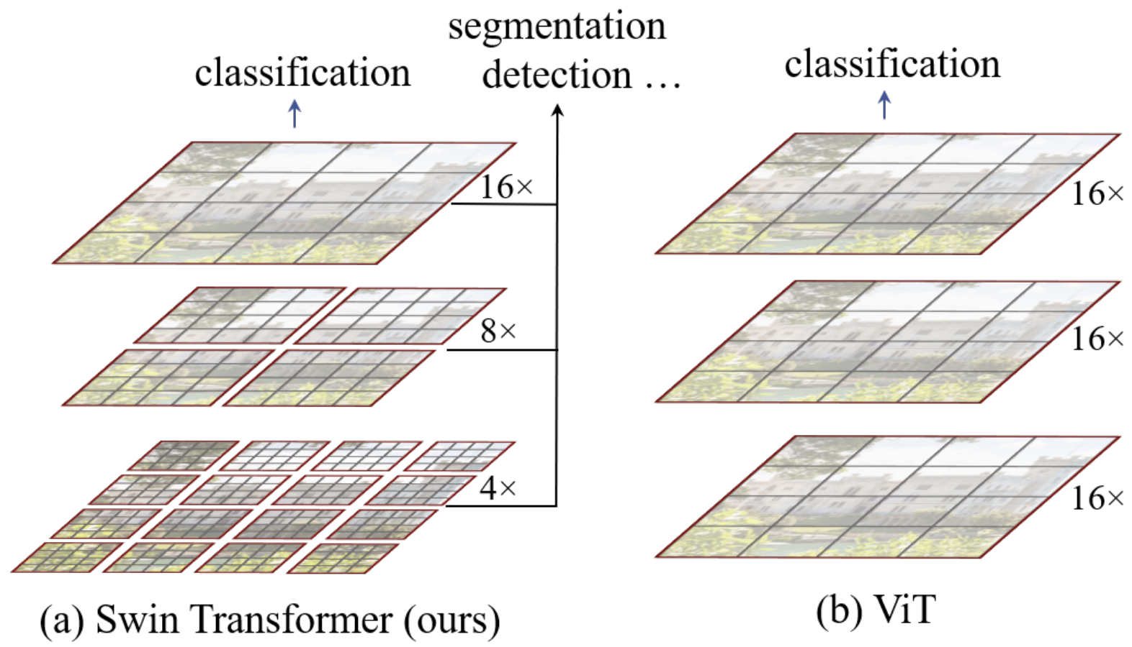
SWIN Transformer
Shifted Window (SWIN) transformer introduces architecture with multiple scales
SWIN Transformer uses hierarchy of scales
SWIN Transformer employs overlapping sliding windows to accommodate different scales
From Lui, et.al., 2021

