Slide 1

CSCI E-25 Computer Vision
Building Blocks of Deep Learning
Steve Elston
Copyright 2021, 2022, 2023, Stephen F Elston. All rights reserved.

Slide 2
Building Blocks of Deep Learning
Deep learning for computer vision
Deep neural networks have revolutionized many areas of machine learning
Object classification
Object detection
Segmentation
Generative models
…
Many types of deep neural networks used in CV
Fully connected NNs – our focus this week
Convolutional NNs for feature extraction – next week
Many others …

Slide 3
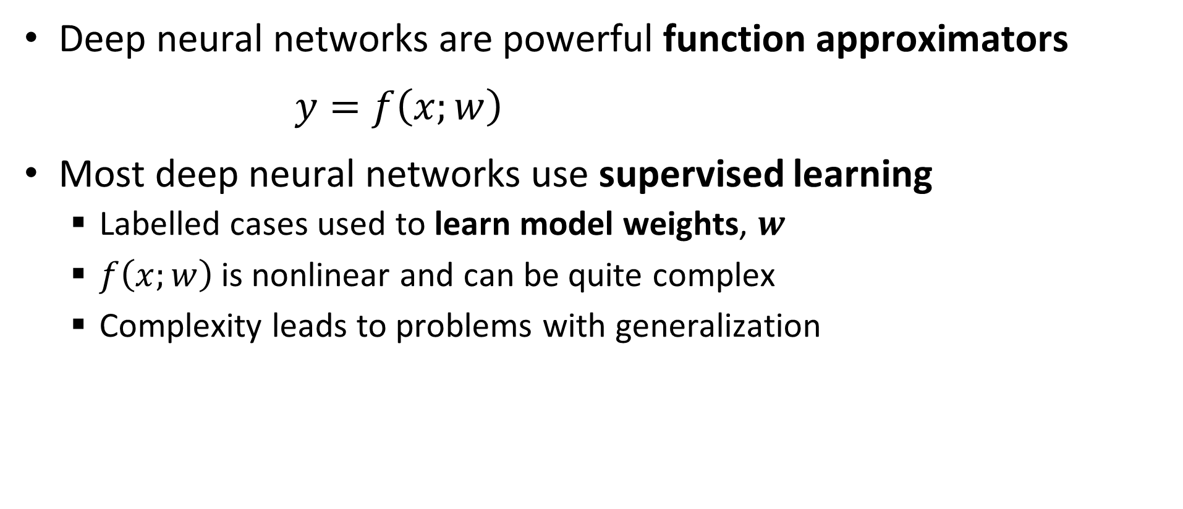
Function Approximation with Deep Neural Networks
Deep neural networks are powerful function approximators
$y=f\left(x;w\right)$
Most deep neural networks use supervised learning
Labelled cases used to learn model weights, $w$
$f\left(x;w\right)$is nonlinear and can be quite complex
Complexity leads to problems with generalization

Slide 4
Essential Elements of Deep Learning
Representation
Inference
Input = X
Output = Y
Learning

Slide 5
Building Blocks of Deep Learning
Key points for this lesson
Preceptron and forward propagation
Depth, breath and model capacity
Nonlinearity and activation functions
Learning weights with backpropagation
Loss functions
Computing gradients and the chain rule
Efficient calculation with execution graphs

Slide 6
Perceptrons and Forward Propagation

Slide 7
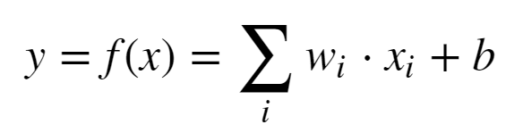
Representation: Linear Neural Network
Proposed by McCulloch and Pitts (1943)
X₁
w₁
w₂
X₂
Σ + b
Y
w₃
X₃

Slide 8

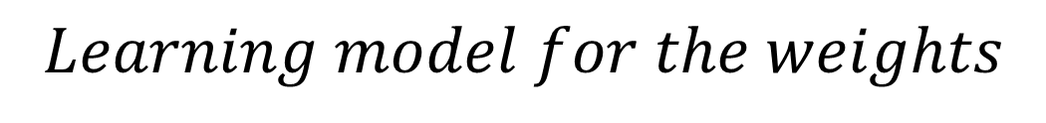


Representation: Linear Neural Network
Early learning model for a neural network - Heeb (1949)
X₁
$$Learning model for the weights$$
w₁
$$w_{ij}=x_{i}x_{j}$$
w₂
Σ + b
$$Δw_{ij}=ηx_{i}x_{j}$$
X₂
Y
w₃
$$Where, η is the learning rate$$
X₃
But, this is just linear regression!

Slide 9
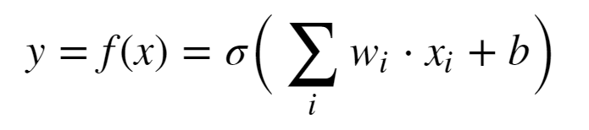
Representation: Perceptron
Use of nonlinear activation proposed by Rosenblatt (1962)
X₁
w₁
w₂
X₂
σ(Σ + b)
Y
w₃
X₃
Minsky and Papert (1969) showed the perceptron cannot represent an exclusive or (XOR)
This is just logistic regression!

Slide 10
We Need a Better Deep Representation
By mid-1980s need for architecture with hidden layers for greater model capacity was recognized
Input layer
Multiple hidden layers
Output layer
Multiple units in layers
Nonlinear activations in units
Fully connect between units in layers
Learn weights for complex function approximation
Can solve XOR problem and much more

Slide 11
We Need a Better Deep Representation
w¹₁₁
X₁
S₁ = σ_{h}(Σ )
w²₁
w¹₁₂
w¹₂₁
S₃ = Σ
X₂
w²₂
w¹₂₂
S₂ = σ_{h}(Σ )
_{Input Layer}
_{Hidden Layer}
_{Output Layer}

Slide 12
We Need a Better Deep Representation
What is the output of the simple network?
Process called forward propagation
Start with the output of the hidden layer:
S₁ = σ(Σ_{i} x_{i} * W¹_{1i})
S₂ = σ(Σ_{i} x_{i} * W¹_{2i})
Next, compute the output of the output layer
S₃ = Σ_{j} W²_{j} * σ(Σ_{i} x_{i} * W¹_{ji})

Slide 13
Model Depth, Width and Capacity

Slide 14
Model Capacity
The universal approximation theorem, Hornik (1991), tells us that an infinitely wide hidden layer can represent any function
Usefulness limited:
It’s nice to know we can represent complex functions
But, completely infeasible in practice
What can we do?
Trade depth for breath

Slide 15
Model Capacity
Model capacity is fundamentally related to the bias-variance trade-off of machine learning
Low capacity models have high bias but low variance
High capacity models have low bias but high variance
High capacity models have a tendency to be overfit
We have more to say about this problem in another lesson

Slide 16
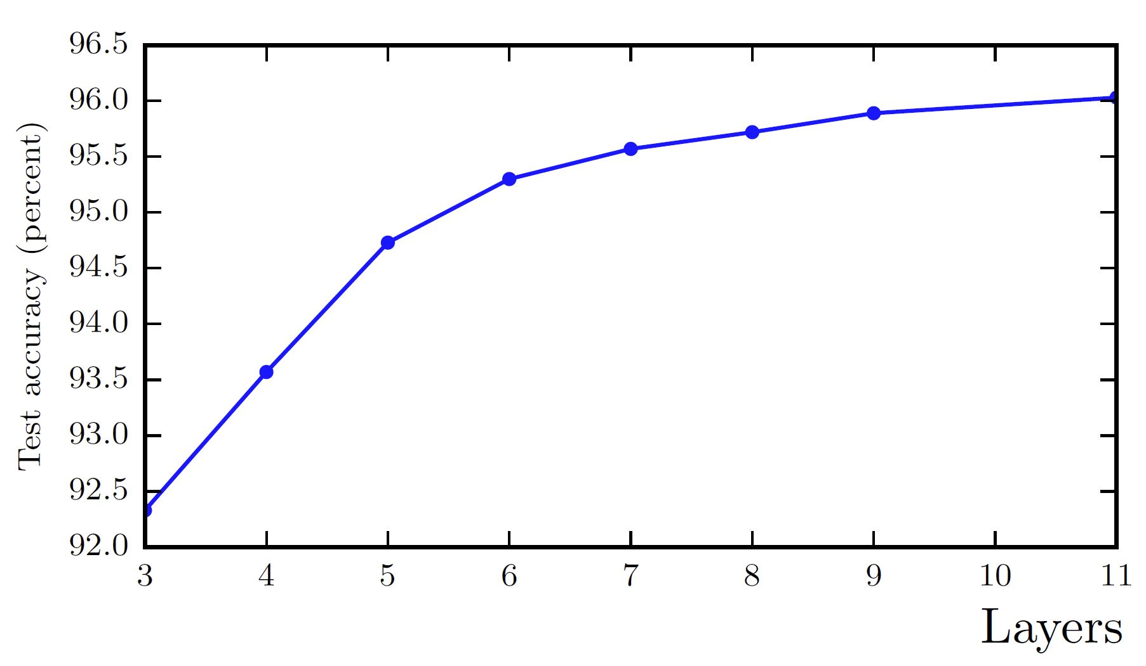
Model Capacity
Model capacity with increasing depth. From Goodfellow et. al. 2014.

Slide 17
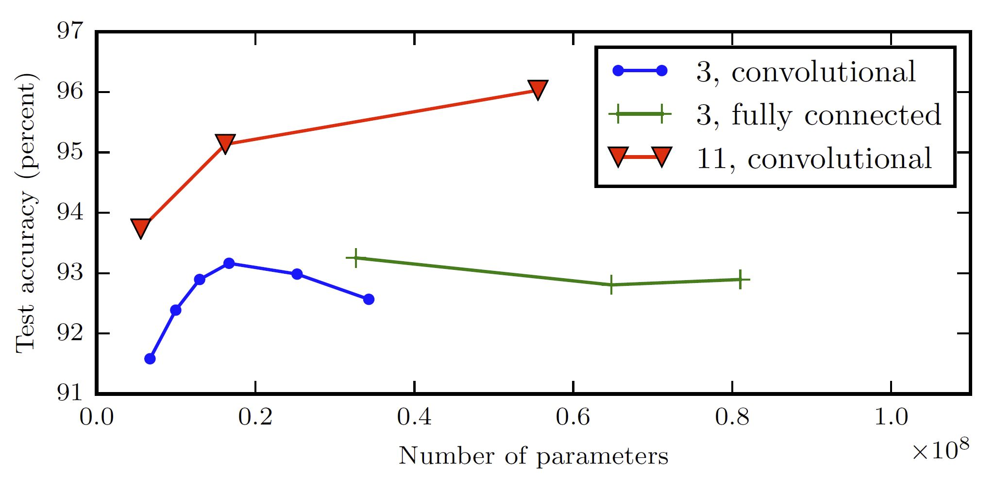
Model Capacity
Model capacity vs. number of parameters. From Goodfellow et. al. 2014.

Slide 18
Nonlinearity and Activation Functions

Slide 19
Activation functions
Nonlinear activation is key to achieving good function approximation.
Many activation functions have been tried, here are a few:
Function | How Used? | Comments
Sigmoid | Binary classifier output layer | Historically the most used
Softmax | Multi-class output layer | For categorical distribution
Linear | Numeric output layer | Regression models
Rectilinear | Hidden layers | Widely used to avoid vanishing gradient
Leak Rectilinear | Hidden layers | Widely used to avoid vanishing gradient
Tanh | Binary classifier output layers Other specialized applications | Better gradient properties than sigmoid

Slide 20
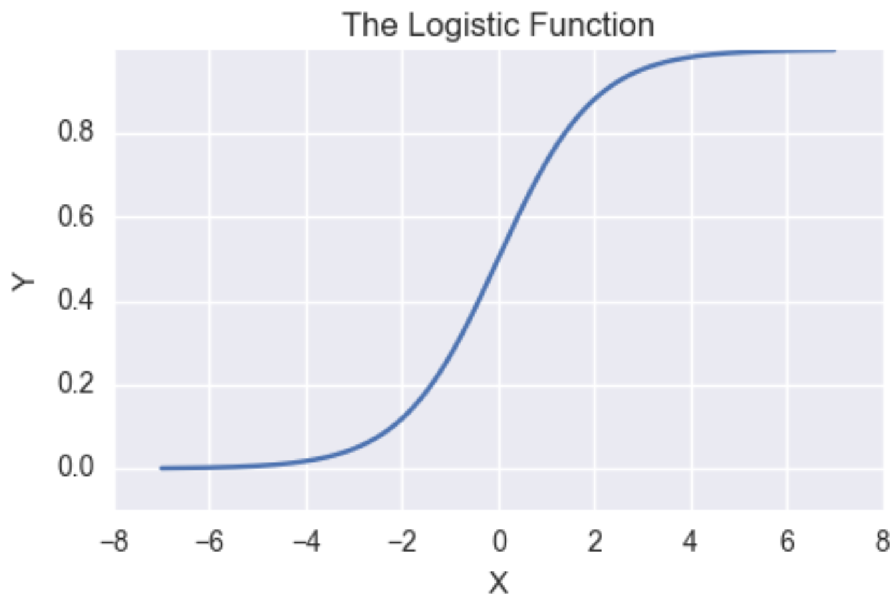
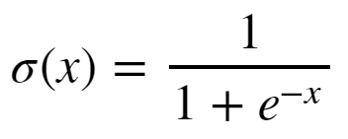
Activation functions
Sigmoid has vanishing gradients
Near-0 gradient
Near-0 gradient

Slide 21
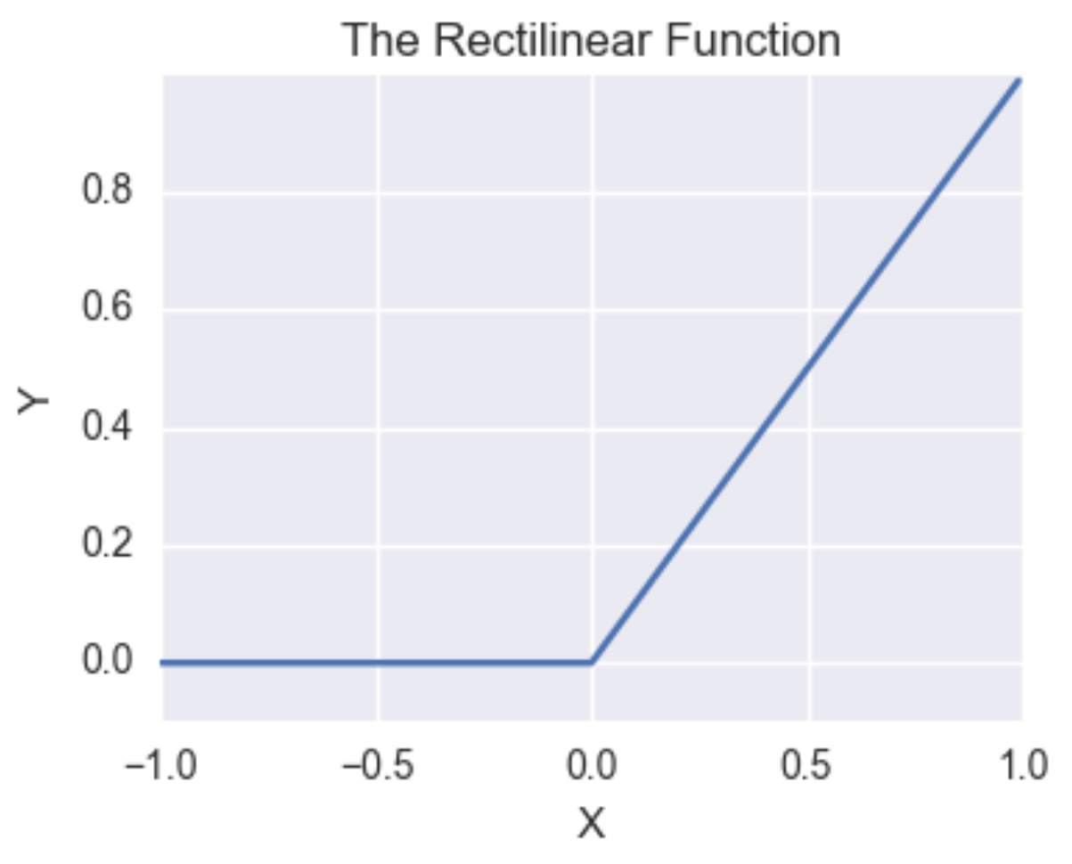

Activation functions
Rectilinear function has constant gradient for positive values
Constant gradient
Gradient of Leaky ReLU < 0

Slide 22
Learning Weights with Backpropagation

Slide 23
The Backpropagation Algorithm
To find function approximation, f(x), we need to learn model weights
The primary algorithm we use to learn model weights is known as backpropagation
Backpropagation was applied to learning (system identification) for control problems as early as 1960 by Henry Kelly and 1961 by Arthur Bryson for dynamic programming
First applied to neural networks by Paul Werbos in 1974
In 1986 by Rumelhart, Hinton and Williams showed that backpropagation was effective for learning the weights of hidden layers

Slide 24
The Backpropagation Algorithm
w¹₁₁
X₁
S₁ = σ_{h}(Σ )
w²₁
w¹₁₂
w¹₂₁
S₃ = Σ
J(W)
X₂
w²₂
w¹₂₂
S₂ = σ_{h}(Σ )
Y
_{Input Layer}
_{Hidden Layer}
_{Output Layer}
_{Loss Function}

Slide 25

The Backpropagation Algorithm
To learn model weight tensor we must minimize the loss function using the gradient:
Where:

Slide 26

The Back Propagation Algorithm
Backpropagation is a gradient decent algorithm
Weight updates are taken as small steps in the direction of the gradient of the loss function
Backpropagation converges when the gradient is approximately 0

Slide 27
Loss Functions

Slide 28

Loss Functions for Training Neural Networks
What are some choices for a loss function, , given the weight tensor?
For regression problems use MSE
Which loss function should we use for classification problems?
Cross entropy is a good choice, but is a bit abstract

Slide 29

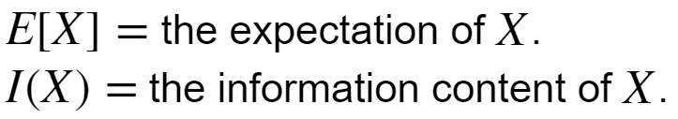
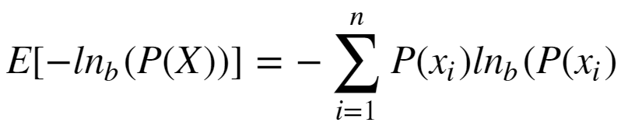
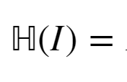
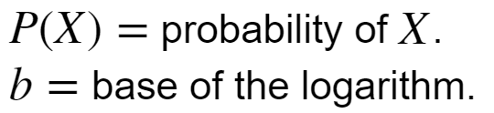
Loss Functions for Training Neural Networks
What is Shannon Entropy?
Where:
We are working with probability distributions, so:
Where:

Slide 30
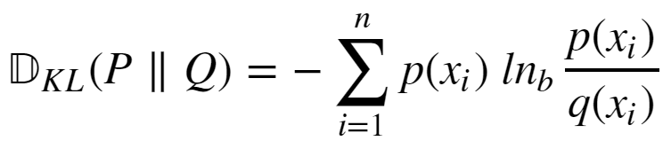
Loss Functions for Training Neural Networks
We need to measure the difference between the distribution of our function approximation and the distribution of the data
The Kullback-Leibler divergence between two distributions P(X) and Q(X) is such a measure:

Slide 31
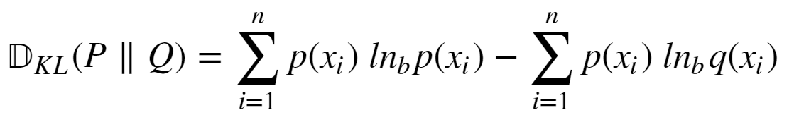
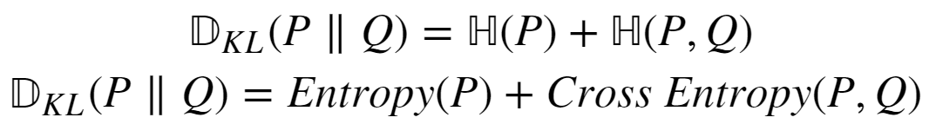
Loss Functions for Training Neural Networks
How do we compute KL divergence?
If we knew P(X) we would not need to compute KL divergence
We can expand KL divergence as:

Slide 32


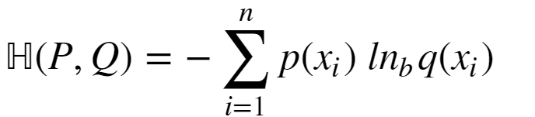
Loss Functions for Training Neural Networks
Given:
The term is constant
So, we only need the cross entropy term:

Slide 33
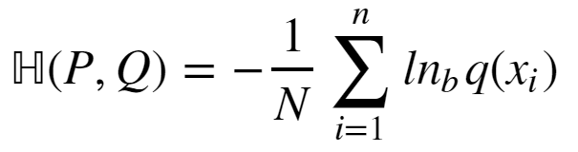
Loss Functions for Training Neural Networks
How can we compute cross entropy when we don’t know P(X):
Since we don’t know P(X), use the approximation:

Slide 34
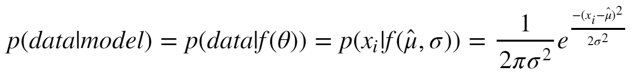
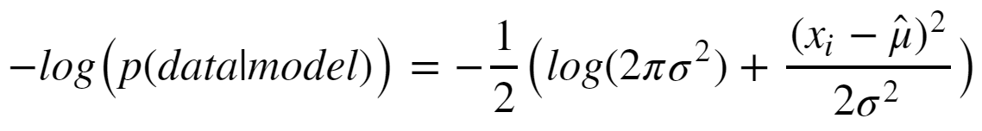
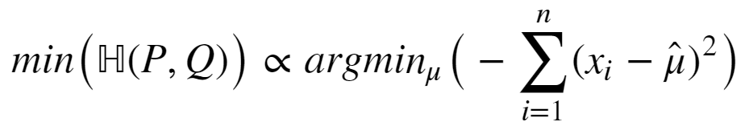
Loss Functions for Training Neural Networks
Consider the special case of Gaussian likelihood:
Taking the negative logarithm:
Ignoring the constant terms, the minimum of cross entropy is:

Slide 35
Performance Metrics for Deep NNs
How can we measure the performance of deep neural networks?
Use the same metrics used for other machine learning algorithms
RMSE, R^2, etc for regression
Accuracy, precision, recall, etc. for classification

Slide 36
Computing gradients and the chain rule

Slide 37
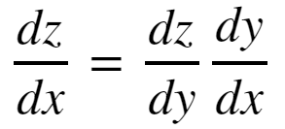
The Chain Rule of Calculus
In order to compute the gradients of the loss function though the layers of a deep neural network we need to apply the chain rule of calculus
To consider a function z = f(y), where y = g(x); then z = f(g(x)). Then the derivative of z with respect to x is:

Slide 38
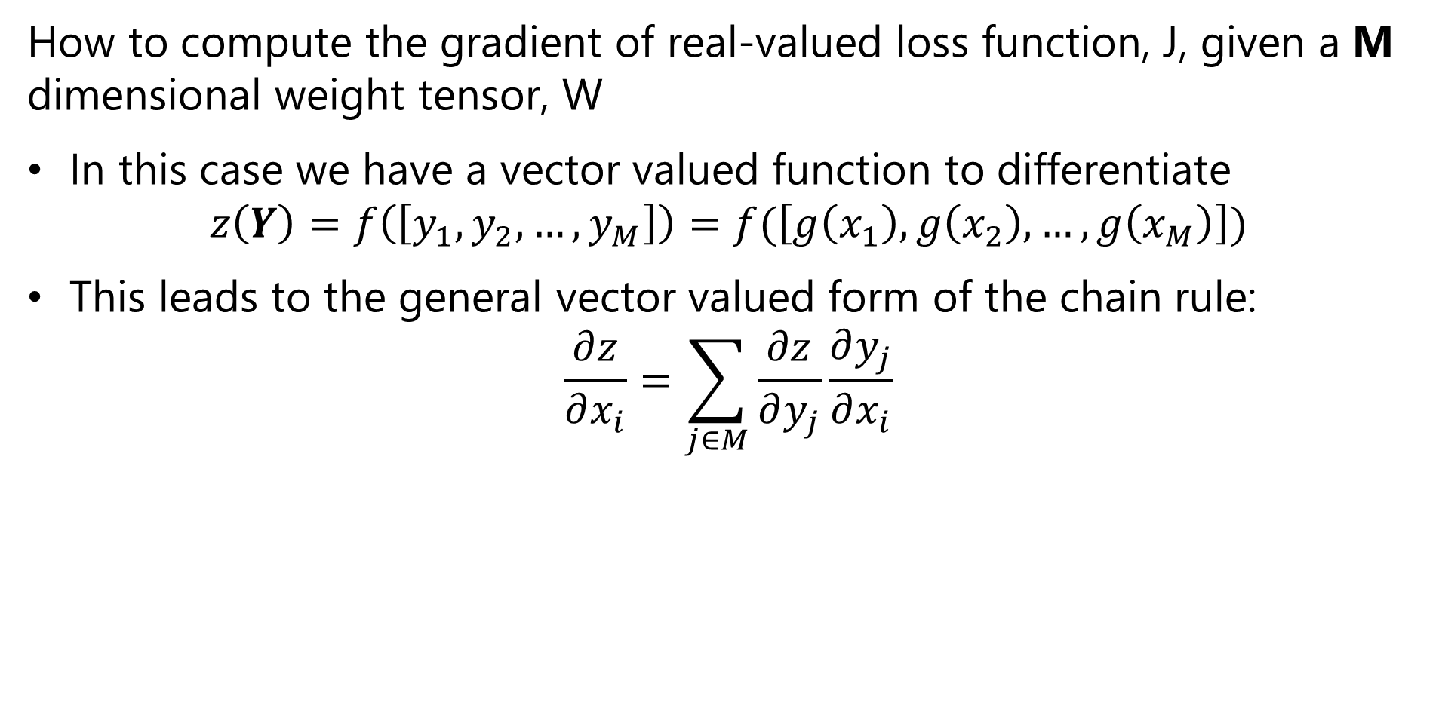
The Chain Rule of Calculus
How to compute the gradient of real-valued loss function, J, given a M dimensional weight tensor, W
In this case we have a vector valued function to differentiate
$$z\left(Y\right)=f\left(\left[y_{1},y_{2},…,y_{M}\right]\right)=f(\left[g\left(x_{1}\right),g\left(x_{2}\right),…,g\left(x_{M}\right)\right])$$
This leads to the general vector valued form of the chain rule:
$$\frac{∂z}{∂x_{i}}=\sum_{j∈M}{\frac{∂z}{∂y_{j}}\frac{∂y_{j}}{∂x_{i}}}$$

Slide 39
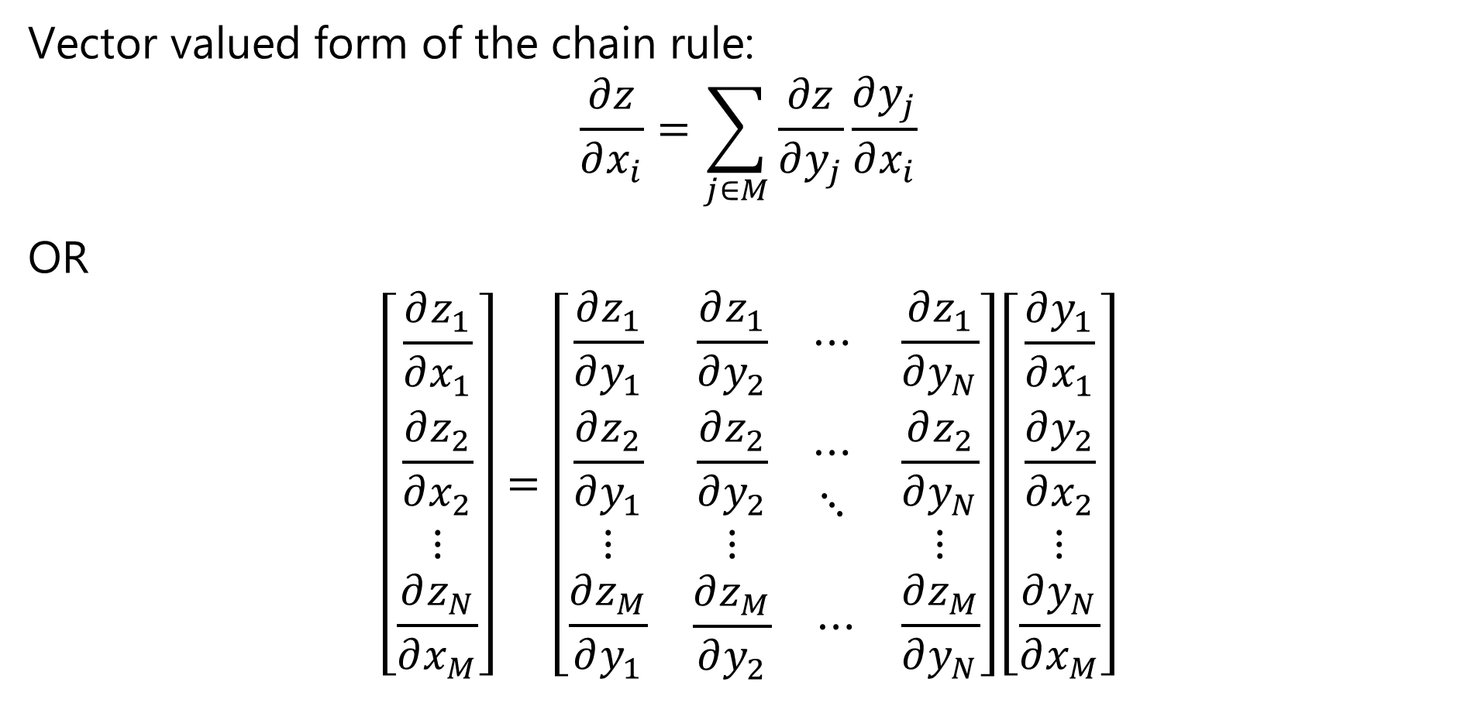
The Chain Rule of Calculus
Vector valued form of the chain rule:
$$\frac{∂z}{∂x_{i}}=\sum_{j∈M}{\frac{∂z}{∂y_{j}}\frac{∂y_{j}}{∂x_{i}}}$$
OR
$$\left[\begin{matrix}\frac{∂z_{1}}{∂x_{1}} \\ \frac{∂z_{2}}{∂x_{2}} \\ \begin{matrix}⋮ \\ \frac{∂z_{N}}{∂x_{M}}\end{matrix}\end{matrix}\right]=\left[\begin{matrix}\frac{∂z_{1}}{∂y_{1}} & \begin{matrix}\frac{∂z_{1}}{∂y_{2}} & ⋯\end{matrix} & \frac{∂z_{1}}{∂y_{N}} \\ \begin{matrix}\frac{∂z_{2}}{∂y_{1}} \\ ⋮\end{matrix} & \begin{matrix}\begin{matrix}\frac{∂z_{2}}{∂y_{2}} \\ ⋮\end{matrix} & \begin{matrix}⋯ \\ ⋱\end{matrix}\end{matrix} & \begin{matrix}\frac{∂z_{2}}{∂y_{N}} \\ ⋮\end{matrix} \\ \frac{∂z_{M}}{∂y_{1}} & \begin{matrix}\frac{∂z_{M}}{∂y_{2}} & ⋯\end{matrix} & \frac{∂z_{M}}{∂y_{N}}\end{matrix}\right]\left[\begin{matrix}\frac{∂y_{1}}{∂x_{1}} \\ \frac{∂y_{2}}{∂x_{2}} \\ \begin{matrix}⋮ \\ \frac{∂y_{N}}{∂x_{M}}\end{matrix}\end{matrix}\right]$$

Slide 40

The Chain Rule of Calculus
We define the $n×m$ Jacobian Matrix, $J$, as:
$$J^{T}=\left[\begin{matrix}\frac{∂z_{1}}{∂y_{1}} & \begin{matrix}\frac{∂z_{1}}{∂y_{2}} & ⋯\end{matrix} & \frac{∂z_{1}}{∂y_{N}} \\ \begin{matrix}\frac{∂z_{2}}{∂y_{1}} \\ ⋮\end{matrix} & \begin{matrix}\begin{matrix}\frac{∂z_{2}}{∂y_{2}} \\ ⋮\end{matrix} & \begin{matrix}⋯ \\ ⋱\end{matrix}\end{matrix} & \begin{matrix}\frac{∂z_{2}}{∂y_{N}} \\ ⋮\end{matrix} \\ \frac{∂z_{M}}{∂y_{1}} & \begin{matrix}\frac{∂z_{M}}{∂y_{2}} & ⋯\end{matrix} & \frac{∂z_{M}}{∂y_{N}}\end{matrix}\right]$$

Slide 41
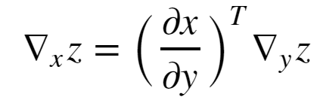


The Chain Rule of Calculus
In matrix notation the vector valued gradient then becomes:
Where, = is the nxm Jacobian matrix of partial derivatives
= the gradient of z with respect to y

Slide 42
Example: Computing a Gradient
w¹₁₁
X₁
S₁ = σ_{h}(Σ )
w²₁
w¹₁₂
w¹₂₁
S₃ = Σ
J(W)
X₂
w²₂
w¹₂₂
S₂ = σ_{h}(Σ )
Y
_{Input Layer}
_{Hidden Layer}
_{Output Layer}
_{Loss Function}

Slide 43
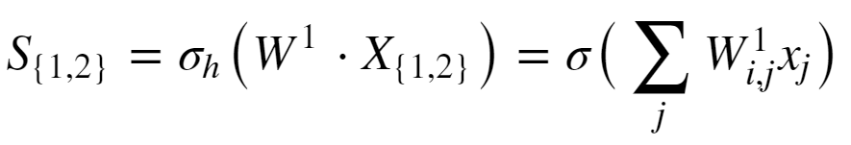
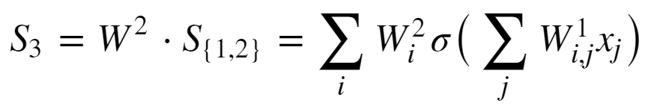
Example: Computing a Gradient
Start with forward propagation relationships
The output of the hidden units are computed as:
The output unit relation is:

Slide 44
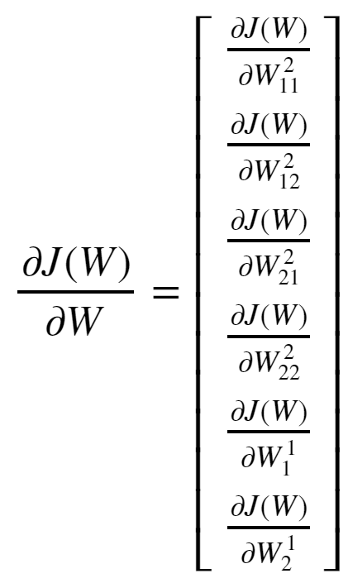
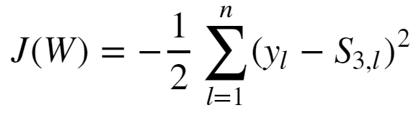
Example: Computing a Gradient
Goal is to compute the gradient:
The loss function is:

Slide 45
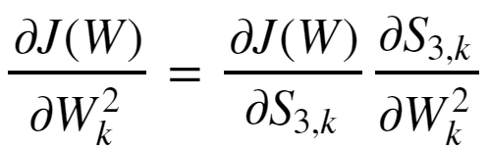
Example: Computing a Gradient
Start with the easier case of the gradient with respect to the output tensor.
Applying the chain rule yields:

Slide 46
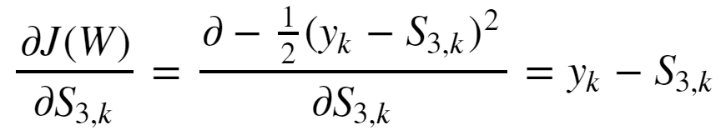
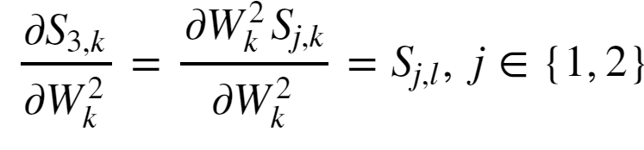
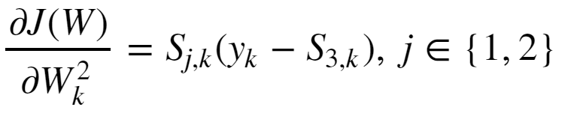
Example: Computing a Gradient
The first partial derivative is:
The second partial derivative is:
And the gradient with respect to the output tensor is then:

Slide 47
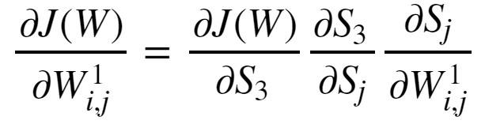
Example: Computing a Gradient
The gradient with respect to the input tensor is a bit more complicated
Apply the chain rule twice to get:

Slide 48
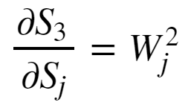
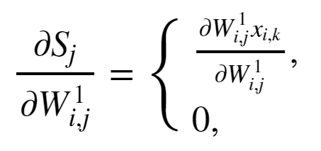
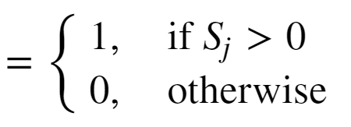
Example: Computing a Gradient
The output layer has linear activation so the left most partial derivative is just 1.
The middle partial derivative :
The right most partial derivative, given ReLU activation:

Slide 49
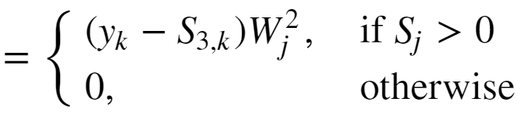
Example: Computing a Gradient
The gradient with respect to the input weights is then:

Slide 50
Automatic Differentiation
In practice, how do we perform the differentiation
Computing all the required derivatives by hand is impractical
Complexity grows with NN depth
Too many opportunities for error
Use automatic differentiation
Automatic differentiators handle the complexity of deep architectures
Automatic differentiators built into all deep learning platforms
See the review paper by Baydin et.al. (2015) or the TensorFlow automatic differentiation tutorial

Slide 51
Quadratic Optimization and Gradient Descent

Slide 52
Optimization for Deep Neural Networks
Gradient descent is a widely used optimization method for machine learning
Neural networks learn weights using the backpropagation algorithm
Weights are learned using the gradient descent method
Where:

Slide 53
Local Convergence of Gradient Descent
Ideally, the loss function, J(W), is convex with respect to the weights
Contours of J(W)_{MLE}
Min_{W} (J(W)_{MLE})
Initial W
Convex loss function has one unique minimum
Convergence for convex loss function is guaranteed

Slide 54


Local Convergence of Gradient Descent
Expand loss function to understand convergence properties of gradient descent:
Where:

Slide 55
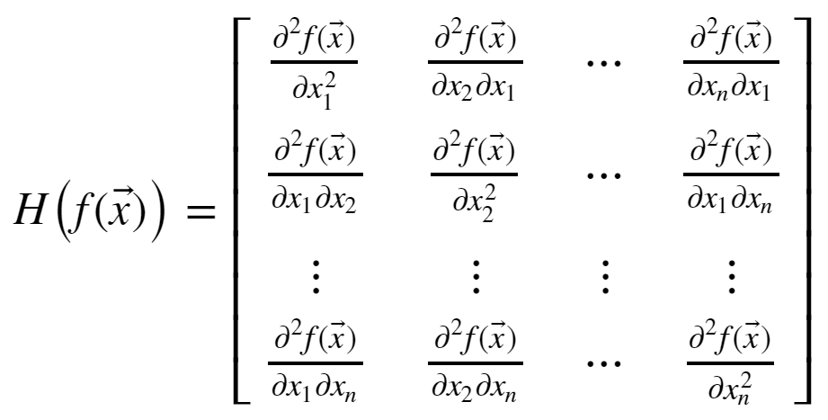
Local Convergence of Gradient Descent
How can you understand the Hessian matrix?
The Hessian is the matrix of all derivatives of the gradient
Properties of the Hessian determine convergence rate

Slide 56
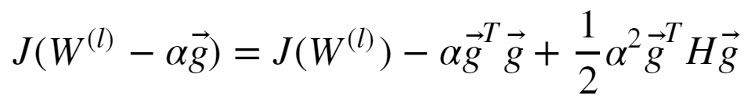

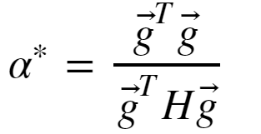
Local Convergence of Gradient Descent
How can we solve this convex optimization problem?
Given a step size α we can rewrite the above quadradic equation:
The minimum occurs where the gradient is 0:
And, with optimal step size:

Slide 57
Local Convergence of Gradient Descent
Real-world loss functions are typically not convex
There can be multiple minimums and maximums; a multi-modal loss function
Finding the globally optimal solution is hard!
The minimum reached by an optimizer depends on the starting value of W
In practice, we are happy with a good local solution, if not, the globally optimal solution
First order optimization found to perform as well, or better, than second order

Slide 58
Properties of Gradients

Slide 59

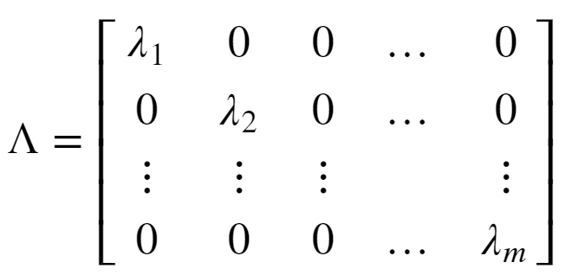
The Nature of Gradients
Convergence of quadratic optimization depends on the Hessian
To understand the behavior of the Hessian we need to examine the eigenvalues
A square matrix can be decomposed into eigenvalues and eigenvectors:
Where Q is the matrix of unitary eigenvectors
The eigenvalues are a diagonal matrix

Slide 60
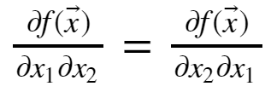
The Nature of Gradients
Some key properties of the Hessian matrix:
The Hessian is symmetric since
For a convex loss function the Hessian has all positive eigenvalues; it is positive definite – a maximum
At a maximum point the Hessian has all negative eigenvalues; it is negative definite - minimum
The Hessian has some positive and some negative eigenvalues at a saddle point
Saddle points are problematic since direction of descent to the minimum is unclear
If Hessian has some very small eigenvalues, the gradient is low and convergence will be slow

Slide 61
The Nature of Gradients
Some key properties of the Hessian matrix:
The Hessian is symmetric since
For a convex loss function the Hessian has all positive eigenvalues; it is positive definite – a maximum
At a maximum point the Hessian has all negative eigenvalues; it is negative definite - minimum
The Hessian has some positive and some negative eigenvalues at a saddle point
Saddle points are problematic since direction of descent to the minimum is unclear
If Hessian has some very small eigenvalues, the gradient is low and convergence will be slow

Slide 62
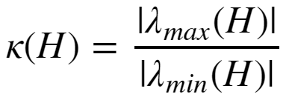
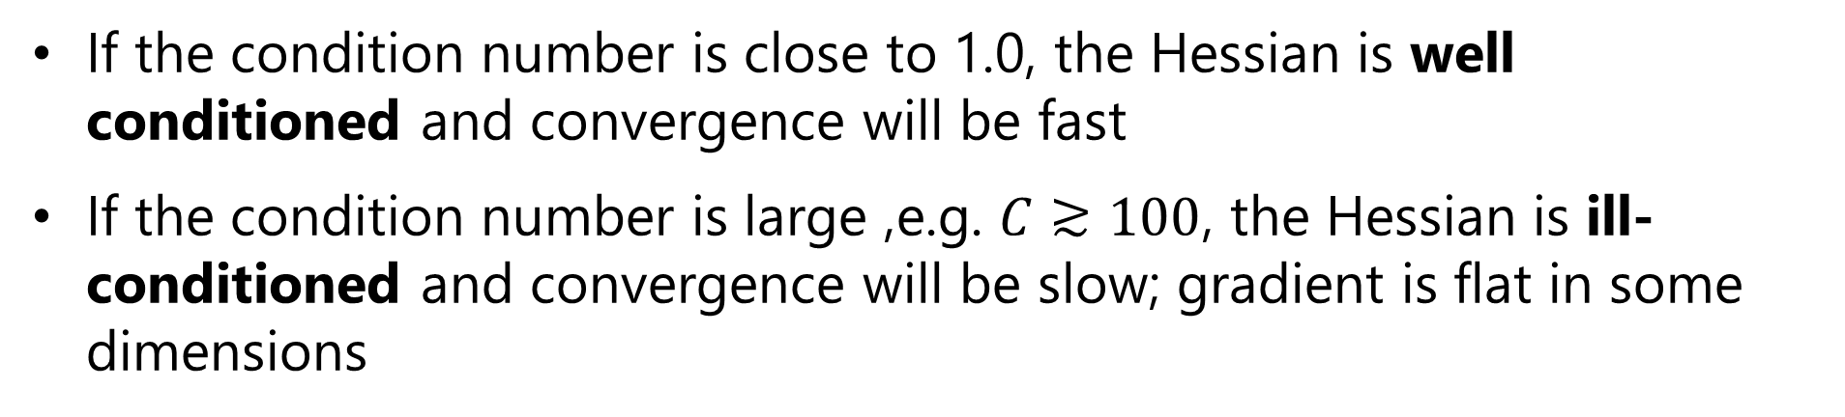
The Nature of Gradients
For quadratic optimization, the rate of convergence is determined by the condition number of the Hessian:
Where:
If the condition number is close to 1.0, the Hessian is well conditioned and convergence will be fast
If the condition number is large ,e.g. $C≳100$, the Hessian is ill-conditioned and convergence will be slow; gradient is flat in some dimensions

Slide 63
The Nature of Gradients
Example of well-conditioned and ill-conditioned gradients:
Min_{W} (J(W)_{MLE})
Min_{W} (J(W)_{MLE})
well-conditioned gradient
ill-conditioned gradient

Slide 64
Vanishing and Exploding Gradient Problems
There is no guarantee that the gradient of the loss function is well behaved
The gradient can vanish
Flat spots in the gradient – Hessian with small eigenvalues
Imagine a loss function with a long narrow valley
Ill-conditioned Hessian
Slow convergence
The gradient can explode
Sudden changes in the gradient; falling off a cliff!
Ill-conditioned Hessian
Very large step; optimizer over-shoots the minimum point

Slide 65


Vanishing and Exploding Gradient Problems
What happens to the eigenvalues of the Hessian?
Consider an n layer NN with linear activation
The gradient is just the weight tensor, W, with eigen decomposition:
Multiplying the n weight tensors for the multi-layer NN:
If the eigenvalue << 1.0, the gradient vanishes
If the eigenvalue >> 1.0, the gradient explodes

Slide 66
Vanishing and Exploding Gradient Problems
What can be done about extreme gradient problems?
Dealing with vanishing gradient can be difficult
Normalization of input values
Regularization is essential!
ResNets – recall last week’s lesson
Dealing with exploding gradients is easy
Gradient clipping prevents extreme values

Slide 67

Convex vs. Non-Convex Optimization
Gradient descent is well-behaved with convex loss function
Only 1 global minimum
From any starting point the gradient leads to global minimum
Hessian is always positive definite – Only positive eigenvalues
Convex loss
Poorly conditioned

Slide 68
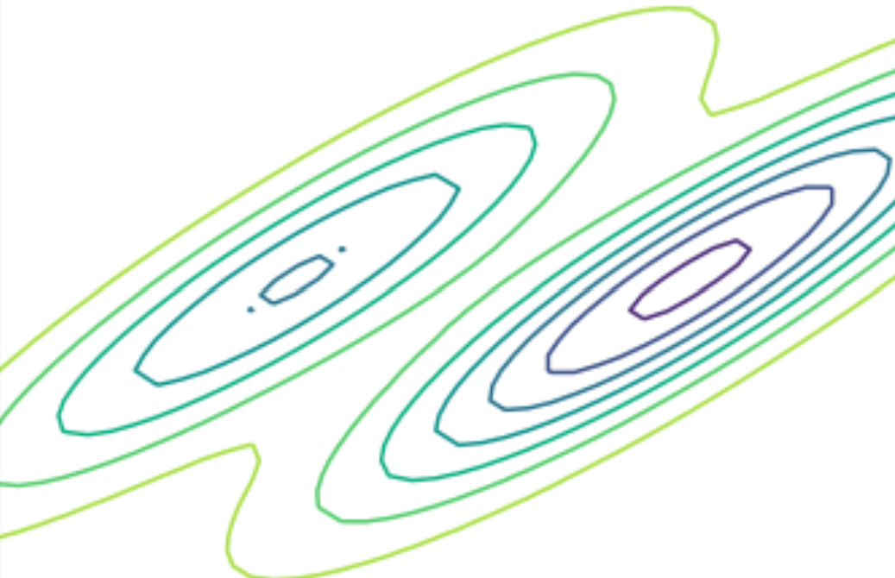
Convex vs. Non-Convex Optimization
Gradient descent can be problematic with nonconvex loss function
There is a global minimum
Possibly many local minimums
Minimum found with gradient descent depends on starting point
A good minimum may be good enough
Hessian positive definite at any minimum, but globally who knows??
Nonconvex loss

Slide 69
Convex vs. Non-Convex Optimization
Gradient descent can be problematic with nonconvex loss function
Can get stuck at saddle point!
Gradient is ambiguous at saddle point
Hessian is not positive definite
?
?
Nonconvex loss

Slide 70
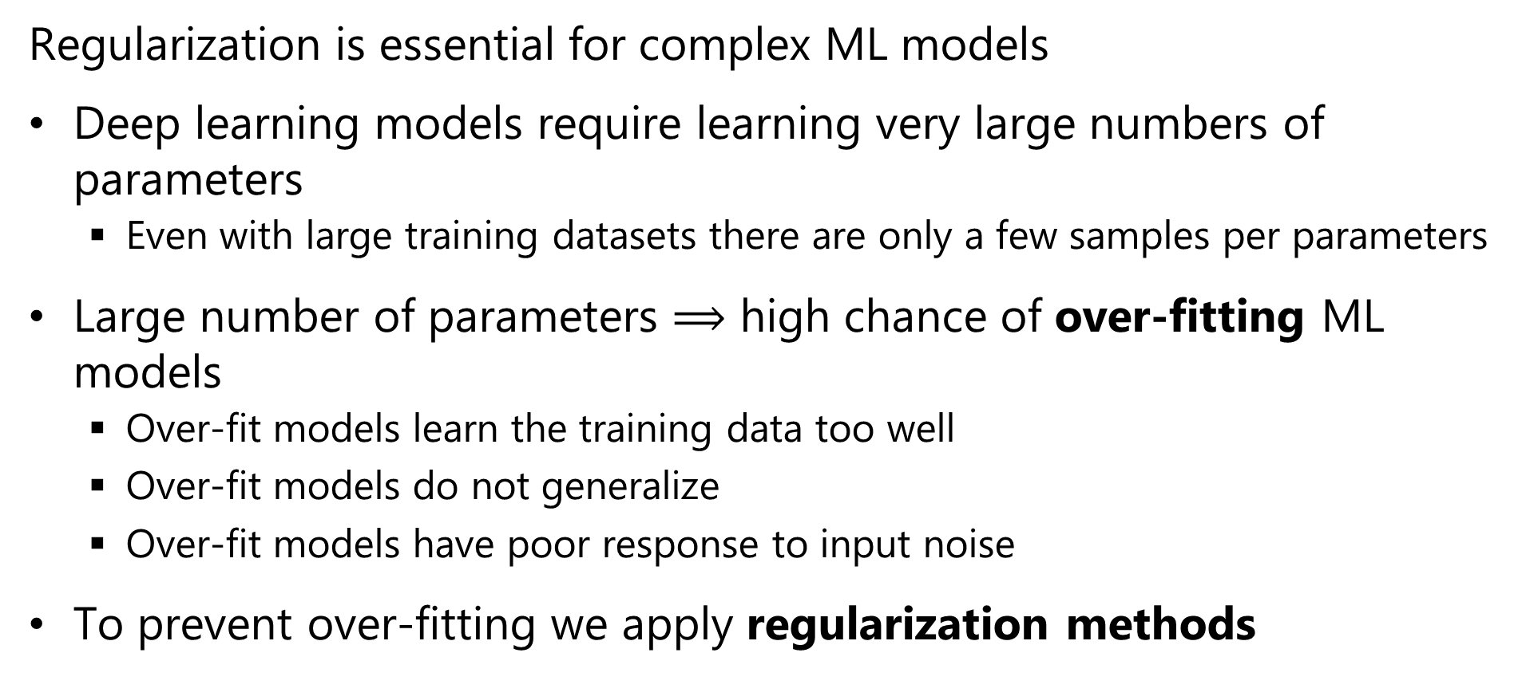
Regularization for Machine Learning
Regularization is essential for complex ML models
Deep learning models require learning very large numbers of parameters
Even with large training datasets there are only a few samples per parameters
Large number of parameters $⟹$ high chance of over-fitting ML models
Over-fit models learn the training data too well
Over-fit models do not generalize
Over-fit models have poor response to input noise
To prevent over-fitting we apply regularization methods

Slide 71
Efficient Calculation with Evaluation Graphs

Slide 72
Workflow Architectures
How can we efficiently perform backpropagation?
Many machine learning algorithms are iterative
Solving linear equations algorithms
Optimization and dynamic programming
Backpropagation
…
Iterative algorithms have complex execution graphs
Must operate on saved values multiple times
Only want to compute required quantities
Reading and writing to disk is too slow!
Need a workflow platform to handle complex execution graphs

Slide 73
Workflow Architectures
Lazy evaluation
Lazy evaluation prevents evaluation of unneeded values
Is an old idea
Independently invented several researchers in mid 1970s
For example: Henderson, et.al. (1976) developed a lazy evaluator for the LISP language
The lazy evaluation model
Lazy evaluation eliminates unnecessary calculations
Execution is performed when needed only for values required to compute the out the output
Contrasts with eager evaluation which requires I/O between operations
For example: Numpy reads and writes between cache and main memory between each operation

Slide 74
Workflow Architectures
Execution graphs
All calculations along the graph are performed in cache/main memory
An execution graph is created for the specified workflow
Using look ahead on the graph, execution done only for values required for the output – lazy evaluation
Use graph to find values to keep in main memory for iterations
Limits disk I/O – can speed execution by orders of magnitude
Concept of lazy evaluation along an execution graph introduced in Spark in 2010 (Zaharia, et. al., 2011)
One of many tutorials on the Spark lazy execution model can be found here
You can find an overview of the TensorFlow graph evaluation model here

Slide 75
Example: Execution graph for forward propagation in fully connected NN with one hidden layer
b²
σ_{ο}
Y
W²
+
U⁵
b¹
U⁴
W¹
dot
σ_{h}
U³
+
U²
Mat
Mult
U¹
X

Slide 76
Example: Computing a Gradient
U⁹
U¹⁰
J
U⁷
sum
+
mult
+
U⁵
λ
sqr
U⁶
sum
U⁸
sqr
J_{MLE}
W¹
W²
Y_{est}
Cross-
entropy
dot
σ_{ο}
U⁴
σ_{h}
Mat
Mult
U¹
U³
Y
X

Slide 77
Platforms for Deep NN Models
Platforms for deep learning combine execution graphs, lazy evaluation and GPU support
Graphics Processing Units (GPU) greatly increase speed of linear algebra computations
First applied to machine learning by Stienkrau et.al. (2005)
The recognition that large scale ML models can be trained with clusters of low-cost hardware revolutionized deep learning
Seminal paper GPUs applied to deep learning is raina et.al. (2009)
Some currently widely used
TensorFlow and the wrapper package Keras
PyTorch built on Torch
Caffé
You can find a review of many currently used deep learning platforms here

Slide 78
Deployment of Deep NN Models
How can we deploy deep NN models to the edge?
Many applications use CV at the edge – a.k.a. Internet of Things (IoT)
Example: advanced smart phone photograpy
Example: security monitoring
Example: industrial inspection
…
Need to push CV processing to edge
Limited network bandwidth precludes central processing
Edge devices typically have limited computing and memory capacity
Can deploy solutions like TensorFlow Lite
Use fixed point or integer arithmetic
Give up a bit of accuracy massive reduction in computing and memory

Slide 79
Summary
Key points for this lesson
Preceptron and forward propagation
Depth, breath and model capacity
Nonlinearity and activation functions
Learning weights with backpropagation
Loss functions
Computing gradients and the chain rule
Efficient calculation with execution graphs

