Slide 1
Bird Sightings Across the US
Bryce Turner

Slide 2
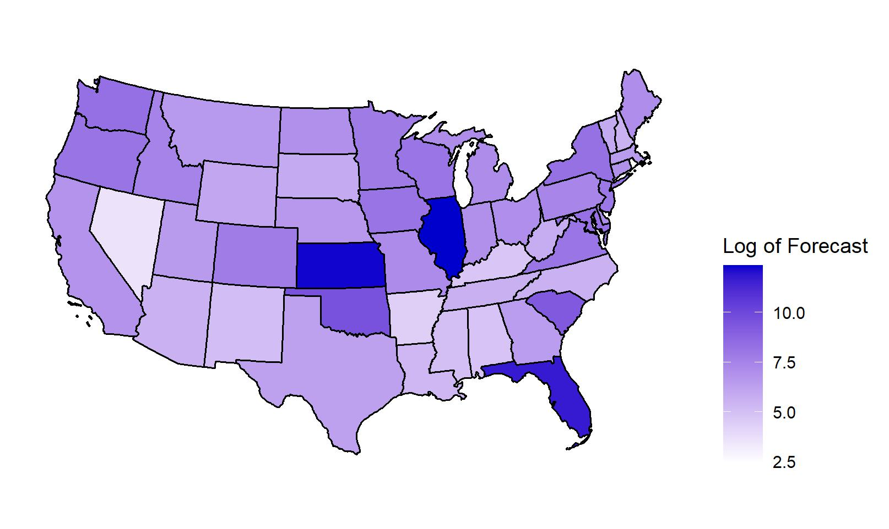
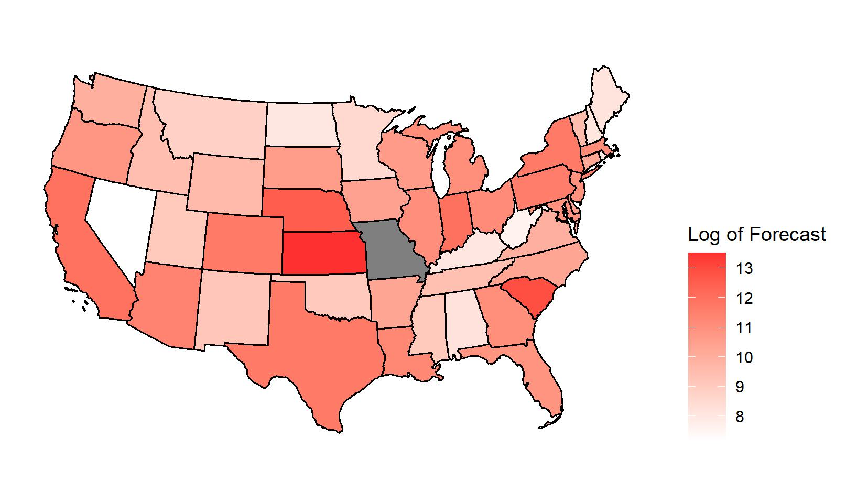
Goal
Forecast Bald Eagle Sightings
March 2023
Build a usable predictions for recreational bird watchers that they may be able to plan a trip given their limited schedule
Forecast Red Wing Black Bird Sightings
March 2023

Slide 3
Introduction – The Problem
There are lots of datasets about Birds and bird sightings, but these are predominately used for Conservation or other scientific purposes.
Therefore, they tend to either cover large swathes of territory (the entire US) or very small regions, like a single national park.
The other popular source is radar monitoring of migrations, but this data is real time.
Neither of these is particularly useful for a Birder trying to plan a trip.

Slide 4
Introduction – Proposed Solution
Mid-size geographic region – State
Forecast monthly bird sightings for specific species.

Slide 5
Road Map
Data Description
Data Exploration
Forecasting Experiments
Final Forecasts
Conclusion

Slide 6
Data Description
Data Description
Data Exploration
Forecasting Experiments
Final Forecasts
Conclusion

Slide 7

Data Description – Bird Sightings
eBird
Free, Open-Source Data on Bird Sightings
From the Cornel Lab of Ornithology
Verifies inputs for plausibility
https://ebird.org/home

Slide 8
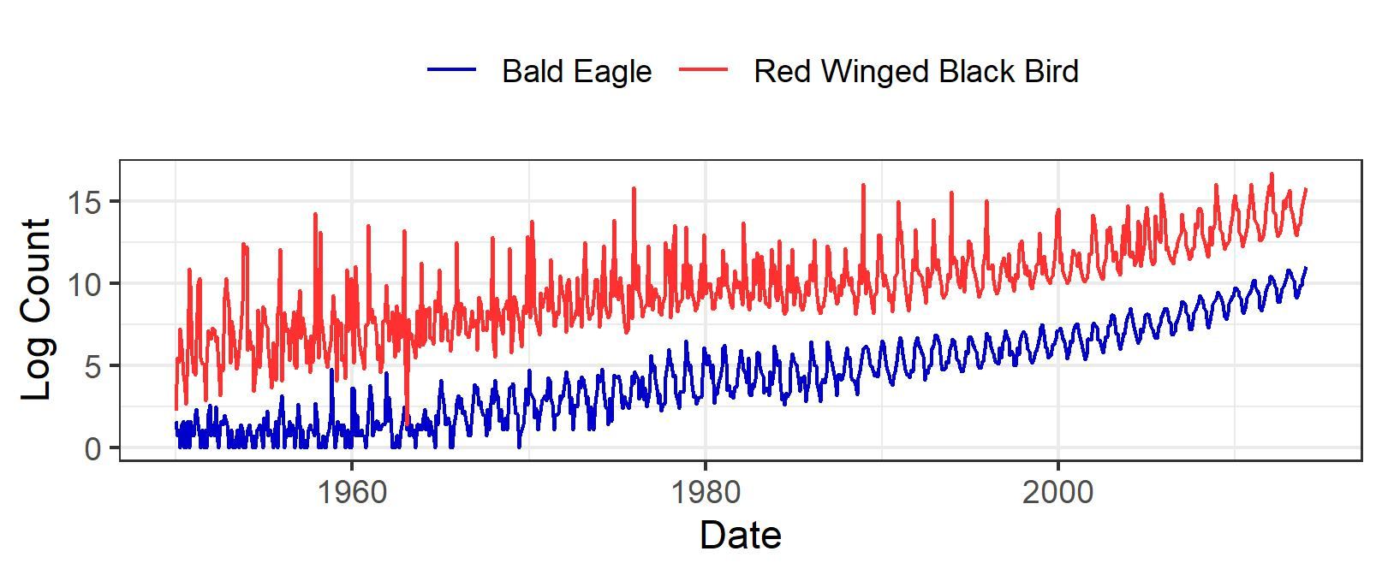
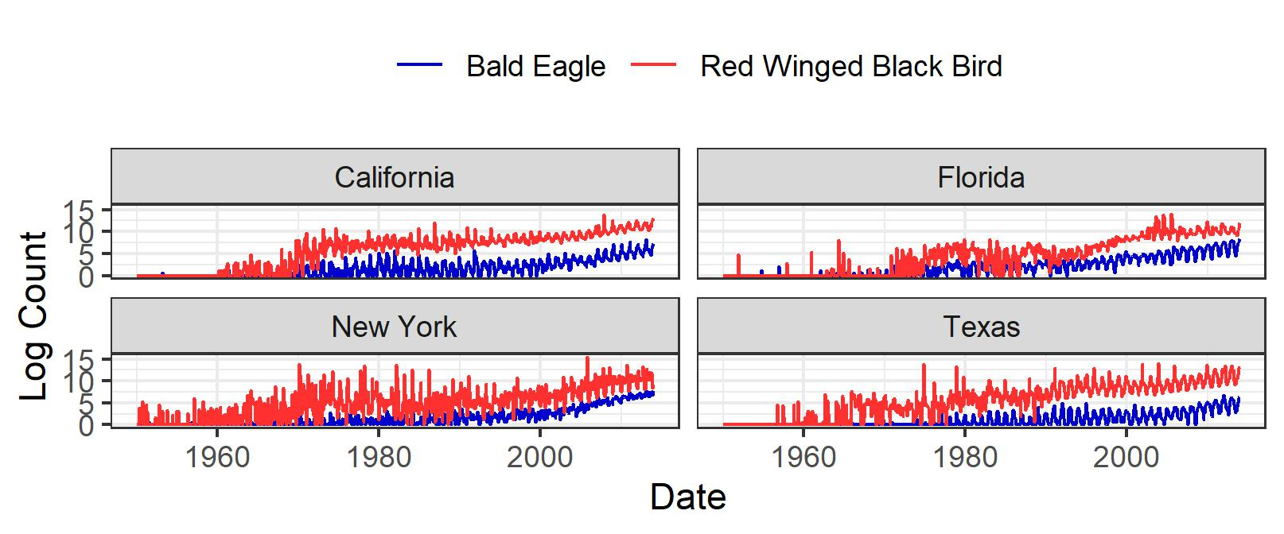
Data Description – Bird Sightings

Slide 9

Data Description – Weather
National Oceanic and Atmospheric Administration
Monthly – State Level
Rain and Average Temperature Data
1900 – 2014
https://www.ncei.noaa.gov/pub/data/cirs/climdiv/

Slide 10
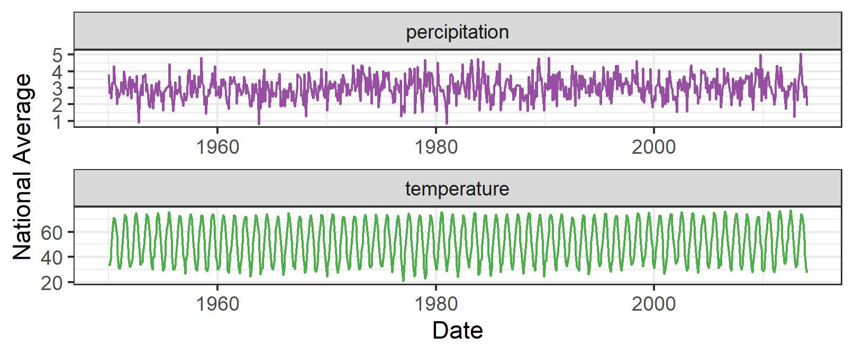
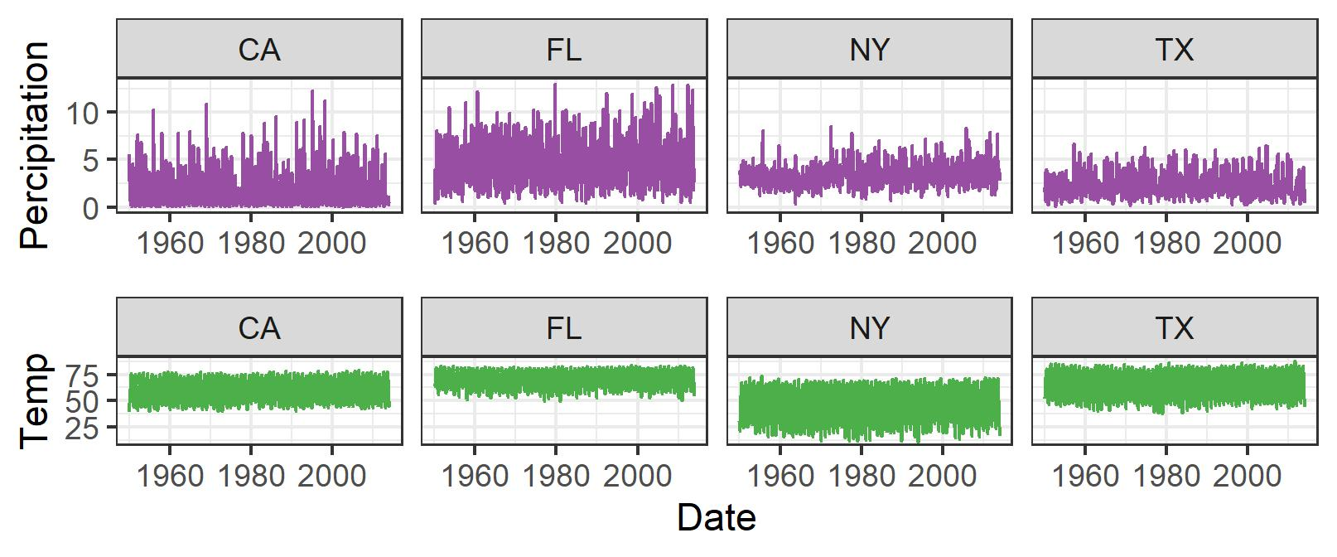
Data Description – Weather Data

Slide 11
Data Exploration
Data Description
Data Exploration
Forecasting Experiments
Final Forecasts
Conclusion

Slide 12
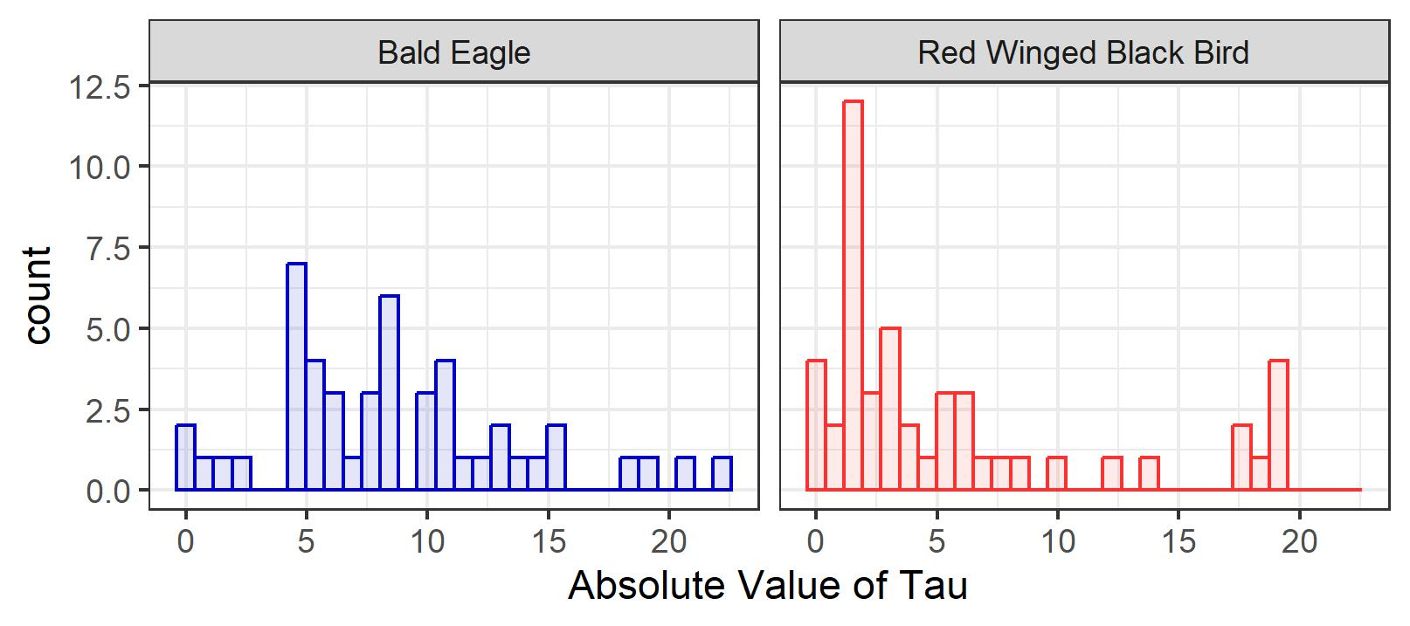
Data Exploration – Stationarity

Slide 13
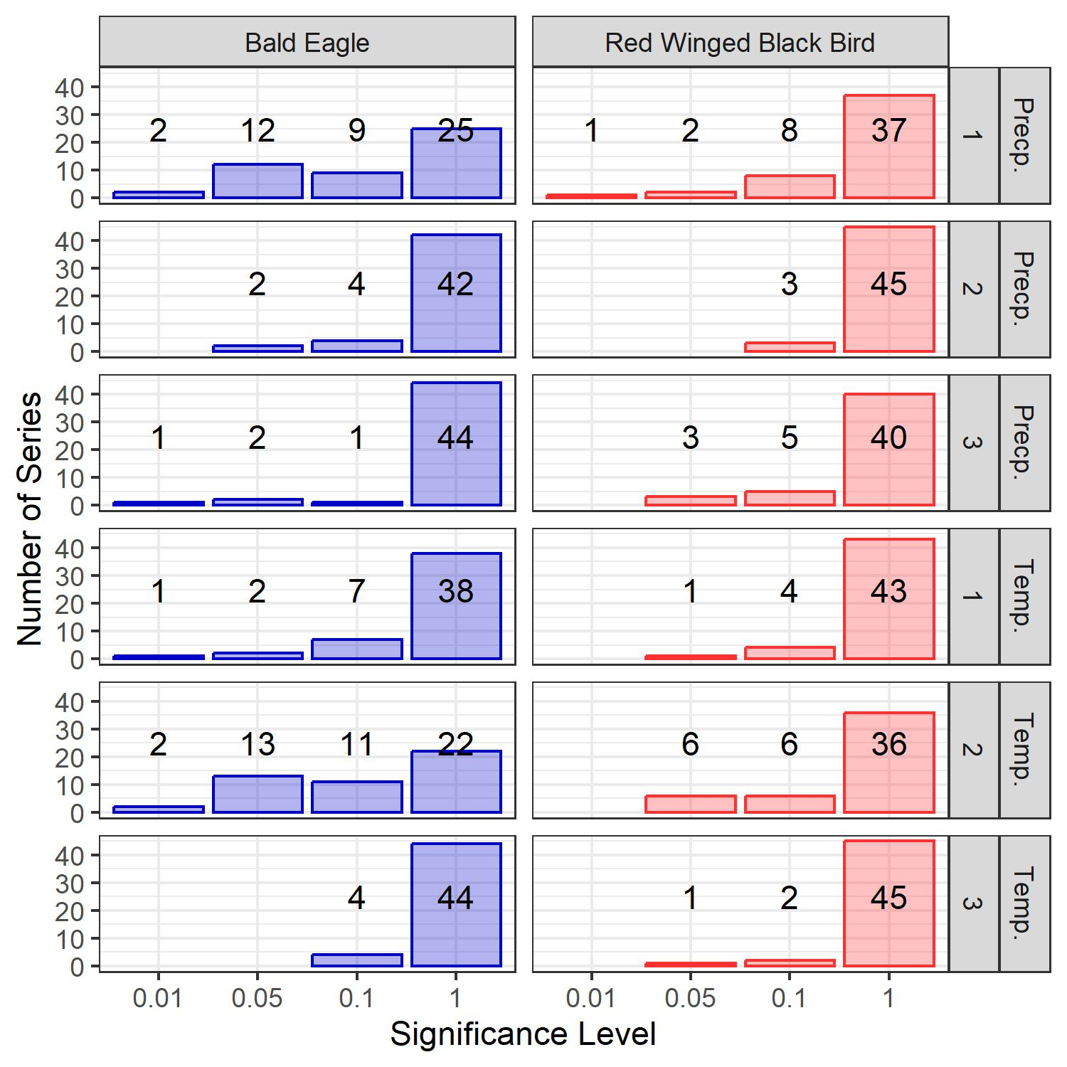
Data Exploration – Cointegration

Slide 14
Forecasting Experiments
Data Description
Data Exploration
Forecasting Experiments
Final Forecasts
Conclusion

Slide 15
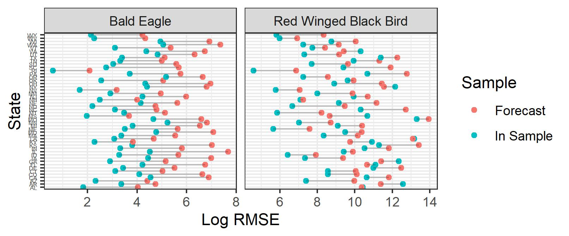
Forecasting Experiments - ARIMA

Slide 16
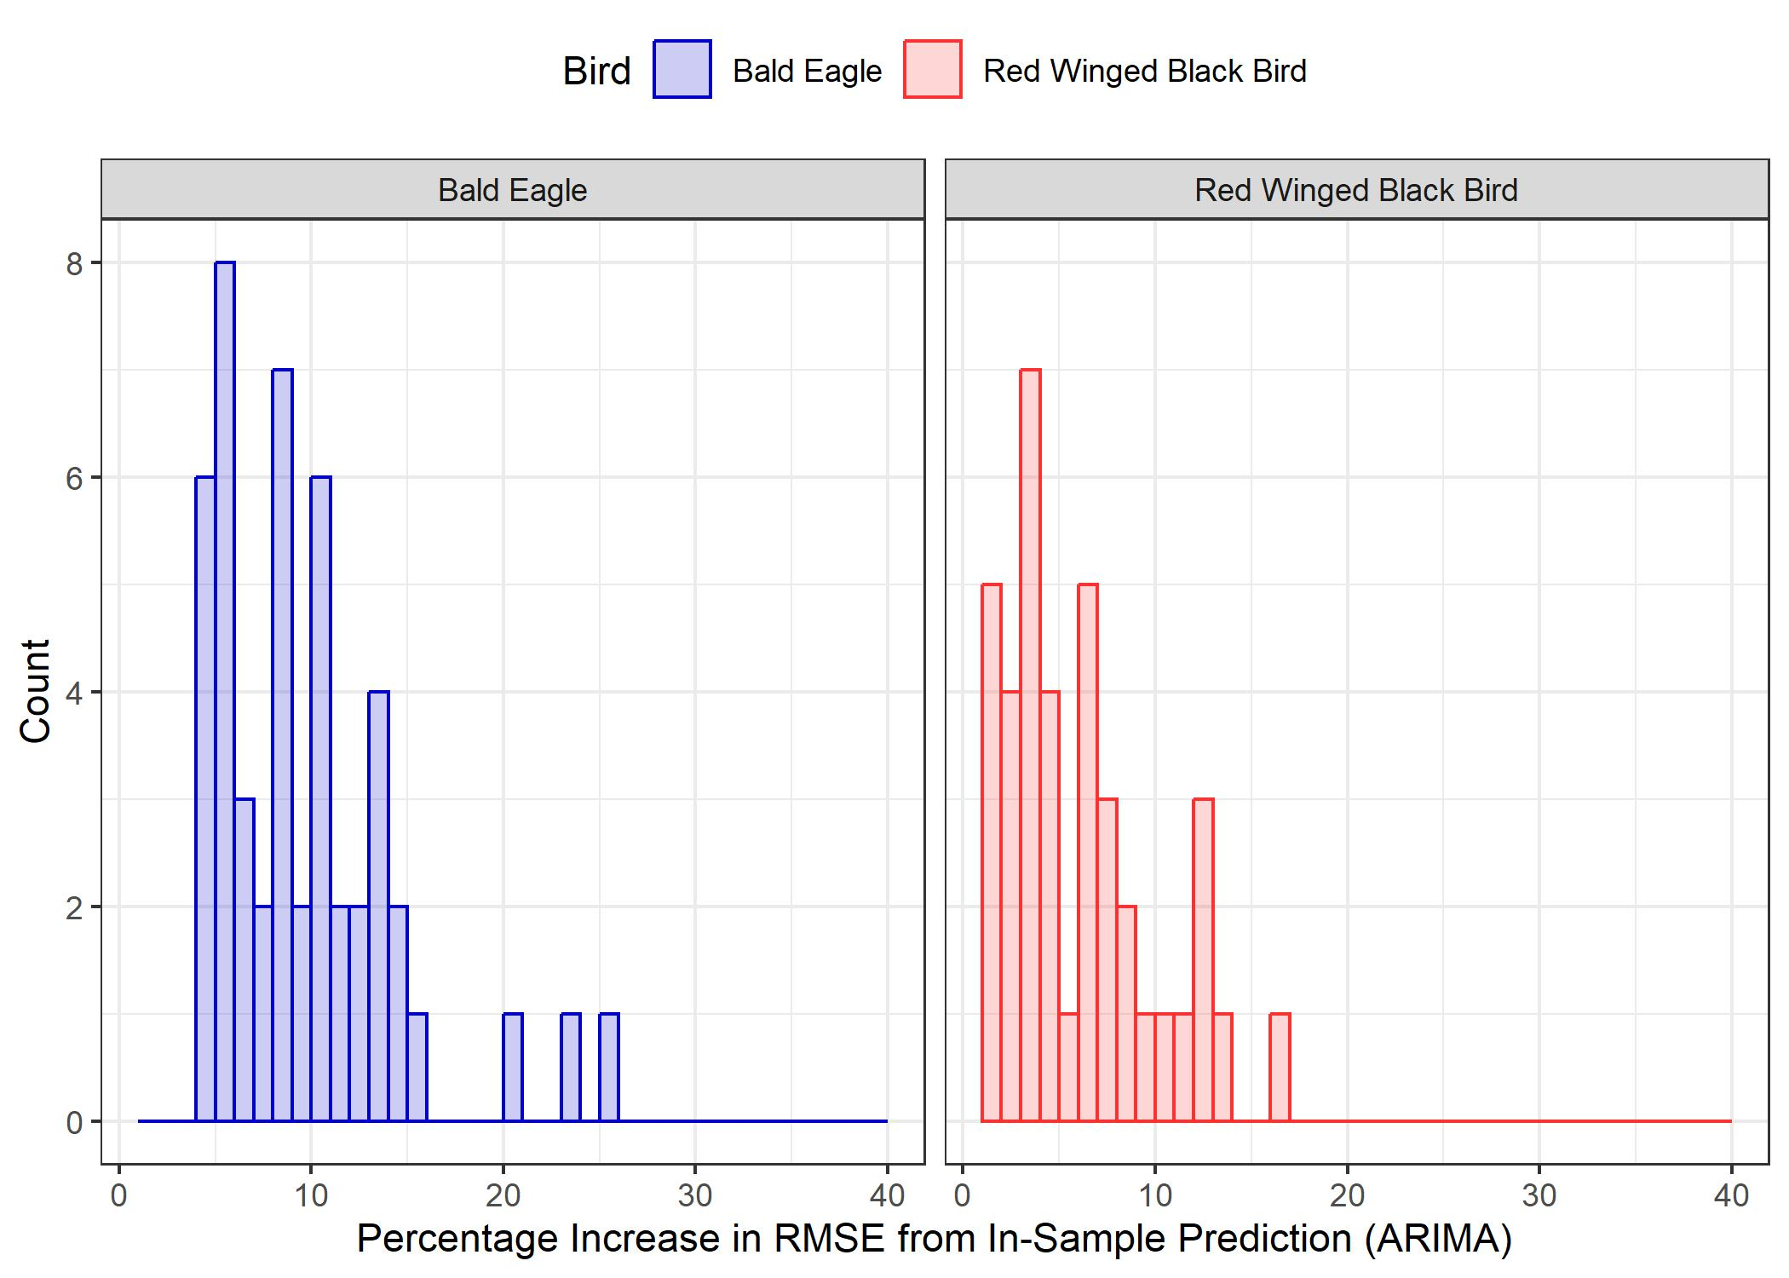
Forecasting Experiments - ARIMA

Slide 17
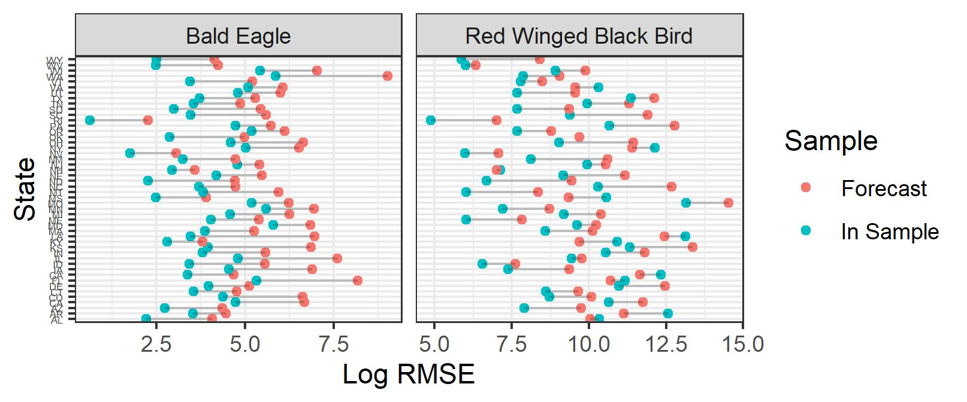
Forecasting Experiments - Structural

Slide 18
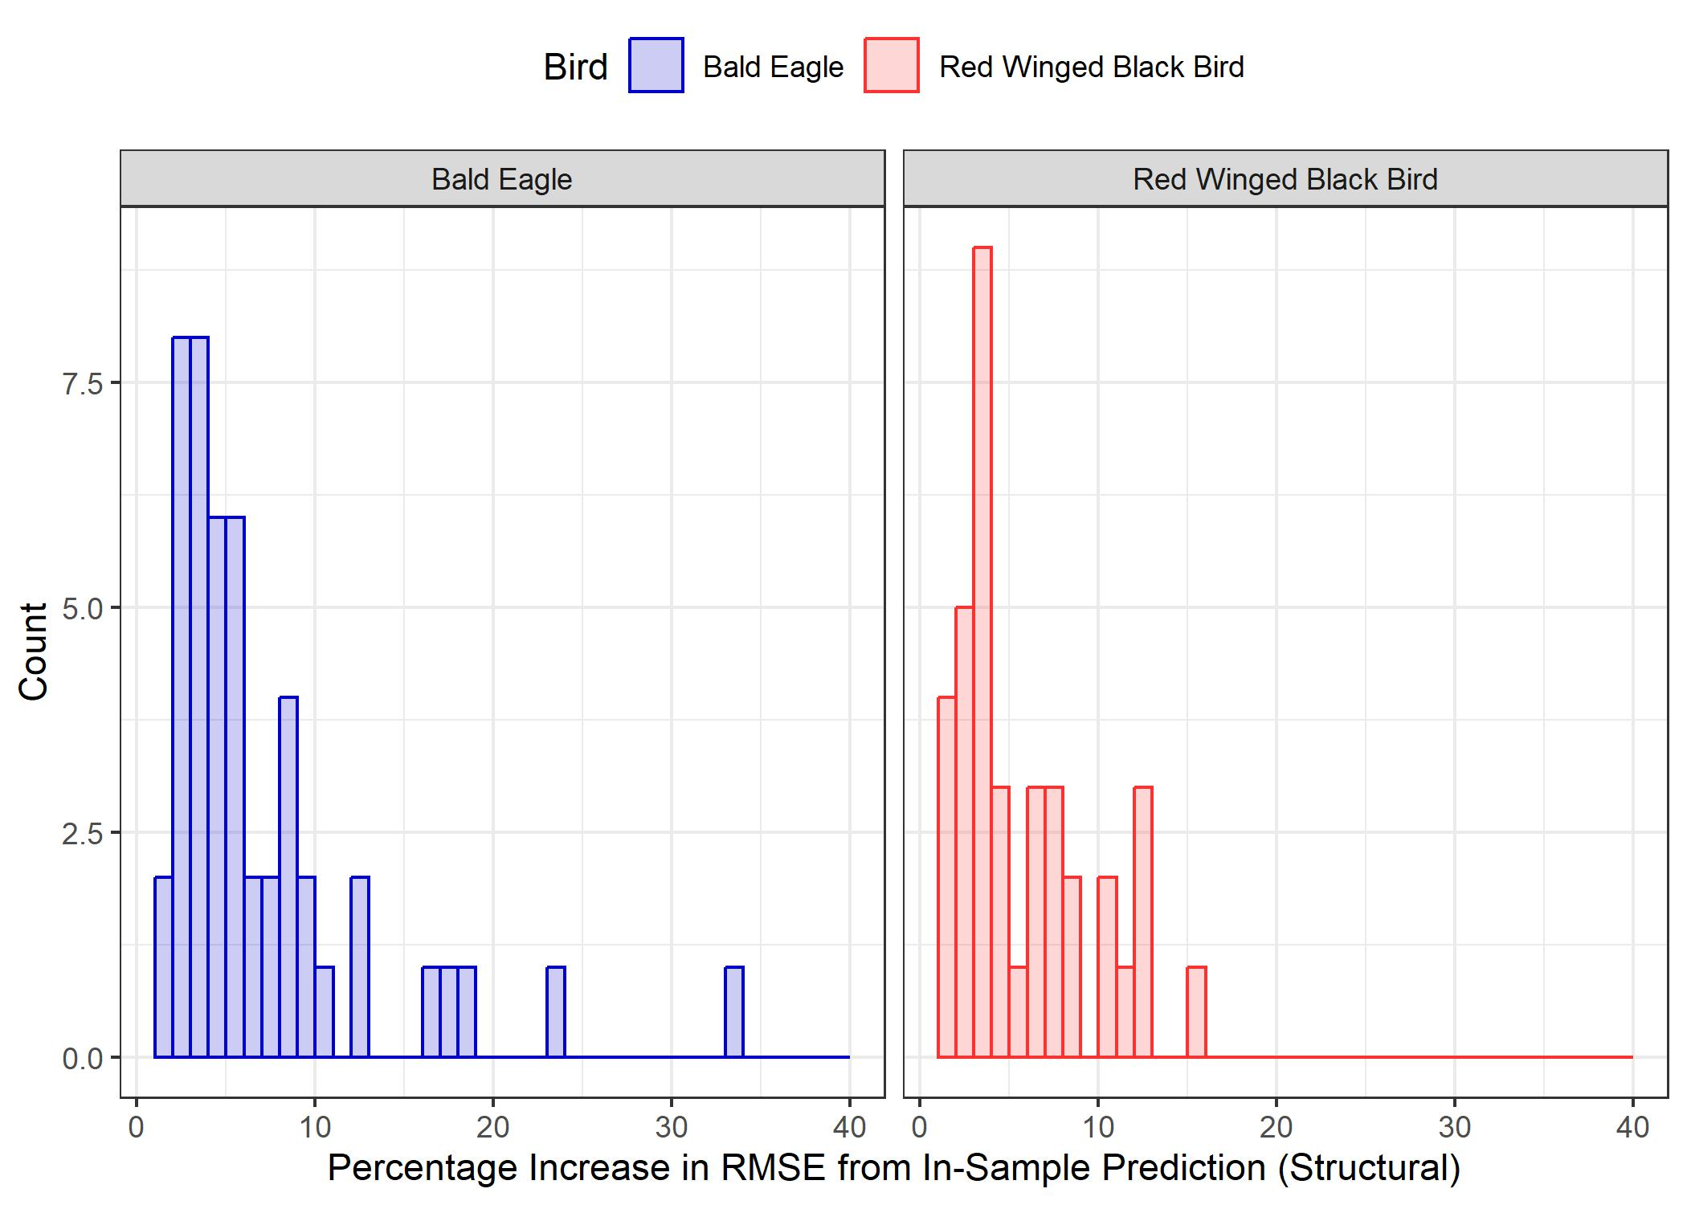
Forecasting Experiments - Structural

Slide 19
Final Forecasts
Data Description
Data Exploration
Forecasting Experiments
Final Forecasts
Conclusion

Slide 20
Final Forecasts

Slide 21
Conclusion
Structural Model performs slightly better than ARIMA model, but differences exist between bird species

