Slide 1
LVL
CARTS
DIGITAL FLAGSHIP
A new website for
St. George's premier
golf cart destination.
Prepared for the LVL Carts founding family · St. George, Utah
MAY 2026

Slide 2
LVL
CARTS
01 · THE OPPORTUNITY
Your inventory is luxury.
Your website isn't (yet).
WHY IT MATTERS
Conversion rate on luxury e-com sites is 3–5× generic templates. Buyers researching $13K carts don't comparison-shop on price — they comparison-shop on trust signals: photography, story, polish.
LVL Carts sells $10K – $13K vehicles with curated finishes, custom builds, and white-glove delivery — but the current site reads like a generic dealer page running on a stock template. The shopping experience and the showroom experience don't match.
02 / 12

Slide 3
LVL
CARTS
02 · THE PROPOSAL
Four moves. One brand.
A complete digital flagship — designed for the way you actually sell.
01
02
03
04
Redesign
Rides Rental Sync
AI Concierge
SEO & Local
Premium black + gold aesthetic that mirrors your showroom. Built on the Stitch "Desert Highline" design system.
Keep your existing inventory backend. Pipe live cart data into the new site via Rides Rental's platform integrations.
An always-on chatbot that answers inventory, financing, delivery, and scheduling questions — and books test drives.
Schema markup, local-business signals, fast page speed, and content built for "St. George golf carts" searches.
03 / 12

Slide 4
LVL
CARTS
03 · BEFORE → AFTER
From template to flagship.
CURRENT
PROPOSED
·
Generic Rides Rental template
→
Desert Highline aesthetic — black, gold, tan
·
Lorem-ipsum testimonials still live
→
Real testimonials from Southern Utah customers
·
"Venom EV" still in meta tags (rebranded to Royal EV)
→
Brand-consistent across every touchpoint
·
Stock orange/black palette — same as 1,000 other dealers
→
Editorial photography, big serif headlines, sharp UI
·
No financing flow on-site
→
Inline financing form — get your out-the-door price
·
No chatbot — every question = a phone call
→
AI assistant: inventory, financing, delivery, scheduling
·
Thin SEO. No schema. No local pages.
→
AutoDealer schema + LocalBusiness markup + city pages
04 / 12

Slide 5
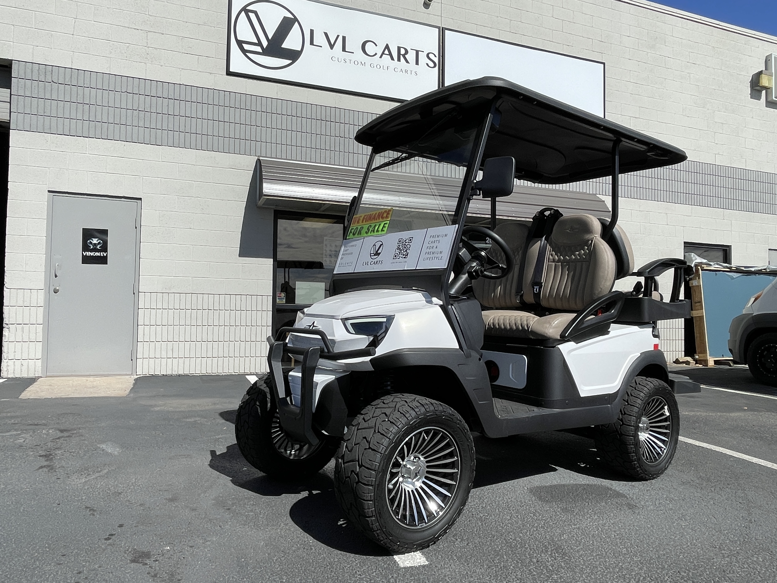
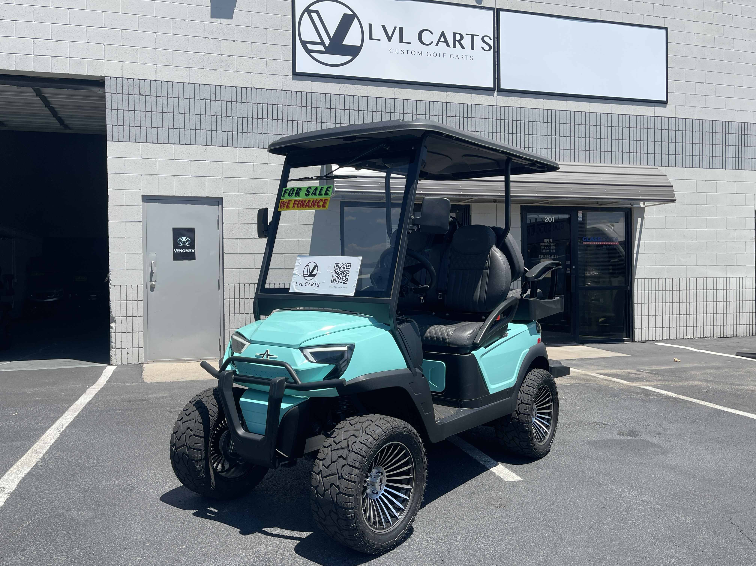
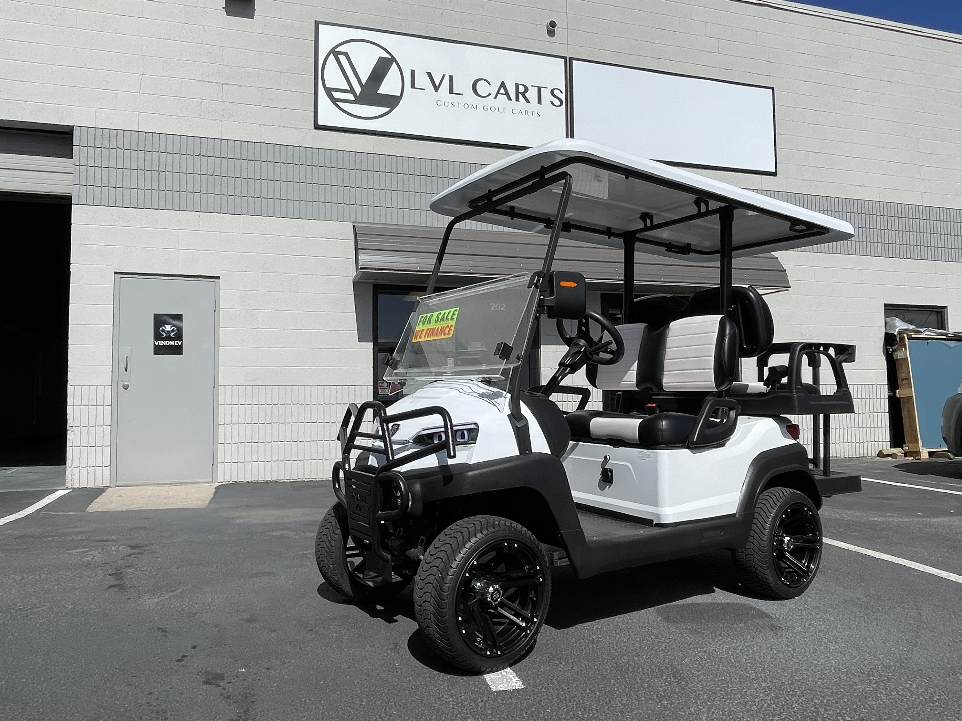
LVL
CARTS
04 · DESIGN PREVIEW
Your real inventory. New frame.
Below: actual product photos from your current site, dropped into the new design language. Week 3 includes a full retouching pass — clean backgrounds, color consistency, editorial cropping.
ATLAS · 4-PASS · LIFTED $12,990
ATLAS · TIFFANY BLUE $12,990
ROYAL EV · CROWN 4 $9,990
05 / 12

Slide 6
LVL
CARTS
05 · RIDES RENTAL INTEGRATION
Keep your backend. Replace the front-end.
You already use Rides Rental Software for inventory, leads, and billing. We don't replace that. We replace the customer-facing site — and pipe the data through.
Rides Rental
Sync Layer
New LVL Site
Inventory · Leads · Customer DB · Payments · Reports
→
Webhooks + nightly sync. Inventory + leads flow both ways.
→
Stitch design. Live inventory. Chatbot. Forms.
INTEGRATIONS RIDES RENTAL ALREADY SUPPORTS
Stripe · Authorize.net · PayPal · Lightspeed · Dealertrack DMS · Google Analytics · Zapier · YouTube
06 / 12

Slide 7
LVL
CARTS
06 · THE AI CONCIERGE
An assistant that knows your inventory cold.
Available 24/7. Trained on your products, pricing, financing, delivery, and hours.
Inventory
Education
Logistics
Lists what's on the floor, by brand, by passenger count, by color. Pulls live from Rides Rental.
Atlas vs Royal EV, lithium vs lead-acid, range, charging, LSV street-legal package, warranty.
Delivery zones, financing pre-qual, scheduling test drives, hours, address — and books appointments.
EXPECTED IMPACT
+30% lead capture · –40% phone-tag · 100% off-hours coverage
07 / 12

Slide 8
LVL
CARTS
07 · SEO & LOCAL
Own "St. George golf carts."
Most local dealers don't bother with structured SEO. We'll fix that in week one.
Schema.org markup
Meta + OG tags
AutoDealer + LocalBusiness JSON-LD on every page so Google reads inventory, hours, address.
Per-page titles, meta descriptions, Open Graph, Twitter cards. Already sloppy on the live site.
Local landing pages
Page speed
/golf-carts-st-george, /golf-carts-washington-ut, /golf-carts-hurricane — each ranking for its own city.
Single-file build, lazy-loaded images, Tailwind CDN. Lighthouse 95+ on every page.
Content engine
Google Business sync
Quarterly long-form posts ("Atlas vs Club Car", "Best golf carts for desert terrain") to capture top-of-funnel.
Hours, photos, posts, reviews — kept in lockstep with the site so Google trusts you.
08 / 12

Slide 9
LVL
CARTS
08 · TIMELINE
Live in 4 weeks.
WEEK 1
WEEK 2
WEEK 3
WEEK 4
Discovery + Brand Lock
Build Phase
Content + SEO
Launch + Handoff
Confirm voice. Photo audit. Real-customer outreach for testimonials. Final brand colors.
Site build complete. Rides Rental sync wired. Chatbot trained on knowledge base.
Local landing pages. Schema. Meta. Photo retouching. GBP optimization.
QA across devices. DNS cutover. Analytics + Search Console set up. Owner training.
09 / 12

Slide 10
LVL
CARTS
09 · DELIVERABLES
Everything you need. Nothing you don't.
✓
New website — 6+ pages, fully responsive, premium design system
✓
Rides Rental data sync (live inventory + lead capture)
✓
AI chatbot trained on your inventory, financing, delivery, hours
✓
On-page SEO: schema, meta, alt text, local landing pages
✓
Editorial photography retouching pass on existing inventory shots
✓
Google Business Profile optimization + review-flow setup
✓
Analytics + Search Console + heatmap install
✓
30 days post-launch support — bug fixes, content tweaks, training
✓
Source files (HTML, CSS, JS, image library) — you own everything
10 / 12

Slide 11
LVL
CARTS
10 · THE DEAL
Our ask is unusual.
We believe in this build. We want skin in the game — and we'd rather drive your product than send an invoice.
THE OFFER
Full digital flagship build, traded for one Royal EV Crown 4 ($9,990 retail).
WHAT WE PROVIDE
WHAT YOU PROVIDE
Site · Chatbot · SEO · Rides Rental sync · 30 days support
One Royal EV Crown 4 + a testimonial if you love the work
11 / 12

Slide 12
LVL
CARTS
11 · NEXT STEPS
Let's build it.
If the offer makes sense, we can kick off discovery this week and have a live demo URL in your inbox in 7 days.
CONTACT
LVL CARTS
Bryce Morgan · brycedmorgan@gmail.com
(435) 414-1180 · info@lvlcarts.com · 677 N 3050 E, St. George UT
12 / 12

