Slide 1
Interface: Final Project
By: Bryce Huston
30003673

Slide 2
Introduction
Notes:
This program is designed to allow the easy saving and browsing of many things related to music.
Here we will create a suitable user interface (UI) so all data can be accessed and maintained through a series of menus and forms.
Instruments, venues, bands musicians and shows are just some of the things that are displayed within this program.
It also features a very user friendly interface that includes help buttons and simple navigation between different parts of the program.

Slide 3
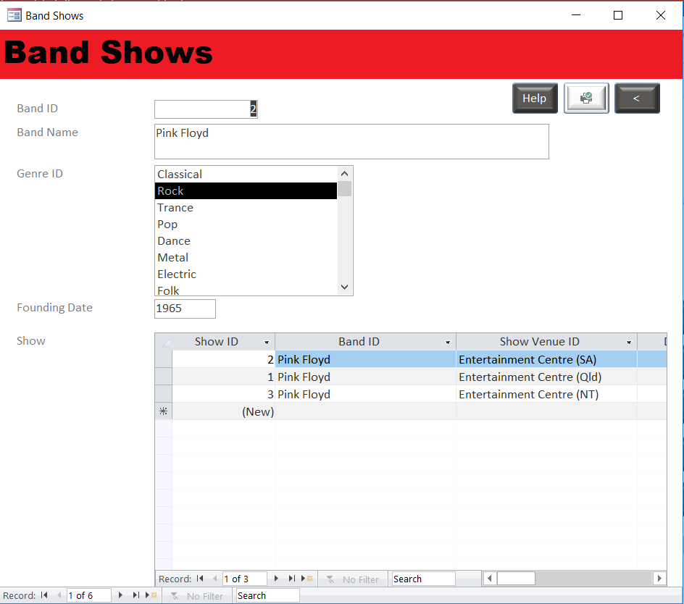
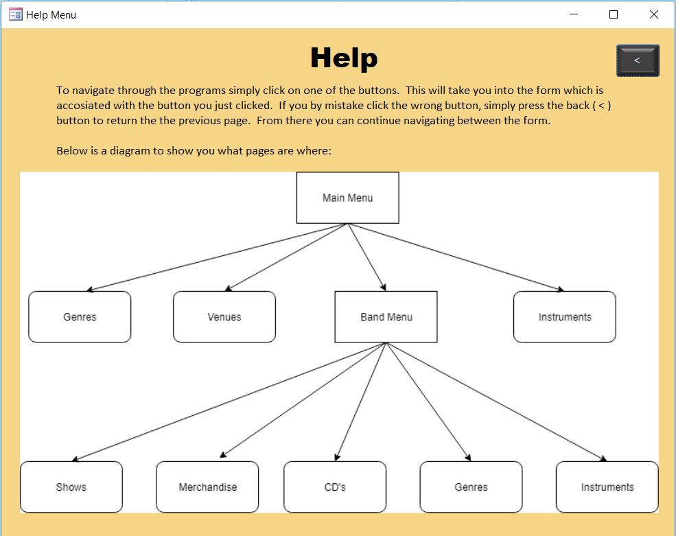
Colour Scheme
Examples:
Notes:
Within my program I went with a red and grey scheme with white as the background for most forms.
The grey is used for the back buttons and red for the main menu and band menu buttons.
Red is also used as the highlights for most form pages.
I chose this scheme as red is a very dominant colour and draws your attention right away.
With the white text font in the buttons it makes it easy to see from far away.
or the main menu help form I used a gold back ground as the information on the page enriched you with useful information.
I kept all the back ( < ) buttons dark grey and except the print report button I made white to stand out a little.

Slide 4
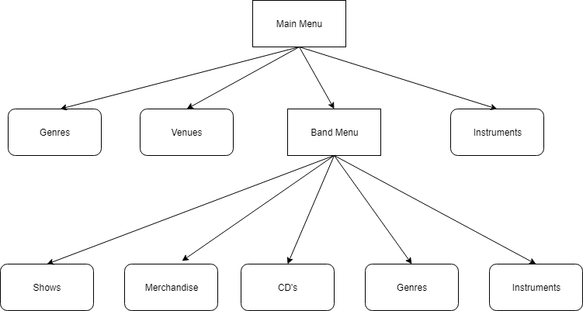
Navigation
Notes:
It’s very easy to navigate through the program.
From the main menu, you can choose one of the categories to look into.
Genres, Venues and Instruments are forms with data that can be that can be clicked on from the main menu.
The bands section however opens up to a sub menu for different forms, all with data that relates directly to bands.
This includes Shows, Merchandise, CD’s, Genres and Instruments.
The Shows form also has a help button to explain how to use the Band Shows form.
There is also a print button that’ll print you a report of all the “Shows” by venue.
There is also a help button on the Main Menu form with a diagram of how to navigate through the program.

Slide 5
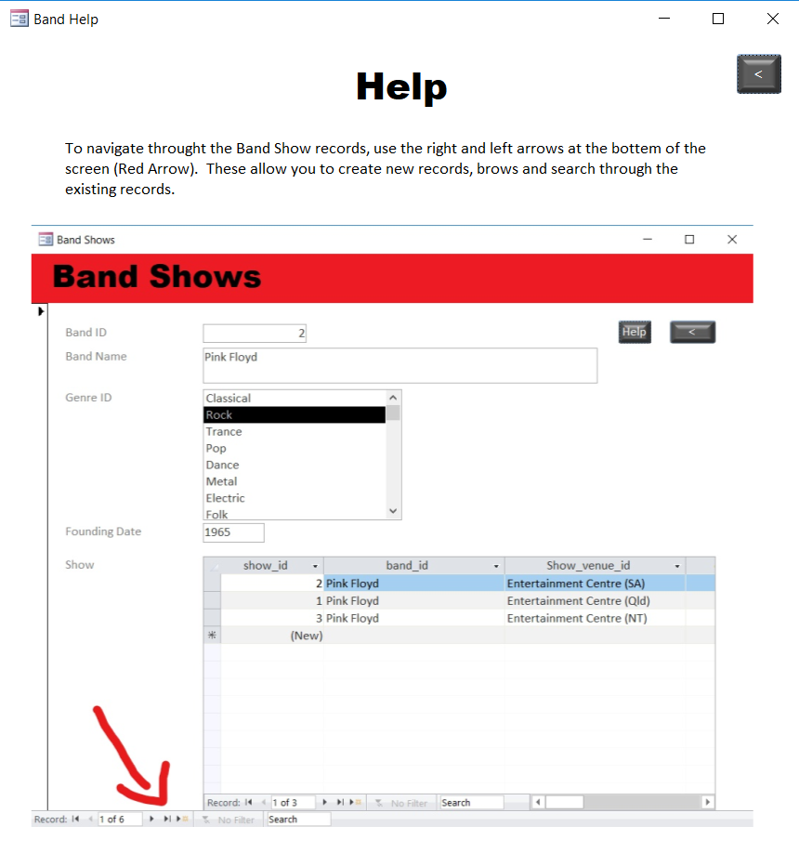
USE
Notes:
The use of this program is to easily store vast amounts of information about something making it easy for the user to navigate through different section.
In this case it’s a band with other musical related things.
You can customize all the data to be personalized to whatever you want, allowing for a different set of data on each user computer.

Slide 6

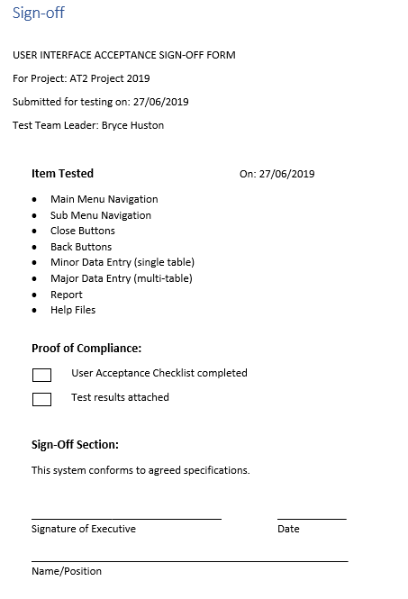

Sign-Off
Notes:
Items will be tested and record for what date they were tested
Proof of compliance will be check off when tasks are complete
Sign-Off Section : This section will be signed Executive along with the date and Name/Position

Slide 7
The end
Thank you and hope you enjoyed the presentation ☺

