Slide 1
Intro to freeCodeCamp JavaScript Algorithms
Bryce Jech
freeCodeCamp OKC

Slide 2
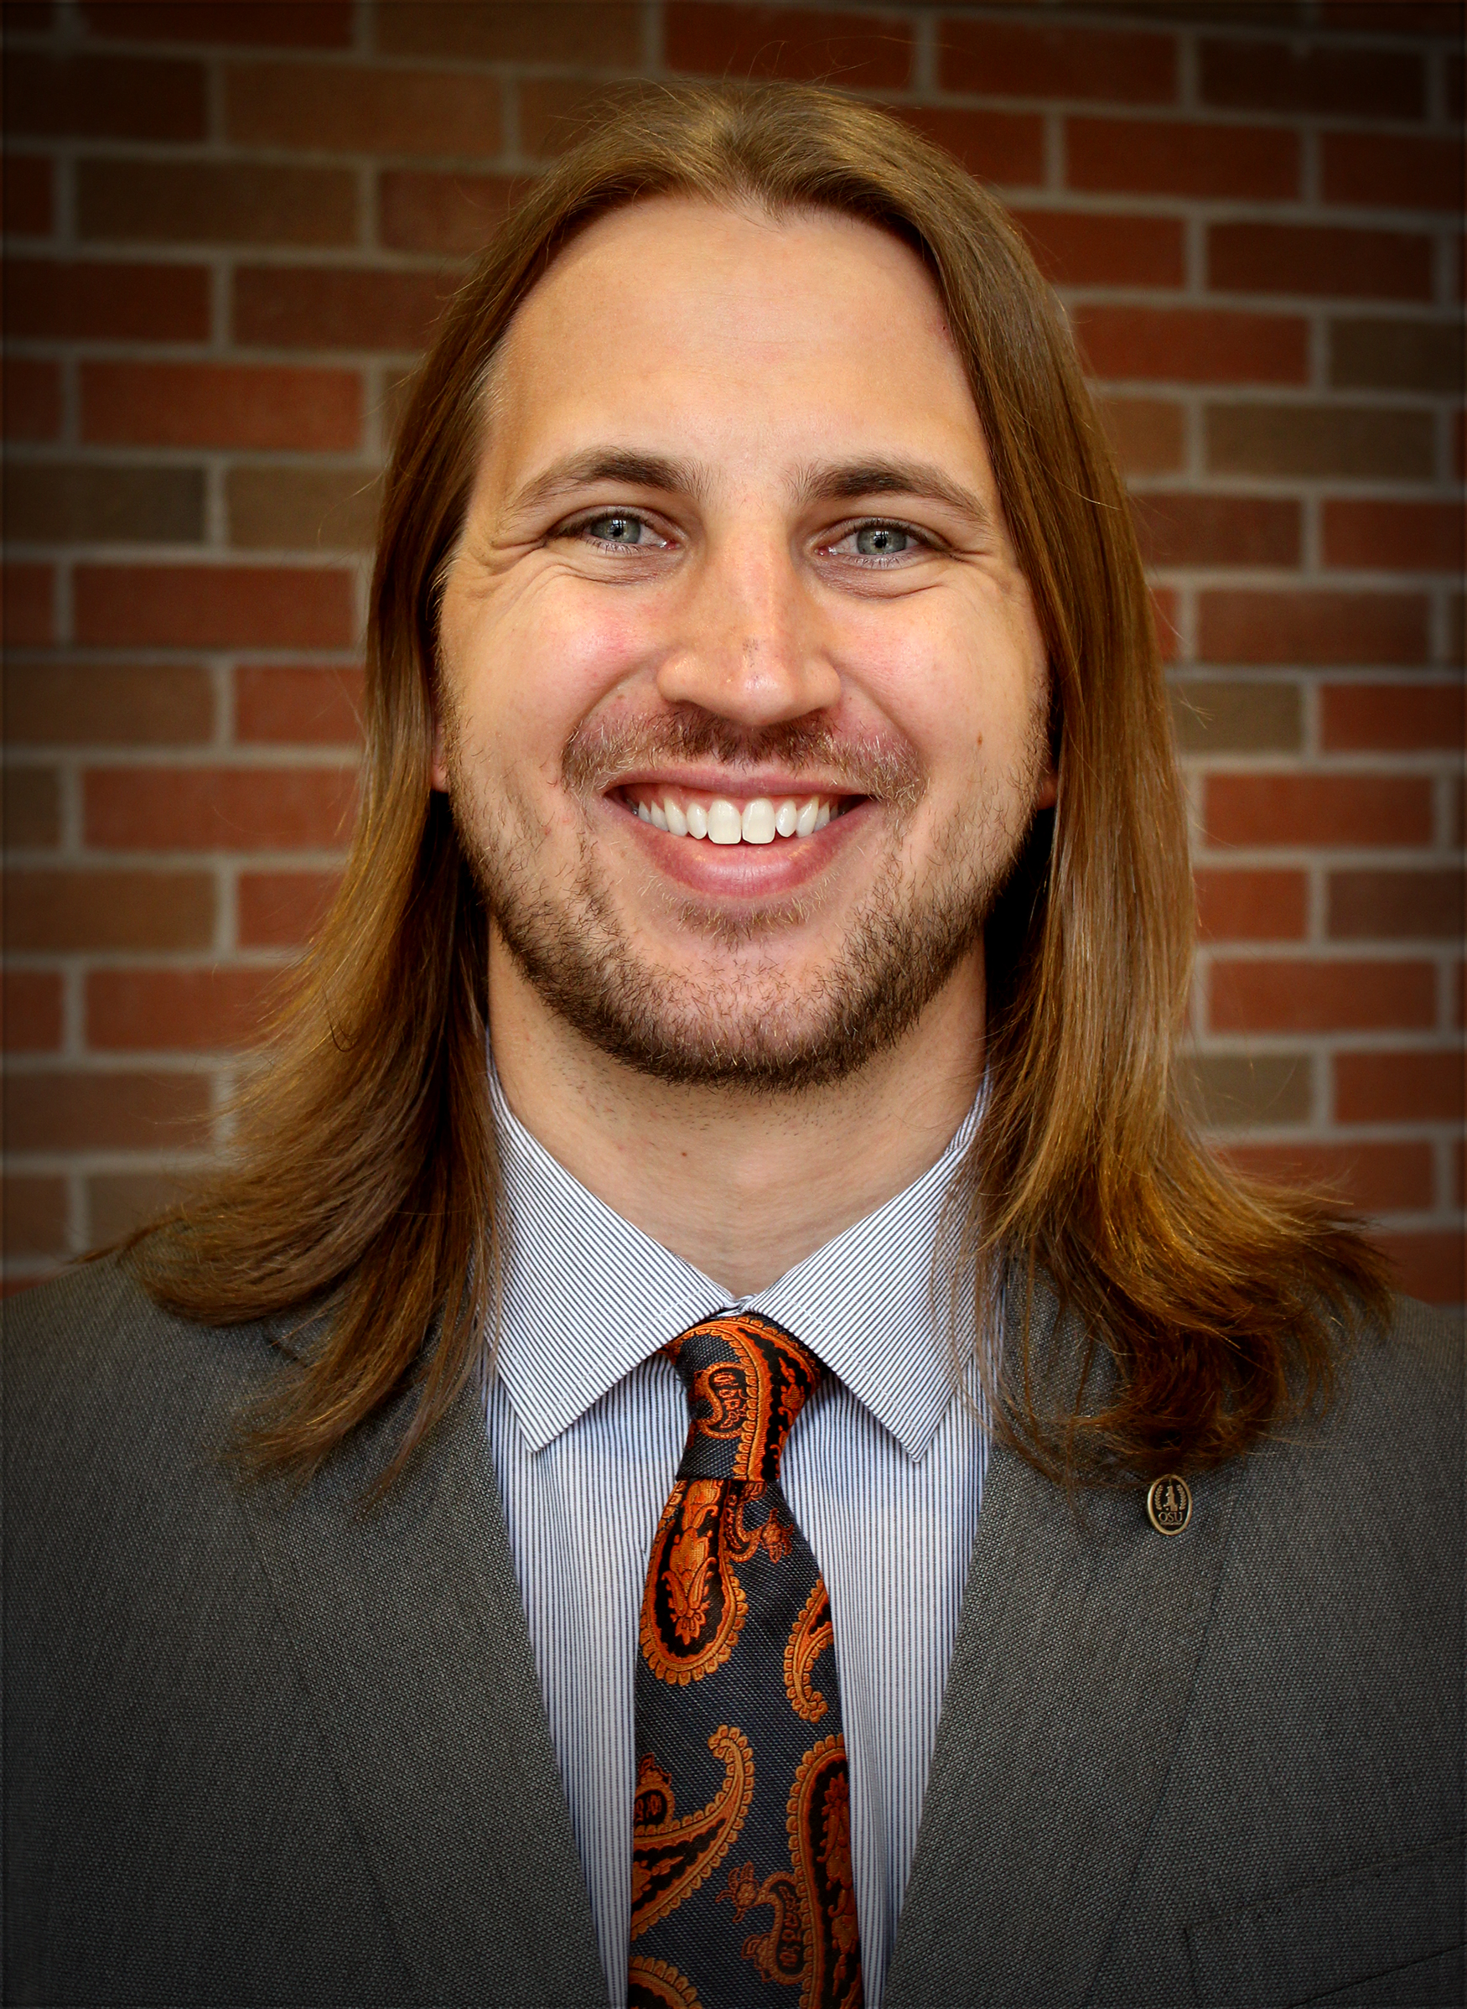
About the speaker
Bryce Jech
Web Developer at LandTrafficControl
Developing web and network applications for 6 years
Work primarily in Angular, Vue, and NodeJS
Previously worked at the Oklahoma State University Foundation
Slack display name: @pyguy
Github: https://github.com/brycejech
LinkedIn: https://www.linkedin.com/in/brycejech/
Twitter: @brycejech
Website: https://brycejech.com

Slide 3
Beginner algorithms

Slide 4
Reverse a string
Reverse the provided string
You may need to turn the string into an array before you can reverse it
Your result must be a string

Slide 5
Factorialize a number
Return the factorial of the provided integer
If the integer is represented with the letter n, a factorial is the product of all positive integers less than or equal to n
Factorials are often represented with the shorthand notation n!
For example: 5! = 1 * 2 * 3 * 4 * 5 = 120
Only integers greater than or equal to zero will be supplied to the function

Slide 6
Confirm the ending
Check if a string (first argument, str) ends with the given target string (second argument, target).
This challenge can be solved with the .endsWith() method, which was introduced in ES2015. But for the purpose of this challenge, we would like you to use one of the JavaScript substring methods instead.

Slide 7
Repeat a string repeat a string
Repeat a given string str (first argument) for num times (second argument). Return an empty string if num is not a positive number.

Slide 8
Boo who
Check if a value is classified as a boolean primitive. Return true or false.
Boolean primitives are true and false.

Slide 9
intermediate algorithms

Slide 10
Sum all numbers in a range
We'll pass you an array of two numbers. Return the sum of those two numbers plus the sum of all the numbers between them
The lowest number will not always come first

Slide 11
Seek and destroy
You will be provided with an initial array (the first argument in the destroyer function), followed by one or more arguments. Remove all elements from the initial array that are of the same value as these arguments
Note You have to use the arguments object

Slide 12
Search and replace
Perform a search and replace on the sentence using the arguments provided and return the new sentence.
First argument is the sentence to perform the search and replace on.
Second argument is the word that you will be replacing (before).
Third argument is what you will be replacing the second argument with (after).

Slide 13
Everything be true
Check if the predicate (second argument) is truthy on all elements of a collection (first argument)
In other words, you are given an array collection of objects. The predicate pre will be an object property and you need to return true if its value is truthy. Otherwise, return false
In JavaScript, truthy values are values that translate to true when evaluated in a Boolean context
Remember, you can access object properties through either dot notation or [] notation

