Slide 1
What is the influence of agricultural capital flows on food availability in West Africa?
Bryce Leary
Carine Ayidehou
Milika Robbins
Zeinabou Saidou Baraze

Slide 2
Introduction
Globally 821 million people suffered from hunger in 2018 (UN).
Global population to feed by 2050: 9 Billion People.
Causes of food insecurity:
Fast population growth
Climate change
Water scarcity
Higher costs of farming
Political Instability
Notes:
Food Security is a situation "...when all people, at all times, have physical, social and economic access to sufficient, safe and nutritious food to meet dietary needs for a productive and healthy life" (UN, 2014)

Slide 3
Context
Policy makers & global leaders are committed to end hunger by 2030
Sustainable Development Goals
Zero Hunger Challenge
Policy makers have direct influence on areas such as bilateral and multilateral aid, as well as import and export regulations
More investment into agricultural sector
Partnership among stakeholders & Farmers

Slide 4
Question & Hypothesis
Question: How does the source of net flows of agricultural capital flows influence the availability of food in West African countries?
Hypothesis: A positive net flow of agricultural capital flows increases the availability of food in West African countries.

Slide 5
Data Description
Outcome Variables
Explanatory Variables
adesa
Average Daily Energy Supply Adequacy
Is there, on average, enough food in the country for each person?
depth
Depth of Food Deficit
The number of kilocalories per day an individual is from caloric sufficiency
bilateral: Net bilateral agriculture development aid
multilateral: Net multilateral agriculture development aid
fdi_net: Net agricultural FDI
exp_value: Value of agricultural exports
imp_value: Value of agricultural exports

Slide 6
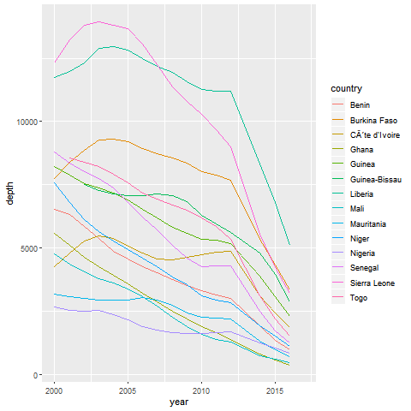
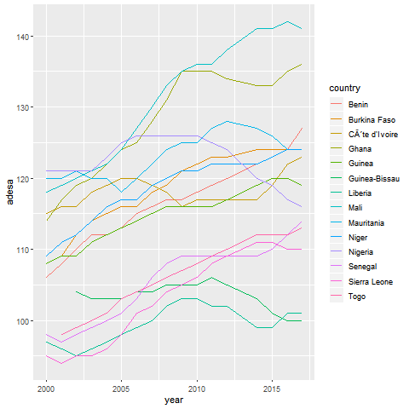
Time Series Trends

Slide 7
First Analysis: Linear Regression
summaidfdiie <- lm(cbind(depth,adesa) ~ bilateral + multilateral + fdi_net + exp_value + imp_value, data = agriculture)
Revealed multilateral donor flow and agricultural exports as the two main influences on our outcome variables
As the multilateral aid flow increases by approximately 79 million USD, the depth of the food deficit decreases by 1,000 calories
An increase in exports reduces available food for populations experiencing hunger across the West African countries

Slide 8
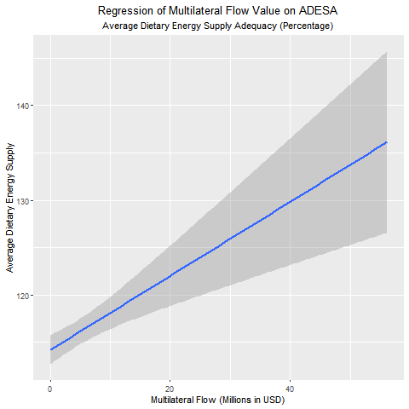
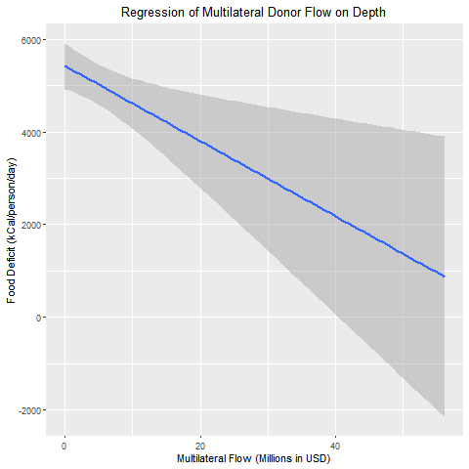
Multilateral Aid

Slide 9
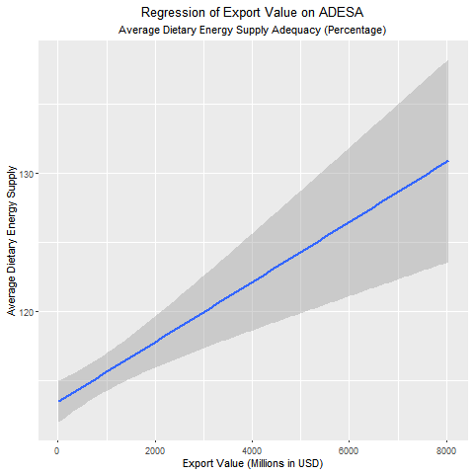
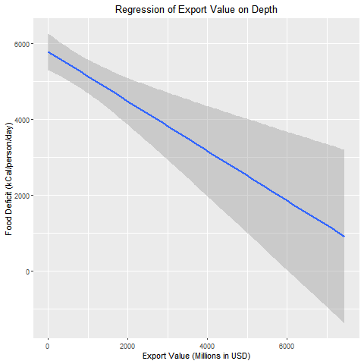
Export Value

Slide 10
Cluster Analysis
Completed a hierarchical agglomerative cluster method
Small-n size made k-means clustering a challenge
Four clusters: 2000, 2005, 2010, 2015
Countries became less similar as the millennium progressed
Maximum height: 4.1 to 7.3
2010-2015 Dendrograms
Bakers Gamma correlation: 0.68
Height increase: 1.24

Slide 11
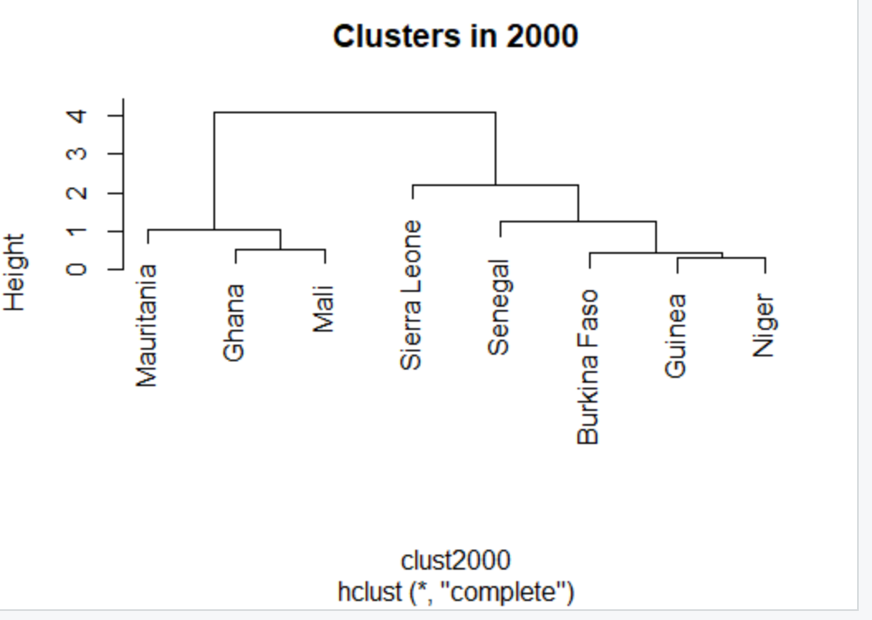
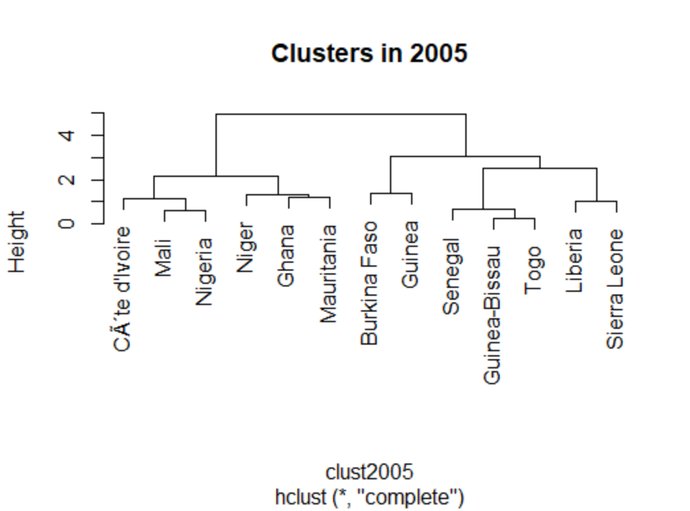
Dendrograms 1

Slide 12
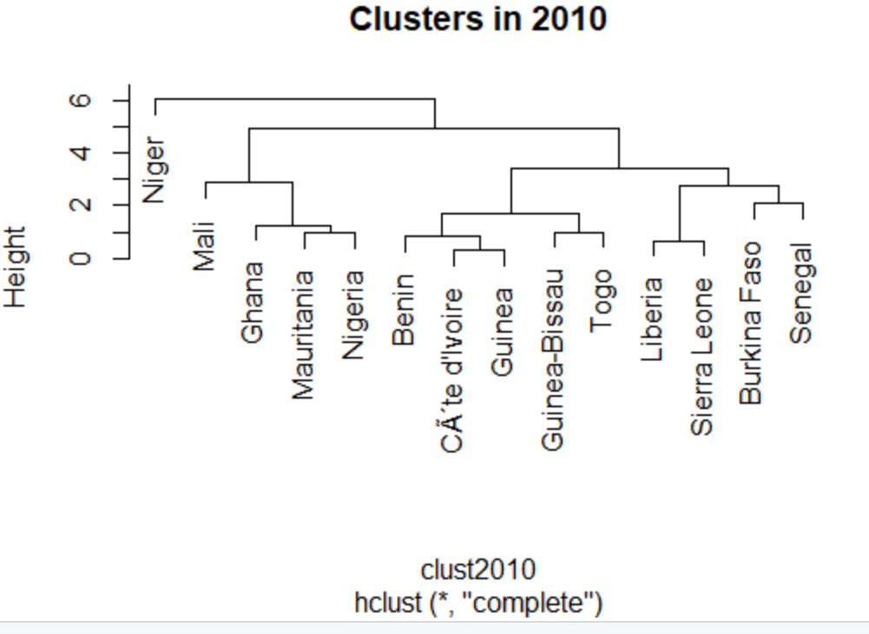
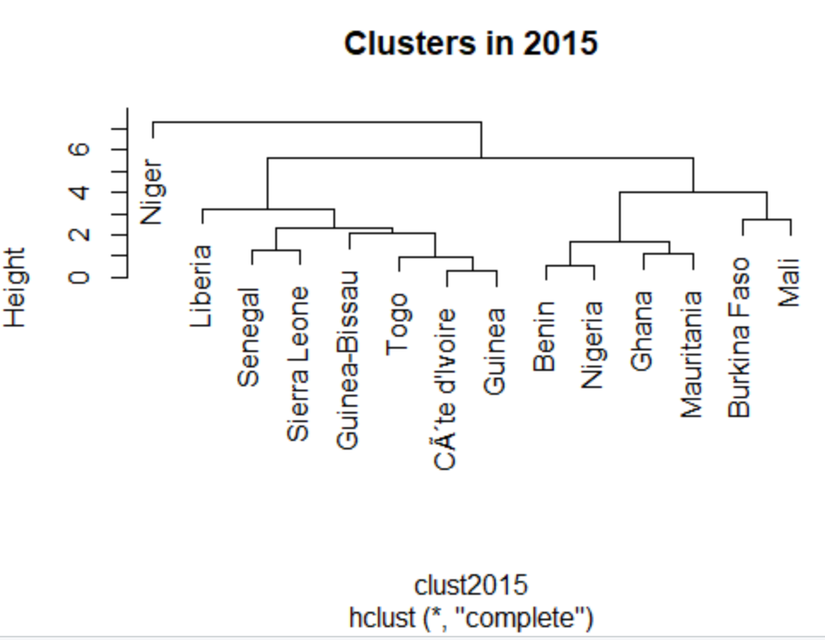
Dendrograms 2

Slide 13
Conclusion and Recommendations
The agricultural capital flow should directly target the most vulnerable population
Policymakers should promote multilateral aid over bilateral aid in food security
Global leaders can examine cluster models to tailor regional or multinational solutions
Further research should consider the targeting nutritional content and whether gains are experienced equally across the population.

