Slide 1

Stripe + Webhooks
AIS Tech Talk
Part 4

Slide 2
What is a Webhook?
Just an API
Intended for other services to talk to your app
Your app
/webhook
/orders

Slide 4
Webhook Use Cases
Notify you of changes to customer data
Notify you of a problem
Notify you of updates
Notify you when you get paid
Notes:
Alternative to webhooks: Continually asking the other server, “hey, did this happen?” ”no”

Slide 5
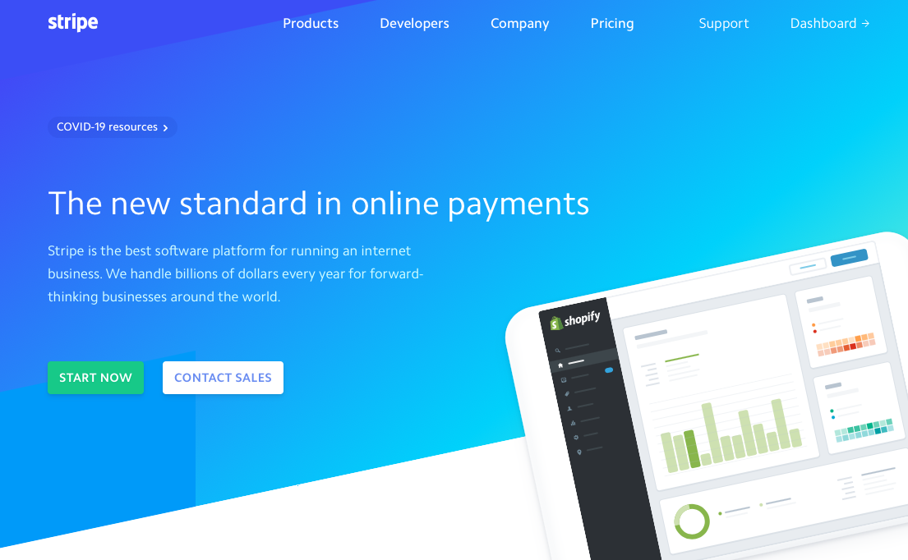
Stripe

Slide 6
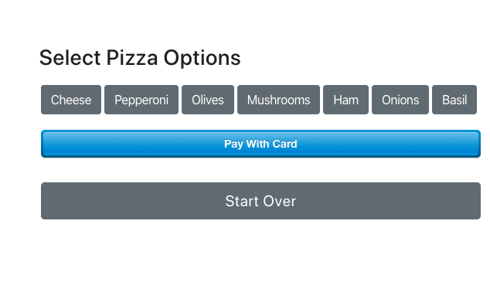
Pizzilla Integration

Slide 7
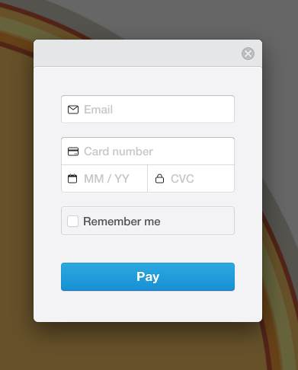
Pizzilla Integration

Slide 8
How Stripe Works
Two keys
Public key
Secret key
Use the public key in the browser to collect their credit card information and send it to stripe. Your server never sees their credit card info. Stripe will send back a token.
Send the token to your server. Use the secret key along with the token to generate a charge.
Notes:
PCI compliance (not needed)
Pause here and create your stripe account

