Slide 1

React UI
Pizzilla

Slide 2
GitHub
Download my code from GitHub
(instead of what we built last time)
https://github.com/brycelund/Pizzilla

Slide 3
React.js
Developed by Facebook
Reusable components
Building dynamic user interfaces

Slide 4
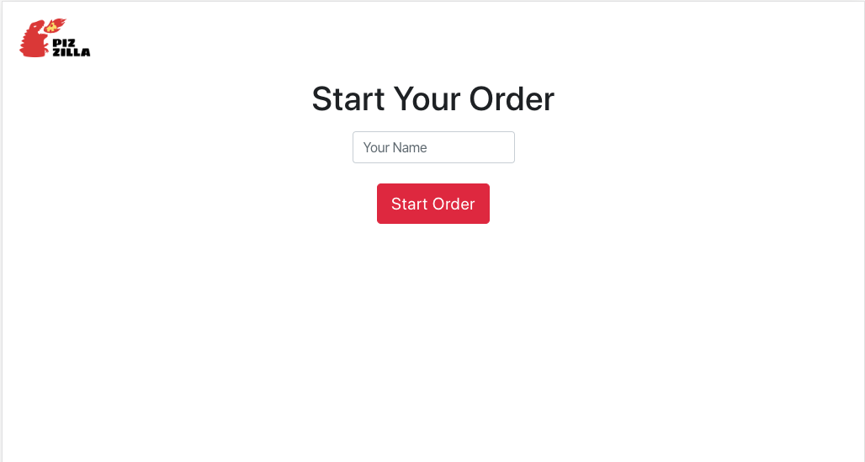
Customer Page

Slide 5
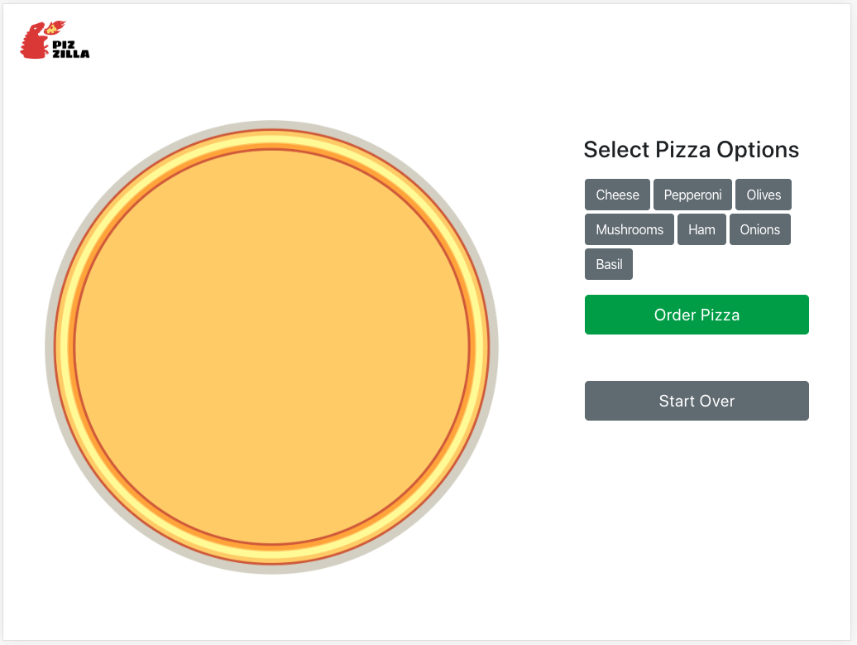
Order Page

Slide 6
Getting Started
npx create-react-app pizzilla
cd pizzilla
npm start

