Slide 1
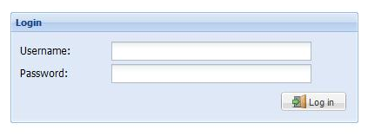
Quickstart - SRSLearning
Visit 'srslearning.com' in your web-browser
You should see be met by a screen asking for your username and password

Slide 2
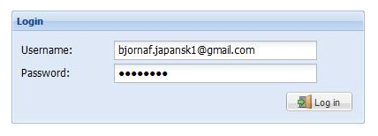
Quickstart - SRSLearning
Enter your username and password
Click 'Log in'

Slide 3
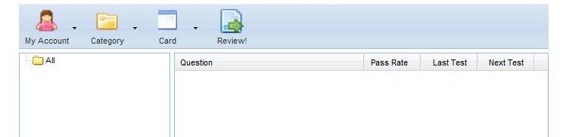
Quickstart - SRSLearning
If you see a screen similar to the one above, then you have logged in successfully

Slide 4
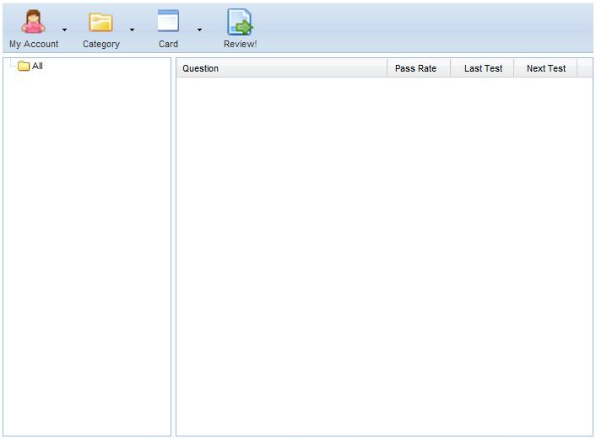
Quickstart - SRSLearning
Menu Bar
Category Tree
Card Grid

Slide 5
Quickstart - SRSLearning
The Category Tree displays all the categories you have made. Categories are useful for helping organise your studying. For example, you might have one category called 'Japansk', and sub-categories called 'Hiragana', 'Greetings', 'Lesson 1'.
The Card Grid displays all the cards in a selected category. Each card is comprised of a question (usually a word or sentence in the language you want to learn) and an answer (the translation or meaning of the question, in your own language).
Next, we will find out how to add categories and cards.

Slide 6
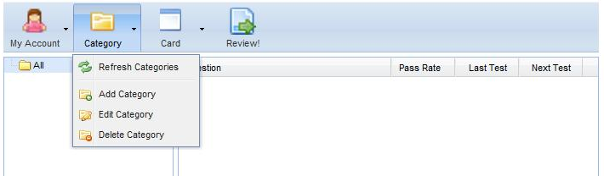
Quickstart - SRSLearning
Click 'Category' in the menu bar.
Click 'Add Category'

Slide 7
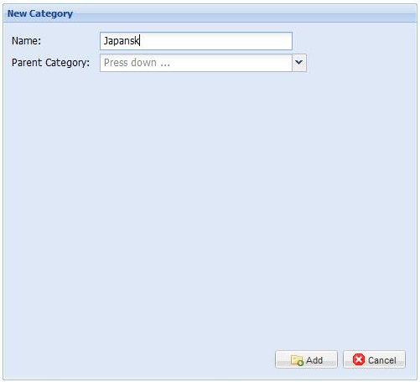
Quickstart - SRSLearning
Type in a name for your new category in the name box
Click on the down arrow on the Parent Category box

Slide 8
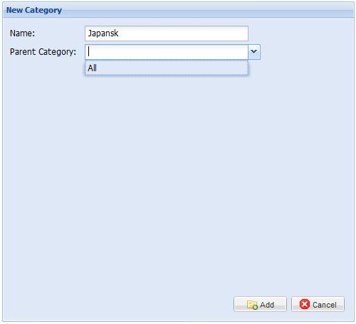
Quickstart - SRSLearning
The Parent Category box will load the names of the categories you have already made.
Click on 'All'
Click 'Add'

Slide 9
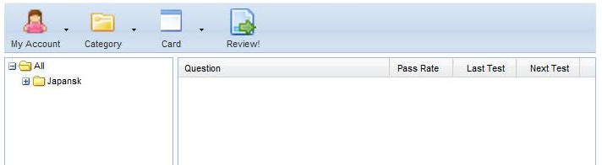
Quickstart - SRSLearning
Your new category will now be available.
If you do not see yur new category, click on the plus ('+') sign next to 'All'. This category will open, and your new category will be on display.

Slide 10
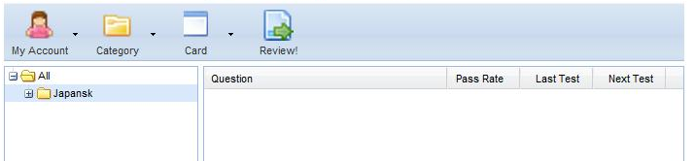
Quickstart - SRSLearning
Now, we will make a new card
First, select the category you want to make the card for. That category will then be highlighted in blue in the Category Tree

Slide 11
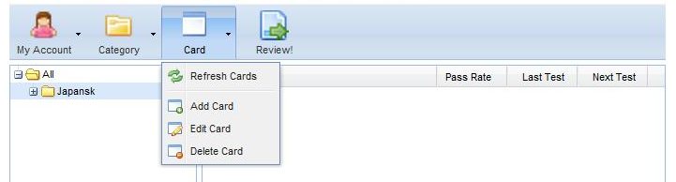
Quickstart - SRSLearning
Click on the 'Card' menu in the Menu Bar
Click on 'Add Card'

Slide 12
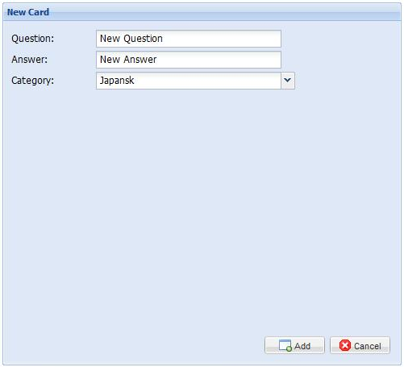
Quickstart - SRSLearning
You should see a panel like the one to the right.
As you can see, the category you highlighted earlier is already selected in the 'Category' box.

Slide 13
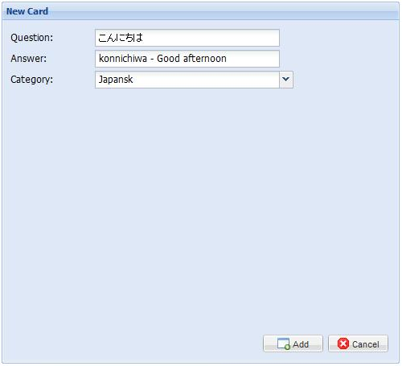
Quickstart - SRSLearning
Fill in the question field. In this case, we have chosen the Japanese word:
'こんにちわ'
Fill in the answer field. In this case, we have written in both the pronunciation and the meaning.
Click 'Add' to create the card

Slide 14
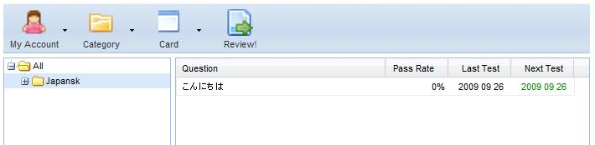
Quickstart - SRSLearning
The new card has now been created and can be seen in the Card Grid
Notice how the date of the next test is today, and displayed in green? All cards with a green date are ready to be reviewed.

Slide 15
Quickstart - SRSLearning
Reviews help you to remember your cards for longer by showing you them just before you forget.
It is very important to review your cards every day. Don't worry, though, you will only be shown a selection of the cards each day, so you will never have to review them all at once.

Slide 16
Quickstart - SRSLearning
To review your cards, select the categroy you wish to review, and click on 'Review' in the Menu Bar

Slide 17
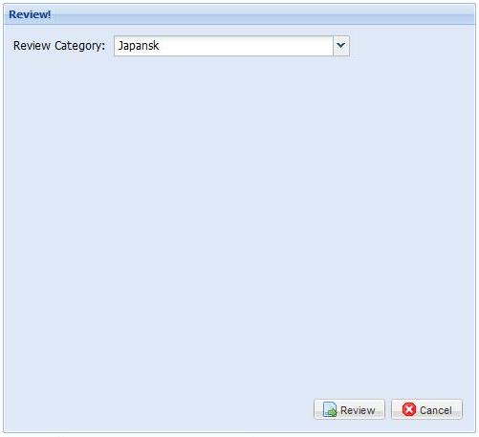
Quickstart - SRSLearning
You should see a panel like the one to the right.
As you can see, the category you highlighted earlier is already selected in the 'Review Category' box.
Click 'Review'

Slide 18
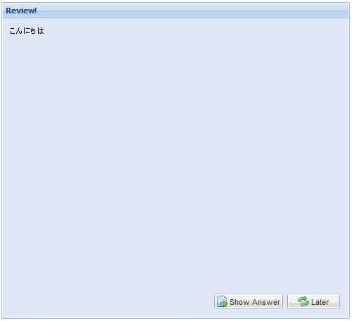
Quickstart - SRSLearning
Your new card is up for review, and the question is displayed at the top left of the panel
If you don't know the answer right now, you can click 'Later' to review the card again at the end
If you think you know the answer, say the question out loud, write down your answer, and click 'Show Answer'

Slide 19
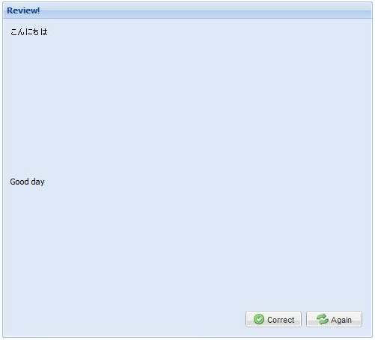
Quickstart - SRSLearning
The answer is displayed about half way down the panel
If you got the answer right, congratulations! Click 'correct'.
If you didn't get the right answer, then you can click 'Again', and you'll get another chance at the end of the review.

Slide 20
Quickstart - SRSLearning
It is important that you are honest. The goal of the system is to help you remember. If you couldn't remember the answer, then the system needs to show you the card more often, so you must click 'Again'. If you click 'Correct', it may be a long tim before you see the card again, and that means it will be more difficult for you to remember.

Slide 21
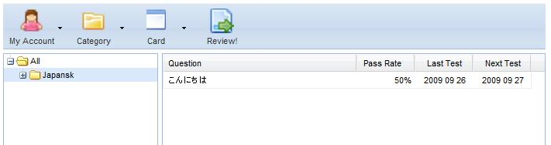
Quickstart - SRSLearning
Once the review is over, the Card Grid will be updated.
As you can see, the Next Test for this card has moved forward one day.
The card has a Pass Rate of 50%, which means I got the wrong answer, but got the right answer when I saw the card the second time.

Slide 22
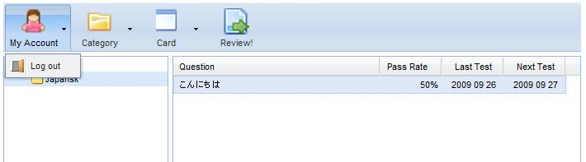
Quickstart - SRSLearning
To log out, select 'My Account' in the Menu Bar
Click 'Log out'
It is important that you log out once you are finished

Slide 23

Quickstart - SRSLearning
At the bottom of the screen, there is a suggestions box.
If you have a problem using the website, or a suggestion on how we can improve it, we would love to hear it.
We like to hear what you don't like about the website too. What's difficult? What's missing?
If you need more space, you can send an e-mail to suggest@srslearning.com

Slide 24
Quickstart - SRSLearning
Four things important to remember:
  Use the system every day
  If you don't get the correct answer first time, try again
  Log out once you are finished
  Have fun

