Slide 1
A TOOLBOX TALK
Useful Python tools for building a quantum harmonic oscillator
… to turn an image upside down, and back up again
uv · ruff · ty · pre-commit · array-api-compat

Slide 2
Two talks in a one
A small, real numerical project — used as an excuse to show the tooling that makes building it easier.
01
The physics
02
The Python
A 2D quantum harmonic oscillator on a periodic grid
uv — project, interpreter, dependencies, lockfile
One Hamiltonian, one exponential, and four increasingly good ways to compute it.
ruff and ty — lint, format and type-check in Rust time
The horse turns upside down and back up again
pre-commit — checks and fixes run automatically
array-api-compat — one algorithm, CPU or GPU

Slide 3





Our goal: turn Schrödinger's horse upside down — and back again
At t = π the horse is inverted; at t = 2π it is exactly back where it started.
$$t=0$$
$$t=π$$
$$t=2π$$

Slide 4
PART ONE
The physics
One Hamiltonian, one exponential, and three increasingly good ways to compute it.

Slide 5
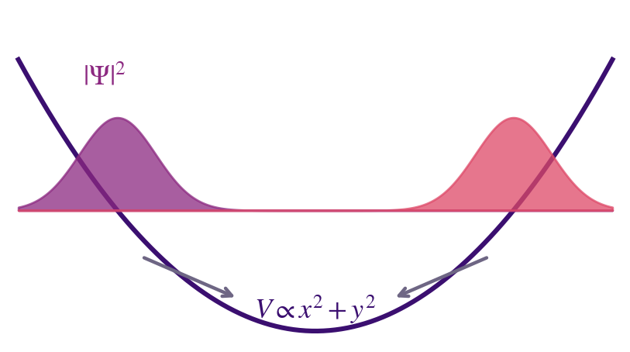

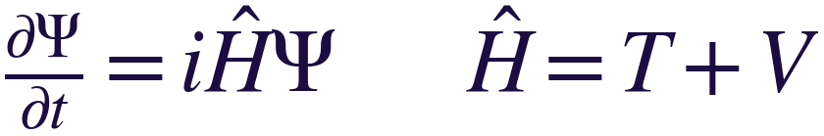


The equation we are solving
Schrodinger Equation describing a state in an infinite well.
$$\frac{∂Ψ}{∂t}=i\hat{H}Ψ \hat{H}=T+V$$
$$Ψ\left(x,y,t\right)∈ℂ^{N×N}$$
$$V\left(x,y\right)=−\frac{1}{2}\left(x^{2}+y^{2}\right)$$
$$T=\frac{1}{2}∇^{2}, ℱ\left[T\right]=−\frac{1}{2}\left(k_{x}^{2}+k_{y}^{2}\right)$$
The picture. One complex number per grid point — modulus is brightness, phase is where it is going.
The infinite well. Depends only on position, so it is diagonal in position space.
Spreading. Depends only on momentum, so it is diagonal in Fourier space.

Slide 6

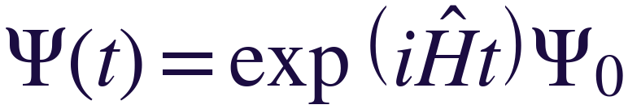


The solution is a single exponential
H does not change with time, so the entire evolution is one operator exponential. Every method that follows computes it.
$$Ψ\left(t\right)=exp\left(i\hat{H}t\right)Ψ_{0}$$
Differentiate it and you get $i\hat{H}$ back. That is the verifies the solution.
$\frac{d}{dt}exp\left(i\hat{H}t\right)Ψ_{0}=i\hat{H}exp\left(i\hat{H}t\right)$ $Ψ_{0}$
So why is this hard?
N=16,384
$$N^{2}≈2.7×{10}^{8}$$
$$𝓞(N^{3})\text{≈}\text{4.4}×{10}^{22}$$
unknowns on a 128 × 128 grid
entries in the matrix $\hat{H}$
operations to compute the dense matrix exponentiation
So we never build $\hat{H}$or compute it’s exponent directly. Every method below only ever needs $\hat{H}$ applied to a vector.

Slide 7










Solution to equations: A rotation in phase space
The oscillator rotates position into momentum. A quarter turn is the Fourier transform; a half turn is the image, inverted.
$$k$$
Fourier Transform of horse
Pure momentum-space
$$t=\frac{π}{2}$$
Modulus what amount of each frequency in $(k_{x},k_{y})$
$$t=π$$
$$t=0$$
$$t=2π$$
$$r$$
Horse
$$t=\frac{3π}{2}$$
Pure position-space
Modulus is how much light is in $(x,y)$

Slide 8
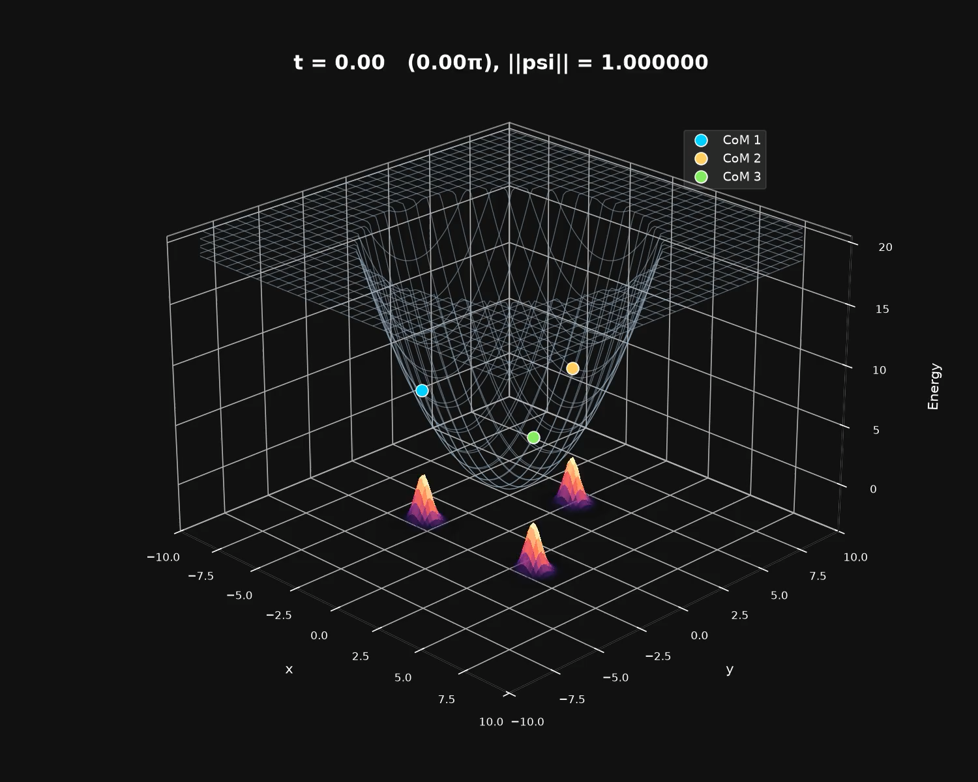
Solution to equations: A rotation in phase space
The oscillator rotates position into momentum. A quarter turn is the Fourier transform; a half turn is the image, inverted.

Slide 9
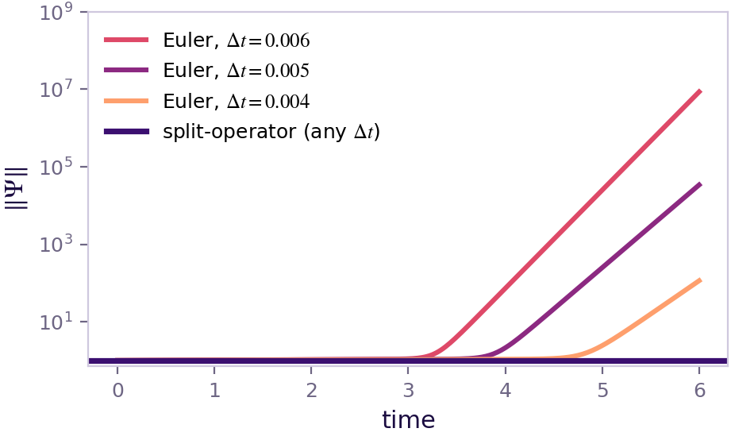

Method 1: Forward Euler
Truncate Taylor series after two term. The norm grows at every single step.
$$exp\left(i\hat{H}Δt\right)=1+i\hat{H}Δt+\frac{1}{2}{\left(i\hat{H}Δt\right)}^{2}+⋯$$
keep two terms
$$Ψ_{n+1}=\left(1+i\hat{H}Δt\right)Ψ_{n}$$
Exact
For any eigenvalue E of $\hat{H}$
$$\left|1+iEΔt\right|=\sqrt{1+E^{2}Δt^{2}}>1$$
Bigger than one for every E and every Δt — there is no step size that makes this method conserve the norm
Same initial state, same 6 units of time. Only the step size changes.
Halving Δt delays the blow-up. It does not prevent it

Slide 10
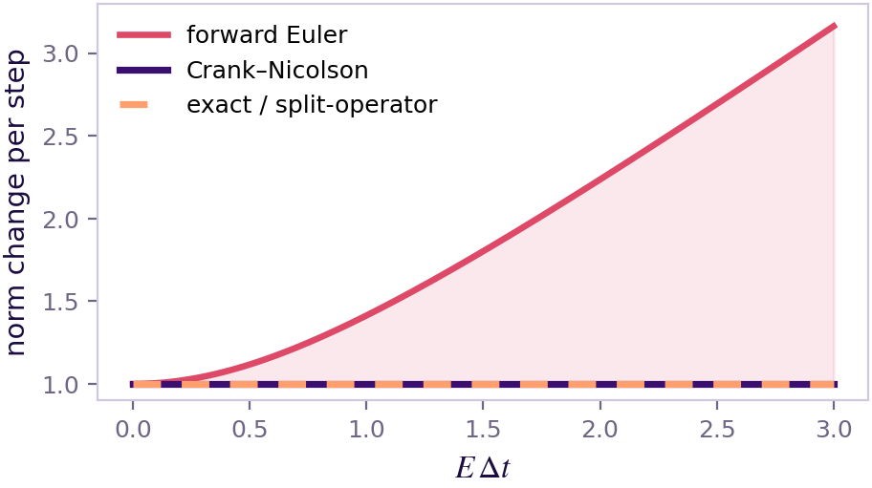
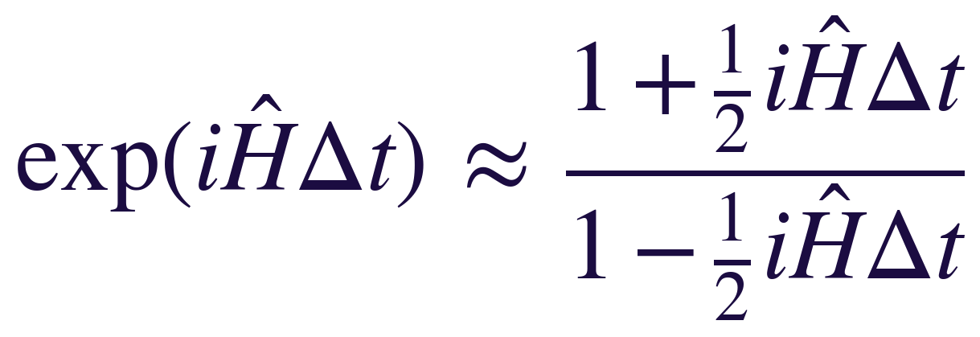
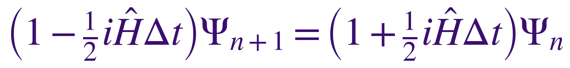

Method 2: Crank–Nicolson
The same series written as a ratio. Norm-preserving at any Δt — you pay with a linear solve every step.
Approximate the exponential by a ratio (a [1,1] Padé approximant):
Exact
which rearranges into one step of the method:
Second-order accurate, stable at any step size
$\left|\frac{1+\frac{1}{2}iEΔt}{1−\frac{1}{2}iEΔt}\right|=1$ for every $E, Δt$
The cost: the left-hand side is not diagonal, so every step is an iterative solve over 16,384 unknowns
Top and bottom have the same modulus, so the norm is preserved exactly.

Slide 11
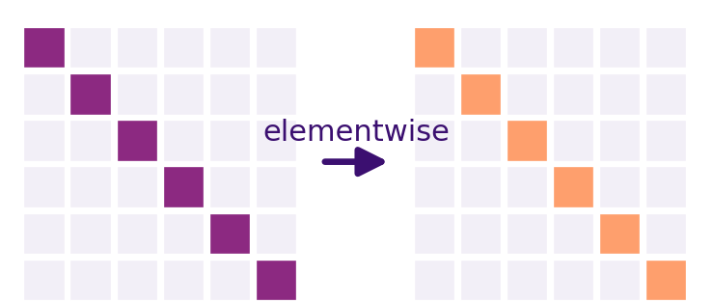



The loophole: the exponential of a diagonal operators is cheap
If an operator is diagonal, its exponential is just the exponential of each entry. No matrix exponential required.
Exponentiate the eigenvalues.
$$exp{\left(iΔt D\right)}_{jj}=exp\left(iΔt d_{j}\right)$$
An N² × N² matrix exponential becomes N² scalar exponentials
So the game is to find a basis where the operator is diagonal
$$iΔtD$$
$$exp(iΔtD)$$
And if a change of basis diagonalises it, the exponential changes basis too (verify by substituting into the Taylor series)
$$T=F^{†}KF ⇒ exp\left(iΔtT\right)=F^{†}exp\left(iΔtK\right)F$$
On a periodic grid, F is the FFT — and the kinetic operator T is diagonal in Fourier space.

Slide 12
Method 3: Operator splitting (Lie–Trotter)
V is diagonal in position. T is diagonal in momentum. FFT between the two and both parts are elementwise multiplies.
$$exp\left(iΔt\left(T+V\right)\right)≈exp\left(iΔt T\right)exp\left(iΔt V\right)$$
FFT
exp(iΔtK)
iFFT
exp(iΔtV)
→ momentum
momentum space
→ position
position space
one step — two FFTs, three elementwise multiplies
Every factor is unitary, so the product is unitary: the norm is conserved exactly, at any Δt
The error since T and V do not commute — O(Δt) error globally

Slide 13
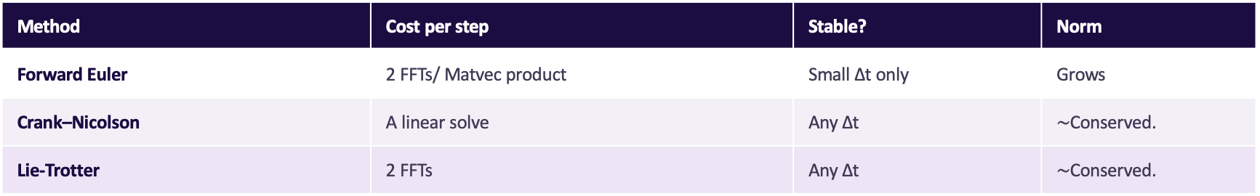
Method Comparison
Split-operator wins here as it conserves the solution norm and does not require a linear solve.
Method | Cost per step | Stable? | Norm
Forward Euler | 2 FFTs/ Matvec product | Small Δt only | Grows
Crank–Nicolson | A linear solve | Any Δt | $\sim$Conserved.
Lie-Trotter | 2 FFTs | Any Δt | $\sim$Conserved.

Slide 14
PART TWO
The Python toolbox
uv · ruff · ty · pre-commit · array-api-compat

Slide 15
The toolchain at a glance
Four of these keep the repo clean and reproducible. The fifth is what lets the same maths run on a laptop CPU and on a GPU.
U
uv
uv sync
Project, interpreter, dependencies, lockfile
R
ruff
ruff check --fix
Linter and formatter — replaces flake8, isort, black
T
ty
ty check
Type checker
P
pre-commit
pre-commit install
Runs all of the above on every commit
A
array-api-compat
xp = array_namespace(psi)
One algorithm; NumPy, PyTorch or CuPy underneath

Slide 16
uv — the project, the Python, and the lockfile
git clone → uv sync → running. One binary replaces pip, pip-tools, pipx, virtualenv, pyenv and poetry.
TERMINAL
Resolves and installs 10–100× faster than pip
$ uv init # pyproject.toml, .venv
$
$ uv add numpy matplotlib array-api-compat
$ uv add --dev ruff ty pre-commit
$
$ uv sync # exact env from uv.lock
$ uv ruff check . # run a tool, install nothing
uv.lock is universal: the same resolution on my Mac and on the CI runner
uv run activates nothing and forgets nothing
It manages the interpreter too, so “which Python?” stops being a question
pyproject.toml — written for you
[project]
dependencies = ["numpy", "matplotlib", "array-api-compat"]
[dependency-groups]
dev = ["ruff", "ty", "pre-commit"]

Slide 17
ruff — lint and format in one pass
The formatter is not configurable enough to argue about, which is the entire point.
pyproject.toml
One tool instead of flake8 + isort + pyupgrade + pydocstyle + black
[tool.ruff]
line-length = 88
target-version = "py313"
[tool.ruff.lint]
select = ["E", "F", "I", "UP", "B", "NPY", "SIM"]
NPY rules catch legacy NumPy patterns — useful when half the repo is array code
Fixes are applied, not just reported
Fast enough to run on save, so the diff never contains formatting noise
TERMINAL
$ ruff check . --fix # lint, and fix what it can
$ ruff format . # formatting

Slide 18
ty — type checking without the wait
Types are documentation the machine checks.
TERMINAL
Rust-based, 10–100× faster than mypy on a cold check, and incremental in the editor
$ uv add --dev ty
$ ty check
error[invalid-argument-type]: argument to
`split_operator_step` is incorrect:
expected `Array`, found `ndarray | None`
--> src/toolbox_talk/physics.py:48:22
Beta on the 0.x line — pin the version anywhere it gates CI
Checks unannotated function bodies by default, unlike mypy: expect a pile of findings on day one
Gradual guarantee — annotating working code should not invent new errors

Slide 19
pre-commit — make it all automatic
Set up hooks that run automatically each commit. Documentation: https://pre-commit.com
.pre-commit-config.yaml
pre-commit install once — then every commit is linted, formatted and type-checked
repos:
- repo: https://github.com/astral-sh/uv-pre-commit
rev: 0.12.3
hooks:
- id: uv-lock
- repo: https://github.com/astral-sh/ruff-pre-commit
rev: v0.16.2
hooks:
- id: ruff-check
args: [--fix]
- id: ruff-format
- repo: local
hooks:
- id: ty
name: ty check
entry: uv run ty check
language: system
types: [python]
pre-commit run --all-files for the first, big cleanup
The same config runs in CI, so local and CI cannot disagree
autoupdate bumps the pinned tool versions for you

Slide 20
array-api-compat — one algorithm, every backend
The maths never changes. Only the array you hand it does.
NumPy
CPU, float64
Lie_trotter_step()
the maths written once
get_namespace(psi)
PyTorch
CPU / MPS / CUDA
CuPy
CUDA, ROCm
Dask, JAX, ndonnx, sparse
and the rest
A common surface
Seven backends
The data decides
xp.exp, xp.abs, xp.fft.fft2 — the standard fixes the names and the semantics, so the algorithm reads the same everywhere.
NumPy, CuPy, PyTorch, Dask, JAX, ndonnx and sparse, all wrapped against the 2024.12 version of the spec.
The namespace comes from the array you were handed — so there is no global backend switch to get wrong.

Slide 21
Example — operator splitting algorithm
Two characters change: np becomes xp — and xp comes from the data.
BEFORE — NUMPY ONLY
AFTER — ANY BACKEND
import numpy as np
def lie_trotter_step(psi, V, K, dt):
# Kinetic phase shift in momentum space
# momentum space -> Kinetic -> position space
psi = np.fft.fft2(psi)
psi = np.exp(1j * K * dt)
psi = np.fft.ifft2(psi)
# Potential wave phase shift in real space
return psi * np.exp(1j * dt * V)
from array_api_compat import array_namespace
def lie_trotter_step(psi, V, K, dt):
# Get the appropriate array namespace
xp = get_namespace(psi)
# Kinetic phase shift in momentum space
# momentum space -> Kinetic -> position space
psi = xp.fft.fft2(psi)
psi = xp.exp(1j * K * dt)
psi = xp.fft.ifft2(psi)
# Potential wave phase shift in real space
return psi * xp.exp(1j * dt * V)
array-api-compat ships fft wrappers for NumPy, CuPy and PyTorch
No if backend == … branches in the physics

Slide 22
TAKEAWAYS
What to take from this
uv init
A creates reproducible project (quickly).
ruff + ty in pre-commit
The repo stays clean without little effort.
xp = array_namespace(psi)
Your maths outlives your hardware.
GitHub: https://github.com/bryceshirley/quantum-oscillator
Questions?

Slide 23
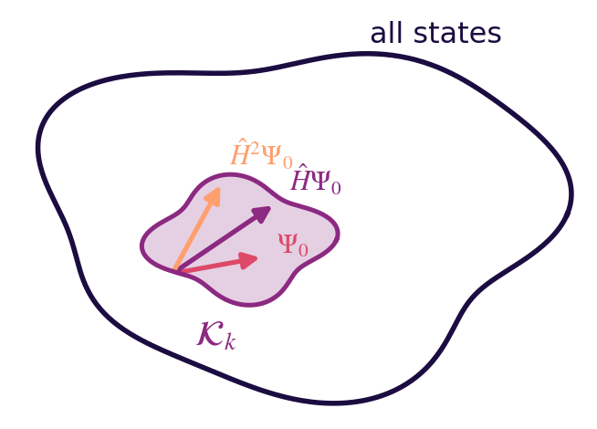

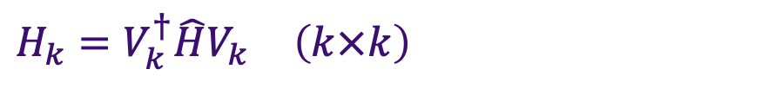
Method 4: Arnoldi — time steps at machine precision
Build a small subspace that already contains most of the answer, exponentiate the small matrix exactly, then project back.
1
Build the basis
$$𝒦_{k}=span\left\{Ψ_{0}, \hat{H}Ψ_{0}, {\hat{H}}^{2}Ψ_{0}, …, {\hat{H}}^{k−1}Ψ_{0}\right\}$$
k applications of the Hamiltonian — each one is an FFT pair.
2
Project H into it
$$H_{k}=V_{k}^{†}\hat{H}V_{k} \left(k×k\right)$$
An upper triangular Hessenberg k × k matrix.
3
Exponentiate exactly, project back
$$exp\left(iΔt\hat{H}\right)Ψ_{0}≈∥Ψ_{0}∥V_{k}exp\left(iΔtH_{k}\right)e_{1}$$
Repeatedly applying $\hat{H}$ sweeps out the directions the state actually visits.
Small enough that a dense matrix exponential is cheap and accurate.

