Slide 1
Sentiment Analysis on a Large Dataset of IMDb Reviews
Chip Simmerman
Advisor: Dr. Mohammad Al Hasan

Slide 2
Project Recap
Project Field: Machine Learning
Specifically: Natural Language Processing (NLP)
Focused application of NLP using Sentiment Analysis
Pre-Processing
Classification Models (Logistic Regression, Multinomial Naïve Bayes, etc.)
Feature Methods (Bag of Words, TF-IDF)
Open-Source Dataset of IMDb Film Reviews
Collected by A. L. Maas et. al. at Stanford University AI Lab
Project implemented in Python with nltk and scikit-learn libraries

Slide 3
Process
Research:
Methods of Pre-Processing
Vectorization (Feature Extraction) Methods
Binary Classification Models
Implement:
Pre-Processing: Remove Punctuation, markup text, etc. → Remove Stop Words → Stemming Vs. Lemmatizing
Feature Extraction: Text Vectorization
Classifying: Classification Model Training → Hyperparameter Tuning → Predict Test Values → Assess Accuracy

Slide 4
Pre-Processing
Remove punctuation and markup text
Remove Stop Words
Words with little contextual meaning (e.g. “at”, “an”, “is”, “it”)
Stemming
3 algorithms ordered least aggressive to most aggressive: Porter, Snowball, and Lancaster
Process of reducing words down to their “stem” by removing 2nd half (e.g. “eating” → “eat”)
Lemmatization
Process of using lookup tables to reduce words to their base form (e.g. “saw” → “see”)
Typically more accurate than stemming as it will always result in words and preserve meaning; stemming may result in non-word items

Slide 5
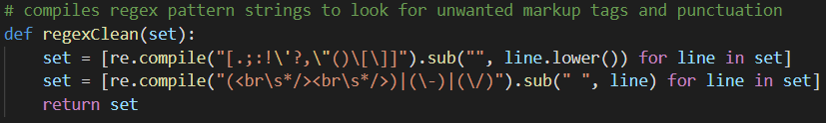
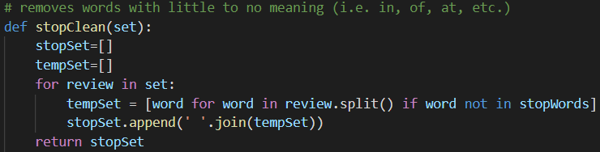
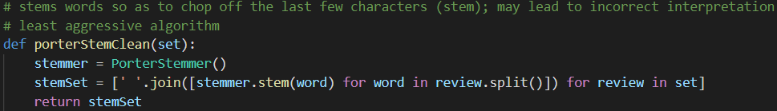

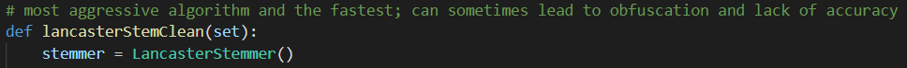
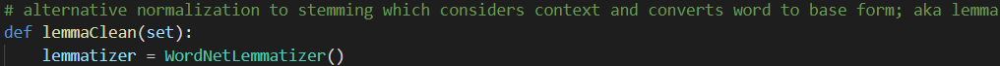
Pre-Processing Examples
Done to every test
Varied

Slide 6
Feature Extraction
Bag of Words (BOW)
Simpler method of turning data (sentences) into vectors
Creates a vocabulary of all unique words
Vector for each review; 1 if a word occurs in a review, 0 if not
Results in sparse vectors of more 0’s than 1’s
Term Frequency – Inverse Document Frequency (TF-IDF)
Calculates frequency of each word in each review (TF)
Calculates the number of documents / documents with each term (IDF)
Multiplication results in a score related to the importance of each word
Each review has a vector of TF-IDF word scores
“It is sad.” “It is mad.” “It is glad.”
[it, is, sad, mad, glad]
“It is sad.” → [1,1,1,0,0]
“It is mad.” → [1,1,0,1,0]
“It is glad.” → [1,1,0,0,1]

Slide 7

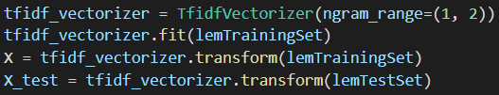
Feature Extraction Examples
Bag of Words
Learn a vocabulary dictionary of all tokens in the raw documents.
Transforms reviews into sparse vectors
TF-IDF
Learn vocabulary and IDF from training set.
Transform documents to document-term matrix.

Slide 8
Sentiment Classification
Logistic Regression
Utilizes an inverse-exponential decay formula to create an S-curve varying between 0 and 1
Multinomial Naïve Bayes
Uses Bayesian probability (P(A|B) = P(A)*P(B|A) *P(B)) to determine classification A given feature vector B
Linear Support Vector Classifier (Linear SVC)
Creates a hyperplane (line) varied between datapoints to find best division between two classes
Stochastic Gradient Descent (SGD)
Picks a random sample of the dataset, and calculates gradients in a randomized descent to convergence

Slide 9
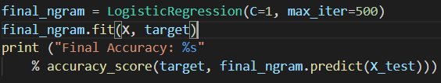

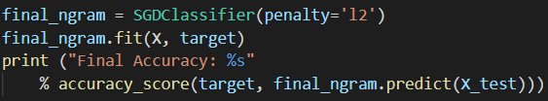
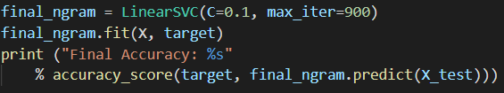
Sentiment Classification Examples
C is tuned hyperparameter
l2 linear regularization penalty
C is tuned hyperparameter

Slide 10
Implementation
4 methods of pre-processing, 2 methods of feature extraction, and 4 methods of classification
Explored 25 total combinations
Found Lemmatizing and Snowball algorithms to be most accurate pre-processing
Bag of Words and TF-IDF performed about the same on average
Logistic Regression and Linear SVC were best-fitting classifiers
Found nltk library of stop words to be too aggressive; actually suppressed accuracy

Slide 11
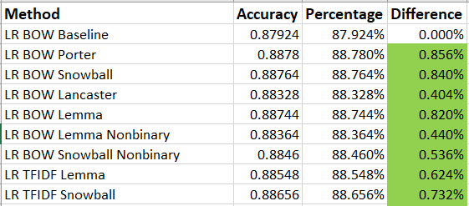
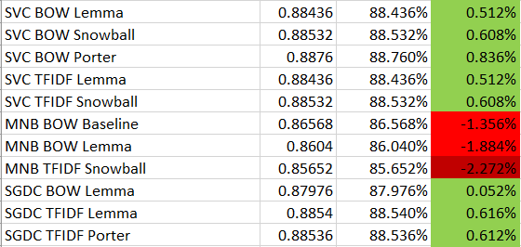
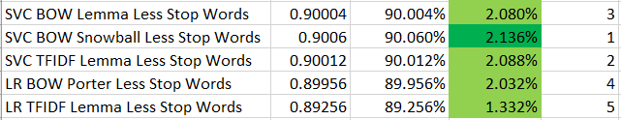
Results
Best Results:

