Slide 1
Analyzing California's Climate Trends for Informed Water Resource Management
Bryce Wilkinson
Colorado State University-Global
MIS 581: Capstone: Business Intelligence and Data Analytics
Dr. Justin bateh
December 3, 2023
Notes:
Hello, I am Bryce Wilkinson and I am going to be presenting on California’s DIRE need for enhanced water resource management infrastructure

Slide 2
Overview
California’s Droughts
GSOM Dataset
Historical Weather Trends
Where to Build Drought Resistant Infrastructure
Predicting CA’s Weather Future
Conclusion
Notes:
Here is a general overview of the topics I will be discussing today

Slide 3
California’s droughts
Notes:
First up… a little background on CA’s droughts

Slide 4
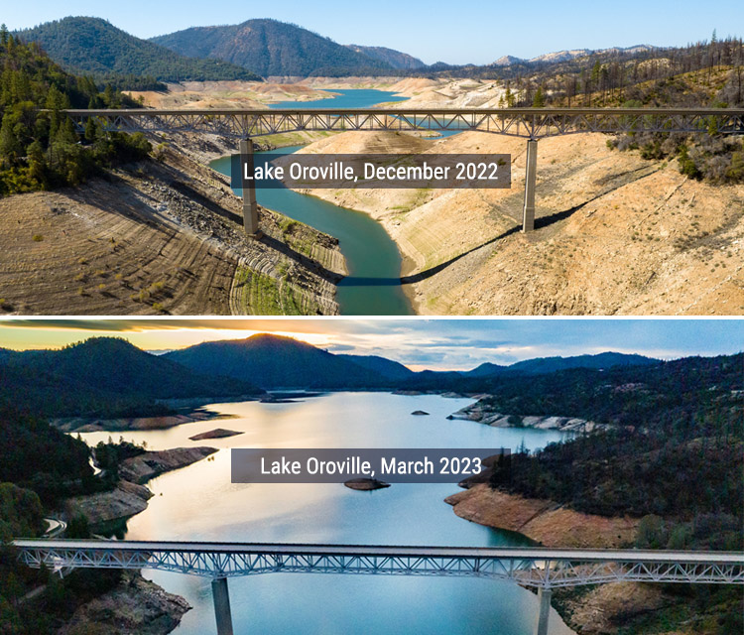
California's Drought Landscape: A Closer Look
3 major droughts have occurred since 2007
2012-2016 was most severe
Over 60% of CA experienced severe drought conditions
Endured 3 of the driest years in recorded state history (Perdew, 2017)
22 million Californians rely on Sacramento and San Joaquin Rivers for water
2017 El Niño prevented a state of emergency
California needs to upgrade their reservoir system
Established irrigation system from the 1930s plays a crucial role.
Many failed upgrades since (Voegeli, 2022)
Figure 1
Lake Oroville water levels before/after El Niño
Note: Adapted from, Weather Extremes Threaten Our Water Resources by the MWD of Southern CA, 2018, Bold Express. https://www.mwdh2o.com/how-we-plan/drought/
Notes:
In my short 25 years of life, I have experienced 6 droughts with 3 of them being some of the most severe ever recorded in the state's history
Specifically, the 2012-2016 drought was the most severe.
It came quickly after the 2007-2009 drought that already depleted the reserved water supply
60% of the state was in severe drought conditions for all 4 years
Specifically, SoCal (my home region) being hit the hardest
SoCal is naturally is already a lower producer in natural water and is extremely dependent on the natural water production from the northern region
22 million Californians rely on Sacramento and San Joaquin Rivers for water.
However, California has been in a sense, “bailed-out” by El Niño which is a weather pattern over the Pacific Ocean where the water’s temperature is above normal and consequently, leads to immense rainfall specifically over California (NASA, 2019).
The 2017 El Nino was saved the state from being in an urgent water supply emergency
The figure on the right helps captivate the effects of California’s droughts and the benefits of an El Nino year
This relentless cycle of droughts has time and time again tested California’s preparedness to mitigate the repercussions.
California went through a major water resource management upgrade in the 1930s and has been incapable of effectively expanding on that work
The current infrastructure is almost 100 years old and in order to survive with an ever growing population, new infrastructure is critical

Slide 5
GSOM Dataset

Slide 6
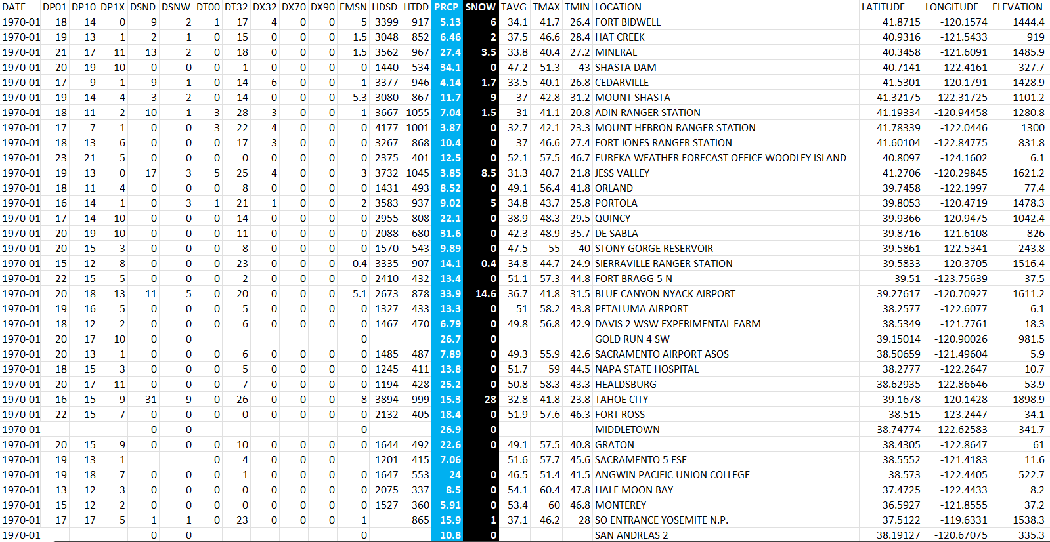
GSOM Weather dataset analyzed
Conducted analysis on historical weather data in CA
Global Summary of the Month (GSOM) from NOAA/NCEI dataset (Lawrimore, 2016)
Location based
50 total variables: (avg. temp, daily temp above/below XX°F, daily snow depth above YY in., etc.)
Most critical: Monthly Total Precipitation and Snowfall
54 years of data included (dating back to 1970)
200 locations
Figure 2
Snapshot of the dataset
Notes:
Global Summary of the Month data set is provided by National Weather Service agency: National Oceanic and Atmospheric Administration (NOAA)
Figure 2 is a snapshot of the dataset
There is interesting sub data like DT00, DT32 which means days in the given month where the temperature was below 0°F or 32°F
I want to highlight the snapshot of the PRCP which means rain and Snow.
I manually added another column that sums up these two variables to have a total water metric in a given month
Interesting data variables contained here that may given insights into predicting the future
Will talk about the selection of 54 years of data and 200 locations on the next slide

Slide 7
Challenges in Data Collection and Selection
Originally selected ~1000 locations to analyze
Inconsistent data collection per site led to poor analysis
Different timeframes per site
Total variables varied per site
Prediction analysis impossible
Down selected to 200 locations
54 years of data (1970-Present)
~Consistent # of variables
Figure 3
Original locations collected vs. the locations utilized for analysis
Notes:
I originally pulled GSOM data from NOAA for a total of ~1000 locations in California
This came with many issues
For one, many locations contained 2 or more stations within a 5 square mile radius of one another.
Secondly, Different time frames, some had 12 years of data, others had two, or only 4.
Made it difficult to have consistent historical data trends
If I am trying to isolate how weather patterns have changed, and I start adding new locations with extra data every year, the trends would not be apparent and would be clouded
Third, Some sites would have 24 variables while others would have 50 or 38
Made it difficult for the utilized software to do prediction analysis
SAS studio would exclude entire rows if any variable was missing
Ended up down selecting to 200 locations
Still all over state to give geographical diversity
Limit the number of multi-locations within similar square area

Slide 8
Historical weather Trends

Slide 9
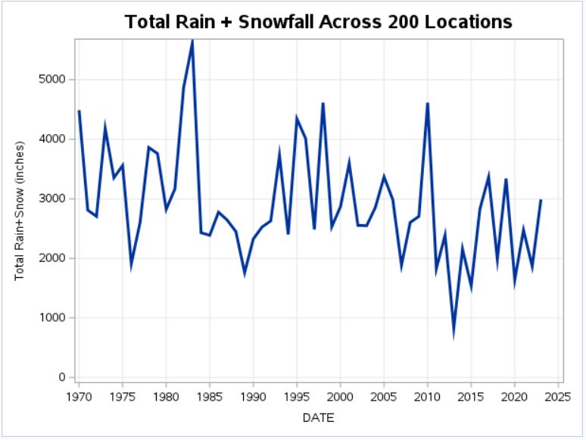
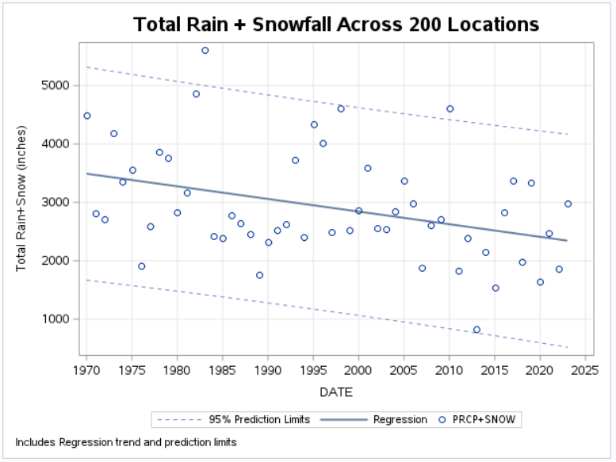
California's Changing Climate: Rain and Snowfall Trends
Figure 4
Total Rain+Snowfall per year across 200 locations since 1970
General decrease in total rain+snowfall
Best year: 1983
Worst year: 2013
Increased number of droughts are contributors
CA needs to develop the necessary drought resistant infrastructure
Notes:
Top graph Figure 4 shows the year-to-year totals since 1970 across the 200 locations,
A negative overall trend can be eyed, but not extremely noticeable.
Helps provide the connection between each dot, and due to the limitations of utilized software, the trend line with prediction limits was not possible.
Hence, the creation of the second Figure below that adds the trend lines with prediction bounds with 95% confidence.
There has been a general negative trend for the total rainfall across California and it is clear in this graphic.
Only two of the points fall outside of the prediction limits since 1970. With them both being on the upper bound rather than the lower which is a reluctant surprise
The peaks in total rain+snowfall has been constantly decreasing and even in 2023, which has been an El Nino year, it still does not compare with the general average from the 1970s-1980s.
Really want exemplify the natural decrease and negative trend overall
CA cannot ignore this issue and must invest in the future survival of the state and the ever-growing population

Slide 10
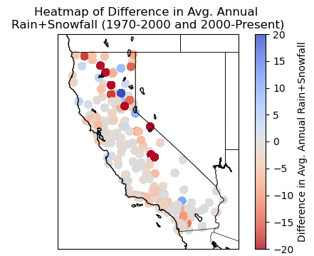
California's Changing Climate: Rain and Snowfall Trends cont.
Figure 5
Heatmap of a location’s average Rain+Snowfall per year in INCHES
Broke down avg. annual rain+snowfall into two segments: 1970-2000 & 2000-Present
Few locations have > 60 inches
Avg. rain+snowfall levels ~ < 40 inches is expected per Britannica (2023)
General trend depicts a decrease in total rain+snowfall per site
Climate change correlation
Figure 6
Heatmap of the difference between two eras avg. Rain+Snowfall
*Note Scale is different
Notes:
To continue on the historical trend analysis
Broke down the analysis location based patterns
Two different eras 1970-2000 and 200-present
Figure 5 provides a much more vivid picture of how the rainfall has changed over the past 54 years.
Few locations averaged > 60 inches and even fewer were able to maintain those trends in both eras
The majority of locations tend to have an average yearly rain+snow level less than 40 inches which is that deep red color seen in both charts,
In-line with Britannica (2023) which states the Los Angeles area on gets about 14 inches per year and the San Francisco Bay area gets about 20 inches annually.
Figure 6 takes the two eras in figure 5 and subtracts their avg. yearly rain+snowfall levels
There is a lot of consistency, but most locations have had decreases in the annual rain+snowfall per year.
By taking this viewpoint on the two eras, it shows the historical trend that the average rainfall generally across each location is decreasing, with minimal locations having increases.
The data presented in figures 4-6 provide enough context to draw insights on climate change in California over the past 54 years.
If it is not direct cause, there is at least a correlation between the climate change and the rain+snowfall totals.
Figures 5 and 6 compare two eras and show that the general average has decreased in the past 23 years vs the previous 30 years.
As a consequence, this will indeed have an effect on impact reservoir planning.

Slide 11
Where to build drought resistant infrastructure

Slide 12
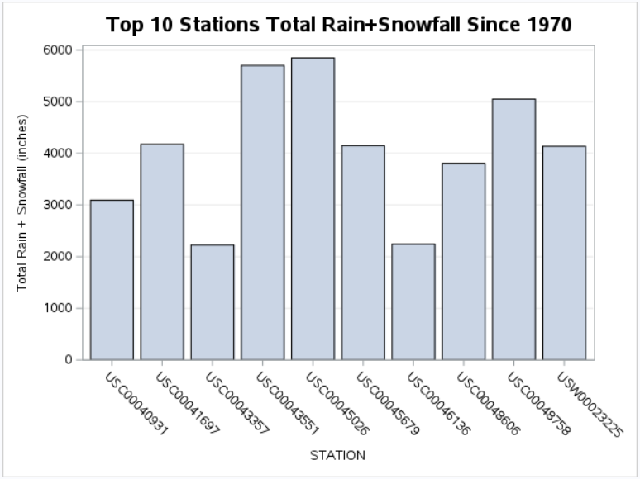
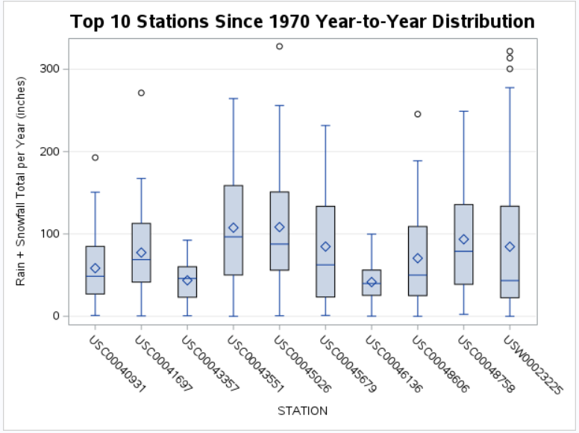
Selecting Prime Reservoir Sites
Figure 7
Top 10 Stations for Total Rain+Snowfall (inches) since 1970
Each location outperforms the CA average
3 locations have >5000 inches over 54 years
Ideally, selected locations for reservoirs would:
Lack outliers
Maintain a high avg. (Diamond) and median (line)
Top 3 locations follow the ideal trend
Notes:
General average is below 100 inches per year
The top three performing locations in figure 7 follow that ideal trend in being stations USC00043551, USC00045026, and USC00048758.
USC00045026 does have an outlier, and the median (line in middle of box) vs. mean (diamond in box) shows the influence the higher numbers have on the mean.
But the overall distinction between the two values does not cause alarm in the top three performers.
The USW00023225 station on the far right in Figures 7 and 8 does have more worry in its vastly different mean and median values.
The upper extension of the upper-quartile whisker with the three outliers does call into question that location’s reliability.

Slide 13
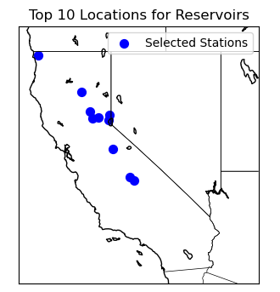
Selecting Prime Reservoir Sites
Figure 8
Top 10 Reservoir Locations
Northern Sierra Nevada Mountains
Coastal cities are not optimal locations
Mountain locations get rain and snow
Southern California was most affected by droughts and has never been the optimal water source location

Slide 14
Predicting ca’s weather future

Slide 15
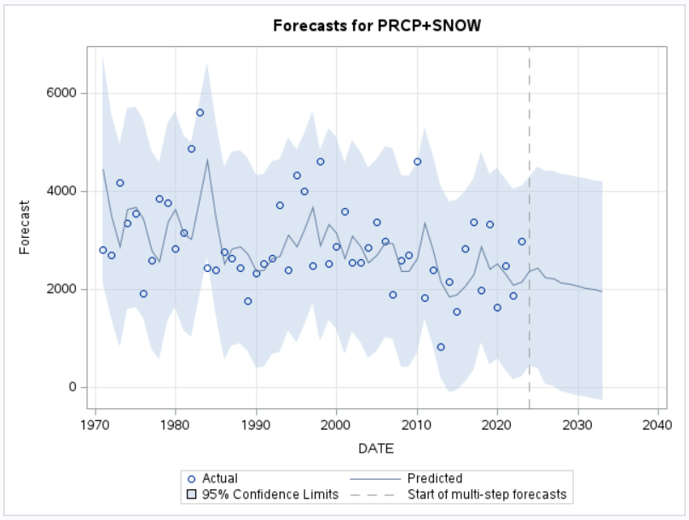
Forecasting CA’s Water Future: 10-Year Rain+Snowfall Trends
10-year forecasting of the rain+snowfall across the 200 locations
Upper/Lower bounds provide a scope for CA to keep an eye on
~2000in. is reasonable expectation
Drought is likely to happen
Model not 100% accurate
2012-2015 drought has lower-bound prediction limit below zero
Model not capped at 0 inches prediction
Figure 9
Forecasting total rain+snowfall across the dataset locations
Notes:
The 2012-2015 drought was the first time where the lower-bound prediction limit dipped below zero.
Obviously, below zero is impossible, but a future where a major drought that has zero rain for a year is possible given the trend of climate change.
This plot is useful for the state of California to have expectations around 2000 inches on average at these 200 locations, and now effectively harvesting this rain+snowfall is essential.
The overall forecast model presented in figure 9 is great for an all-in-one plot to see the overall effect,
But a valuable model to possess is the ability to predict the monthly rain totals based on certain criteria.

Slide 16
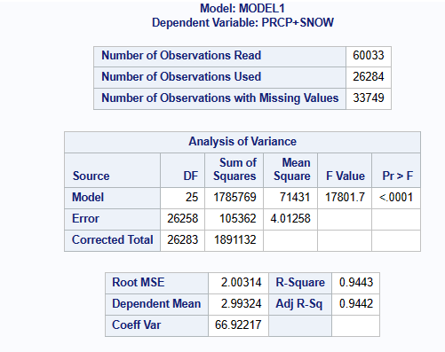
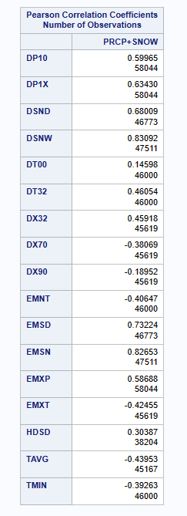
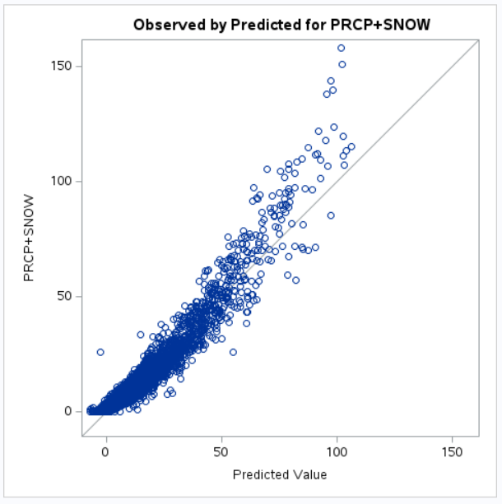
California's Changing Climate: Rain and Snowfall Trends
Figure 10
Linear Regression Predication Model
Only ~44% of available rows utilized
R² = 0.9443 implies strong prediction model
Pearson Correlation Coefficients depicts positive/negative relationship between listed variable to Rain+Snowfall
Closer to 1 or -1 implies stronger correlation
# of obs shows where data was lacking
Reveals which metadata categories are strong predictors for total monthly rainfall
Notes:
The number of observations differs as in SAS Studio, there is a lack of control on how to handle missing values in the linear regression module.
In other SAS products, there is more freedom for the user, but in SAS Studio it was more restrictive.
As seen in figure 10, there was >60,000 observations, and >33,000 observations were eliminated since if one variable possessed an empty cell, the entire row was skipped.
This is a fallout of the consistency of data across each location.
However, given the data pitfalls, an accurate model was produced and is reliable since still over 27,000 months of data was utilized.
The R-square of 0.9443, which is an almost perfect linear prediction model.
It does not encapsulate all the variables that were tested.
By using the forward-selection method, certain variables were eliminated based on their unfavorable p-value to the PRCP+SNOW variable.
The PCC effectively measures the positive and negative trends between variables.
The strongest relationship was the depth of the snow (DSNW), which makes sense as if there is a larger depth, there is more or less snow.
The PCC between the TAVG, TMIN, and TMAX actually has a comparable relationship to the likes of DT32, DX32, and DX70,
But a negative trend
The state of California could notice trends in the monthly outcomes and start to plug values into the model to garner how a location will do in the given month
or play the “what-if” game to understand, what the outcome would be given certain circumstances.
The forecast model in addition to the predictive model equip California to understand the future of their state’s rain+snowfall conditions.

Slide 17
Conclusion

Slide 18
Conclusion
54 years & 200 locations of data showed a general decline in total rain+snowfall
Proactive measures need to be taken to combat water challenges, particularly in the context of reservoir planning
California's water infrastructure is a vital component of its resilience to climate change and population growth
Top 3 Reservoir locations: Grant Grove, Lodgepole, & Tahoe City
Findings advocate for a forward-thinking approach to water resource planning, emphasizing the importance of leveraging historical data and predictive analytics
Notes:
The examination of 200 locations over 54 years has provided a nuanced understanding of the changing patterns of rainfall and snowfall, pointing towards a general decline in total rain+snowfall.
The observed decrease in annual rain and snowfall totals across the state raises concerns about water scarcity and drought resilience.
The identification of top-performing locations offers a valuable starting point for the construction of new reservoirs.
By focusing on areas that have consistently demonstrated higher precipitation levels, California can enhance the efficiency and effectiveness of reservoir planning efforts.
The predictive models, forecasting future trends in rainfall and snowfall, provide the state with tools to anticipate and prepare for potential challenges in the coming years.
By doing so, California can navigate the complex landscape of climate change, ensuring a resilient water supply for its communities and ecosystems. The insights derived from this analysis should serve as a catalyst for informed decision-making, guiding the state towards a water-secure and sustainable future.

Slide 19
References
Britannica (2023). Climate of California. Britannica. https://www.britannica.com/place/California- state/Climate
Lawrimore, J. H., Ray, R., Applequist, S., Korzeniewski, B., & Menne, M. J. (2016). Global Summary of the Month (GSOM), Version 1. NOAA National Centers for Environmental Information. https://doi.org/10.7289/V5QV3JJ5.
Perdew, L. (2017). The California Drought. Essential Library.
Schober, P., Boer, C., Schwarte, L. A. (2018). Correlation Coefficients: Appropriate Use and Interpretation. Anesthesia & Analgesia, 126(5), 1763-1768. https:/doi.org/10.1213/ANE.0000000000002864
Voegeli, W. (2022). All the Lawns Are Brown: Crisis politics and the California drought. Claremont Review of Books, 23(1), 51.

