Slide 1
Exploring Life Expectancy
Andrea Pope, Dominic Delmoli, Sarah Kelley

Slide 2
HIV Prevalances

Slide 3
Change in HIV Prevalance

Slide 4
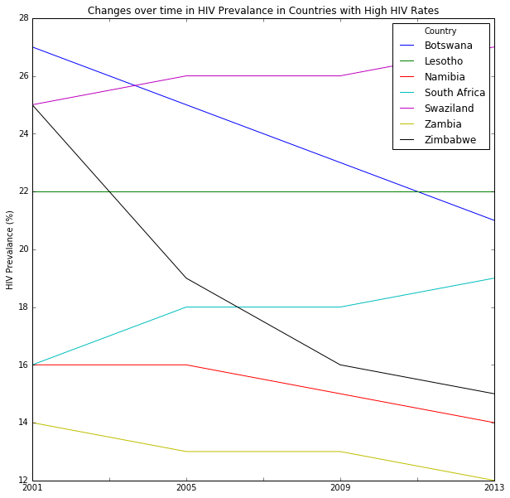
High HIV Countries

Slide 5
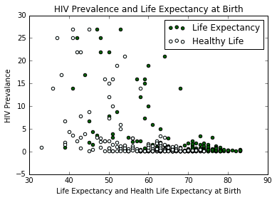
HIV and Life Expectancy

Slide 6
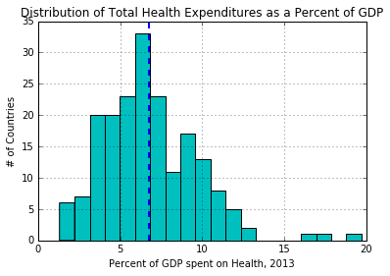
Health Expeditures

Slide 7
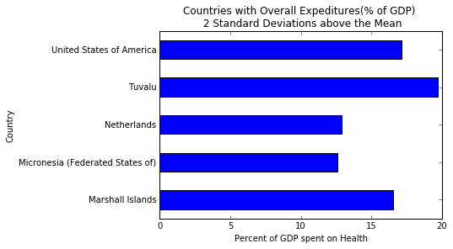
Countries with High Health Expeditures

Slide 8
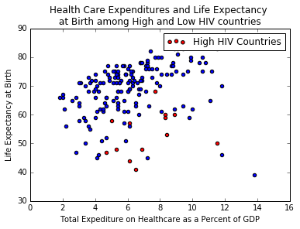
Health Spending, HIV and Life Expectancy

