Slide 1
Exploring Life Expectancy
Andrea Pope, Dominic Delmoli, Sarah Kelley

Slide 2
Introduction
Focus: Relationship between life expectancy, life expectancy at age 60 and Healthy life expectancy with:
Access to clean water/sanitation
Aid spending
HIV prevalence
Government spending on health care
Source: World Health Organization

Slide 3
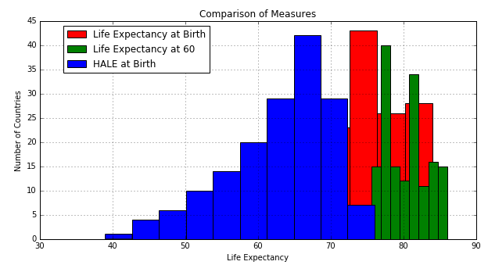
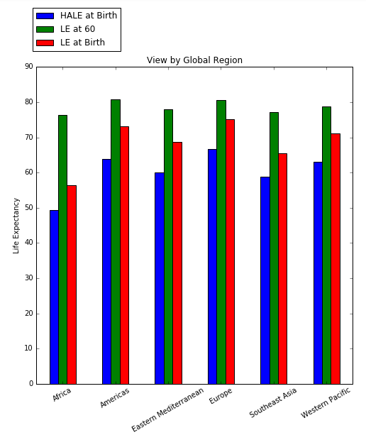
Life Expectancy

Slide 4
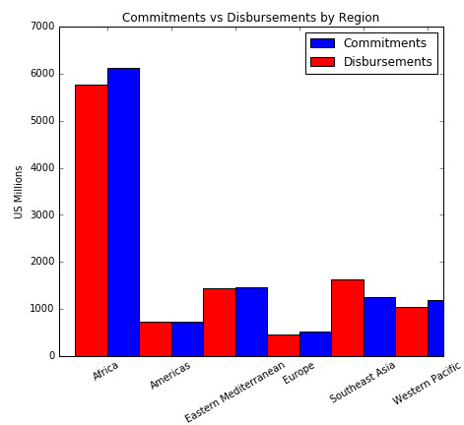
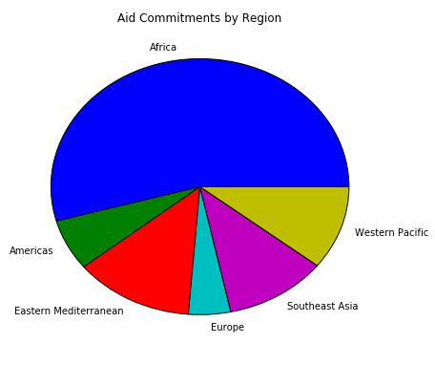
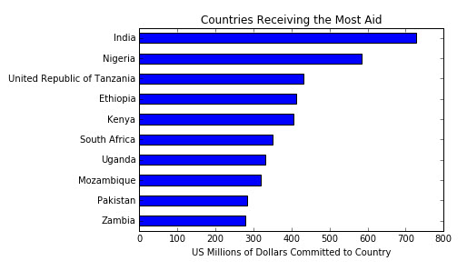
AID

Slide 5
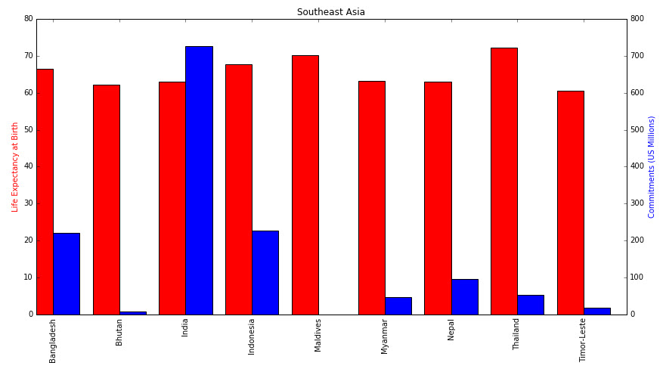
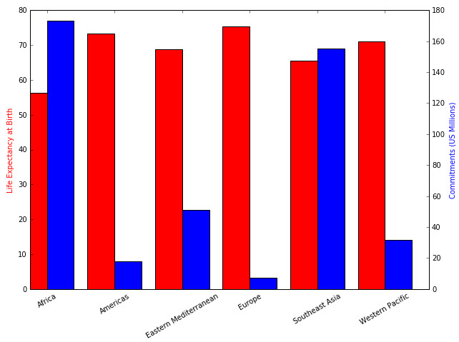
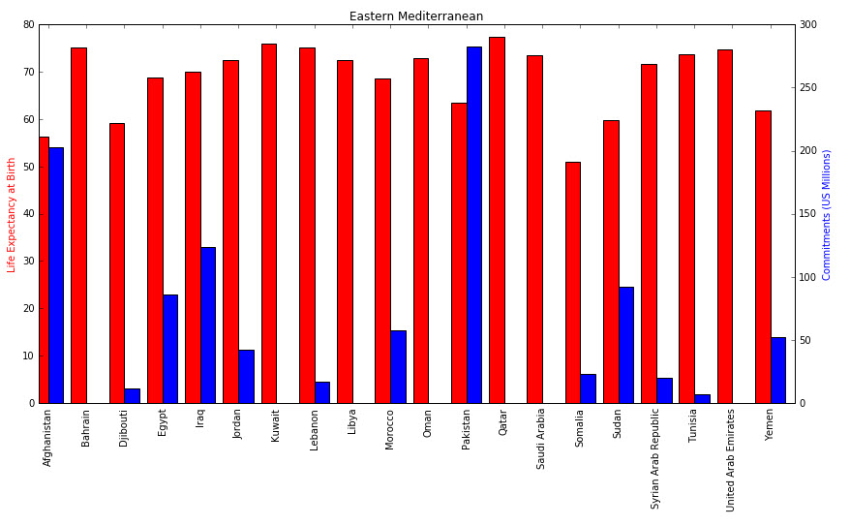
Aid & Life Expectancy

Slide 6
HIV Prevalances

Slide 7
Change in HIV Prevalance

Slide 8
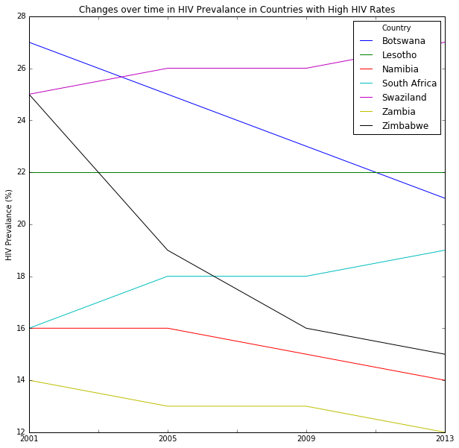
High HIV Countries

Slide 9
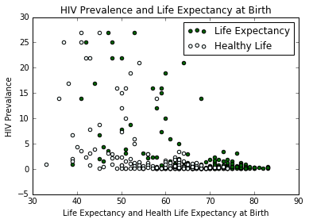
HIV and Life Expectancy

Slide 10
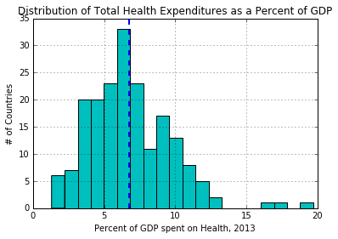
Health Expeditures

Slide 11
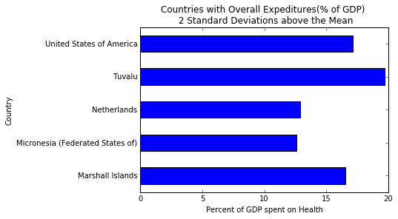
Countries with High Health Expeditures

Slide 12
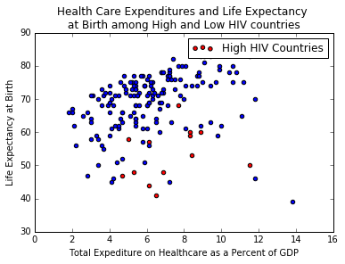
Health Spending, HIV and Life Expectancy

