Slide 1

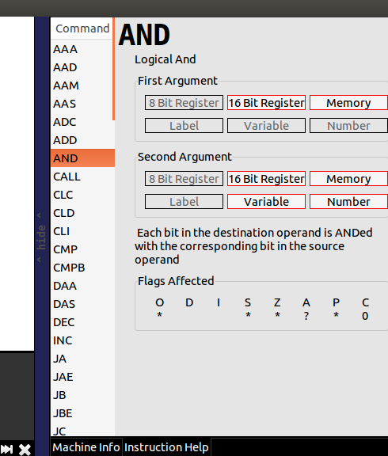
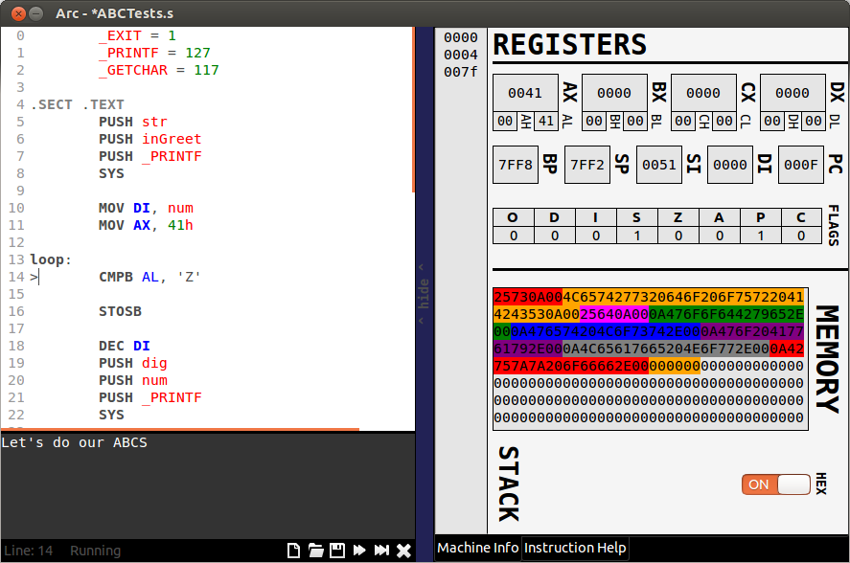
Arc
Learning assembly code is hard enough as is,
it shouldn't be made harder by learning to use
some cryptic tool!
Your tools should make learning easier – you are
the artist, if a brush isn't working for you change it!
Built in Documentation
Program name is the only program you'll need for
writing assembly code.
  Full featured IDE with syntax highlighting.
  Built in documentation of each instruction right at
  your fingertips.
  Visually run your code line by line
  Full representation of the underlying CPU
  Helpful error messages for debugging
  View the CPU in Hexadecimal or ASCII in order
  to provide deeper understanding
  Watch your code change the computer in real time
All within ONE helpful graphical interface
View the Effects of Each Line of Code
© Brydon Eastman

