Slide 1
Web based Voting System for Student Government Elections of Mater Dei Academy

Slide 2
Proponents
Eduria, Bryan Joel M.
Project Manager/Programmer
Garrido, Erica Mae C. Reyes, Christian V. Torres, Jericho Ian E.
Technical Writer Programmer Systems Analyst

Slide 3
Project Overview
This project intends to solve the project beneficiary’s problems in their current system of voting, which is done manually by using paper ballots and manual counting of votes

Slide 4
Project Overview
Here, the proponents are suggesting the use of a web-based voting system as a replacement for the manual voting system which has been the method that the school has been employing ever since they started conducting elections.

Slide 5
High-level System Components
The proposed voting system has two sides which will also define the type of its users, the Admin side and the Client side. The Admin side contains the modules that are necessary for the creation, monitoring, and management of the election(s), as well as management the records of voters and accounts of administrators. On the other hand, the Client side is the one that will be utilized by the voters.

Slide 6
Admin-side Application
Login Module – to access the system internally as an admin, the user must provide certain credentials which will be verified by the system if it is correct or not.
Election Module – this is a collection of submodules that are pertinent to the Creation, Management and Closing of an Election event.

Slide 7
Admin-side Application
Monitoring Module – this module allows the admin user to track status of the ongoing election(s) (e.g. who is in the lead right now or at a certain point of time), who is currently voting, as well as keeping and printing records of those who have voted already and who did not.
Account Settings and Management – an admin user can change his/her user name and password, and through this module, an admin user can also create, update, and delete admin and client accounts.

Slide 8
Client-side Application
Login Module – to access the system internally as a voter, the user must provide a control number which will be verified by the system if it is correct or not.
Voting Module – This is the part of the system which enables the voter to vote for his/her desired candidates in for every position.

Slide 9
Optional-Functional Units
Election Monitoring (Client-side) – with some similarities from the Monitoring Module in the Admin-side, this aims to provide the voters a real-time display of the partial results of the election.
Password Settings (Admin/Client-side) – the user can change his/her password which must meet the system’s requirements for a valid password.

Slide 10
Application Architecture
The project is using the Enterprise Web Based Architecture as defined by the Woodger Computing Inc., which utilizes the following logical layers: Client Layer, Presentation Layer, Business Logic Layer and the Data Layer.

Slide 11
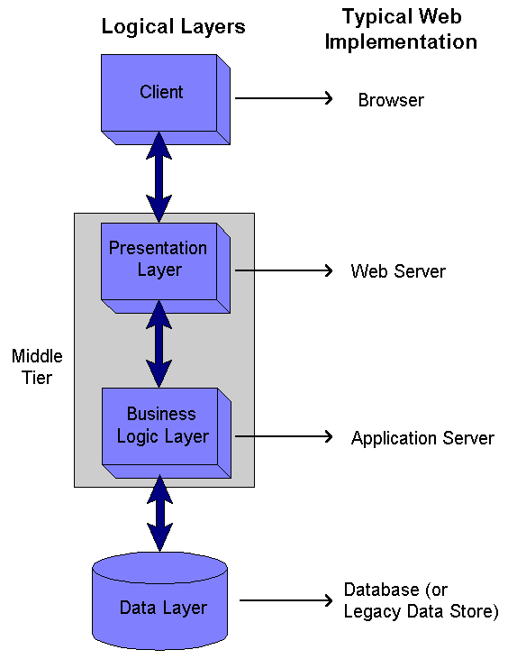
Application Architecture

Slide 12
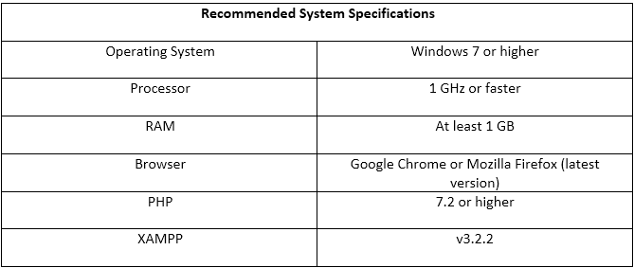
Hardware and Software Specifications

Slide 13
Tools and Technologies Used
LANGUAGES/FRAMEWORKS:
FRONT-END
HTML and CSS for the visual design/layout
Bootstrap (front-end framework)
jQuery for the JavaScript library (Front-end programming language)
BACK END
PHP 7.2 for server-side programming language
Laravel 5.6 (PHP framework)
SQL for the database

Slide 14
Other Tools and Technologies
Heroku App for web hosting
Git for Version Control System
Adobe Photoshop CS5 for graphic designing
Visual Studio Code for IDE
PhpMyAdmin/ MySQL for SQL Database
PeachPie for the conversion of PHP script to .exe file

