Slide 1
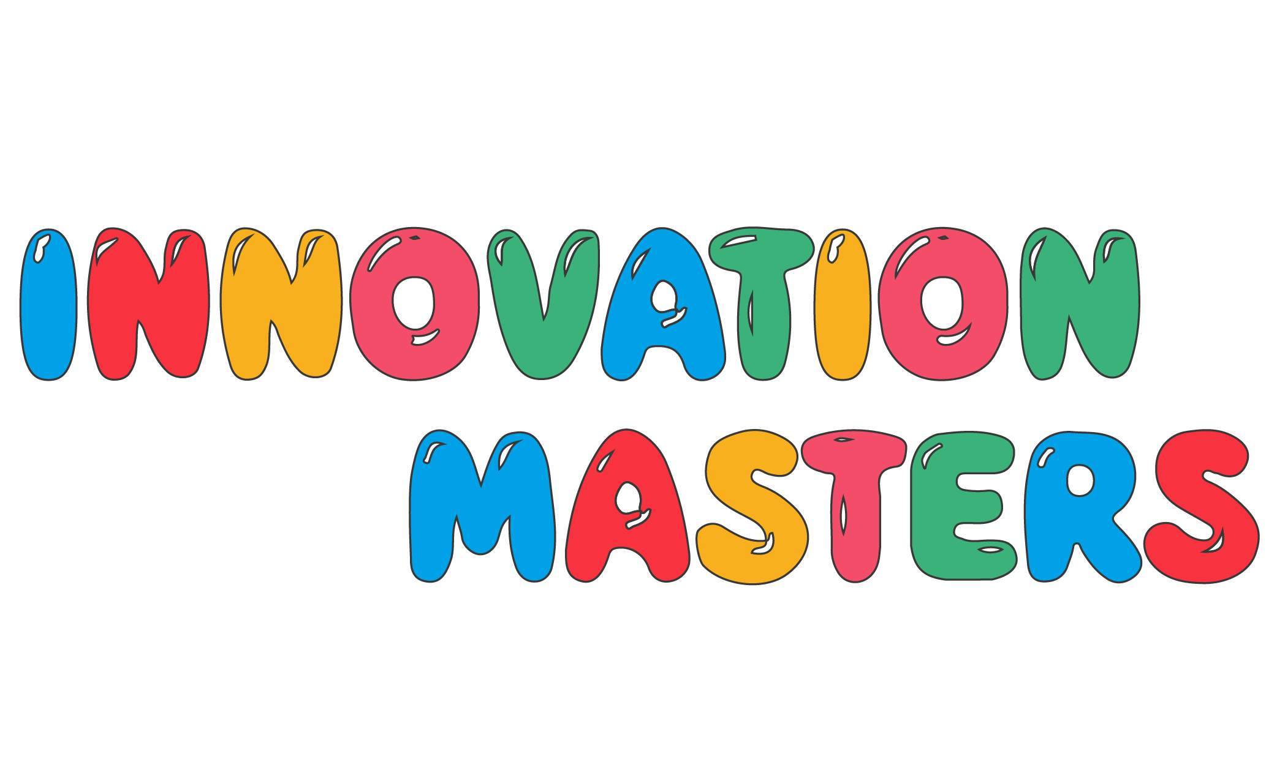
Python Fundamentals
Day 1
Innovation Masters

Slide 2
Todays Lesson
What will we learn in class
Classroom Etiquette
Icebreaker to get to know each other
Introduction to Computer Science(No coding today)

Slide 3






\What will We Learn?
How to make thoughts into computer programs
Learn about the most fundamental concepts of programming
Transferable coding skills between other coding languages
Learn how to make programs during and after class
Discuss new tech innovations (Tech Talk)
Explore a new field of study and just have fun

Slide 4
Who am I?
Bryan Indelicato
Computer Science and Mathematics
I want to be a data science consultant and teacher
Some hobbies/interests: practicing the guitar, riding my bike around the city, learning about new technology, and taking care of my amazing cat(Noel)

Slide 5
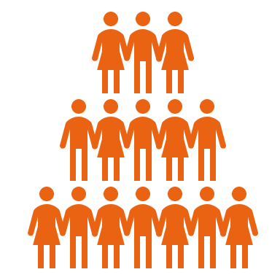




Classroom Etiquette
We respect each other.
Keep mic muted if you aren’t speaking.
We will try to sit in a quiet and distraction free room during class.
Don’t feel shy about asking questions if something isn’t clear.
If possible, let’s share our videos

Slide 6
Let’s get to know the class
Feel free to share what you want to
Here are some points to help you:
Name and age/school grade
What subjects do you find interesting?
Music?
Anime?
Video Game?
Favorite Superhero?
Sports?

Slide 7
Introduction
What is computer science?
In simple terms its the study of computers and how to make programs
Why is this important?
Computers do mathematical operations insanely fast.
Everything that we do consist of some form of computers science(phones to robots)

Slide 8
When and where did it start
The first computer was invented in 1936, and it was basic calculator.
This computer called the Z1 did 10 to 20 operations per second!
Computers from modern times can do on average 1.8billion operations per second!

Slide 9
What is a computer
A computer has 2 main components:
Hardware is all the physical parts that we can touch -CPU, RAM, Speakers, Keyboard, Mouse, etc.
Software is the instructions that tells what the hardware to do -Video Games, Applications, Music files, etc.

Slide 10
How to make a program
Software needs to be written in a language that computers understand
Computers use languages called programming languages
Popular languages are: Python, Java, C++, Swift, etc.
Python is one of the easiest languages to learn and used for general application

Slide 11
Before Programming Languages?
How did programmers write programs before languages were made?
They would use tape film and punch out numbers to create an instruction set to create a program
They would also use circuits that would have switches to store the electricity to represent the data
Then the computers wold use the data to execute the program.

Slide 12
Continued

Slide 13
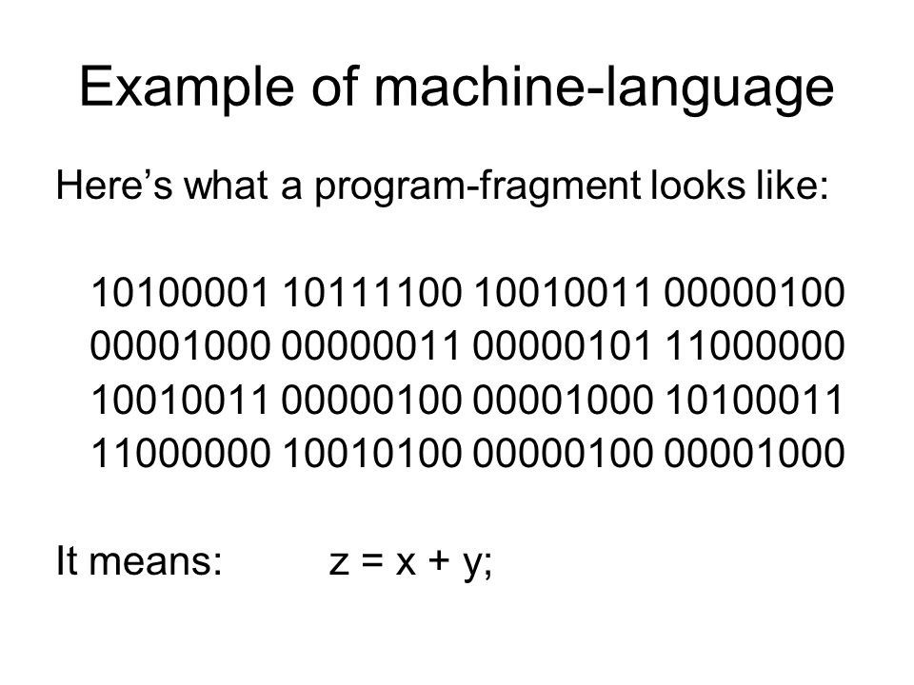
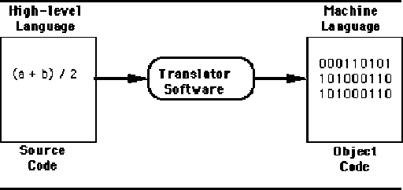
Machine Language
Hardware can only be on or off, so Machine Language is Binary
A binary 1 means High or On
A binary 0 means Low or Off
Programming languages get translated to machine language

Slide 14
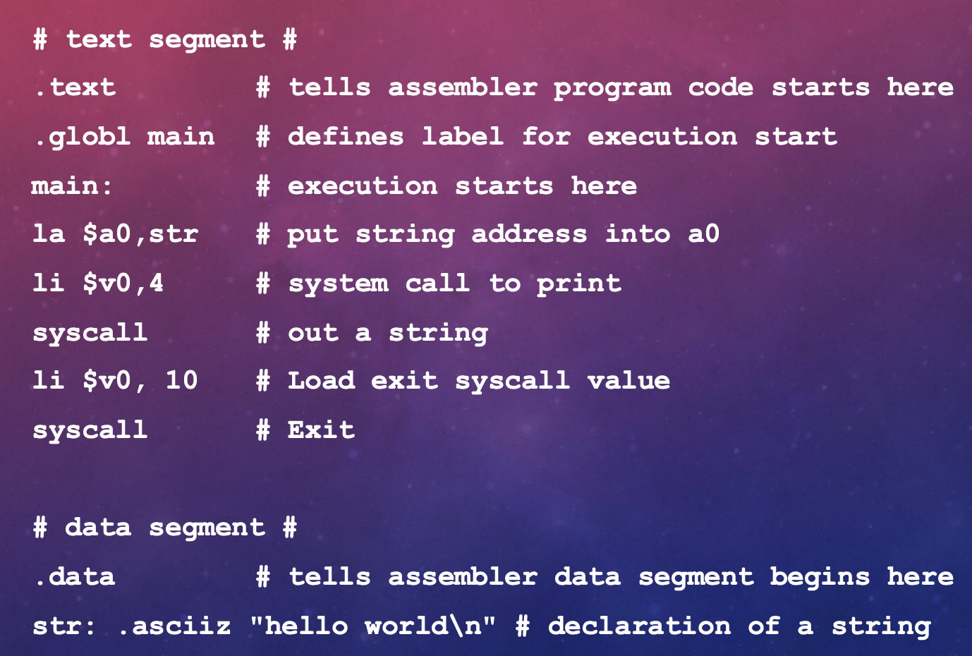
Assembly Language
Next development was the Assembly language
It’s a low level language that can use the CPU’s instruction set(text) and write code thats not binary.
The text is then converted to binary for the machine/hardware to understand
Just to write the program “Hello World”

Slide 15
High Level Language
After low-level languages come High-Level Languages
Examples: Python, Java, C++, Swift
High level language is much more like human language
It’s easier to understand and make more complicated programs.

Slide 16
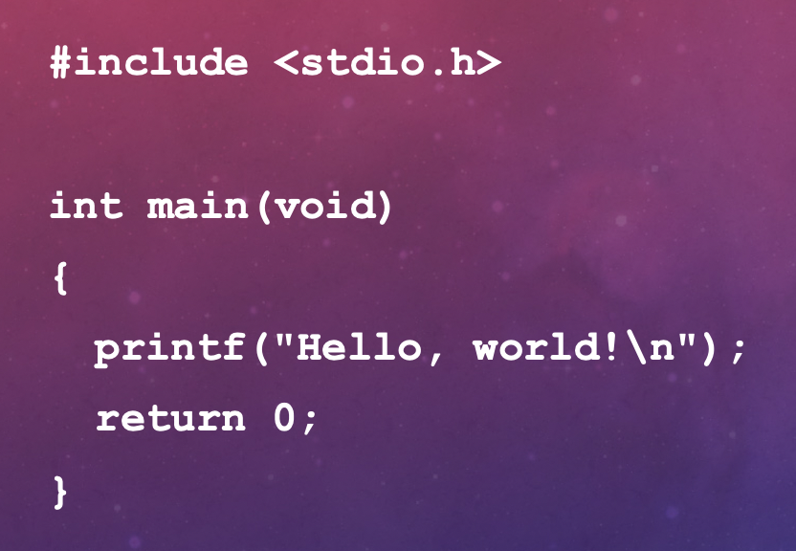
High Level - C++
“Hello World”

Slide 17
End of Class
Homework: Install Python and PyCharmCE
Homework Instructions: https://tinyurl.com/t8xuahc
Be prepared to participate and start to code!

