Slide 1

Python Fundamentals
Day 2
Innovation Masters

Slide 2
TODAY is the fun stuff(Coding)
Install PycharmCE and setup our development enviorment
Learn how to navigate PycharmCE and make our first program “Hello World”
Introduction to basic syntax
Introduction to variables and inputs

Slide 3
First Program
We’re gonna create our first Hello World Program
Discuss the basics of the print function

Slide 4
Basic Syntax
Python is a dynamic programming language
We don’t need to specify the type of variable or object
Python is a case sensitive language, this means the variable name “bryan” and “Bryan” are different
When naming variables be sure to not use Python reserved words

Slide 5
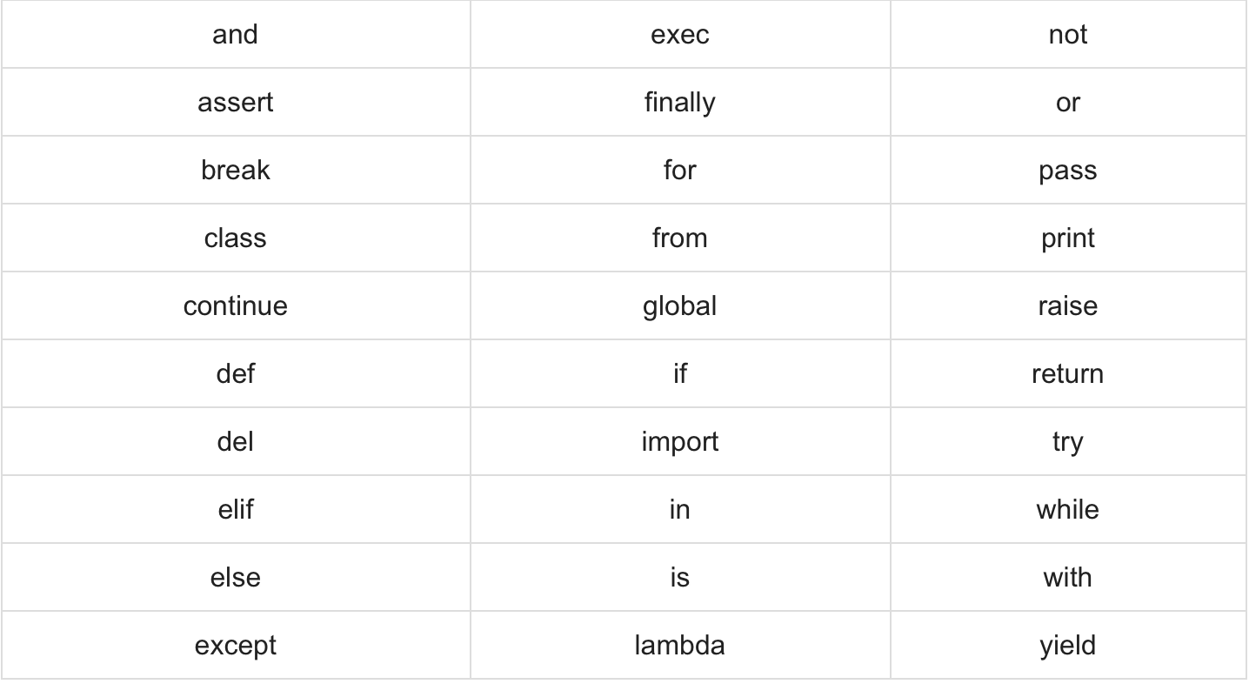
Basic Syntax - Continued
Don’t use these reserved words for variable names

Slide 6
Variables
Variables are used for to store data that we can reference too later.
Python has 5 main variable types
Numbers -Three types “Integer,Float, Complex”
String -Continuos set of characters
List -A list contains items(any data type) separated by commas and enclosed within square brackets ([]). A list can also be updated
Tuple -Its pretty much the exact same as a List with the only difference it’s read only and can’t be updated.
Dictionary -Is a collection of keys with associated values, similar to a Hash Table

Slide 7
Variables - Continued
We can evaluate the type of variable stored in the program by using the Type function(type())
The type() will return the type of object that is stored
type(argument) - the type function takes the argument of the variable you want to evaluate
We can also manipulate the variables after we create them to be different variable type
By using typecasting we can use pythons built-in functions to change the variable types

Slide 8
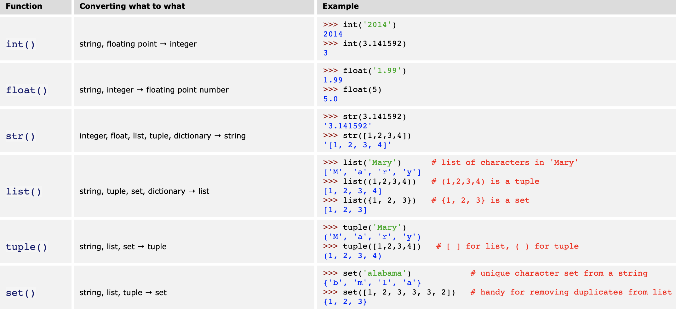
TypeCasting
These are just the basic typecast functions, there are more on the python documentation

Slide 9
Input
In python we can take inputs from the command line using the input() function
The input(argument) function takes the argument of a string
The input() function by default is stored as a string
We can typecast the input function by using on of the built in python typecast functions

Slide 10
End of Class
Homework: Create 2 python programs
Homework Instructions: https://tinyurl.com/2zzzvfyb
Have a great week!

