Slide 1

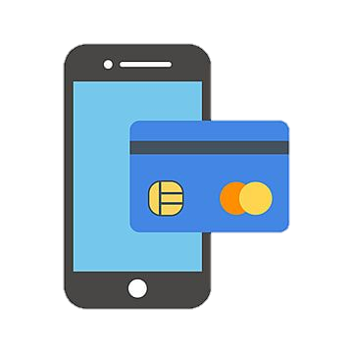


GDetech
Detecting Duplicate and Fraudulent GCash Entries using Deep Learning Methods

Slide 2


INTRODUCTION

Slide 3



About the project
High-Tech Verification
Avoid Account Duplication
Secured Identity

Slide 4



now
Easier Identity Fraudulence
Manual Validation
Unintuitive as face-to-face process

Slide 5

then
Tighter Identity Verification Security
AI Validation
Intuitive as face-to-face process

Slide 6

SIGNIFICANCE OF THE PROBLEM

Slide 7


Why is it necessary?
COVID-19 hinders most of day-to-day activities
Makes it possible to do online transactions

Slide 8


Problems and issues
Faulty verification process
Fake identities and frauds
Security Issues

Slide 9


Significance of the problem
Improves security of users and company
Improves fraud detection
Hastens the process of verification through AI usage

Slide 10

IMPACT OF THE SOLUTION

Slide 11



Benefit to the target audience
Reducing costs and driving growth
Security Increases
Faster Transaction

Slide 12

SOLUTION’S EDGE FROM EXISTING SOLUTIONS
High security Customers’ experience

Slide 13
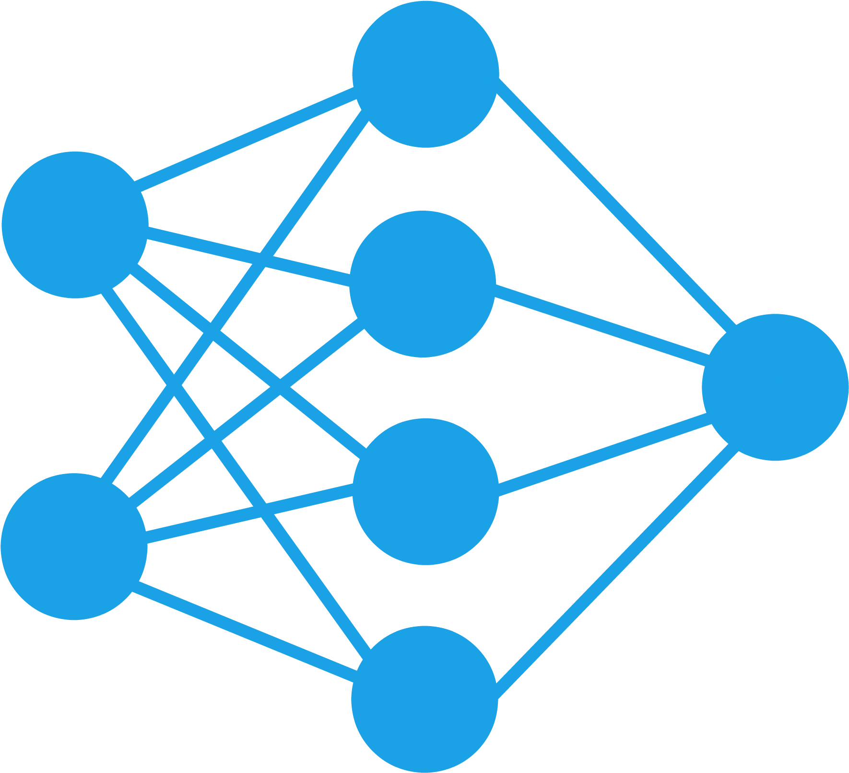

COMPETITIVE ADVANTAGE/UNIQUE SELLING POINT
Deep Learning Method

Slide 14
SOLUTIONS INTRODUCTION

Slide 15
Countermeasures to fraudulent entries
Automatic Face Detection
Makes sure that faces can be detected by the system
Facial Similarity Test
Detects if the face in the selfie picture matches with the face in the ID picture
Used for detecting fake id
ID Information Validation
Used for detecting fake information
ID Type Validation
Used for detecting fake/unsupported IDs
Duplicate Face Detection
Prevents duplicate/fraudulent entries

Slide 16

TECHNICAL DETAILS

Slide 17
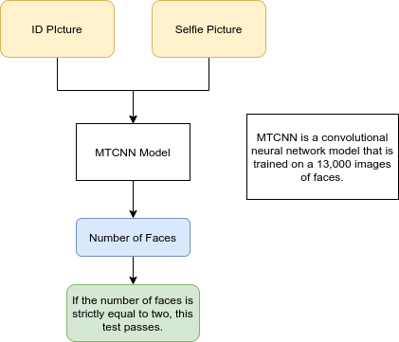
Face Detection

Slide 18
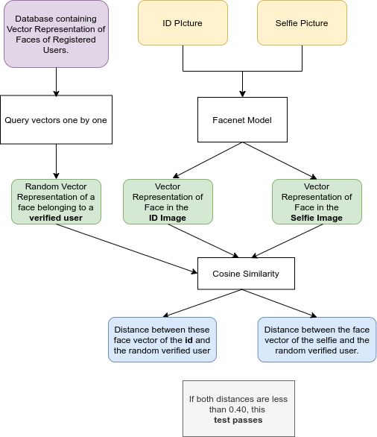
Duplicate Face Detection

Slide 19
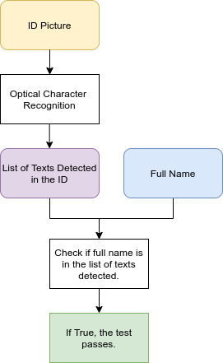
ID Information Validation

Slide 20
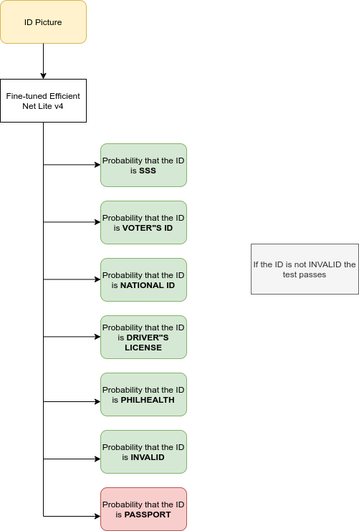
ID Type Validation

Slide 21
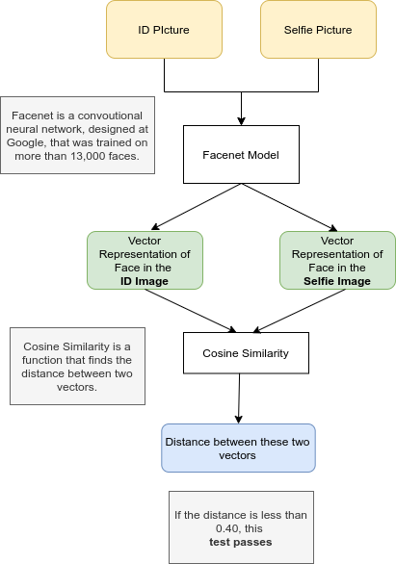
Facial Similarity Detection

Slide 22
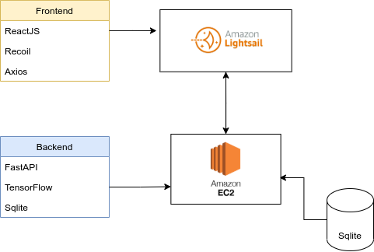
AWS Architecture

Slide 23

DEMO

Slide 24

GOING FURTHER

Slide 25



Subsequent improvements
Financial Aid
User Friendly
Application Programming Interface

Slide 26



Swim lane diagram
Screening Process
Bottleneck
Impact, risk, failure mode, and effects analysis

Slide 27

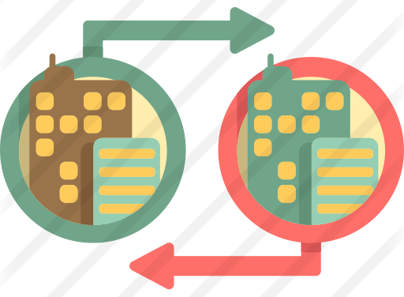
commercialization
Target User
Market Analysis
B2B Business Model

Slide 28

Thank You for listening!
Prepared by:
Brymer Bernard r. menses
Julie-mark s. cabingas
Natasha ann a. marañon
Gillian Hannah g. llagas
Paul t. jimenez

