Slide 1

Foundations of Classification Algorithms
By: Brynn Beaman, Elise Eldridge

Slide 2
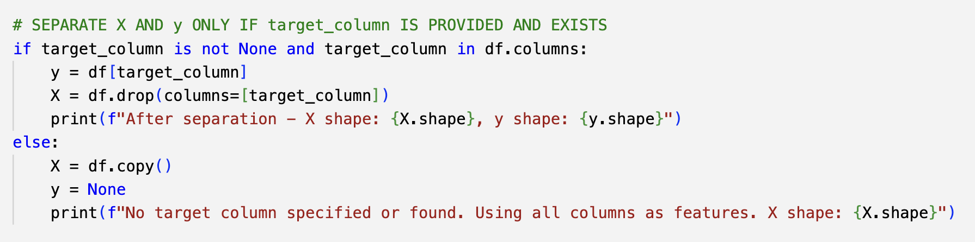
Part 1 – Preprocess
The data was preprocessed using a slightly modified preprocessing function from our class code. Most everything ran smoothly, missing values were handled, categorical variables were label-encoded, and numerical features were standardized to ensure all inputs were on the same scale. This step was important because both the Perceptron and Adaline rely on gradient-based updates, which can be negatively affected by features with very different ranges.
I ran into some slight trouble because I wanted to be able to preprocess both data sets with the same function, but the 'validation.csv' did not have the target column like the 'adult.csv' did (which is normal because it is used for validation) but once I adjusted the function for this everything ran smoothly.

Slide 3
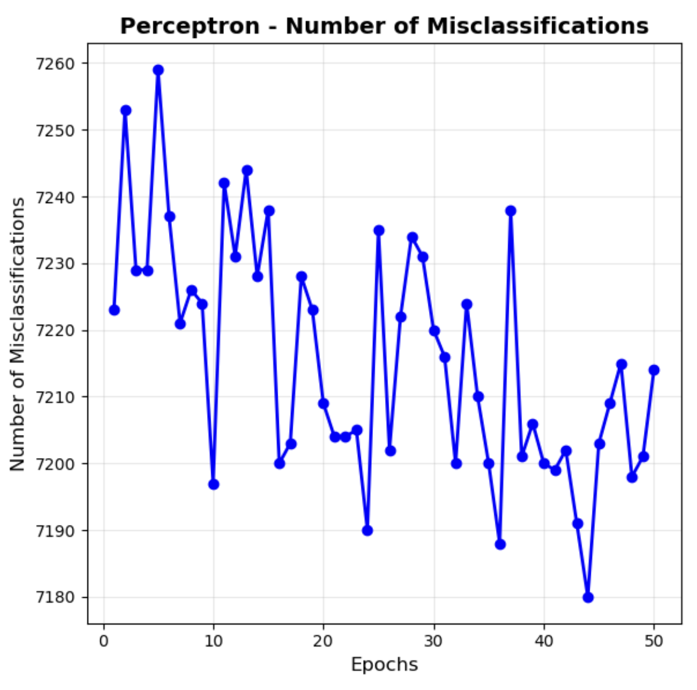
Part 2 – Perceptron
After preprocessing, the 'adult.csv' dataset was ready to be used for training the models. The Perceptron’s training progress was evaluated by plotting the number of misclassifications over the number of epochs.
The best performing model achieved an accuracy of about 75.08% but did not fully converge and had 7,214 misclassifications.

Slide 4
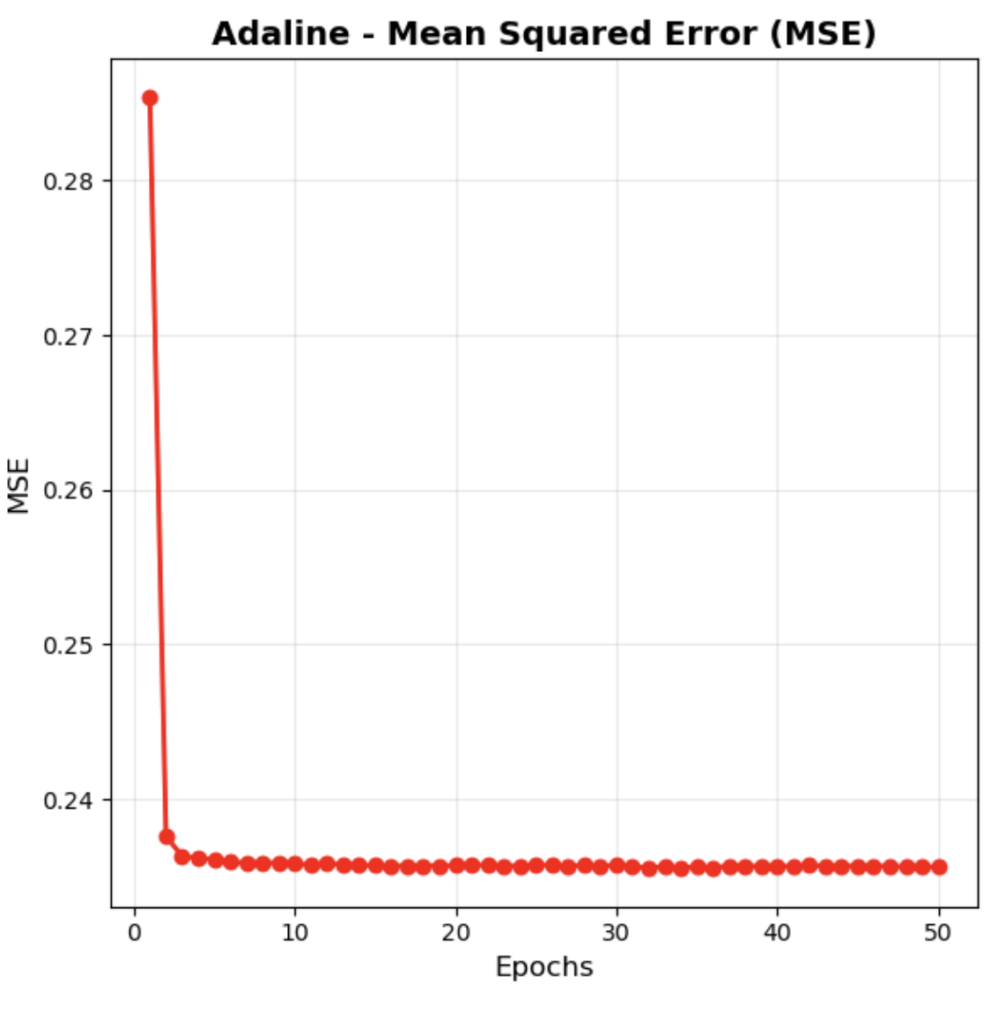
Part 2 – Adaline
The Adaline's training progress was evaluated by plotting the mean squared error (MSE) over number of epochs.
The best performing model was trained using stocastic gradient decent (AdalineSGD), and recived accuracy of 75.12% with an MSE of 23.56%

Slide 5
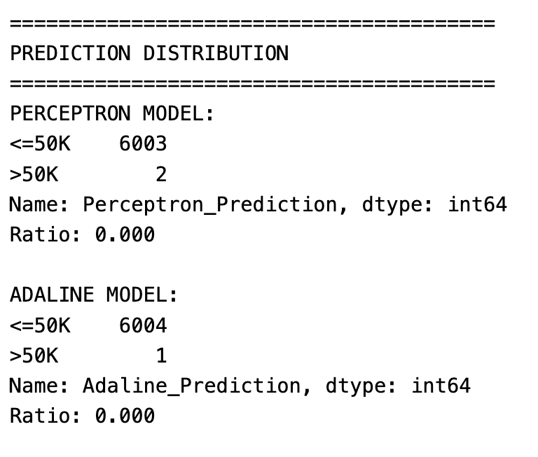
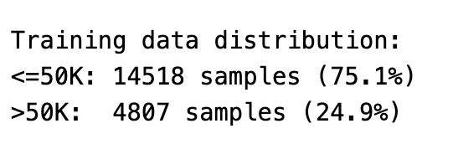
Part 2 – Prediction Results for Validation Data
Since both models' performances were nearly identical, the best-performing models from each were selected for making predictions on the validation inputs.
Both models overwhelmingly predicted the less than or equal to 50,000 income class.
The Perceptron predicting 6,003 cases of less than or equal to 50K and only 2 of above 50K, while Adaline predicted 6,004 as less than or equal (≤50K) and just 1 as above (>50).
This strong skew toward the majority class reflects the imbalance in the training data, because of this imbalance both our models achieve around 75% accuracy just by guessing the majority class every time. This suggests that the models are not really learning strong patterns beyond the baseline majority-class prediction.
To improve accuracy, we could try using more powerful models instead.

Slide 6
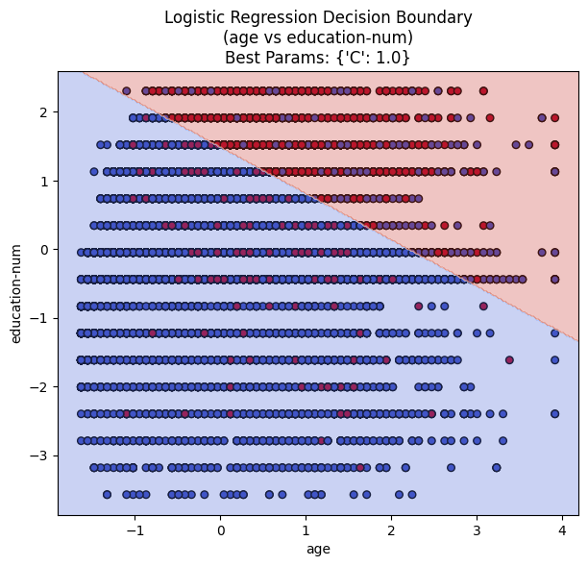
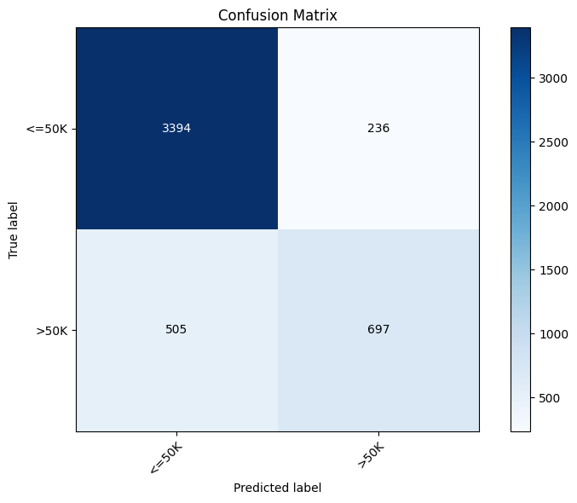
Part 3 – Logistic Regression
Initialized a Logistic Regression model with no tuning and got an accuracy of 0.8466. Then, using GridSearchCV and C values of 0.01, 1, and 100, got an accuracy of 0.8466 with a C value of 1. Because the accuracy didn't change, the model found by GridSearchCV was used for predictions. Finally, the decision boundary was plotted for age and education-num. Overall, the Logistic Regression implementation was straightforward and didn't present many challenges.

Slide 7
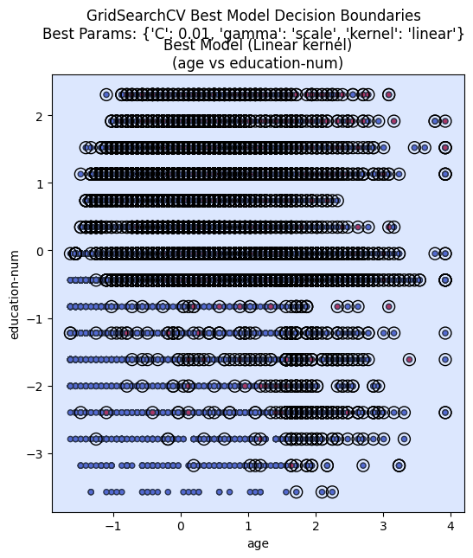
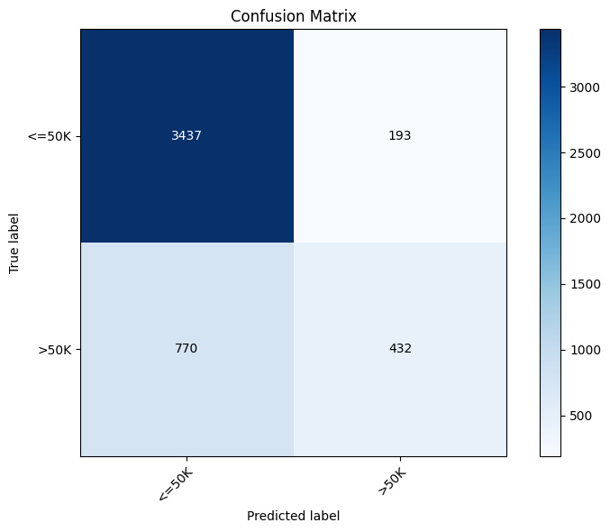
Part 3 – SVM
First, a sample of the dataset was created to improve runtime, and this sample was used with GridSearchCV. We varied the values for C but manually set the kernel to 'linear', then predicted on the full test set and repeated with the kernel set to 'rbf' for comparison. The 'linear' kernel resulted in a higher accuracy (0.8007), so it was used for predicting the validation set.
Overall, the SVM implementation was more challenging than Logistic Regression, mainly due to the extra parameter tuning and longer runtimes. The decision boundaries were also more interesting for SVM.

Slide 8
Conceptual Questions
Compare the decision boundaries of logistic regression and SVM.
The decision boundary of the Logistic Regression model is linear by default, and the decision boundary of the SVM model is also linear because GridSearchCV selected the linear kernel for the best SVM model (when given 'linear' and 'rbf' as options. 'poly' dramatically increased runtime so it was removed as an option.). The data is not perfectly linearly separable so using a linear decision boundary will result in some inaccuracies, but if an overly complex decision boundary was chosen, this could result in overfitting and poor results on unseen data.
We can see the decision boundary for the Logistic Regression model splits the data in the top right corner (high age and high education-num) from the rest of the data. However, the decision boundary is not even visible for the SVM model, and most of the points were highlighted as support vectors. This indicates that a linear decision boundary may not be the best fit, even though it produced the highest accuracy.

Slide 9
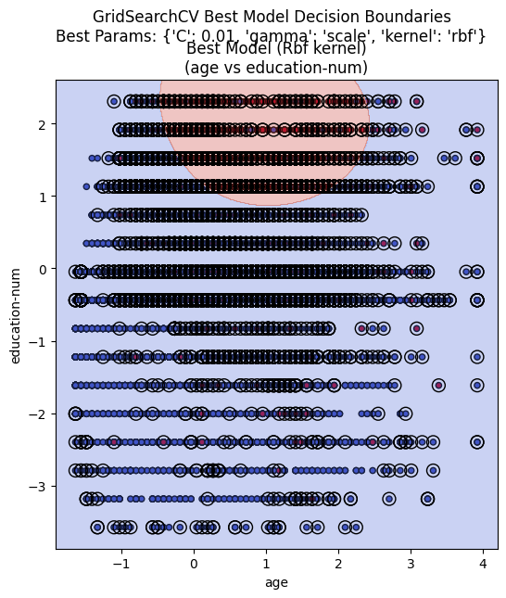
Conceptual Questions
Compare the decision boundaries of logistic regression and SVM.
Here we can see that changing the kernel from 'linear' to 'rbf' made the decision boundary visible. The 'rbf' decision boundary is a circular shape, separating the top center (high education-num and middle age) from the rest of the data. The accuracy of the model decreased when the kernel was changed from 'linear' to 'rbf', and the confusion matrix actually shows 0 records getting categorized as >50K. This could indicate that even though the decision boundary is more visually apparent, it did not actually fit the data well.
It is possible that the 'poly' kernel would be a better fit than both 'linear' and 'rbf', but the complexity made the runtime infeasible, even against a subset of the data.

Slide 10
Conceptual Questions
Why is feature scaling important for gradient-based algorithms?
Feature scaling is a crucial step in data preprocessing for gradient-based algorithms because it facilitates an unbiased comparison between features. Consider an instance where one feature has values ranging from 0-1,000,000 while another feature ranges from 0-1. The drastic difference between the scales of these features will result in more weight being given to the feature with a larger range of values. This will result in a biased model and inaccurate results. Transforming the data to have a similar scale will prevent these inaccuracies. Feature scaling can also help algorithms converge quicker.

Slide 11
Conceptual Questions
Explain the difference between batch gradient descent and stochastic gradient descent.
Batch gradient descent (BGD) uses the entire dataset in every iteration to calculate the gradient of the loss function, while stochastic gradient descent (SGD) only uses a small subset of the data in each iteration. This can make SGD converge quicker and reduce overfitting, but the use of a subset of data means that the estimates can be less accurate than BGD. It is also important to note that SGD may converge to a local minimum rather than a global minimum, whereas BGD converges to the global minimum more reliably.

Slide 12
Conceptual Questions
Why do scikit-learn's Perceptron and Adaline algorithms outperform book code?
Scikit-learn's algorithms outperform the book code because scikit-learn automatically adds things like L2 regularization and optimization to the algorithm, which helps prevent overfitting and high variance. This can also make scikit-learn's algorithms more efficient than the book code. An example of the automatic regularization/optimization could include the use of cross validation in the gridsearch algorithm. This allows gridsearch to outperform manual hyperparameter tuning.

Slide 13
Conceptual Questions
What is the role of regularization in preventing overfitting?
Regularization utilizes a penalty in the loss function that penalizes certain values, usually extreme values. Doing this prevents the model from fitting the data too closely, and helps maintain a lower variance. The strength of the regularization can be controlled by tuning lambda, where a higher value of lambda results in stronger regularization/simpler model. The two main techniques are L1 and L2 regularization, with the main difference being the coefficients. L1 regularization keeps some coefficients at 0, while the coefficients of L2 regularization are small but never 0. While both methods simplify the model and prevent overfitting, L2 regularization strikes a balance between bias and variance.

Slide 14
Conceptual Questions
Vary the C values of the scikit-learn LogisticRegression and linear SVC models with [0.01, 1.0, 100.0]. Discuss the impact.
LogisticRegression: GridSearchCV selected 1 as the best C value, resulting in an accuracy of 0.8079 on the test set. Setting C = 0.01 resulted in an accuracy of 0.8075, and setting C = 100.0 resulted in an accuracy of 0.8065. We can see that changing the value of C resulted in very small accuracy changes for LogisticRegression, and as the value of C increased, fewer records were accurately predicted as <=50K.
Linear SVC: GridSearchCV selected 0.01 as the best C value, resulting in an accuracy of 0.8007 on the test set. Changing C to 1.0 resulted in an accuracy of 0.7926, and changing C to 100.0 produced an accuracy of 0.7935. Changing the value of C resulted in small fluctuations in the accuracy of the predictions, and as the value of C increased, fewer records were acurately predicted as >50K.
C is a regularization parameter that helps find the balance between overfitting and underfitting. A higher value for C means that it will fit the data more closely and have a more complex decision boundary, but this will result in overfitting and the model will not be generalizable. On the other hand, a lower value for C means that the data will have a smoother decision boundary and will not fit the data as closely, which can result in a low accuracy. It is important to find the right C value so that the model can be both generalizable and accurate. GridSearchCV selected 1 as the best C value for LogisticRegression, while 0.01 was chosen for the SVM model. This makes sense because a higher C value could result in overfitting, leading to a lower accuracy score on unseen data.

