Slide 1
HTTP and Servlets Intro

Slide 2
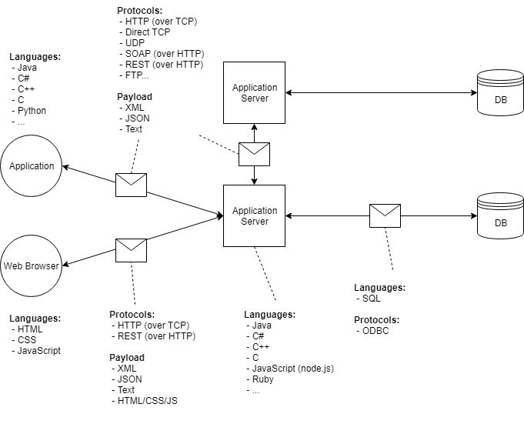
Client-Server-Database Architecture

Slide 3
Types of Client-Server Architecture
2 tier architecture –
UI on client machine
the database stored on the server
fat client thin server architecture
thin client fat server architecture.
limitations in performance, security, and portability.
3 tier architecture –
presentation tier,
application tier, and
data tier
n-tier architecture
multiple Business Logic & Data Logic layers

Slide 4
How the Internet Works
Browsers and servers generally do not keep open connections to each other.
Browser → Request → Server
Browser ← Response ← Server
Connection is closed
HTTP is a protocol. It defines how communication happens.
Other protocols: FTP, SMTP, HTTPS, Telnet
Browser sends HTTP request to URL.
HTTP request arrives at server.
Server finds requested resource (page, file, or program). Server may forward request to program
Server returns requested resource in HTTP response
Browser renders (draws) response to screen, or downloads file

Slide 5
HTTP Requests are composed of:
Verb
Indicates the executing HTTP method.
URI
Specifies the endpoint where resource is located.
HTTP Version.
Request Header
META-DATA (information) of the Request as key-value pairs such as: format supported by client, browser type, etc.
Request Body
Message content or resource representation.

Slide 6
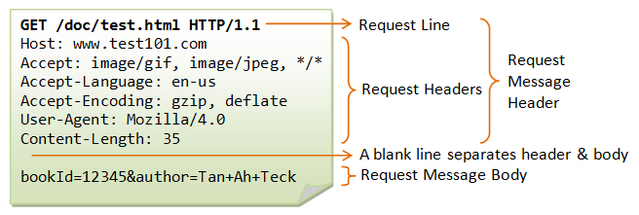
Structure of HTTP Requests
HTTP Requests have a head (filled with “headers”) and a body www.test101.com/doc/test.html?bookId=12345&author=Tan+Ah+Teck
Request Line: method, path, protocol
“Accept” headers: What types of data can be in the response. Restrictive. No match: no response/404.

Slide 7
HTTP Request Verbs/Methods
HTTP request verbs or methods indicate the action that a client hopes to perform.
Characteristics of requests: (Basically a request either is or isn't each of these)
idempotent
"identical request can be made once or several times in a row with the same effect while leaving the server in the same state"- MDN
safe
doesn't alter server's state
read-only
cacheable
Determines if there is a chance the the response to the corresponding method can be cached
allowed in html forms
request has a body
GET, POST, PUT, DELETE, OPTION, TRACE, HEAD etc
Also called “HTTP methods”.

Slide 8
GET requests
Used to “retrieve” data from the server
Parameters will be included in the URL after ‘?’
Whenever an HTTP request is generated from typing a URL into an address bar, or clicking a link, it’s a GET request.
URLs typically have a character limit depending on browser and server settings. Generally < 2000 characters is safe

Slide 9
Types of HTTP Request Cont.
POST requests:
Used to send data to a server
Parameters are only in the “body” of the request, do not appear in URL
Data is sent as key-value pairs
HTTP POST requests typically have a maximum size depending on the server configuration (~2-10 MB)
What if I need to send a bigger file?
Multipart POST requests: used to break data up across multiple requests to respect size limits.
Server must be configured to accept multipart requests.

Slide 10
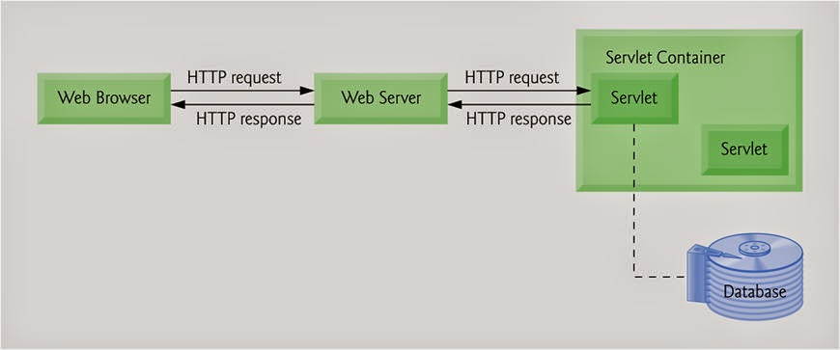
Servlet Intro
A Servlet is a Java class that takes incoming requests, processes them, and generates a response to send back to the user.
The Servlet container is the component of an application server that interacts with Java servlets.

Slide 11
Servlet Container Configuration
<web-app xmlns="http://xmlns.jcp.org/xml/ns/javaee"
xmlns:xsi="http://www.w3.org/2001/XMLSchema-instance"
xsi:schemaLocation="http://xmlns.jcp.org/xml/ns/javaee http://xmlns.jcp.org/xml/ns/javaee/web-app_3_1.xsd"
version="3.1">
<welcome-file-list>
<welcome-file>index.html</welcome-file>
<welcome-file>index.htm</welcome-file>
<welcome-file>index.jsp</welcome-file>
<welcome-file>default.html</welcome-file>
<welcome-file>default.htm</welcome-file>
<welcome-file>default.jsp</welcome-file>
</welcome-file-list>
<servlet>
<servlet-name>welcome</servlet-name>
<servlet-class>
com.revature.ExampleXMLMappedServlet
</servlet-class>
</servlet>
<servlet-mapping>
<servlet-name>welcome</servlet-name>
<url-pattern>/welcome</url-pattern>
</servlet-mapping>
</web-app>
Using annotations
@WebServlet( “PATH”)
Using the web.xml
a.k.a. the deployment descriptor
XML file that specifies which servlets should map to which paths

