Slide 1
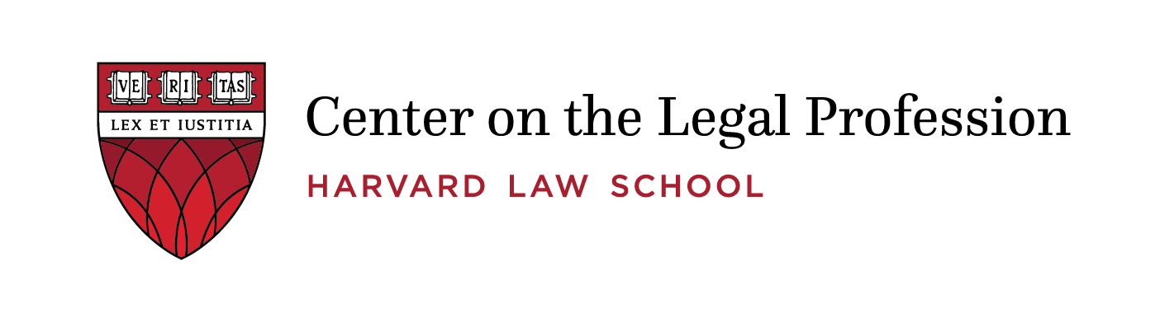
The Future is Here – But So is the Past:
AI, Complex Decision Making, and the Future of the Legal Profession
Professor David B. Wilkins
OpenAI
September 17, 2026
Notes:
N

Slide 2
The Best of Times and the Worst of Times?
2025 was another banner year for most top firms (Am Law)
  PPP for the Am Law 100 up 14%, with 70 out of 100 grew by 10% or more only 2 firms declined
  90% of fees still billed by the hour with top rates skyrocketing to $4000/hour – and up!
But 2025 was another belt-tightening year for corporate clients (Axiom)
  96% in-house departments faced budget cuts
  89% no long view law firms as a “complete solution” with 100% expressing displeasure with cost, quality, and following directions
And while the Big 4 and top consulting firms slash entry level hiring, a record 93% of law school graduates were employed 10 months after graduation (87% in jobs requiring a law degree), with 37% of those in private practice (another record) going to firms with 500+ lawyers
  Several top firms are hiring 1Ls with no grades and paying them $50K NOT to work for another firm in their first summer

Slide 3
The Traditionalist Answer: The Empire Strikes Back!
Notwithstanding current challenges, law firms will learn how to adapt and thrive
  A majority of top firms have adopted Harvey or Legora, with many rolling out firm-wide programs to make their lawyers AI-fluent (e.g., HSF Kramer’s firm-wide roll out of Legora and Ropes & Grey devoting 20% of all associate hours to AI)
  Several firms are developing their own AI products – with Cleary buying Springbok AI to develop AI tools for the firm and to market to others
  In late April, Anthropic and Freshfields announced a new collaboration to deploy Claude firm-wide and co-develop AI-native workflow tools (just as Harvey was incubated in A&0)
  And in May Kirkland announced it is committing $500M to build its own AI models and solutions, partnering with Palantir and hiring 120+ engineers and consultants to drive adoption
And people have been predicting the death of the billable hour since I was in law school!

Slide 4
The Disrupter’s Answer: When Empires Appear Invincible The Rebellion Strikes!
Christensen: Kodak and DEC were making record profits before insurgents with new technologies put them out of business
  Last week, Harvey received a new $500M for an $18B+ valuation – the largest of any domain specific vertical
  Legal tech investment in the US alone is expected to top $4-5B this year with unicorns like Legora (Sweden) and Enter (Brazil) spreading around the world
  And there is now an explosion of “AI Native” law firms – Covenant, Manifest, Norm AI, Carta (which bought a whole law firm in the UK!) – all of which are back by PE capital
    Salesforce GC Sabastian Niles announced on July 9 that he intends to include AI Native firms among its “preferred providers”
And now, you are all here attending the entry of the original foundation model company entering directly into the legal field (with the other top company close behind) – both of which have already launched multibillion dollar partnerships with major PE firms to drive their models through all of your clients
Are the turkeys voting for Thanksgiving?!

Slide 5
Moving From Either Or To Both And
Artificial intelligence will structurally reconfigure how legal services are delivered, who delivers them, how lawyers are trained, and what it means to exercise professional judgment
And while this will undoubtedly lead to the automation of many legal tasks, it will create important new ways for lawyers to add value for the increasingly complex issues facing clients and society
But unlocking this potential will require a deep understanding of BOTH technology and of the structures and practices of lawyers

Slide 6
AI, Complex Decision Making, and the Future of the Legal Profession
Our Collaboration (AI and the Legal Profession - Harvard Law School Center on the Legal Profession)
  Professor David Wilkins, who has spent 40+ years studying lawyers and legal institutions
  Professor Anthea Roberts (ANU), who is an expert in global governance and complex systems thinking, including on how to understand tradeoffs among risks, rewards, and resilience
  Dragonfly Thinking, an orchestrated multi-agent AI system for analyzing complex problems (https://www.dragonflythinking.com/)

Slide 7
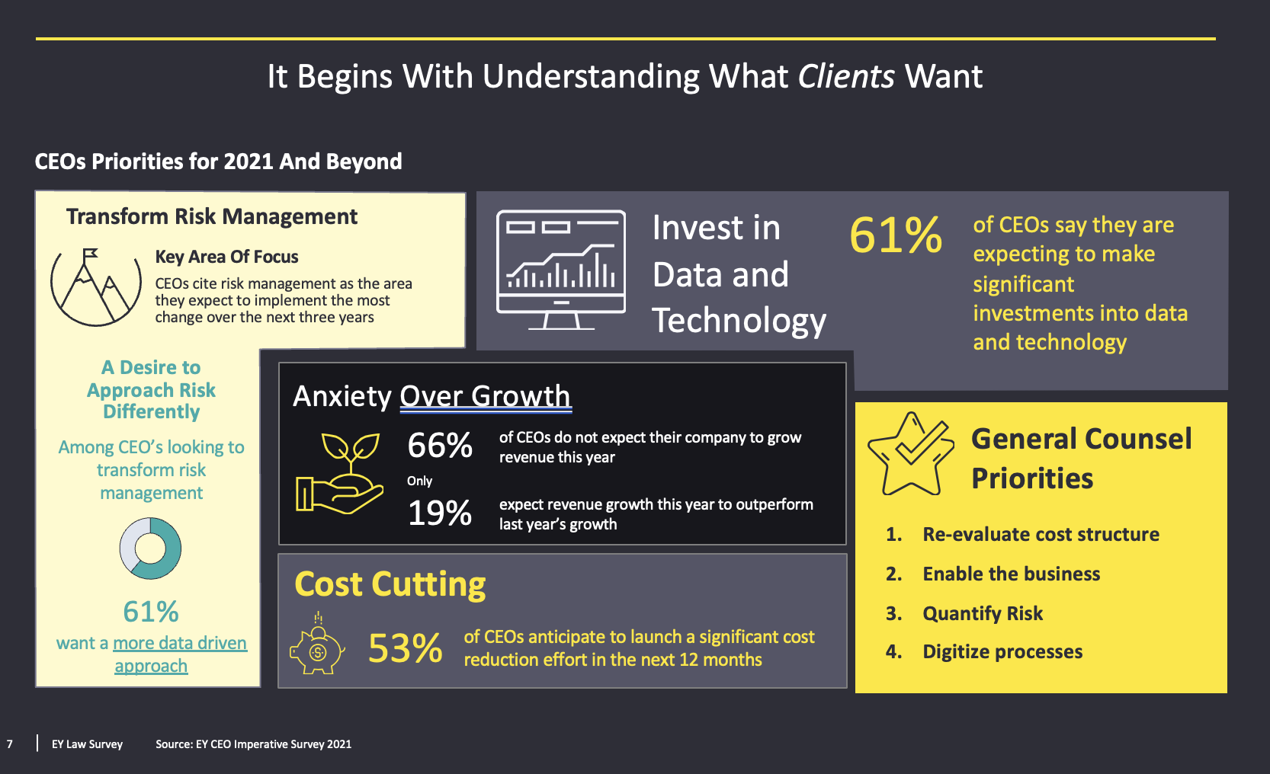
It Begins with What Clients Want: EY-CLP Research

Slide 8
And the World Keeps Getting Riskier
Consider new and complex issues turbocharged after covid:
  Cybersecurity and data privacy
  Anti-bribery and corruption
  Safety and catastrophic risk
  Implementing AI and adopting policies for its responsible use
In all these areas, there is an exploding amount of new law around the world – almost none of it clear or consistent
And yet law is only a part – and often not the most important part – about solving these problems
Clients are therefore looking to integrate law into a wider business solution

Slide 9
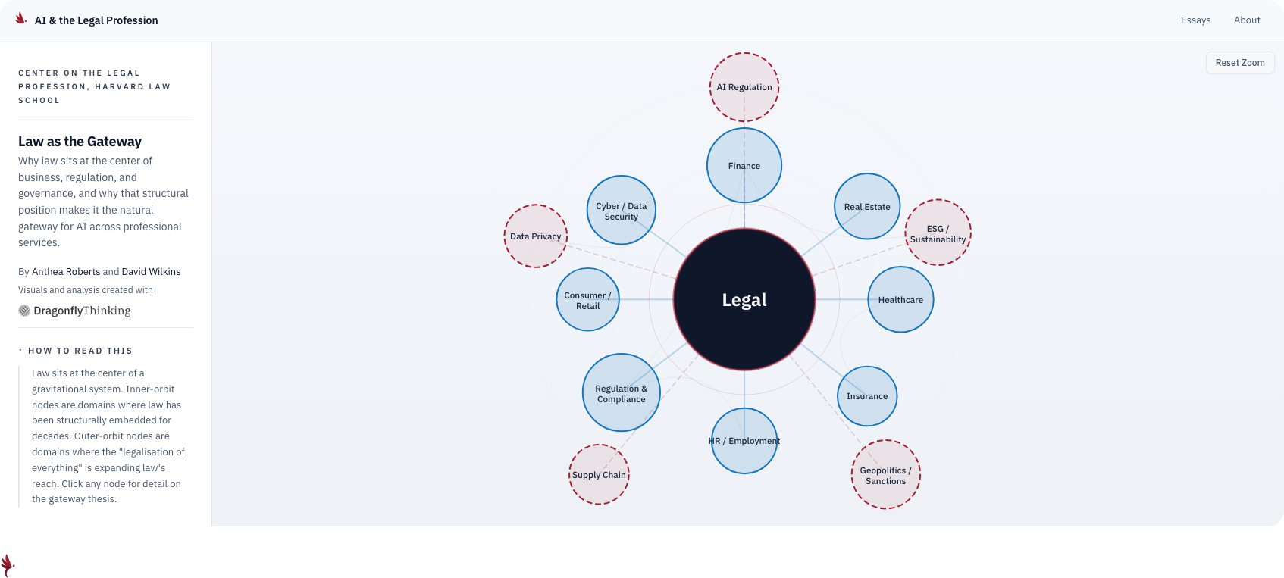
Law as a “Gateway Drug”
But like all drugs, law can be addictive – both to lawyers and clients

Slide 10
In the Short-Term AI will Be a Full Employment Act for Lawyers!
Everything about AI and its use is going to land on the desk of lawyers – e.g., litigation over “training data,” liability for AI’s “hallucinations” and misinformation, claims for breach of confidentiality and fiduciary duty
Moreover, every organization is going to have to adopt new policies to deal with the use of AI – and then continually revise these policies in response to new legal rules like the EU’s new AI regulation, court regulations requiring disclosure of when and how AI is being used, and changes in technology and client expectations/demands
And it will raise novel issues in established fields of law (Davis Polk Client Alert: “Agentic AI and Securities Law,” July 9,2026)

Slide 11
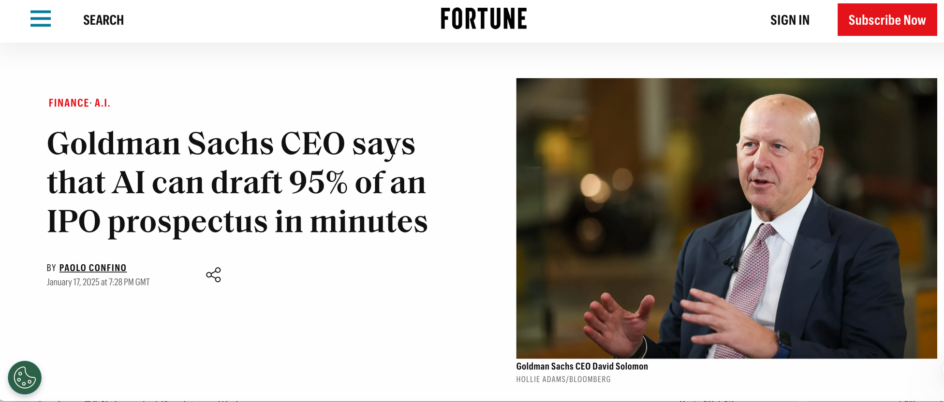
But AI Will Also Replace Legal Jobs
“The last 5% now matters because the rest is now a commodity.”

Slide 12
The Marketplace Was Shifting Even Before AI
Threat of new entrants
Barriers to entry
Bargaining power of suppliers
Rivalry among existing competitors
Bargaining power of buyers
Threat of substitutes
Note: Rivalry is strongest among undifferentiated competitors in a crowded market with transparent metrics and slow growth
Source: M. Porter

Slide 13
And the Forces Will Only Be With Firms that Embrace AI!
AI will facilitate entry into new markets decreasing traditional barriers like geography, regulation, and domain-specific expertise. Lawyers who embrace AI will be able to expand capacity while focusing on the “human” qualities of judgment and creativity
Clients are increasingly turning to AI solutions to reduce “demand” and to select, manage, and control lawyers. But AI will also allow lawyers to collaborate with clients and provide “integrated solutions”
Law firms will have to expand their search for the “best” talent in an AI world, but AI can also facilitate this search and create better matches
“Alternative” providers from the Big 4 to legal tech are increasingly seen by your clients as viable – even preferable – substitutes, all of which are embracing AI and data faster than law firms. But law firms can also use these tools to improve delivery and expand service
All of this will continue to raise competition among firms for clients and talent to a fever pitch
The winners of this competition will be those who can harness AI – but also understand its limitations and best uses to provide integrated human-centered solutions to the complex problems clients will increasingly face

Slide 14
And Yet Not Everything Will – or Should – Change
Notwithstanding all of these developments, for the foreseeable future law remains a human capital business -- albeit humans who know how to work with machines
  Every law firm must therefore continue to recruit, develop, manage, and most of all, retain talent
  And if they want to provide legal services, rely on law schools to educate future lawyers and prepare them for practice
And, as the CEOs of all of the most important foundation models now expressly acknowledge, AI will only reinforce the importance of tradition and stability for lawyers, clients, and the societies in which we live
  Law and lawyering linked to fundamental goods that will never be deregulated completely
  Both people and institutions make long term investments that are difficult to change
Law firms will have to learn to integrate these competing forces of continuity and change as they serve clients, manage legal organizations, and serve the needs of society

Slide 15
Four Near-term Challenges
The Production Challenge
  Navigating the “Jagged Technological Frontier” between humans and machines in a world in which both technology and humans are change at an exponential rate
The Verification Challenge
  How to ensure that results are not just accurate but viewed as trustworthy and legitimate, by lawyers, clients, regulators, and the public, including systematic output-based metrics
The Organizational Challenge
  What to “make” or “buy” – and from who – and when to compete, partner, or leave the field
The Pricing Challenge
  Moving from an “input” to “output” based pricing model

Slide 16
Four Even More Difficult Longer-Term Ones
The Training Challenge
  How to develop lawyers with deep domain expertise when much of the work on which they trained is done by machines
The Identity Challenge
  Professionals always think technology allows them to do what they already do cheaper and faster. Instead, it redefines what it means to be a professional
The Expertise Challenge
  How to move from “linear” specialization to “T-Shaped” judgment to “Diamond-Complete” integration and orchestration of AI and humans
The Human Challenge
  Auon: “I’m not afraid of machines thinking like humans, I’m afraid of humans thinking like machines
  In an AI-powered world preserving, human qualities like judgment, creativity, and empathy will be more important than ever, both for lawyers, clients, and the public

Slide 17
Toward a New Partnership
These are all “adaptive” rather than “technical” problems for which not only do we not know answers, we don’t even know how to define the problems!
To make progress will require an unprecedented collaboration among all relevant stakeholders
Our project is an attempt to start this vital conversation, both through a series of short essays meant to be read by busy practitioners which you can already find on our website (AI and the Legal Profession - Harvard Law School Center on the Legal Profession) and in a trio of in-depth forthcoming articles mapping how AI is restructuring the corporate legal market, creating a new verification frontier defining when and how legal work will be machine or human led, and redefining the meaning of professional expertise
We would love to have all of you join us in this critical dialogue
In other words, if this all sounds like a shameless plug for the Center’s work, it is!

Slide 18

Visit the Center’s AI and the Legal Profession Microsite

