Slide 1
Benchmarking in the Cloud
Gianluca Sartori

Slide 2




Gianluca Sartori
Independent SQL Server consultant
SQL Server MVP, MCTS, MCITP, MCT
Works with SQL Server since version 7
DBA @ Scuderia Ferrari
Blog: spaghettidba.com
Twitter: @spaghettidba

Slide 3
Agenda
Migration scenarios
Benchmarking: tools and challenges
Benchmarking in the cloud: less tools, more challenges
DEMO!

Slide 4
What is a benchmark?
Describes performance in a given scenario
Evaluates whatif scenarios
HW/Software Upgrade
Virtualization, Migration…
Helps rating tuning efforts
Server-wide configuration changes
Addition / removal of indexes

Slide 5

What’s in a Benchmark?
Performance data
Batches / sec
CPU
Wait Stats
Source workload
Queries
Duration
CPU
Reads
Writes

Slide 6
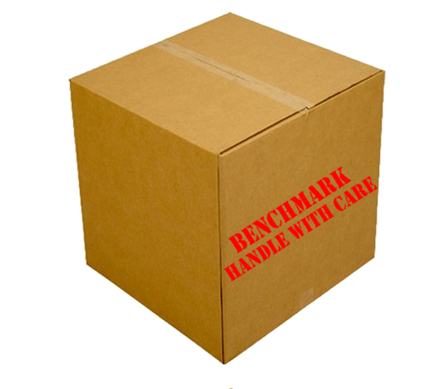

Scenarios
Workload Analysis
Capture Workload
Analyze Captured Data:
Most Expensive Queries (CPU/Reads/Writes/Duration)
Most Recurring Queries

Slide 7


Scenarios
PROD
Performance Comparison
Capture Workload
Replay Workload
Compare Performance
COMPARE
TEST

Slide 8
Benchmarking is hard
?
Capture source workload and performance data
Which tool?
What to capture?
Replay and capture performance data
Which tool?
What to capture?
Compare results
Which tool?

Slide 9
Benchmarking Tools

Slide 10

Capture Tools - SQLServer
Profiler
Non-negligible performance impact on the server
Extended Events
Low performance overhead
Big files
Non compatible with all versions of SQL Server
SQL Trace
«Old school»
Compatible with all versions and many analysis/replay tools

Slide 11
Capture Tools - Windows
Performance Counters
Windows general counters
SQL Server specific
PAL
Provides list of important counters for MS applications
https://github.com/clinthuffman/PAL

Slide 12

Analysis Tools
RML Utilities
ReadTrace
Reporter
SQLNexus
Based on RML Utilities
ClearTrace
Can analyze trace files
PAL
Performance counters analysis with thresholds

Slide 13
Replay Tools
Profiler
Can set breakpoints for debugging
RML Utilities
Ostress
Stress / Replay mode
Distributed Replay
Introduced in SQL Server 2012
Can replay a workload from multiple clients
Supports synchronization mode

Slide 14
Benchmarking In the Cloud

Slide 15
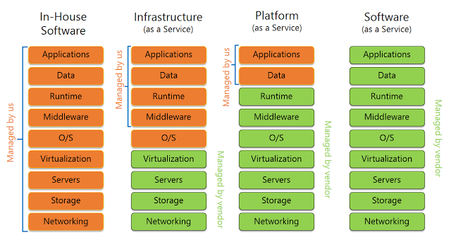
PAAS
Cloud Paradigms
IAAS
SAAS
ON-PREMISES

Slide 16
Cloud Benchmarking Scenarios
IAAS: Azure VM
Same as on-premises
PAAS: Managed Instance
Traces not supported
Supports Extended Events:
blob storage file target
event streaming
Perfmon not supported
PAAS: SQL Database
Traces not supported
Supports Extended Events:
blob storage file target
Perfmon not supported

Slide 17
Introducing WorkloadTools
Collection of Open Source tools
https://github.com/spaghettidba/WorkloadTools
Takes care of all aspects of benchmarking
Workload capture
Workload analysis
Workload replay
Works against Azure SQL Database
UNIQUE FEATURE!!!!

Slide 18

WorkloadTools
Multiple Listener types
SqlTrace
Extended Events
File (saved workload)
Multiple Consumer types
File (save workload)
Analysis
Replay
Easy to configure
Accepts .json configuration files
Scriptable via PowerShell
Easy to visualize
PowerBI for data analysis WorkloadViewer
Workload Analysis
Workload Comparison

Slide 19
Benchmarking with WorkloadTools

Slide 20
PROBLEM #1: Analyzing a Workload
What to capture?
SqlTrace?
Extended Events?
Which Events?
Templates?
How to analyze the workload?
Reports?
Queries?

Slide 21
Capture Workload and Analyze Performance

Slide 22
PROBLEM #2: Capturing a workload for replay
What type of format to use?
Raw capture format (SqlTrace, Extended Events)?
Open Standard format?

Slide 23
DEMO
Capture Workload to a Workload file

Slide 24
PROBLEM #3: Replaying a Workload
How to execute the replay?
Should I consume the query results?
Might be a non-negligible part of the query duration
What about network latency?
Choose the appropriate location
What happens when a query fails?
How do I measure the replay?
Tools for this?

Slide 25
DEMO
Replay a Workload file

Slide 26
PROBLEM #4: Comparing benchmarks
How do I make sense out of the data I capture?
Which visualization tools?

Slide 27
DEMO
Compare performance

Slide 28
PROBLEM #5: Realtime Replay
How do I deal with huge workloads?

Slide 29
DEMO
Replay in Real-Time

Slide 30
Benchmarking is hard
as easy as pie!
Capture source workload and performance data
Which tool?
What to capture?
Replay and capture performance data
Which tool?
What to capture?
Compare results
Which tool?
WorkloadTools

Slide 31
QUESTIONS? ASK ME! gianluca.sartori@sqlconsulting.it

