Slide 1
GoTalks 2026.01

Slide 2
Preventing Drift
by Design
Code generation, contracts, and Go tooling

Slide 3

Who am I?
Tomas Espeleta
Senior Software Engineer
tomas.espeleta@fonoa.com

Slide 4
Agenda
01
Code generation and SSOT
Generating models and validators
Lisa DSL
Conclusions
Appendix: more examples
02
03
04
05

Slide 5
Distributed Systems
….means Distributed Truth
Facts about the system are fragmented.
Code
At Fonoa we have multiple:
Schemas
Validations
Data Models
Documentation
Model Mappings
type MyRequest struct {
CountryCode string `json:"country_code"`
}
Documentation
country_code: ISO 3166-1 alpha-2 uppercase country code the transaction is taking place in.

Slide 6
Why the fragmentation?
We need optimisations that solve specific problems
Contracts define a shared reality
Need to be optimised for reading and change control
Data Models: we need them language-specific!
Data Validations: we want them fast!
Documentation: we want it beautiful and readable!
Model Mappings: we want them… to disappear! :(
Each specific problem needs a specialised technology
Notes:
Complexity of each layer is reduced and limited to the specific problem they are solving!

Slide 7
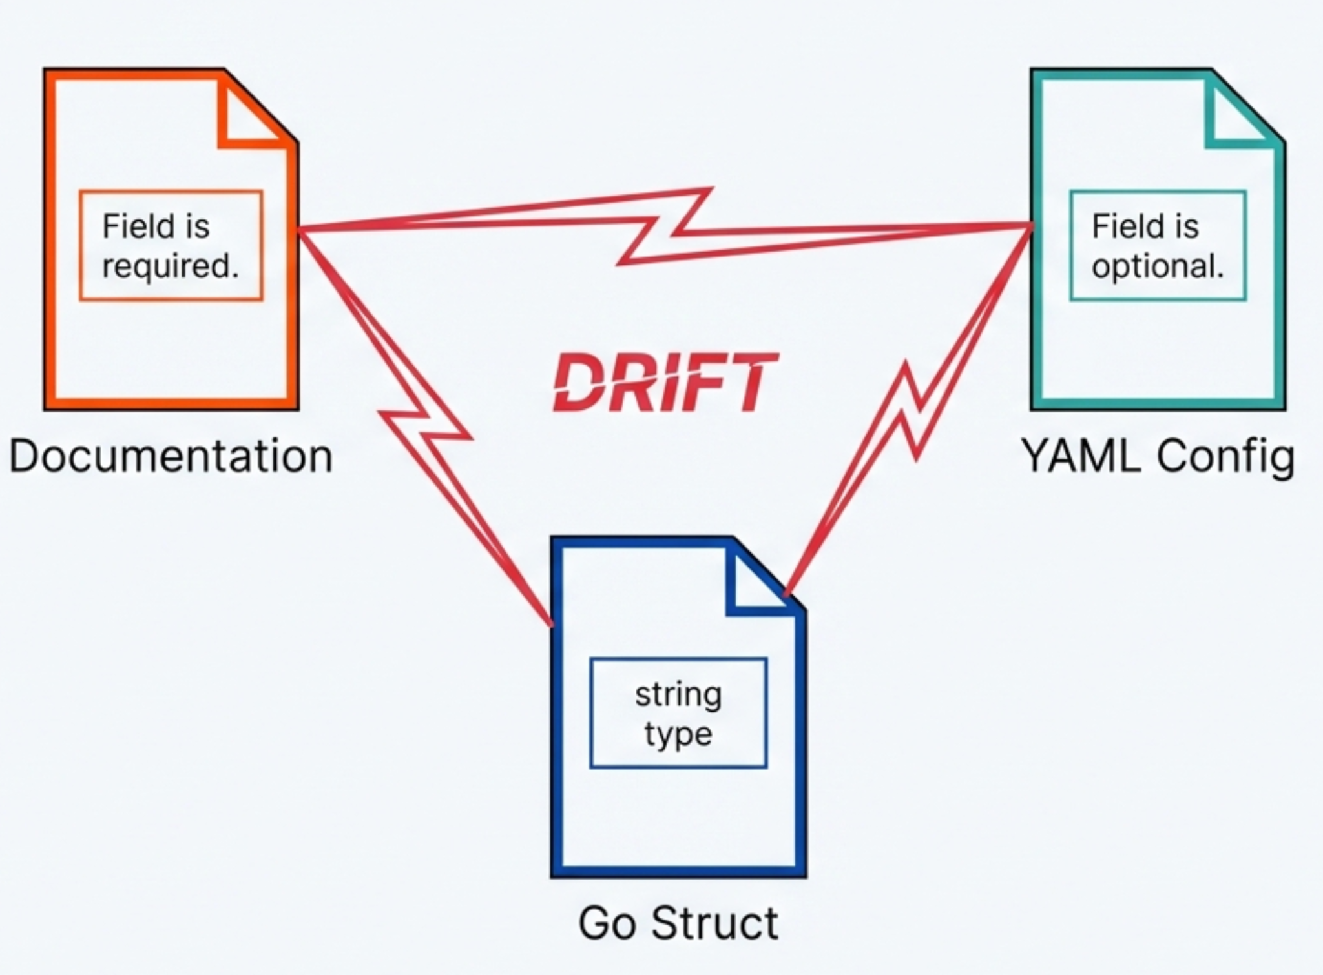
The problem: Drift
Drift is the gap between what we think the system does and what it actually does
Documentation go stale
Comments lie
APIs diverge
Different models
Different life cycles
We end up spending a lot of time synchronizing them!
Notes:
!!!!!!!!Drift is extremely expensive!!!!!!!!

Slide 8
Do not repeat yourself?
DRY…
…or not to DRY?
Changes are expensive and error-prone
Change becomes a maintenance nightmare.
DRY increases coupling
Difficult with multiple technologies
Repetition is generally preferable to coupling
“A little copying is better than a little dependency” - Rob Pike
Notes:
“DRY is the worst paradigm that happened to our industry, except maybe ORMs”
Tomas Espeleta

Slide 9

Single Source Of Truth
And its challenges
Authoritative representation in one place
The Challenge
Choosing an expressive and easy to read SSOT is important for maintenance
Targets
Systems need specialized artifacts (Go code for speed, JSON for UI, HTML for browsers)
The Solution
Code generation: “copy and paste at scale!!!”
Notes:
Source of Truth: Edited by humans (not always developers), Reviewed, Approved
Artifacts: Generated, Disposable, Re-creatable, Optimized for machines

Slide 10
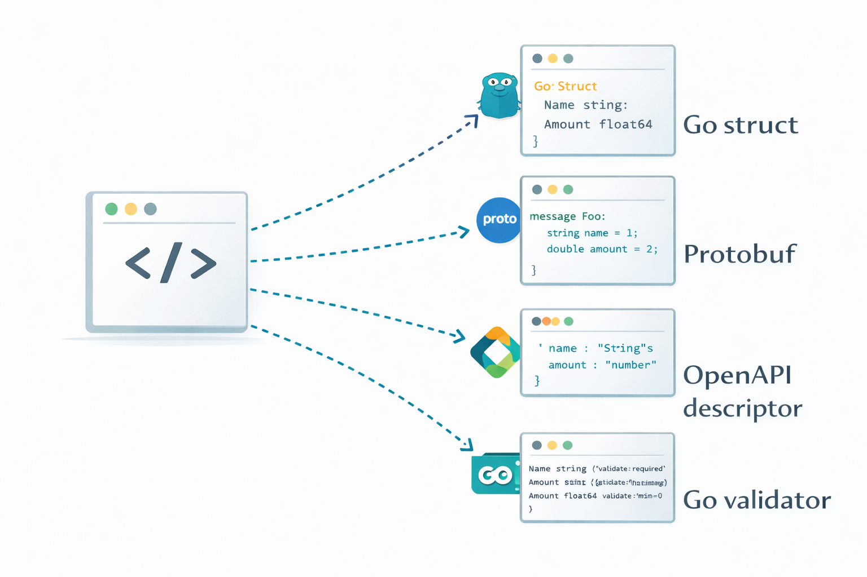
Code Generation
SSOT
Targets
A better solution
Code generation solves coupling by embracing repetition
Automates the synchronization of multiple “copies”
Multiple targets (e.g. documentation and multiple programming languages)
Notes:
At Fonoa, OpenAPI is an artifact, not a source

Slide 11
First example:
Models and
API validators

Slide 12
API Model
Declarative API model, generated go structs
SSOT: Custom YAML
TransactionRequest:
properties:
language_code:
type: string
description: "Language of the transaction document represented as ISO 639-1 uppercase language code. Required when document generation is enabled. Defaults to EN (English) if not provided."
example: "EN"
country_code:
type: string
description: "ISO 3166-1 alpha-2 uppercase country code the transaction is taking place in."
example: "PT"
different when operation regime is EXPORT."
transaction_date:
type: google.protobuf.Timestamp
description: "RFC3339 datetime string representing the point in time when transaction is executed."
example: "2021-01-07T01:00:00+00:00"
items:
type: repeated TransactionLineItem
description: "Goods, services, and discounts exchanged in a transaction."
supplier:
type: TransactionEntity
total_amount:
type: common.Decimal
description: "A high precision decimal representing the total amount. If you are using the legacy integer representation for this field refer to this documentation on how to migrate to decimals: https://docs.fonoa.com/reference/amounts-and-rounding"
example: 122.00
issue_date:
type: google.protobuf.Timestamp
description: "The date when the transaction was issued by an external application."
Notes:
We decided to use custom YAML because it’s EXPRESSIVE and COMPLETE.
The YAML file defines the schema and the business rules (we’ll see this later).
We embed Go expressions directly inside the YAML for complex cross-field validation.
We use protobuf types because we’ll end up mapping to them and use them internally. MORE EXPRESSIVE.

Slide 13
API Model (I)
The tool: go template
Tool: go template
package {{ .PackageName }}
{{- if .Imports}}
import (
{{- range .Imports}}
{{.}}
{{ end}}
){{- end }}
{{- range .Types }}
{{- $modelName := .Name }}
{{ (printf "%s is in need of a description." .Name) | commentBlock }}
{{- if .OneOfTypes }}
type {{.Name}} struct {
{{- range .OneOfTypes }}
{{ .Name }}
{{- end}}
}
...

Slide 14
API Model (III)
The output: Generated go srtruct for our external API
Output: go validator
type TransactionRequest struct {
// CountryCode: ISO 3166-1 alpha-2 uppercase country code the transaction is taking place in.
CountryCode string `json:"country_code,omitempty"`
// IssueDate: The date when the transaction was issued by an external application.
IssueDate *string `json:"issue_date,omitempty"`
// Items: Goods, services, and discounts exchanged in a transaction.
Items []*TransactionLineItem `json:"items"`
// TotalAmount: A high precision decimal representing the total amount. If you are using the legacy integer representation for this field refer to this documentation on how to migrate to decimals: https://docs.fonoa.com/reference/amounts-and-rounding
TotalAmount *json.Number `json:"total_amount,omitempty"`
// IssueDate: The date when the transaction was issued by an external application.
IssueDate *string `json:"issue_date,omitempty"`
// TransactionDate: RFC3339 datetime string representing the point in time when transaction is executed.
TransactionDate *string `json:"transaction_date"`
// TransactionId: Unique external transaction identifier provided by the customer.
TransactionId string `json:"transaction_id,omitempty"`
// [...]
}

Slide 15
API Validators
Declarative API Validation, generated go validators
SSOT: Custom YAML
ExportRequest:
properties:
format:
type: string
description: "One of the supported formats: saft, csv-pt, csv-hr, internal-act-hr, csv-generic, csv-tr"
validation:
- required: true
- value_in: ['saft', 'csv-pt', 'csv-generic', 'csv-tr']
date_from:
type: google.protobuf.Timestamp
description: "Starting date to filter transactions"
validation:
- rfc3339_string: true
- required: true
when: m.Format != "csv-tr"
- must: isNullOrEmpty(m.DateTo)
when: m.Format == "csv-tr"
with_message: "{{.propertyName}} must be empty for the 'csv-tr' format"
Notes:
We embed Go expressions directly inside the YAML for complex cross-field validation.

Slide 16
API Validators (I)
The tool: go template
Tool: go template
func (r rule{{$modelName}}) ValidateStruct(ctx context.Context, m external.{{.Name}}) error {
{{- if .Fields }}
ctx = helpers.AddAsParent(ctx, m)
structErrors := validation.ValidateStructWithContext(ctx, &m,
{{- range .Fields}}
{{- $elementType := (printf "%s%s" (upper $country) .ElementType) -}}
{{- if .Validation }}
validation.Field(&m.{{ toPascalCase .Name}}, {{ validationsList .Validation $country .Name -}}
{{- if and .CanBeNested (.HasValidations $allTypes) (not .IsCollection) -}}
, NewRule{{$elementType}}(ctx, "{{.Name}}")
{{- end }}),
{{- else if and .CanBeNested (.HasValidations $allTypes ) (not .IsCollection) }}
validation.Field(&m.{{ toPascalCase .Name}}, NewRule{{$elementType}}(ctx, "{{.Name}}")),
{{- end}}
{{- end}}
)
{{- range .Fields}}
{{- if and .IsCollection (.HasValidations $allTypes) }}
{{- $elementType := (printf "%s%s" (upper $country) .ElementType) }}
structErrors = helpers.ValidateNestedCollection(ctx, "{{.Name}}", m.{{ toPascalCase .Name}}, structErrors, NewRule{{$elementType}}(ctx, "{{.Name}}"))
{{- end}}
{{- end}}
return helpers.FlattenErrors(structErrors)
{{- end }}
[...]

Slide 17
API Validators (II)
The tool: astutils as refinement of the output.
Tool: go/astutil
func toGo(expression string, country string) string {
parsed, err := parser.ParseExpr(expression)
if err != nil {
panic("error parsing go expression: '" + expression + "'")
}
result := astutil.Apply(parsed, func(cr *astutil.Cursor) bool {
n := cr.Node()
// some AST replacements to implement shorter syntax for certain functions
if call, ok := n.(*ast.CallExpr); ok {
if call.Fun == nil {
return true
}
if id, isId := call.Fun.(*ast.Ident); isId {
if id.Name == "pathValue" && len(call.Args) > 0 {
cr.Replace(&ast.CallExpr{
Fun: ast.NewIdent("helpers.PathValue"),
Args: append([]ast.Expr{ast.NewIdent("ctx")},
&ast.IndexExpr{
X: ast.NewIdent("expMap" + strings.ToUpper(country)),
Index: call.Args[0],
}),
})
}
if funcName, exists := functions[id.Name]; exists {
cr.Replace(&ast.CallExpr{
Fun: ast.NewIdent(funcName),
Args: call.Args,
})
}
}
}
if ident, ok := n.(*ast.Ident); ok {
switch ident.Name {
case "null":
// null -> nil
cr.Replace(ast.NewIdent("nil"))
}
}

Slide 18
API Validators (III)
The output: Generated go validator for our external API
Output: go validator
func NewRuleReportedTransactionRequest(ctx context.Context, fieldName string) ruleReportedTransactionRequest {
return ruleReportedTransactionRequest{fieldCtx: helpers.AddFieldToPath(ctx, fieldName)}
}
func (r ruleReportedTransactionRequest) ValidateStruct(ctx context.Context, m external.ReportedTransactionRequest) error {
ctx = helpers.AddAsParent(ctx, m)
structErrors := validation.ValidateStructWithContext(ctx, &m,
validation.Field(&m.CountryCode, rules.Required, NewCountryCodeValidator()),
validation.Field(&m.TaxAuthorityId1, rules.MaximumLength(150)),
validation.Field(&m.TransactionDate, rules.Required, rules.RFC3339String),
validation.Field(&m.TransactionId, rules.MaximumLength(150), rules.Required),
validation.Field(&m.TransactionNumber, rules.MaximumLength(50)),
)
return helpers.FlattenErrors(structErrors)
}
[...]
res.Amount = mapping.ToExternalMoneyAsJsonNumber(ctx, in.Amount, helpers.PathValue(ctx, expMap[".CurrencyCode"]))
We experimented with HTML generation with another template.
We also generate OpenAPI from the custom descriptors (github.com/getkin/kin-openapi/openapi3)
Notes:
OpenAPI is optmised for documentation generation.
We realised that OpenAPI was requested by customers AND there is a massive ecosystem, beautiful templates. We can create standard and compelling API documentation.

Slide 19
Internal Models
A brief recap…
We have a centralised repository of protobuf models
We generate go specific structs with buf tool, we try to use them everywhere
External model
Internal model
type TransactionRequest struct {
CountryCode string `json:"country_code,omitempty"`
IssueDate *string `json:"issue_date,omitempty"`
Items []*TransactionLineItem `json:"items"`
TotalAmount *json.Number `json:"total_amount,omitempty"`
IssueDate *string `json:"issue_date,omitempty"`
TransactionDate *string `json:"transaction_date"`
TransactionId string `json:"transaction_id,omitempty"`
}
type Transaction struct {
state protoimpl.MessageState
sizeCache protoimpl.SizeCache
unknownFields protoimpl.UnknownFields
CountryCode string `protobuf:"..."`
InvoiceIssueDate *timestamppb.Timestamp `protobuf:"..."`
Items []*TransactionItem `protobuf:"..."`
TotalAmount *Money `protobuf:"..."`
TransactionDate *timestamppb.Timestamp `protobuf:"..."`
TransactionUid string `protobuf:"..."`
}
Notes:
We try to

Slide 20
Model Mappers
Fields mapped automatically by name and structure
All the exceptions can be specified in a custom descriptor
- internal: total_net_amount
expression: ToInternalMoneyFromJsonNumberRef(ctx, in.TotalNetAmount, in.CurrencyCode)
SSOT: Custom YAML
res.ActivityCode = in.ActivityCode
res.CountryCode = in.CountryCode
res.TotalNetAmount = mapping.ToInternalMoneyFromJsonNumberRef(ctx, in.TotalNetAmount, in.CurrencyCode)
res.CurrencyCode = helpers.ToUpper(in.CurrencyCode)
res.Direction = m.ToInternalTransactionDirection(ctx, in.Direction)
res.InvoiceIssueDate = utils.StringRefToPbTimestampFlexible(in.IssueDate)
res.Issuer = m.ToInternalTransactionNonOnboardedEntity(ctx, in.Issuer)
res.Items = m.ToInternalTransactionLineItems(ctx, in.Items)
res.LanguageCode = in.LanguageCode
res.Note = in.Note
Output: go validator
Notes:
The philosophy is:
We try to automate most of the conversions,
We let customers create custom expressions
We provide many functions for data

Slide 21
Lifecycle
Go helps us to keep control!
In the CI, on each git push:
We generate everything: models, validators, mappers (FAST!)
We run all the tests: no merge without passing tests
Breaking changes are flagged by:
Incompatible types in assignments (!)
Failing contract tests
More difficult to find: missing mappings
Default mapping by field name mitigates this

Slide 22
Why not interpreting?
01
02
03
Easy debugging
Type Safety
Performance
Compiled Go code is much easier to debug than interpreted code.
Compiled Go code catches errors that a YAML parser won't.
Evaluating expressions at runtime can be slow.
Although, this is a micro optimization!

Slide 23

A more complex use case
Lisa

Slide 24
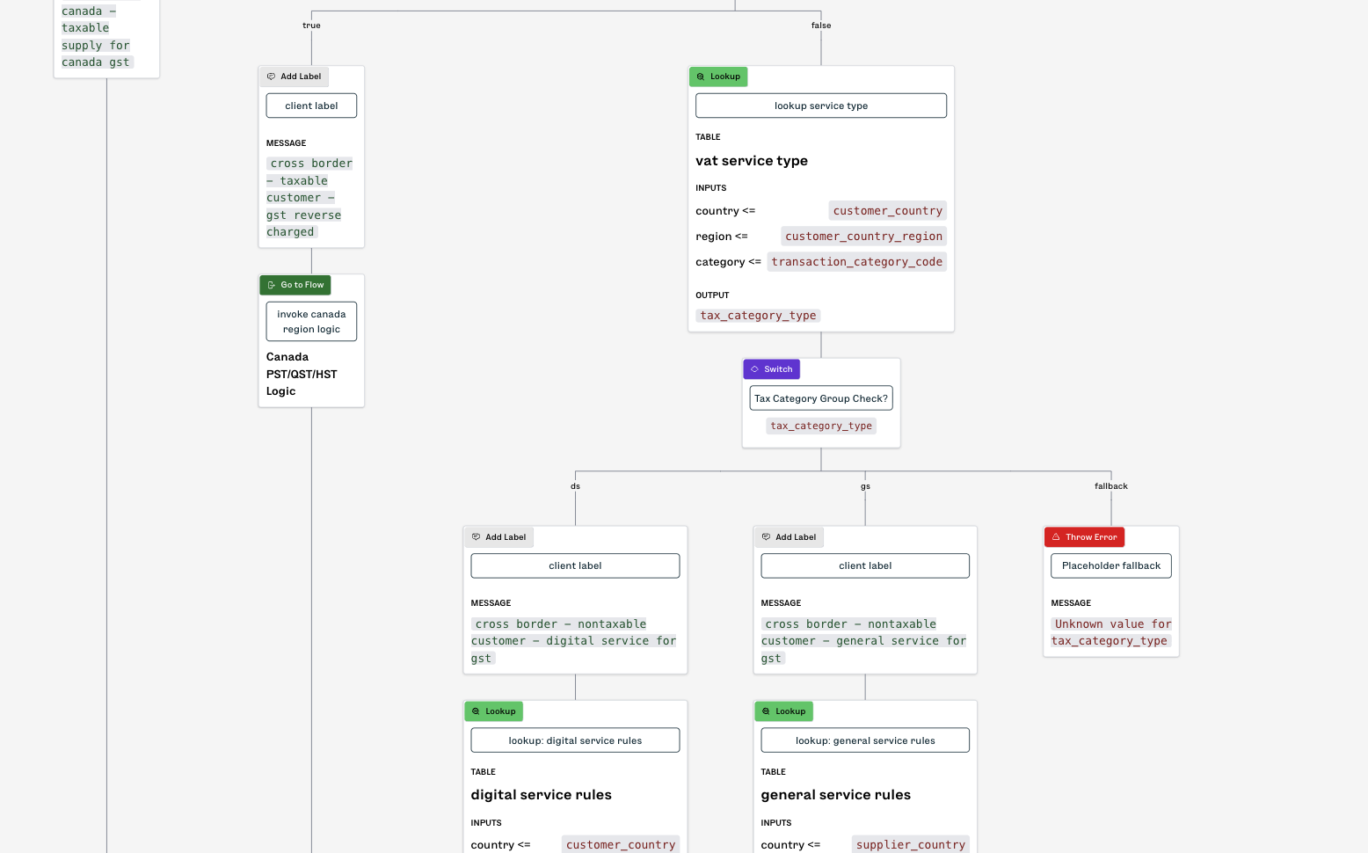
Tax logic rules
Slightly more than a rules engine
In the tax determination engine:
We let non-technical users to edit tax logic with a no-code approach
The backend of the editor uses an in-memory hierarchical model (JSON)
Main Challenge: what should we store?
JSON is not great for reading and change management

Slide 25
We store “Lisa”
A go-derived DSL
We decided to define a subset of go for the logic definition, that we call “Lisa”.
Lisa supports:
Assignments
Expressions
Conditionals
Loops (very limited)
Global variables
Frontend JSON
Volatile
Backend
“Transpiler”
Lisa code
SSOT
Notes:
The Challenge: The visual editor needs JSON to render the UI.
The Conflict: We want the logic stored as Go (for PR reviews, versioning, and execution).
The Solution: Use the Go Parser to read Go code and turn it back into JSON for the editor.
Why? Go code is easier for a human to approve in a PR than a massive JSON execution tree.

Slide 26
Lisa example
Lisa is a simple go subset
SSOT: lisa
package logic
// Apply Car Rental Tax
func applyCarRentalTax() {
// Is there an airport code for the pickup?
if transit_origin_airport_code != "" {
// add airport fee to breakdown
addToBreakdown(transit_origin_country, transit_origin_airport_code, "carRental", "std")
} else {
// Is there an airport code for the drop off?
if transit_destination_airport_code != "" {
// add airport fee to breakdown
addToBreakdown(transit_destination_country, transit_destination_airport_code, "carRental", "std")
}
}
// lookup all the regions mapped to a zip code
transaction_country_regions = lookup("zip_to_regions", country_regions, Values{"zip": zip_code})
...

Slide 27
Frontend json
A target for rendering
Output: Lisa UI json
{
"flows": [
{
"id": "applyCarRentalTax",
"name": "Apply Car Rental Tax",
"block": {
"id": "applyCarRentalTax",
"endsWith": "return",
"statements": [
{
"id": "4",
"label": "Is there an airport code for the pickup?",
"type": "decision",
"decideWith": "condition",
"condition": {
"predicate": {
"left": {
"kind": "parameter",
"value": "transit_origin_airport_code"
},
"operator": "!=",
"right": {
"kind": "literal",
"value": ""
}
}
},

Slide 28
Lisa to Frontend json
We parse lisa into our json UI format
Tool: ast package
func (t *LisaTranspiler) toOperand(expr ast.Expr) (model.Operand, error) {
switch v := expr.(type) {
case *ast.Ident:
str := identifier(v)
if str == "true" || str == "false" {
return model.Operand{Kind: model.LITERAL_OP, Value: str}, nil
} else {
return model.Operand{Kind: model.PARAMETER_OP, Value: str}, nil
}
case *ast.BasicLit:
str, err := literalToString(v)
if err != nil {
return model.Operand{}, fmt.Errorf("cannot convert literal: %s", v.Kind)
}
return model.Operand{
Kind: model.LITERAL_OP,
Value: str,
}, nil
default:
return model.Operand{}, fmt.Errorf("could not convert operand with type %T", expr)
}
}

Slide 29
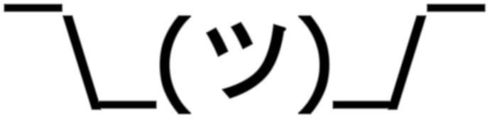
Frontend json to Lisa
Simple and basic string Builder
Tool: String Builder
func (t *LisaTranspiler) toLisaFunctions(flow model.Flow, allFlows []model.FlowDescription, params paramsMap) (string, error) {
code := strings.Builder{}
for _, f := range allFlows {
t.flowsById[f.ID] = &f
}
blockCode, err := t.blockToLisa(flow.Block, params.WithLocal(flow.Parameters))
if err != nil {
return "", fmt.Errorf("failed to transpile flows: %w", err)
}
funcName := flow.ID
if len(flow.Name) > 0 {
code.WriteString("// ")
code.WriteString(flow.Name)
code.WriteRune('\n')
}
code.WriteString("func ")
code.WriteString(funcName)
code.WriteString("(")
for i, param := range flow.Parameters {
code.WriteString(param.Name + " " + ToLisaType(param.Type))
if i < (len(flow.Parameters) - 1) {
code.WriteString(", ")
}
}
code.WriteString(") {\n")
code.WriteString(blockCode)
code.WriteString("}\n")
return code.String(), nil
}

Slide 30
We love go!
No duplication: standard practices
Business logic and tooling
Source / Target
go code
go as target
Normal, plain, handwritten go code
Generation to go:
API validators
XSD validators
Lisa generation
go tools
go templates
go parser
AST manipulation
go as SSOT
Generation from go:
Lisa UI generation
HTML generation

Slide 31
Summary
Source (SSOT) | Tool | Target (Artifact)
Database / Go Structs | Go Templates | Web pages (HTMX)
API Descriptors | Go Templates Astutils package OpenAPI library | Go Models Go Validators OpenAPI
Lisa Editor -> Lisa Code | String Builder | Go Tax Engine
Lisa Code -> Lisa Editor | Go AST Parser | Visual Editor JSON
XSD Files | Go Templates | Go Models Go Validators

Slide 32
Conclusion
Preventing Drift by design
Drift is inevitable when you expect humans to synchronize artifacts.
Humans time is too precious!
Code generation is not about removing repetition
It’s about embracing repetition and automating synchronization
Stable and deterministic
Go fits naturally in this role
Strong types catch drift early: errors move to compile time
Generated code stays plain, debuggable Go

Slide 33
Thank you!
?
?
?
?
Q&A

