Slide 1
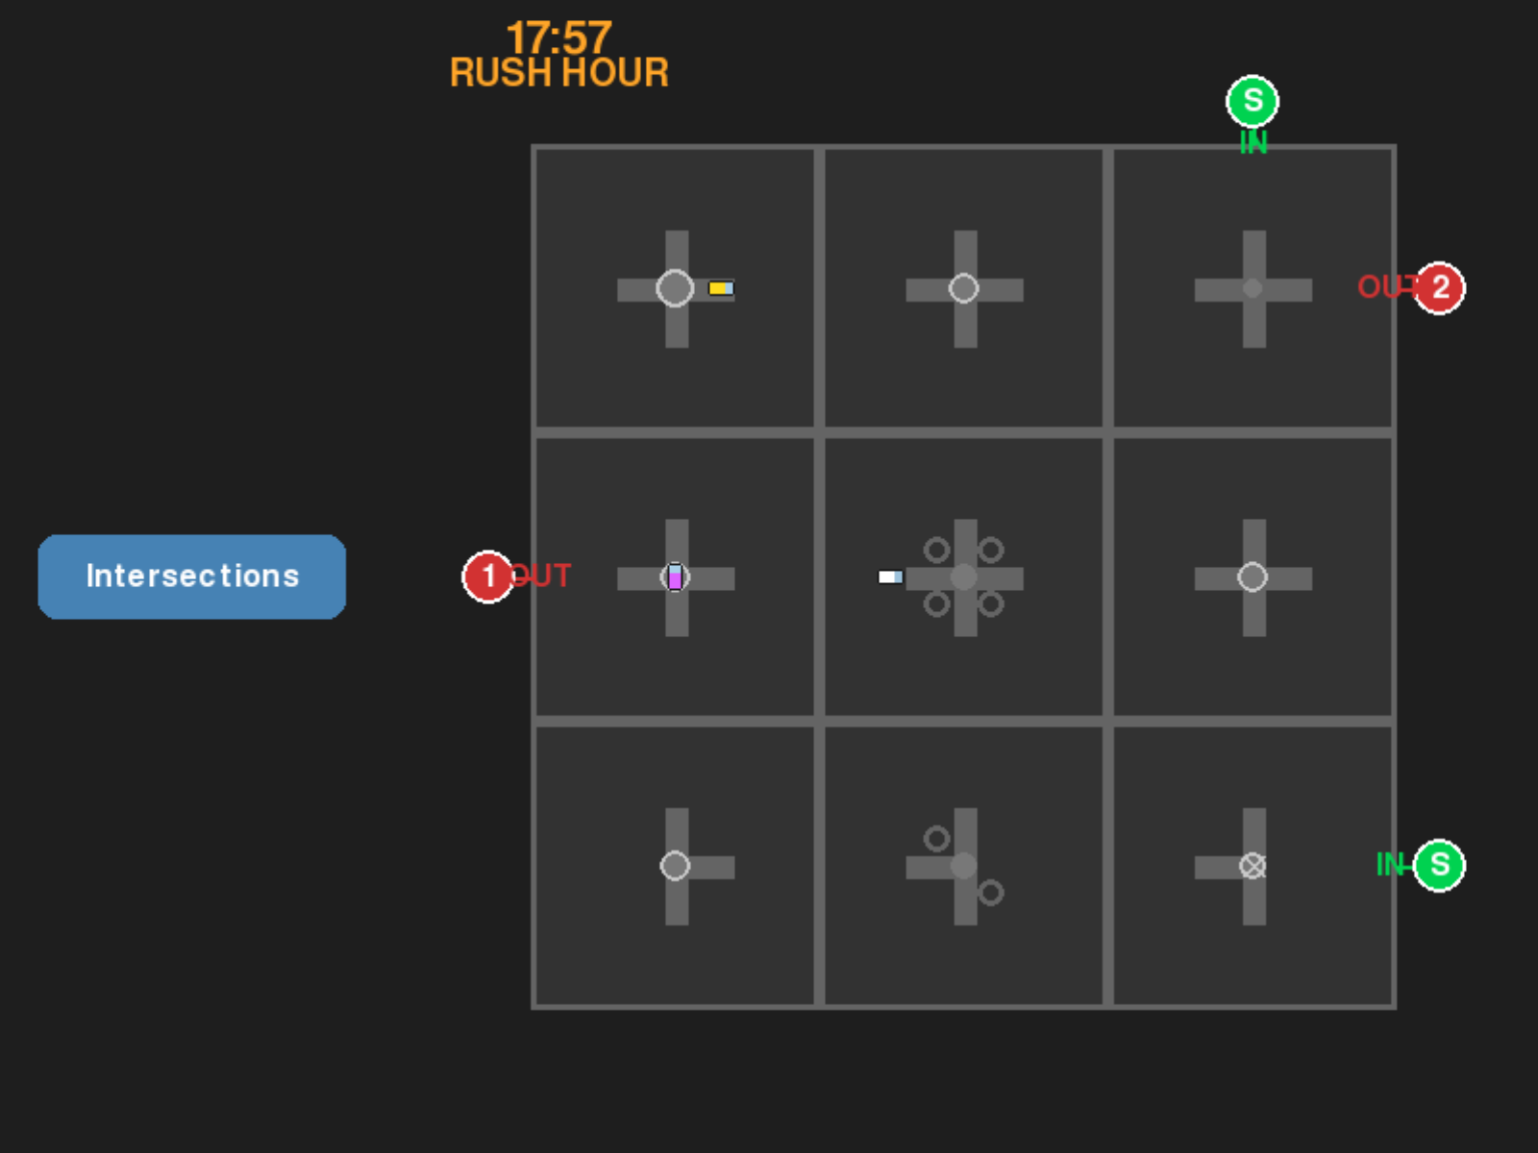
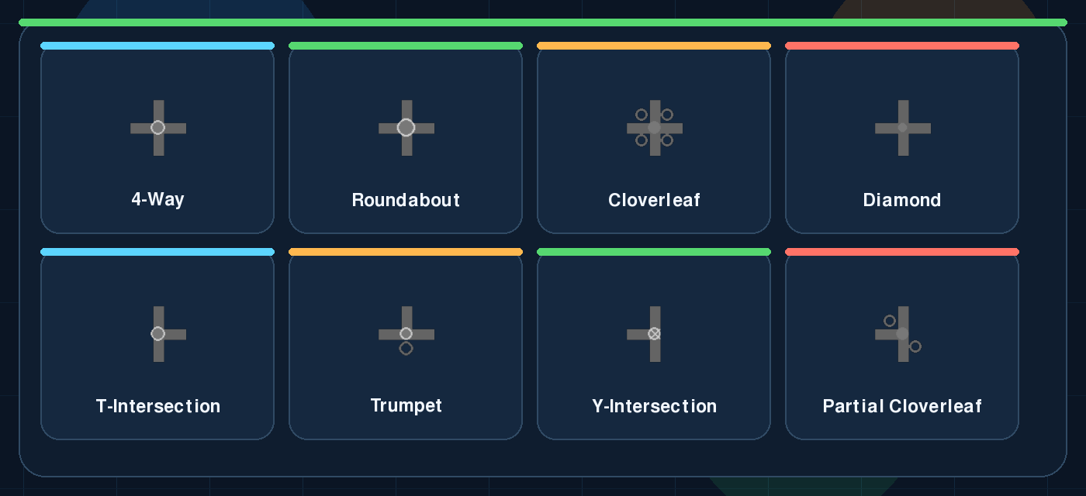

DATA-DRIVEN TRAFFIC SIM
Live Gameplay
City Limits
A single board shows the live clock, route endpoints, and the intersections players can place to keep traffic moving.
Build better intersections before rush hour wins.
Clock + rush hour
Time-of-day pressure rises and falls through the day, so layouts must survive both calm and peak traffic.
City Limits is a top-down traffic simulation game where players choose a city, place real-world intersection types on a constrained grid, and keep flow rates high as hourly traffic surges across the day.
Build on the grid
Players drag intersection types onto open tiles and rotate pieces until a valid route connects every required path.
Python
Pygame
Real Traffic Data
Score the flow
github.com/brzozs/City-Limits
Efficient paths keep cars moving, reduce idle time, and raise the flow-rate score shown elsewhere on the poster.
Educational traffic design + urban planning
3
8
3
city traffic profiles
intersection types
progressive levels
Core Loop
Traffic Profiles
Intersection Toolkit
Pick a city, build a route network, then survive the traffic curve.
Hourly real-world volume data drives spawn timing, rush-hour spikes, and city difficulty.
Players drag from a library that mixes everyday junctions with more advanced highway-style designs.
1
Pick a city
New York City
00
06
12
18
23
New York City, Los Angeles, and Chicago each change the hourly volume curve and overall difficulty.
Normal
3012 vph peak
Peak 3012
2
Build the network
Los Angeles
Place and rotate intersections so start and end markers connect through a valid path across the grid.
Hard
3456 vph peak
Peak 3456
3
React to rush hour
Chicago
Morning and evening peaks shorten spawn intervals and punish layouts that create idle time or dead ends.
Easy
2867 vph peak
Peak 2867
City choice changes the challenge.
New York City
Los Angeles
Chicago
Each city uses a different hourly traffic curve, so the same road design can feel balanced, punishing, or beginner-friendly depending on where you start.
Balanced AM + PM peaks
Hardest rush-hour load
Best first-play starting point
Rush-hour design insight: Los Angeles creates the heaviest peak pressure, Chicago is the easiest lane to learn on, and New York stays balanced through both AM and PM surges.
T-Intersections, trumpets, Y-intersections, and partial cloverleafs expand the route design space at higher complexity.
Scoring Model
Levels Scale Up
Try The Game
Flow rate rewards fast movement, efficient routing, and low idle time.
Each stage increases the grid size, travel points, and target flow rate.
Scan the live phone demo and play City Limits straight from your browser.
Flow Rate = (Vavg / Vlimit) x (Tideal / Tactual) x (1 - Tidle / Tactual)
Level 1
Level 2
Level 3
2 travel points | target 0.45
3 travel points | target 0.55
4 travel points | target 0.65
Speed
Average speed is compared against the speed limit so efficient layouts score higher.
IN
OUT
IN
OUT
IN
OUT
Travel Time
Ideal travel time is measured against actual travel time to reward shorter, cleaner routes.
Idle Time + Routing
2 travel points | target 0.45
3 travel points | target 0.55
4 travel points | target 0.65
Stopped cars and failed paths drag the score down, so broken networks are visibly punished.
Scan to play
Live now on GitHub Pages.
https://brzozs.github.io/City-Limits/
Notes:
City Limits poster.
Sources: README.md, src/main.py, src/intersection.py, src/traffic_data.py, and local screenshots rendered from the game code.
Planned QR destination after publish: https://brzozs.github.io/City-Limits/

