Slide 1
Inventory Manager AGLIE PROJECT REPORT
INTRODUCTION
As the name itself suggests, this project is an attempt to manage the inventory in a more efficient and manageable way. Sometime we can’t remember where our stock goes. And we can’t handle our flow of the stocks in the inventory this app will help in doing so.
For this problem, we need a solution that one can manage their stock. So, we decided to find an easier way to get rid of this problem. So, our application attempts to free the user with as much as possible the burden of manual calculation and to keep the track of the stocks.
Instead of keeping a diary or a log of the stocks, this application enables the user to not just keep the control on the stocks but also to generate and save reports of the weekly and monthly stocks. With the help of this application, the user can manage their stocks in the inventory on a daily, weekly and monthly basis. Users can insert and delete stock in the inventory as well as can generate and save their reports.

Slide 2
What is Xamarin?
Xamarin is an open-source platform for building modern and performant applications for iOS, Android, and Windows with .NET. Xamarin is an abstraction layer that manages communication of shared code with underlying platform code. Xamarin runs in a managed environment that provides conveniences such as memory allocation and garbage collection.
Xamarin enables developers to share an average of 90% of their application across platforms. This pattern allows developers to write all of their business logic in a single language (or reuse existing application code) but achieve native performance, look, and feel on each platform.

Slide 3
Who Xamarin is for?
Xamarin is for developers with the following goals:
Share code, test and business logic across platforms.
Write cross-platform applications in C# with Visual Studio.

Slide 4
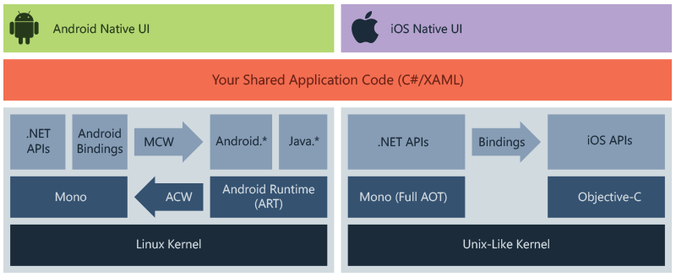
How xamArin works?
The diagram shows the overall architecture of a cross-platform Xamarin application. Xamarin allows you to create native UI on each platform and write business logic in C# that is shared across platforms. In most cases, 80% of application code is sharable using Xamarin.
Xamarin is built on top of .NET, which automatically handles tasks such as memory allocation, garbage collection and interoperability with underlying platforms.

Slide 5
What is Agile SDLC?
Agile SDLC model is a combination of iterative and incremental process models with focus on process adaptability and customer satisfaction by rapid delivery of working software product. Agile Methods break the product into small incremental builds. These builds are provided in iterations.

Slide 6
Modules of the Application:
The modules which are currently covered are:
Sign up/Login:
The module is responsible for the sign up a new user in the application so that the user can use the application. For the sake of the Signing up the user have to press the sign-up button on the main screen than a new page will appear where the user will enter the “username”, “password”, “confirm password”, “first name”, “last name” and “account type”. If the user is a previously registered user, then the user has to press the Login button on the main screen and enter the username and password of the user and the application will ready to go and will take the user to the main menu.

Slide 7
Modify Inventory Products:
If the user wants to delete any inventory product, then the user has to click the product in the inventory that is available in the inventory list then press the delete button in the navigation bar and the product will be deleted from the inventory.
Filter Product view:
In the search tab, the user can filter the product. The user can just enter the name of the product or the type of the product in the search bar and all the products will be filtered and only the products related to the keyword that is entered to the search bar will appear in the inventory list.

Slide 8
Add inventory Products:
If the user wants to add any inventory product, then the user has to click the + product in the navigation menu bar then a new page will open here you have to enter the product name, price of the product and can add the product image URL then the product will be added into the inventory.
Multiple Accounts
Users can create multiple accounts. In the account tab. User has the option available for creating a new account. Users will click the “+” sign button then a dialog will appear on the screen and the user can enter the name of the account then that name will be saved in the account tab. If a user wants to delete the particular account, then the user has to l click the account name user want to delete. Then that account will be deleted.

Slide 9
Thank You

