Slide 1
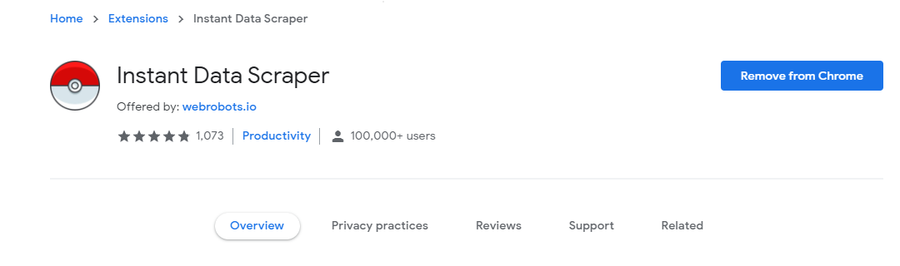
Facebook Analysis
Instant Data Scraper is an automated data extraction tool for any website. It uses AI to predict which data is most relevant on a HTML page and allows saving it to Excel or CSV file (XLS, XLSX, CSV).

Slide 2
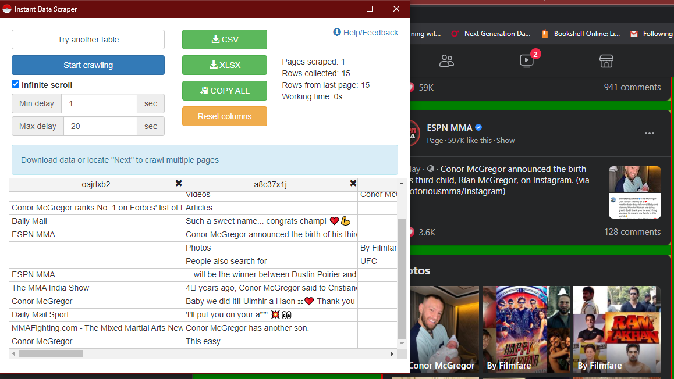
Instant Data Scrapper
This tool does not require website specific scripts
Instead it uses heuristic AI analysis of HTML structure to detect data for extraction.
If the prediction is not satisfactory, it lets the user customize the selections for greater accuracy.

Slide 3
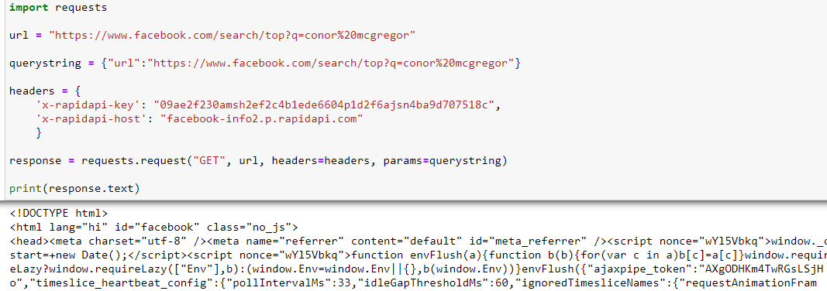
Request Library
Once our client is connected to the host, we can simply pass the URL of the page/group for which the data will be scrapped.
A query is made using request() using request library and the data is scrapped in a HTML file

Slide 4

BeautifulSoup Library
Then we use BeautifulSoup i.e a library in python that can be used to parse through an Html file.
In python to extract our features. Those features are extracted in tabular form with inputting “class” and “attr”.
We then simply convert the tables to a csv to further analyse our data.

Slide 5
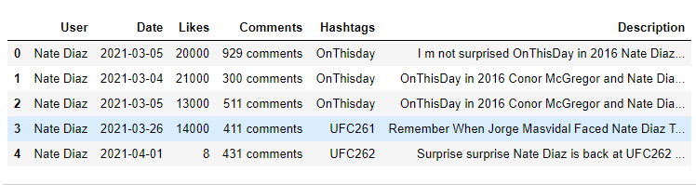
Sentimental Analysis
Sentimental analysis (TextBlob) is a python library that is used for Natural language processing.
Textblob uses Natural Language toolkit(NLTK) actively to achieve its results.
Nltk in python helps with categorization, classification and many other tasks.

Slide 6
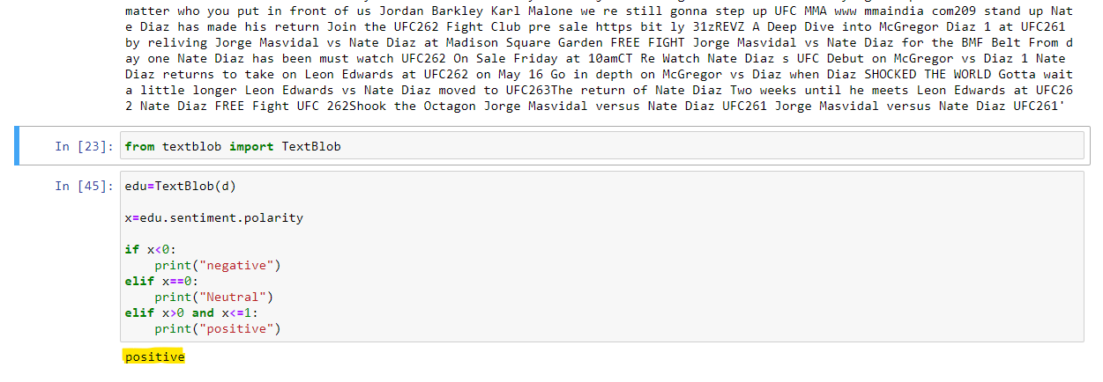
TextBlob Library #Conor McGregor

Slide 7
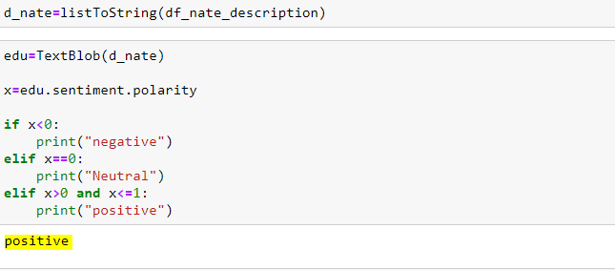
Nate Diaz

Slide 8
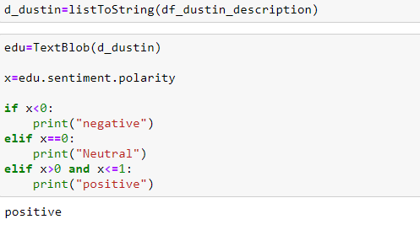
Dustin Poirier

Slide 9
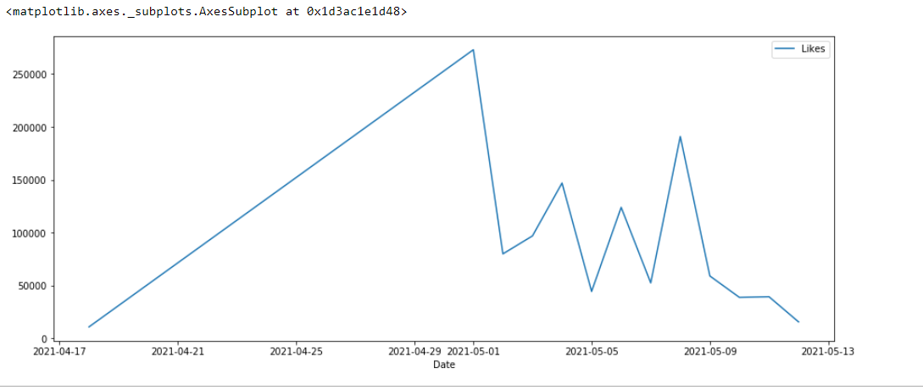
Like over time graph McGregor

Slide 10
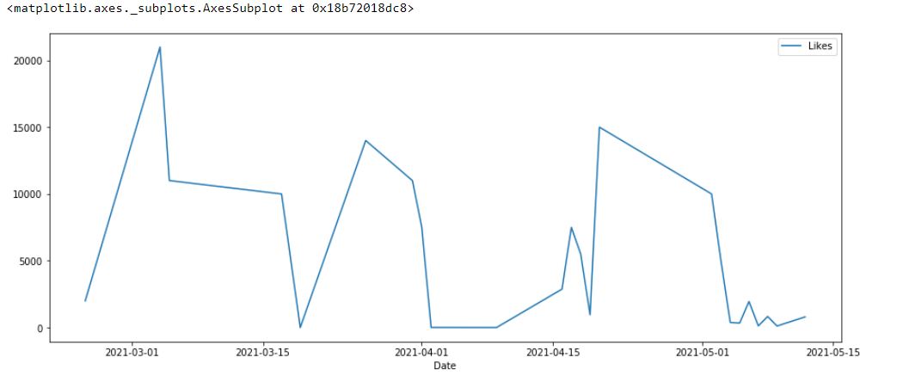
Nate Diaz

Slide 11
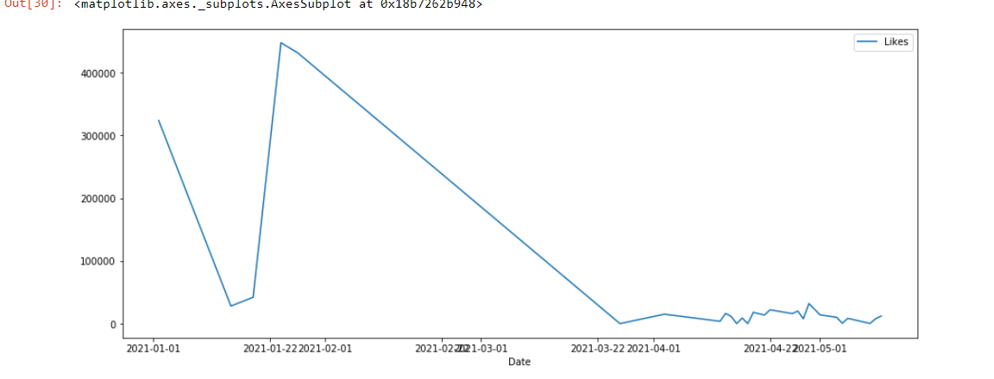
Dustin Poirier

Slide 12
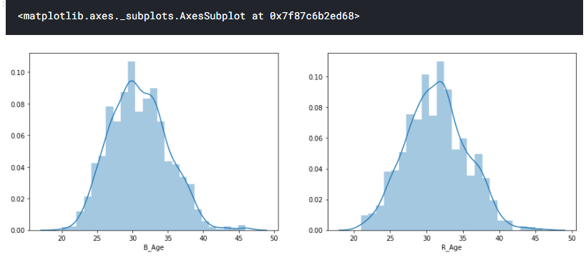
Age factor

Slide 13
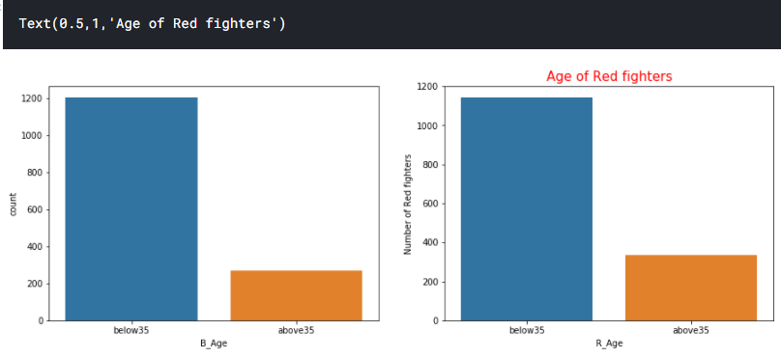

Slide 14
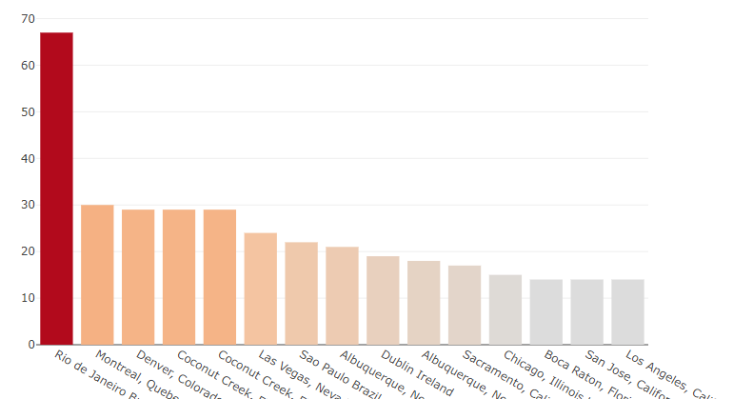

Slide 15
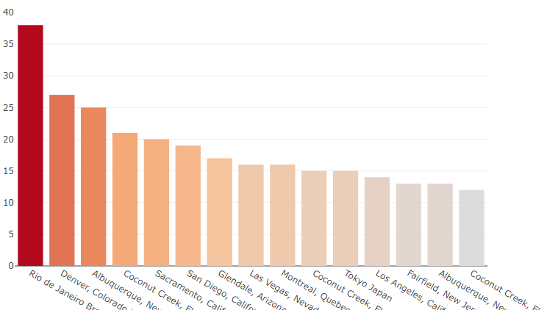

Slide 16
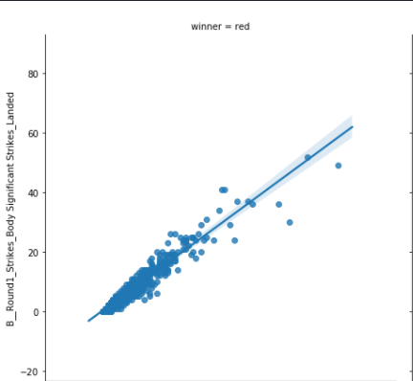

Slide 17
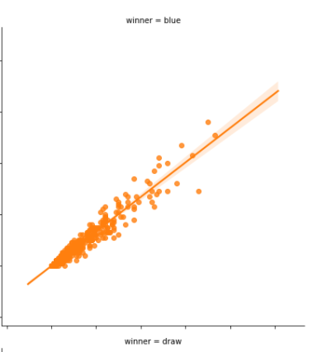

Slide 18
THANK YOU!

