Slide 1

MSc Artificial Intelligence Machine Learning Course
Prediction of Breast Cancer through Mammography Data
Professor/Researcher: Dr. Theodoros Giannakopoulos
Student: Vassilis Carlis
Academic Year: 2020-2021

Slide 2
The Problem
Recognize breast cancer through mammography data
Why;
Support and optimization of the prediction procedure
Minimization of the mistaken estimation
How;
Classification Models
Logistic Regression
Decision Trees
K- Nearest Neighbors
Support Vector Machines
Naive Bayes Classifier

Slide 3
The Data
Public Data
Source:https://raw.githubusercontent.com/jbrownlee/Datasets/master/mammography.csv
The data consists of 11.183 objects that include values for 6 features each. The data extracted from 24 mammograms.

Slide 4
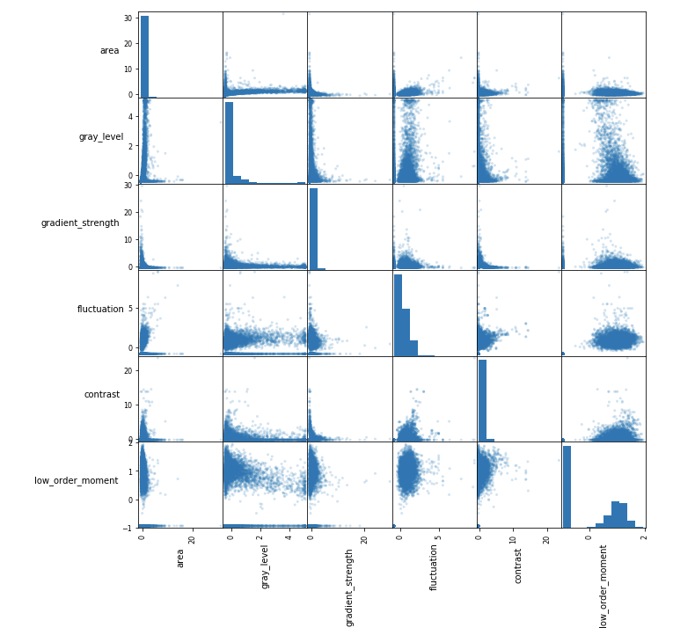
Scatter Matrix

Slide 5
The Features
6 Feature
Data pre - processing:
Dissociation correlated feature (correlation >90%)
Normalization with min max operation

Slide 6
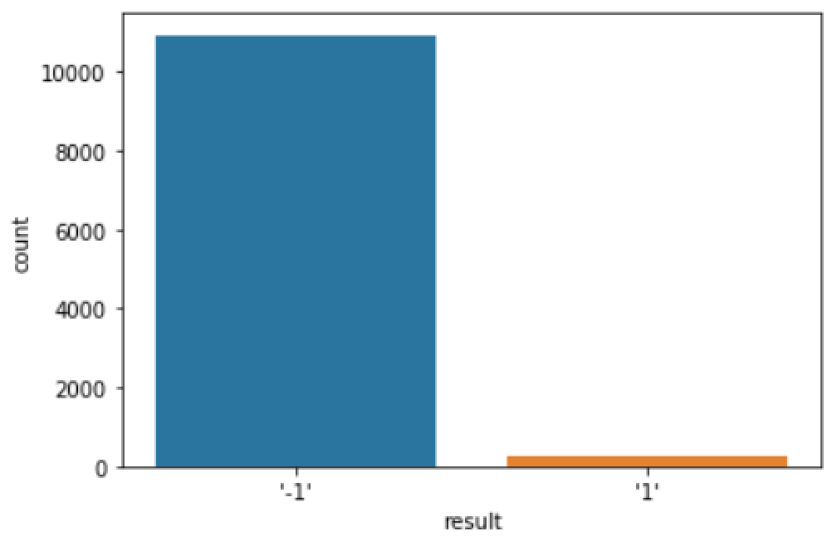
Class Comparison
2 classes (binary)
1 Positive to cancer examples
-1 Negative to cancer examples

Slide 7
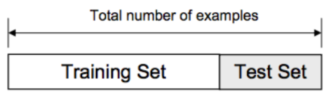
Train and Test Set
After many experiments
Train set = 50% objects
Test set = 50% objects

Slide 8
Results

Slide 9
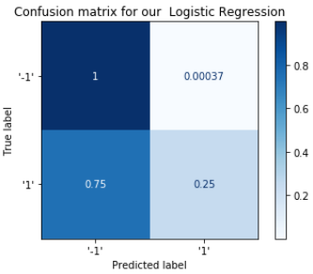
Logistic Regression
Accuracy: 0.9821162444113264
Precision: ﻿0.9354838709677419
Recall: 0.25
Specificity: ﻿0.9996347699050402
F1 score: ﻿0.39455782312925164
True Positive: 29
False Positive: 2
True Negative: 5474
False Negative: 87

Slide 10
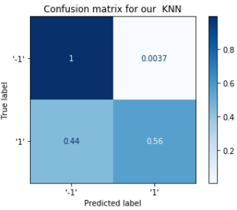
K - Nearest Neighbors
Accuracy: ﻿0.9873032904148784
Precision: ﻿0.7647058823529411
Recall: ﻿0.5603448275862069
Specificity: ﻿0.9963476990504018
F1 score: ﻿0.6467661691542288
True Positive: 65
False Positive: 20
True Negative: 5456
False Negative: 51

Slide 11
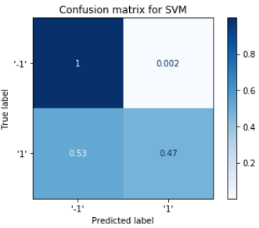
Support Vector Machines
Accuracy: ﻿0.9871244635193133
Precision: ﻿0.8333333333333334
Recall: 0.47413793103448276
Specificity: ﻿0.997991234477721
F1 score: ﻿0.6043956043956044
True Positive: 55
False Positive: 11
True Negative: 5465
False Negative: 61

Slide 12
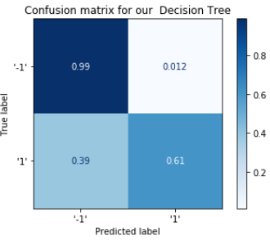
Decision Trees
Accuracy: ﻿0.9803290414878397
Precision: ﻿0.5220588235294118
Recall: ﻿0.6120689655172413
Specificity: ﻿0.9881300219138057
F1 score: ﻿0.5634920634920634
True Positive: 71
False Positive: 65
True Negative: 5411
False Negative: 45

Slide 13
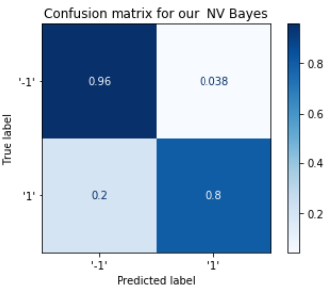
Naive Bayes
Accuracy: ﻿0.9583333333333334
Precision: 0.3069306930693069
Recall: ﻿0.8017241379310345
Specificity: ﻿0.9616508400292184
F1 score: ﻿0.44391408114558467
True Positive: ﻿93
False Positive: 210
True Negative: 5266
False Negative: 23

Slide 14
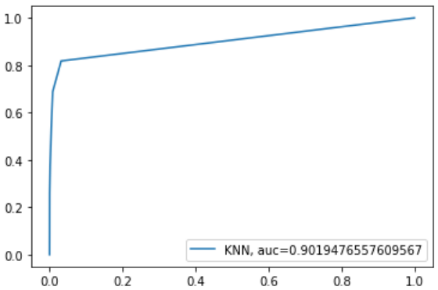
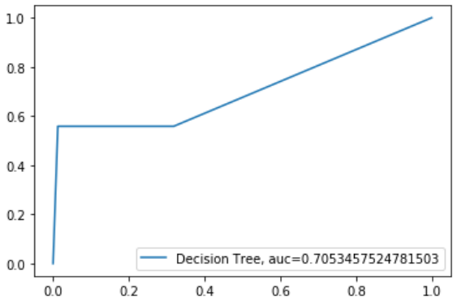
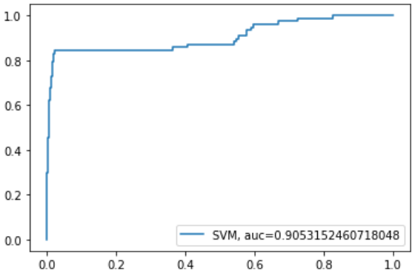
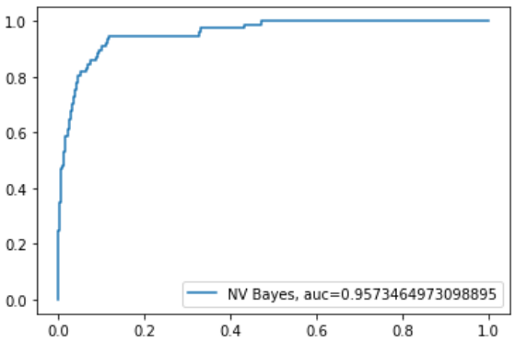
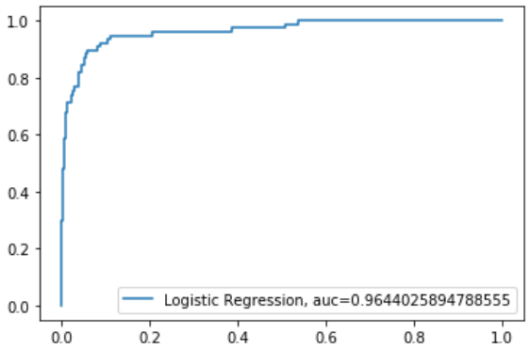
Roc Curves

Slide 15
Conclusion – Future Work
Conclusion:
Optimal Classifier: Naïve Bayes
Annotation agreement >70 Recall Not Optimal Classification for this field
Future Work:
Model training with a balanced data set
Experiments with Random Forest
Cross Validation
Find the project in GitHub: https://github.com/bs1993/ML-TGIAN-Mammography

Slide 16

Thank you!
Questions

