Slide 1

Visualization and Analysis –
Tutorial Presentation for Feedback
Date:
Group Id: A115 Name of Student Presenting: Bhavithra

Slide 2
We are using the dataset IMDb_movies , DS035
Our Research Question
Is there a correlation between the average audience rating and production budget of movies listed on the Internet Movie Database (IMDb) released between 2000 and 2019?
This dataset is interesting to us because:
This dataset is interesting because it lets us examine how a movie’s budget relates to its audience ratings (avg_vote).
Our Independent variable is: movie budget
This is the category of movie’s budget
This Independent variable datatype is: ratio
Our Dependent variable is: audience rating
This is average IMDb user rating for each movie.
This Dependent variable datatype is: Interval
The dataset contains 81273 rows & 22 columns
imdb_title_id | avg_vote | budget
tt0000574 | 6.1 | $ 2250
tt0002101 | 5.2 | $ 45000
tt0002445 | 6.2 | ITL 45000
tt0002452 | 6.7 | ROL 400000
tt0002461 | 5.5 | $ 30000

Slide 3
1. A scatterplot including the linear trendline
(ensuring your dependent variable is on the y-axis)
2. A histogram include the normal curve overlay. The histogram plots data from your dependent variable only.
Clearly labelled axes to including variable name and units of measurement. Included a title to give visualization a context.
Correlation: Included two visualizations
Correlation analyses how an interval/ratio dependent var correlates to an ordinal/interval/ratio independent variable

Slide 4
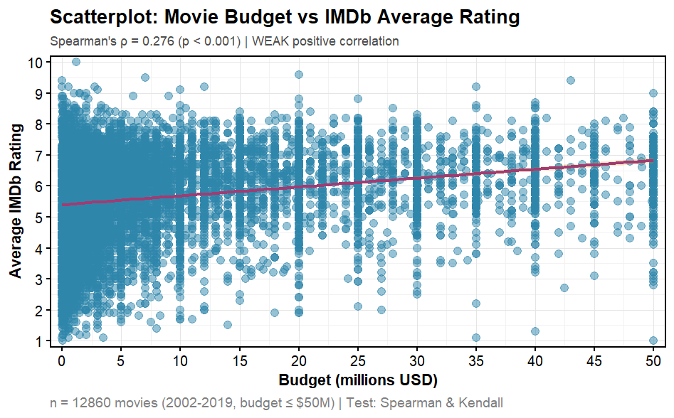
Part 1: VISUALISATION ( Scatter Plot )

Slide 5
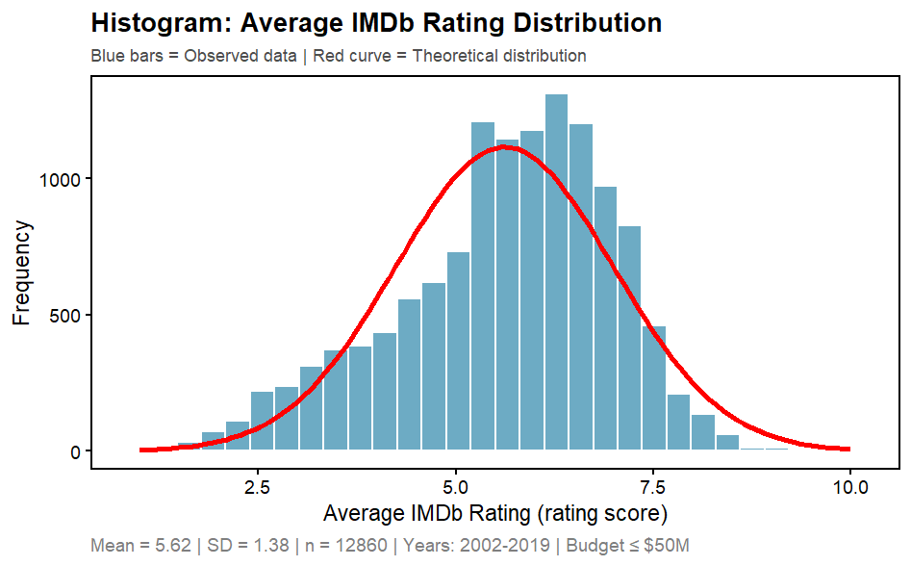
Part 1: VISUALISATION ( Histogram)

Slide 6
Part 2: Analysis (building on Visualizations)

Slide 7
Here is a Histogram showing the frequencies of our dependent variable to include the normal curve overlay.
Our RQ asks about Correlation
The normal curve overlay does not follow the shape of the underlying data, so for our analysis we use the non-parametric test for correlation that does not assume normality: Spearman’s Rho
7
Notes:
7

Slide 8
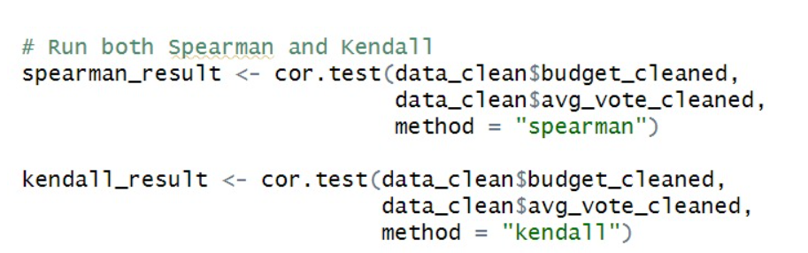
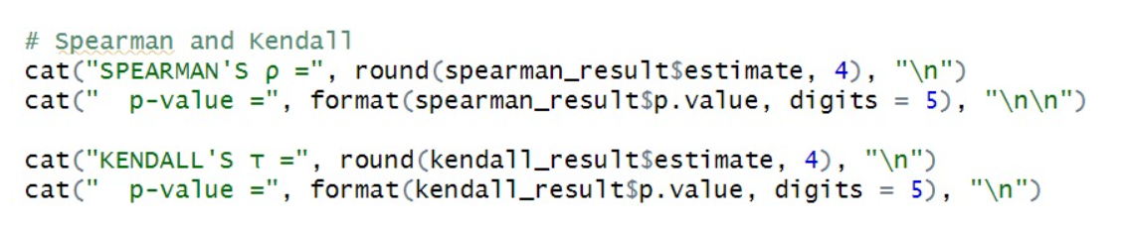
R Script and Results (For ALL types of test) – The Analysis
PRE 7COM1079-2022 Student Group No: ?????
8
Include a snippet of the R code you use to calculate test statistic.
Notes:
8

Slide 9
R Script and Results (For ALL types of test) – The Analysis
PRE 7COM1079-2022 Student Group No: ?????
9
Give the value of the test statistic.
The analysis produced two test statistics because the data did not meet normality assumptions, requiring non-parametric correlation tests. The Spearman's rank correlation coefficient equals 0.276, and the Kendall's tau coefficient equals 0.190. Both values indicate a positive relationship between movie budget and IMDb rating.
Tell us the p-value. Is the p-value > or < 0.05?
The p-values for both tests are less than 0.001, which falls substantially below the standard significance threshold of 0.05. This indicates that the probability of observing such correlations by chance alone is essentially zero.
Notes:
9

Slide 10
R Script and Results (For ALL types of test) – The Analysis
PRE 7COM1079-2022 Student Group No: ?????
10
Is the result significant?
Yes, the results are statistically significant. When p-values fall below 0.05, we conclude that the observed pattern is unlikely to have occurred due to random variation in the data. These p-values are far below this threshold, providing strong statistical evidence of a genuine relationship.
Do you ‘fail to reject the null hypothesis’ or ‘reject the null hypothesis’?
Reject the null hypothesis. In correlation analysis, the null hypothesis states that no relationship exists between the variables, meaning the true population correlation equals zero. The extremely low p-values provide sufficient evidence to reject this null hypothesis and conclude that a non-zero correlation exists between movie budget and IMDb rating.
Notes:
10

Slide 11
R Script and Results (For ALL types of test) – The Analysis
PRE 7COM1079-2022 Student Group No: ?????
11
What does the result actually mean in the wider context of learning something useful / answering RQ?
While the relationship is statistically significant, the practical significance requires careful interpretation. The weak positive correlation indicates that higher-budget films do tend to receive slightly higher IMDb ratings on average, but this effect is modest. Budget explains only approximately seven to eight percent of the variation in movie ratings, suggesting that financial investment plays a minor role compared to other factors in determining film quality as perceived by audiences.
This finding confirms that budget has a measurable but limited influence on ratings. For decision-makers in the film industry, this result suggests that simply increasing production budgets does not guarantee improved audience reception. Excellence in filmmaking depends far more heavily on creative execution, storytelling quality, direction, performances, and other elements that cannot be directly purchased with higher budgets. The data reveals that many low-budget films achieve excellent ratings while numerous expensive productions receive poor audience scores, demonstrating that financial resources represent just one factor among many more influential determinants of film success.
The analysis was conducted on 12,860 movies released between 2002 and 2019 with budgets at or below fifty million dollars and complete budget and rating information. This focused subset allows for meaningful comparison within a specific segment of the film industry, though the findings may not generalize to blockbuster productions or films outside this timeframe.
Notes:
11

