Slide 1
Data analytics
Dr. Brenda mullally

Slide 2
Age of technology
Technology has made it possible to collect and store huge amounts of data.
Retailers, credit agencies, investment companies, government agencies,
It is difficult for businesses to make sense of all of the data collected.
Many more people now have the power to analyse data and make decisions on the basis of quantitative analysis.
Quantitative analysis is now conducted by people other than those that traditionally had done the number crunching.
Most employees now have access to software to analyse data, particularly spreadsheet and database software.
Quantitative analysis is now an integral part of these people’s job.
Notes:
retailers: point of sale, products, customers,
Credit: applications, payments etc
Investment: historical patterns of stock, bonds, securities,
Government: economic trends, environment, social welfare, consumer product safety,

Slide 3
Data Discovery
Basic data summaries and visualisations:
Summary statistics
Frequency tables
Histograms
Boxplots
Scatterplots
Correlation tables
Cross-tabulations
Notes:
Basic skills that should be part of everyone’s toolset and should be consulted every single time we explore new data.
These are the minimum toolset that each analyst should possess. Mastering these tools is an absolute must.

Slide 4
Data Discovery
Typical employees today not just the managers and technical specialists have a wealth of easy-to-use tools at their disposal, and it is frequently up to them to summarize data in a way that is both meaningful and useful to their constituents: people within their company, their company’s suppliers, and their company’s customers. It takes some training and practice to do this effectively.

Slide 5
Data Discovery
Data analysis in the real world is never done in a vacuum. It is done to solve a problem. Typically, there are four steps that are followed, whether the context is business, medical science, or any other field.
Recognise a problem that needs solving
Gather data to help understand and then solve the problem.
Analyse the data
Act on the analysis by changing policies, undertaking initiatives, publishing records etc.
Notes:
The first step is to recognize a problem that needs to be solved. E.g. Perhaps a retail company is experiencing decreased sales in a particular region or or a par-
ticular product. Why is this happening?
The second step is to gather data to help understand and then solve the problem. This might be done through a survey of customers, by assembling data from already-existing company systems, by finding relevant data on the Web, or from other sources. Once the data is gathered, the third step is to analyze the data using the tools you will learn in this module. The fourth step is to act on this analysis by changing policies, undertaking initiatives, publishing reports, and so on. Of course, the analysis can sometimes repeat steps. For example, once a given set of data is analyzed, it might be apparent that even more data needs to be collected.

Slide 6
Data Discovery
Populations and Samples
Population includes all of the entities of interest: people, households, machines, or whatever.
Sample is a subset of a population, often randomly chosen and preferably representative of the population as a whole.
It is very important that the sample is representative of the population. This means that any observed characteristics of the sample can be generalised to the population as a whole.
Notes:
Population example: all potential voters in a presidential election, all subscribers to a cable vision service, all invoices submitted for tax deduction to medical care.
In most cases it is far too expensive to get access and gather data on all members of a population. Therefore we often try to gain insight into the characteristics of a population by examining a sample.
If you look at political polls the sample is representative of the general population so that the results should represent how the voting population are going to vote. Poll samples usually have 1000 to 1500 members are representative and can almost surely predict a candidates percentage of votes within 3 percent.

Slide 7
Data Discovery
Data Sets, Variables, and Observations
Data set: a rectangular array of data where columns contain Variables, such as height, gender, and income.
Each row contains an observation.
Each observation contains the attributes of a particular member of a population: a person, a company, a city, a machine…
A variable (column) is often called a field or an attribute.
An observation (row) is often called a case or a record.

Slide 8
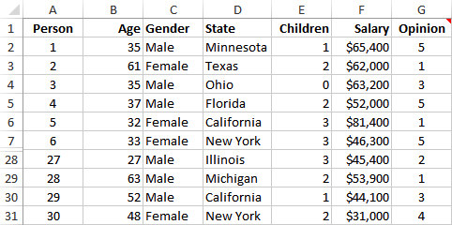
Example 2.1: Questionnaire Data.xlsx
Objective: To illustrate variables and observations in a typical data set.
Solution: Data set includes observations on 30 people who responded to a questionnaire on the president’s environmental policies.
Variables include: age, gender, state, children, salary, opinion.
Include a row that lists variable names.
Include a column that shows an index of the observation.

Slide 9
Data Discovery
Data Types
Numerical and Categorical data
Do you want to do arithmetic on the data?
Can you average days of the week or gender?
What about a variable that has 1, 2, 3, 4, or 5 as its value?
Ordinal: a natural ordering to categories.
Nominal: no natural order to categories.
All categorical variables can be encoded with numbers but not all are, it is personal choice.
Dummy variable
Notes:
It makes sense to do arithmetic on numerical data not on categorical data.
For example: Age, Salary and number of children are all numeric data.
You can easily average age or salary or sum them.
Gender and state are clearly categorical, they are text not numbers.
What about opinion of 1, 2, 3, 4, or 5. can you average that? No it’s not appropriate to average them. But it does have an order to the meaning of the values whereas for gender there is no order.
Both ordinal and nominal are categorical data.
A good tip is that Excel automatically right aligns numbers and left aligns text. You should change all of the categorical numeric data so they are centre aligned.
It is also useful to add comments to columns to remind you of what categorical numbers equate to, so for example 1=strongly agree etc.
Dummy variable is when you code a categorical variable, for example gender changes to 1 and 0, it can help to simplify analysis.

Slide 10
Data Discovery
Data Types
Sometimes a number variable is coded using a category.
binning (discretising)
Notes:
For example Age could be categorised as Young (<=34), middle-aged (35-59), and elderly (60+)
This is known as binning, which is putting the data into discrete bins, each category is called a bin.

Slide 11
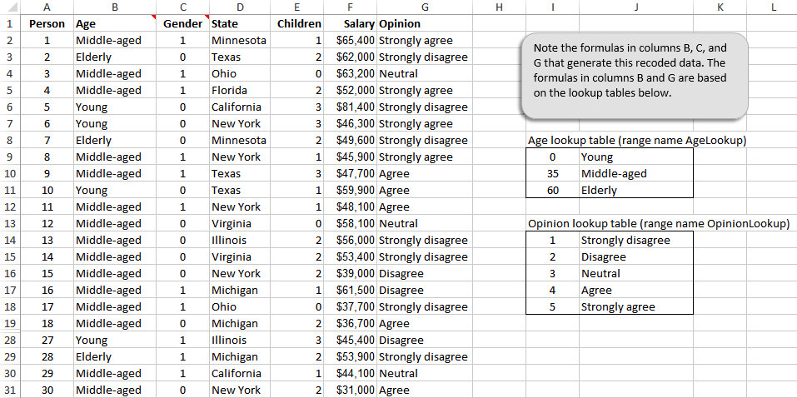
Environmental Data Using a Different Coding (slide 3 of 5)
Notes:
Vlookups are used here. You can take a look at these functions to see how it works, it is a very important function and very useful one in excel. Table array stores values to be evaluated against, either using TRUE for approximate, or FALSE for exact match.

Slide 12
Types of Data
A numerical variable is discrete if it results from a count, such as the number of children.
A continuous variable is the result of an essentially continuous measurement, such as weight or height.
Data Set:
Cross-sectional data are data on a cross section of a population at a distinct point in time.
Time series data are data collected over time.
Notes:
Discrete is suitable for counts
Continuous suitable for salary, weight, height, production, sales etc
The distinction is important as it will determine the analysis conducted on the data.
A data set can be cross sectional or time series.
Polls are cross sectional
Time series tracks one or more variables over time, daily closing values of dow jones.
Different types of anlaysis are appropriate on cross sectional to time series. In a time series set of data, there is usually one column that indicates the time period.

Slide 13
How to describe categorical variables?
There are only a few possibilities for describing a categorical variable, all based on counting:
Count the number of categories.
Give the categories names.
Count the number of observations in each category (referred to as the count of categories).
Once you have the counts, you can display them graphically, usually in a column chart or a pie chart.
Notes:
Not appropriate to conduct arithmetic on the values there are only a few possibilities for describing the variable and these are based on counting.
Many categorical variables such as gender have only two categores. Others such as region can have more. As you count the categories you can also give them names.
These counts can be reported as “raw counts” or transformed into percentages of totals.
You can report from 1000 observations there are 560 males and 440 females, or 56% males 44% female and then display them graphically. Eg column chart.

Slide 14
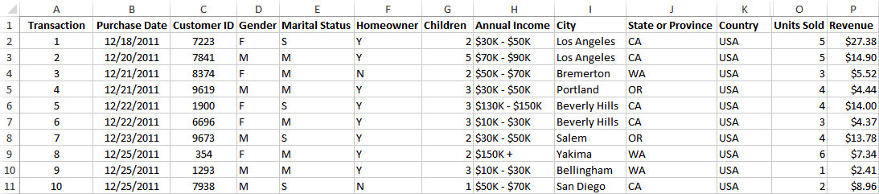
Example 2.2: Supermarket Transactions.xlsx
Objective: To summarize categorical variables in a large data set.
Solution: Data set contains transactions made by supermarket customers over a two-year period.
Children, Units Sold, and Revenue are numerical.
Purchase Date is a date variable.
Transaction and Customer ID are used only to identify.
All of the other variables are categorical.
Notes:
14000 transactions made by supermarket customers over two years.

Slide 15
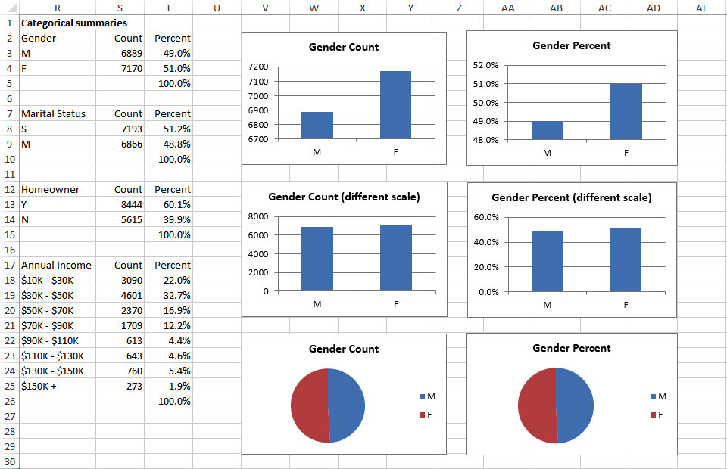
Example 2.2: Supermarket Transactions.xlsx
To get the counts in column S, use Excel’s COUNTIF function.
To get the percentages in column T, divide each count by the total number of observations.
When creating charts, be careful to use appropriate scales.
Notes:
You could manually count the instances of each category but that is time consuming and error prone.
=countif($D$2:$D$1400,R3)
You should sum the percentages to always ensure they are correct.

Slide 16
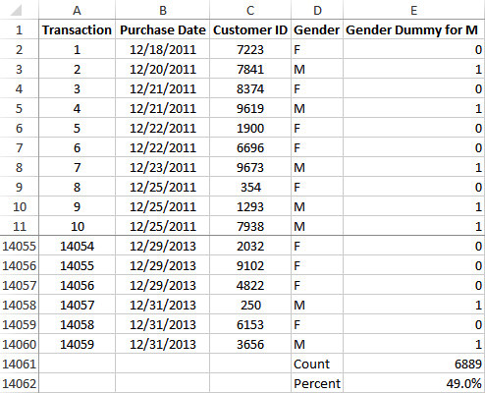
Example 2.2: Supermarket Transactions.xlsx
Another efficient way to find counts for a categorical variable is to use dummy (0–1) variables.
Recode each variable so that one category is replaced by 1 and all others by 0.
This can be done using a simple IF formula.
Find the count of that category by summing the 0s and 1s.
Find the percentage of that category by averaging the 0s and 1s.
Notes:
Dummy category is very useful to find count and percentage.
Create a column for males 0 if it’s not 1 if it is.
Count gives count of all 1’s and Average gives average of 1’s so if you had three entries, a zero and two 1’s = 2 divided by 3 to get average 1’s.
Understand this method and the arithmetic behind it, as this is why is it used so much for data analysis.

Slide 17
Descriptive Measures for Numerical Variables
There are many ways to summarize numerical variables, both with numerical summary measures and with charts.
To learn how the values of a variable are distributed, ask:
What are the most “typical” values?
How spread out are the values?
What are the “extreme” values on either end?
Is the chart of the values symmetric about some middle value, or is it skewed in some direction? Does it have any other peculiar features besides possible skewness?
Notes:
Excel has a number of built in tools for summarising numerical variables. The addin tools available for Excel provide even better tools. StatTools is one of these.

Slide 18
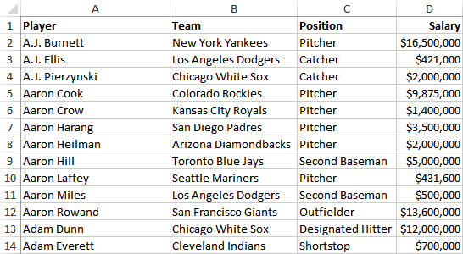
Example 2.3: Baseball Salaries 2011.xlsx
Objective: To learn how salaries are distributed across all 2011 MLB players.
Solution: Data set contains data on 843 Major League Baseball players in the 2011 season.
Variables are player’s name, team, position, and salary.
Create summary measures of baseball salaries using Excel functions.
Notes:
Throughout this section we focus on a salary variable, we examine the 2011 salaries for major league baseball players.

Slide 19
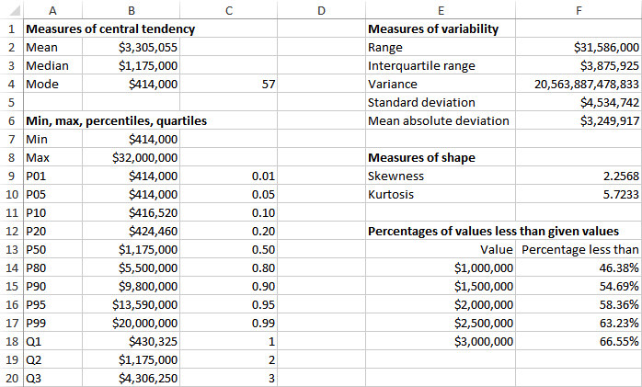
Example 2.3: Baseball Salaries 2011.xlsx

Slide 20
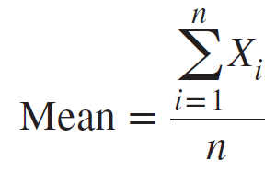
Measures of Central Tendency
The mean is the average of all values.
If the data set represents a sample from some larger population, this measure is called the sample mean and is denoted by X.
If the data set represents the entire population, it is called the population mean and is denoted by μ.
In Excel, the mean can be calculated with the AVERAGE function.
Notes:
Three most commonly methods of central tendency all try to answer the question of what is most typical in the data set? Mean, Median, Mode.
In the formula n is the number of observations, Xi is the value of observation i. Add all observations and divde by n.
The average salary is 3,305,055! Is this a typical salary?

Slide 21
Measures of Central Tendency (slide 2 of 3)
The median is the middle observation when the data are sorted from smallest to largest.
If the number of observations is odd, the median is literally the middle observation.
If the number of observations is even, the median is usually defined as the average of the two middle observations.
In Excel, the median can be calculated with the MEDIAN function.
Notes:
The median salary is 1175,000 in others words half the players make less than this and half make more.
Why is the median in the example so much smaller than the mean? Which is more appropriate?
The mean is strongly influenced by those few players that have very high salaries. The median is unaffected by those high salaries.
In this case the median is a more representative measure however both the mean and mode are usually quoted. For those data sets that are not skewed in either direction the mean and the median are usually very close to one another.

Slide 22
Measures of Central Tendency (slide 3 of 3)
The mode is the value that appears most often.
In most cases where a variable is essentially continuous, the mode is not very interesting because it is often the result of a few lucky ties.
However, it is not always a result of luck and may reveal interesting information.
In Excel, the mode can be calculated with the MODE.SNGL function.

Slide 23
Minimum, Maximum, Percentiles, and Quartiles
For any percentage p, the pth percentile is the value such that a percentage p of all values are less than it.
The quartiles divide the data into four groups, each with (approximately) a quarter of all observations.
The first, second and third quartiles are the percentiles corresponding to p = 25%, p = 50%, and p = 75%.
By definition, the second quartile (p = 50%) is equal to the median.
The minimum and maximum values can be calculated with Excel’s MIN and MAX functions, and the percentiles and quartiles with Excel’s PERCENTILE and QUARTILE functions.
Notes:
You probably have come across percentiles before, standardised tests in schools now from 1st class on show where a child is in terms of the norms, so if you result is in the 95% percentile then you scored higher than 95% of those taking the test. Same with weights and heights for childrens development.
Percentile function takes two arguments, the range of data and a value of p between 0 and 1, if you want the 95th percentile then enter 0.95
Quartile function also takes two arguments, the range of data and a value of 1,2, or 3 depending on the quartile you want.

