Slide 1
Data Analytics
Dr. Brenda Mullally

Slide 2
Outliers
An outlier is a value or an entire observation (row) that lies well outside of the norm.
Some statisticians define an outlier as any value more than three standard deviations from the mean, but this is only a rule of thumb.
Even if values are not unusual by themselves, there still might be unusual combinations of values.
When dealing with outliers, it is best to run the analyses two ways: with the outliers and without them.
Notes:
Most books and examples use cleaned data, the data you will encounter in business will not be clean. Outliers and missing data will be problems you encounter.
Alex Rodriguez’s salary of 32 million is an outlier.
Outliers are extreme values, you can decide for a given data set how extreme a value needs to be to qualify as an outlier.
Sometimes an outlier is easy to detect and deal with, sometimes they are identified as errors. You can go an check the observation. Sometimes combinations of values are noticed, like someone aged 10 with a height of72 inches.
It is not appropriate to remove outliers just to produce nicer results, there has to be a legitimate reason for removing outliers, e.g. if you want to analyse typical manager salaries then it makes sense to remove CEO salary.

Slide 3
Missing Values
Most real data sets have gaps in the data.
There are two issues: how to detect these missing values and what to do about them.
The more important issue is what to do about them:
One option is to simply ignore them. Then you will have to be aware of how the software deals with missing values.
Another option is to fill in missing values with the average of nonmissing values, but this isn’t usually a very good option.
A third option is to examine the nonmissing values in the row of a missing value; these values might provide clues on what the missing value should be.
Notes:
There are no missing values in the baseball salaries data, all 843 observations have values for each of the four variables. For real data sets this is probably the exception rather than the rule.
They could be missing because a person didn’t want to provide the info or that it didn’t exist for that observation, or because some values are not known. Missing values are obvious in excel by finding blank cells. Some are coded such as 9999 or -9999 or – or * if you know the code you can do a search and replace with blanks.
What happens if you do an average on a column with missing values? It divides my the number of nonmissing values

Slide 4
Excel Tables for Filtering, Sorting, and Summarizing
Tables are a tool introduced in Excel 2007.
You now have the ability to designate a rectangular data set as a table and then employ a number of powerful tools for analyzing tables.
These tools include:
Filtering
Sorting
Summarizing

Slide 5
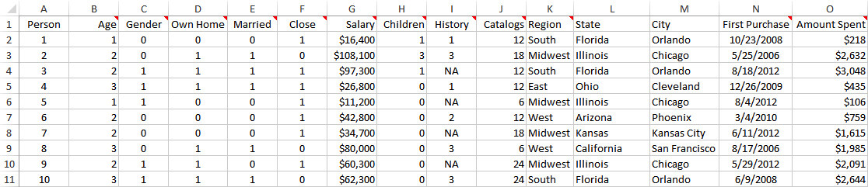
Example 2.7:Catalog Marketing.xlsx
Objective: To illustrate Excel tables for analyzing the HyTex data.
Solution: Data set contains data on 1000 customers of HyTex, a fictional direct marketing company.
Designate the data set as a table by selecting any cell in the data set and clicking the Table button on the Insert ribbon.
Use the dropdown arrows next to the variable names to filter in many different ways.
Notes:
Apply these tools to the new file type .xlsx

Slide 6
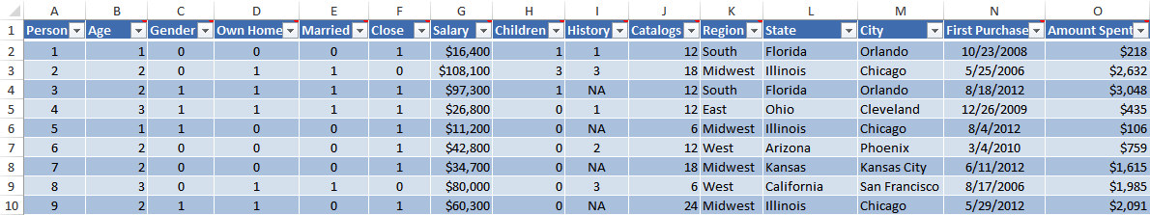
Catalog Marketing.xlsx
Notes:
The data set is now designated as a table, it is formatted, and a dropdown arrow appears next to each variable name, a new table tools design ribbon is now available. It is called Table1 by default (on ribbon), you can change it to a more descriptive name. variable names remain visible even when you scroll down, this is only when the active cell is within the table.

Slide 7
Filtering
Finding records that match particular criteria is called filtering.
One way to filter is to create an Excel table, which automatically provides dropdown arrows next to the field names that allow you to filter.
There are also three ways to filter on any rectangular data set with variable names:
Use the Filter button from the Sort & Filter dropdown list on the Home ribbon.
Use the Filter button from the Sort & Filter group on the Data ribbon.
Right-click any cell in the data set and select Filter. You get several options, the most popular of which is Filter by Selected Cell’s Value.
Notes:
The two main advantages of filtering on a table as opposed to the three options here are the nice formatting (banded rows etc) provided by tables and more importantly the total row. If this total row is showing it totals only those visible records not the hidden ones.

Slide 8
Catalog Marketing.xlsx
Objective: To investigate the types of filters that can be applied to the HyTex data.
Solution: There is almost no limit to the filters you can apply, but here are a few possibilities:
Filter on one or more values in a field.
Filter on more than one field.
Filter on a continuous numerical field.
Top 10 and Above/Below Average filters.
Filter on a text field.
Filter on a date field.
Filter on color or icon.
Use a custom filter.
Notes:
On continuous fields the dropdown arrow gives you toption like all salaries greater than 75,000 choose from number filters, other number filters include top10, above average, below average etc. The top 10 filter can be used to select the top n items.
For text values you can enter choice like begins with, ends with, contains and others.
Dates show as year with a plus sign you can drill down to months, days etc. in the date filters option you can access yesterday, next week, last month etc.
Coloured cells are often used for size of number value.
If nothing else works you can use a custom filter.
When you click the down arrow you always have sorting options also

Slide 9
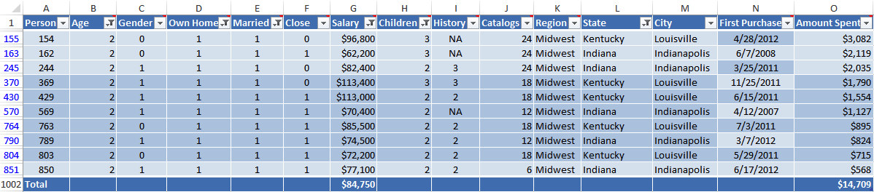
Example 2.7 Catalog Marketing.xlsx
Results from a Typical Filter

Slide 10
Relationships among variables
The primary interest in data analysis is usually in relationships between variables.
The most useful numerical summary measure is correlation.
The most useful graph is a scatterplot.
To break down a numerical variable by a categorical variable, it is useful to create side-by-side box plots.
Excel’s® pivot table breaks down one variable by others so that all sorts of relationships can be uncovered very quickly.
Notes:
Scatterplot and correlation are carried out on numerical data.

Slide 11
Relationships Among Categorical Variables
The most meaningful way to examine relationships between two categorical variables is with counts and corresponding charts of the counts.
You can find counts of the categories of either variable separately, as well as counts of the joint categories of the two variables.
Corresponding percentages of totals and charts help tell the story.
It is customary to display all such counts in a table called a crosstabs (for crosstabulations). This is also sometimes called a contingency table.
Notes:
Smoking and drinking, non smoker, occasional smoker, heavy smoker, same for drinking.

Slide 12
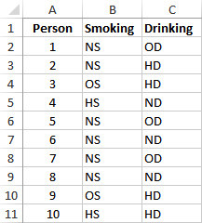
Smoking Drinking.xlsx
Objective: To use a crosstabs to explore the relationship between smoking and drinking.
Solution: Data set lists the smoking and drinking habits of 8761 adults.
Categories have been coded “N,” “O,” “H,” “S,” and “D” for “Non,” “Occasional,” “Heavy,” “Smoker,” and “Drinker.”

Slide 13
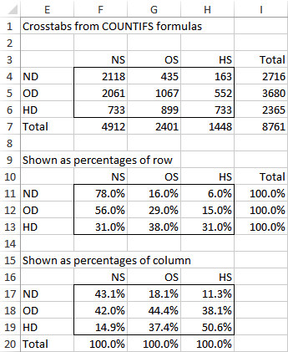
Example 3.1: Smoking Drinking.xlsx (slide 2 of 2)
To create the crosstabs, enter the category headings in Excel and use the COUNTIFS function to fill the table with counts of joint categories.
Next, sum across rows and down columns to get totals.
Then express the counts as percentages of row and percentages of column.
Notes:
=countifs($b$2:$B$8762,F$3,$C$2:$C$8762,$E4)
The countif only lets you specify on a single criteria, now there are two criteria.
So the above formula in entered in F4 and the copied across from F4 to H6
The first two arguments are for the condition on smoking the last two on drinking you then also get the totals across categories.
There are big differences between the totals (many more non smokers that heavy smokers) any relationship is difficult to detect. It is useful to express these raw counts as percentages.
The second tables show a relationship clearly,
You can create column charts of the percentage crosstabs, highlight E10:H13 and insert a column chart

Slide 14
Relationships Among Categorical Variables and a Numerical Variable
The comparison problem is one of the most important problems in data analysis. It occurs whenever you want to compare a numerical measure across two or more subpopulations.
Examples:
The subpopulations are males and females, and the numerical measure is salary.
The subpopulations are different regions of the country, and the numerical measure is the cost of living.
The subpopulations are different days of the week, and the numerical measure is the number of customers going to a particular fast-food chain.
Notes:
The list could go on and on, exploratory methods are used to investigate if there are differences across the subpops on the numerical variable of interest. Generalisation of the relationships are then tested by confidence intervals and hypothesis testing (beyond scope of this module)

Slide 15
Stacked and Unstacked Formats
There are two possible data formats, stacked and unstacked.
The data are stacked if there are two “long” variables, such as Gender and Salary. The idea is that the male salaries are stacked in with the female salaries.
This is the format you will see in the vast majority of situations.
You will occasionally see data in unstacked format, when there are two “short” variables, such as Male Salary and Female Salary.
Most tools are capable of dealing with either format and can convert from stacked to unstacked or vice versa.

Slide 16
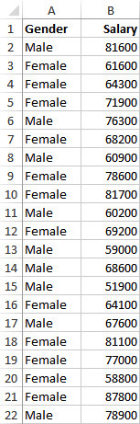
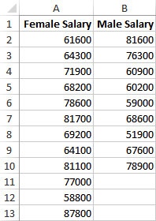
Stacked and Unstacked Data
Stacked Data Unstacked Data

Slide 17
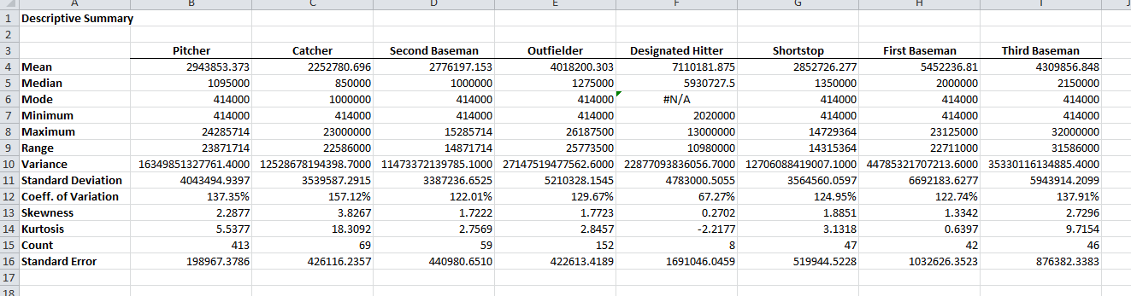
Baseball Salaries 2011 Extra.xlsx
Objective: To learn methods in PhStat tool for breaking down baseball salaries by various categorical variables.
Solution: Data set contains the same 2011 baseball data examined previously, as well as several extra categorical variables.
First unstack the position and salary columns using PhStat. Then create summary measures by selecting multi groups unstacked

Slide 18
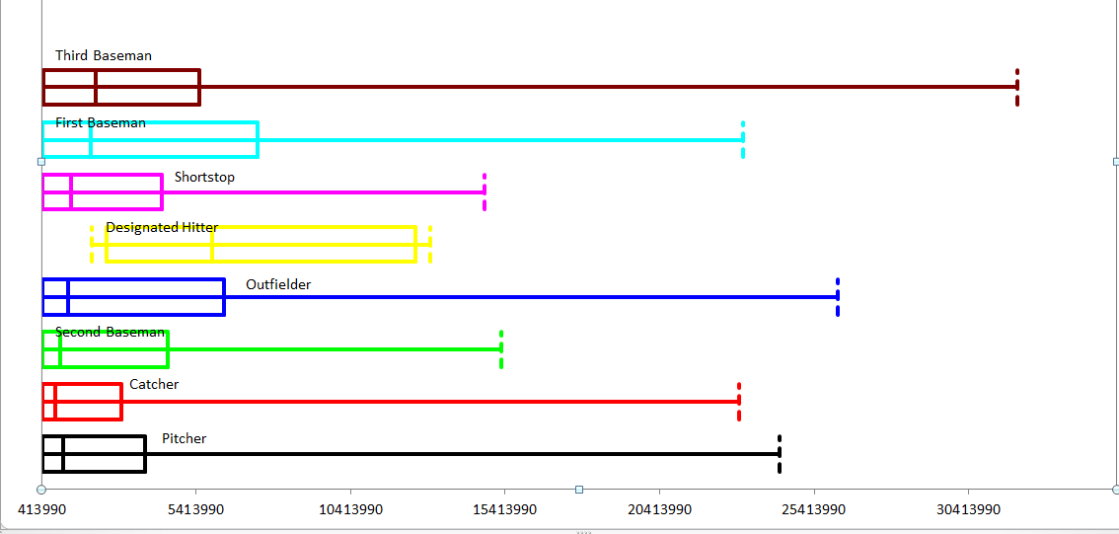
Baseball Salaries 2011 Extra.xlsx
Create side-by-side boxplots, by selecting boxplots from the phstat descriptive statistics option.
Select the data range, phstat will only show the first eight categories.

Slide 19
Baseball Salaries 2011 Extra.xlsx
You can carry out further analysis by unstacking the salary and playoff variables or the salary and Yankees variables. Then present the box plots comparing those variables.
The Yankee payroll is much larger than the payrolls for the rest of the teams.
Aside from many outliers, the playoff teams of 2011 tend to have slightly larger payrolls than the non playoff teams.

Slide 20
Relationships Among Numerical Variables
To study relationships among numerical variables, a new type of chart, called a scatterplot, and two new summary measures, correlation and covariance, are used.
These measures can be applied to any variables that are displayed numerically.
However, they are appropriate only for truly numerical variables, not for categorical variables that have been coded numerically.

Slide 21
Scatterplots
A scatterplot is a scatter of points, where each point denotes the values of an observation for two selected variables.
It is a graphical method for detecting relationships between two numerical variables.
The two variables are often labeled generically as X and Y, so a scatterplot is sometimes called an X-Y chart.
The purpose of a scatterplot is to make a relationship (or the lack of it) apparent.

Slide 22
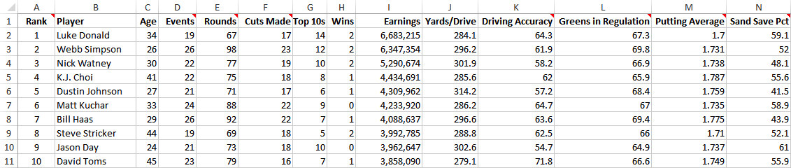
GolfStats.xlsx
Objective: To use scatterplots to search for relationships in the golf data.
Solution: Data set includes an observation (stats) for each of the top 200 earners on the PGA Tour.
Using PhStat you can create a scatterplot for two variables such as Age and Events

Slide 23
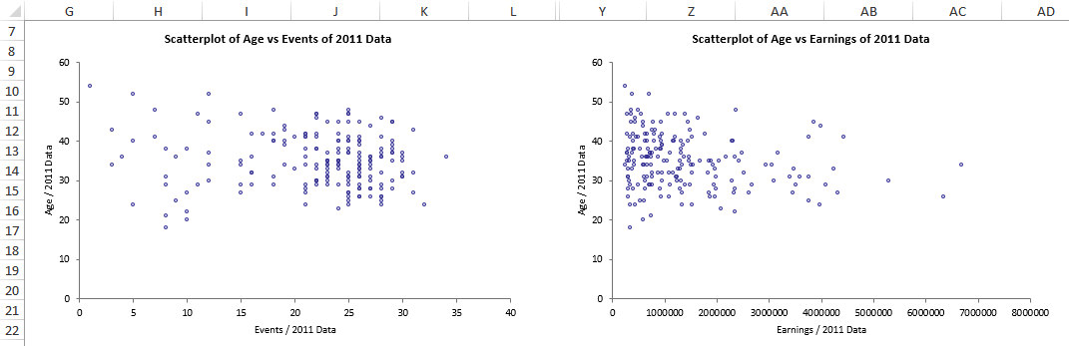
GolfStats.xlsx

Slide 24
Trend Lines in Scatterplots
Once you have a scatterplot, Excel enables you to superimpose one of several trend lines on the scatterplot.
A trend line is a line or curve that “fits” the scatter as well as possible.
This could be a straight line, or it could be one of several types of curves.
On the Layout tab for the scatterplot click on Trendline and choose the appropriate one.

Slide 25
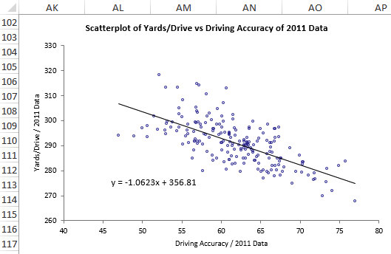
Scatterplot with Trend Line and Equation Superimposed

Slide 26
Correlation and Covariance (slide 1 of 4)
Correlation and covariance measure the strength and direction of a linear relationship between two numerical variables.
The relationship is “strong” if the points in a scatterplot cluster tightly around some straight line.
If this straight line rises from left to right, the relationship is positive and the measures will be positive numbers.
If it falls from left to right, the relationship is negative and the measures will be negative numbers.
The two numerical variables must be “paired” variables.
They must have the same number of observations, and the values for any observation should be naturally paired.

Slide 27

Correlation and Covariance (slide 2 of 4)
Covariance is essentially an average of products of deviations from means.
Excel has a built-in COVAR function, and PhStat also calculates covariances automatically.
Covariance has a serious limitation as a descriptive measure because it is very sensitive to the units in which X and Y are measured.

Slide 28

Correlation and Covariance (slide 3 of 4)
Correlation is a unitless quantity that is unaffected by the measurement scale.
The correlation is always between -1 and +1.
The closer it is to either of these two extremes, the closer the points in a scatterplot are to a straight line.
Excel has a built-in CORREL function and the built in Add-In data analysis can calculate correlation on multiple variables.

Slide 29
Correlation and Covariance (slide 4 of 4)
Three important points about scatterplots, correlations, and covariances:
A correlation is a single-number summary of a scatterplot. It never conveys as much information as the full scatterplot.
You are usually on the lookout for large correlations, those near -1 or +1.
Do not even try to interpret covariances numerically except possibly to check whether they are positive or negative. For interpretive purposes, concentrate on correlations.

