Slide 1
Data Analytics
Dr. Brenda Mullally

Slide 2
Information Presentation
Disseminate the discovered insights to make BI more valuable to concerned users.
Technologies that support decision making
Tactical decisions
Strategic decisions
Online analytical processing (OLAP)
Visual analytics
Business Performance Management
Performance dashboards

Slide 3
Online Analytical Processing
Transactional databases are accessed by online transaction processing (OLTP) applications
OLAP was coined by Edgar Codd [1970 ]
OLAP is used essentially to query the DW
OLAP supports the presentation of data in a multi-dimensional format called a cube
The numeric facts in the DW known as the measures

Slide 4
Analysis of Data in DW
Online analytical processing (OLAP)
Data driven activities performed by end users to query the online system and to conduct analyses
Data cubes, drill-down / rollup, slice & dice, …
OLAP Activities
Generating queries (query tools)
Requesting ad hoc reports
Conducting statistical and other analyses
Notes:
OLAP
User navigates to a particular subset of data – practical classes using business explorer

Slide 5
Analysis of Data Stored in DW OLTP vs. OLAP
OLTP (online transaction processing)
A system that is primarily responsible for capturing and storing data related to day-to-day business functions such as ERP, CRM, SCM, POS,
The main focus is on efficiency of routine tasks
OLAP (online analytic processing)
A system is designed to address the need of information extraction by providing effectively and efficiently ad hoc analysis of organizational data
The main focus is on effectiveness
Notes:
OLTP- transaction oriented, operational data, automating routine tasks, events/business process driven
OLAP – report/monitor, analyse outcome of business process, decision support,

Slide 6
OLAP Operations
Slice – a subset of a multidimensional array
Dice – a slice on more than two dimensions
Drill Down/Up – navigating among levels of data ranging from the most summarized (up) to the most detailed (down)
Roll Up – computing all of the data relationships for one or more dimensions
Pivot – used to change the dimensional orientation of a report or an ad hoc query-page display
Notes:
Cubes are used in OLAP to facilitate the viewing and analysis of multidimensional data. A cube overcomes the limitation of a relational db which is poor for accessing large amounts of data instantaneously. Relational db good for CRUD, reporting slow for multidimensional queries (multiple joins, normalised data) Why do you have multiple joins? Normalised data.
Slice specific product sales (1 dimension and fact)
Dice specific product in salesarea 1 (2 dimensions and fact)
Drill down sales area to county/district/zip code? –determined by dimensions available, in turn determined by granularity of facts
Roll up: for one dimension so total revenue/sales per year.
Pivot: perspective using a different dimension – done in practical, switch sales area with year

Slide 7
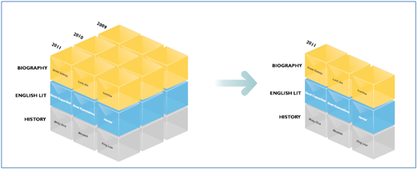
OLAP
Slice of one year

Slide 8
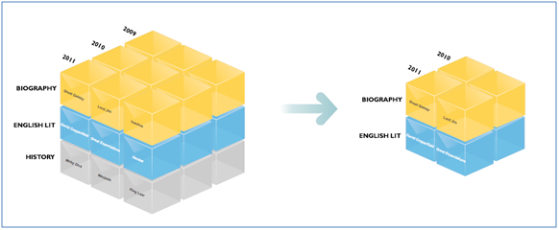
OLAP
Slice and dice, 2 dimensions

Slide 9
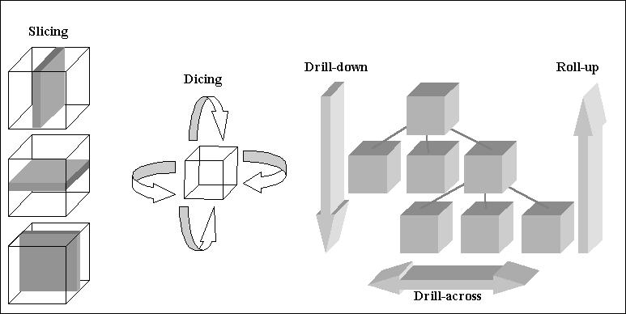
OLAP

Slide 10
Business Reporting Definitions and Concepts
Report = Information → Decision
Report?
Any communication artifact prepared to convey specific information
A report can fulfill many functions
To ensure proper departmental functioning
To provide information
To provide the results of an analysis
To persuade others to act
To create an organizational memory…

Slide 11
What is a Business Report?
A written document that contains information regarding business matters.
Purpose: to improve managerial decisions
Source: data from inside and outside the organization (via the use of ETL)
Format: text + tables + graphs/charts
Distribution: in-print, email, portal/intranet
Data acquisition → Information generation → Decision making → Process management

Slide 12
Business Reporting

Slide 13
Key to Any Successful Report
Clarity …
Brevity …
Completeness …
Correctness …
Report types (in terms of content and format)
Informal – a single letter or a memo
Formal – 10-100 pages; cover + summary + text
Short report – periodic, informative, investigative

Slide 14
Types of Business Reports
Metric Management Reports
Help manage business performance through metrics (SLAs for externals; KPIs for internals)
Can be used as part of Six Sigma and/or TQM
Dashboard-Type Reports
Graphical presentation of several performance indicators in a single page using dials/gauges
Balanced Scorecard-Type Reports
Include financial, customer, business process, and learning & growth indicators

Slide 15
Components of Business Reporting Systems
Common characteristics
OLTP (online transaction processing)
ERP, POS, SCM, RFID, Sensors, Web, …
Data supply (volume, variety, velocity, …)
ETL
Data storage
Business logic
Publication medium
Assurance

Slide 16
Data and Information Visualization
“The use of visual representations to explore, make sense of, and communicate data.”
Data visualization vs. Information visualization
Information = aggregation, summarization, and contextualization of data
Related to information graphics, scientific visualization, and statistical graphics
Often includes charts, graphs, illustrations, …

Slide 17
Visual Analytics
Visual analytics refers to the use of computer graphics to create a visual representation of large collections of information
Purpose of visualization is to enable knowledge discovery
Importance: visualization helps users see patterns

Slide 18
The Emergence of Data Visualization and Visual Analytics
Emergence of new companies
Tableau, Spotfire, QlikView, …
Increased focus by the big players
MicroStrategy improved Visual Insight
SAP launched Visual Intelligence
SAS launched Visual Analytics
Microsoft bolstered PowerPivot with Power View
IBM launched Cognos Insight
Oracle acquired Endeca

Slide 19
Visual Analytics
A recently coined term
Information visualization + predictive analytics
Information visualization
Descriptive, backward focused
“what happened” “what is happening”
Predictive analytics
Predictive, future focused
“what will happen” “why will it happen”
There is a strong move toward visual analytics

