Slide 1
Data Analytics
Dr. Brenda mullally

Slide 2
Business performance management
Performance measurement system
A system that assists managers in tracking the implementations of business strategy by comparing actual results against strategic goals and objectives
Comprises systematic methods of setting business goals together with periodic feedback reports that indicate progress (or lack thereof) against goals
Notes:
A performance measurement system focuses on results, rather than the whole process of how managers begin with strategic obj and planning.
All measurement is about comparisons ( count of repair service incidents, salespersons’s sales on a product in a month, top speed (performance), new product development cycle time, component costs +procurement costs+inventory costs).
Raw numbers are rarely of little value.
If you were told that a salesperson completed 50% of the deals he or she was working on within a month, that would have little meaning as you’ve no benchmark or standards.
Now suppose you were told that the same salesperson had a monthly close rate of 30% last year. Obv the trend is good. Until you were told that the average close rate for all salespeople at the company was 80%? Obv that salesperson needs to pick up the pace.
Key comparisons revolve around strategies, goals and objectives.

Slide 3
Performance Measurement KPIs and Operational Metrics
Key performance indicator (KPI)
A KPI represents a strategic objective and metric that measures performance against a goal
Distinguishing features of KPIs
Encodings
Time frames
Benchmarks
Strategy
Targets
Ranges
Notes:
Metric is a measurement. Two types: Run-of the mill metrics which are not strategically aligned and maybe operational metrics.
KPI is a strategically aligned metric (different because it is aligned to goals, it has achievement targets that were set out in goals, encoding is software with colour coded alerts in visual display, timeframes because the goals set out with milestones or interval for comparisons, benchmarks to compare against a standard or previous year figures) Operations metric , measures the efficiency and effectiveness of an operation. E.g. number of calls per hour, length of call etc. KPI measures the performance of an identified idicator associated to a strategic goal. Goal – customer satisfaction, KPI, resolution time
Operational managers need to see metrics tracking activities, upper mgmt need small number of KPI’s to track performance
Measure the time new product development time cycle – metric: NPD cycle time – time to develop new products and time to react to market
Other metrics could be: lost customers, % from new products,
KPI for Customers: customer complaints, customer turnover rate, customer retention rate
KPI for an employee: revenue per employee, employee satisfaction, salary competiveness ratio,
IT: IT project earned value, IT security breaches, system downtime, website non-availability
Operations: six sigma level, order fulfillment cycle, time to market, inventory shrinkage rate.
HR: compensation, training, recruitment, employee loyalty
Sales: sales rep, sales contact by phone, customer care
Marketing: public relations, promotion, advertisement
Production: mm, order management, quality, plant maintenance

Slide 4
Performance Measurement
Key performance indicator (KPI)
Outcome KPIs vs. Driver KPIs
(lagging indicators (leading indicators
e.g., revenues) e.g., sales leads)
Operational areas covered by driver KPIs
Customer performance
Service performance
Sales operations
Sales plan/forecast
Notes:
A distinction is sometimes made with KPIs – ones that are outcomes and ones’ that are drivers.
Outcome known as lagging indicators measure the outcomes of past activity (e.g. revenues) They are often financial in nature but not always
Driver KPIs sometimes known as leading indicators or value drivers - measure activities that have a significant impact on outcome KPIs (sales leads) Also known as operational KPIs
Operational areas covered by operational KPIs:
Most org collect a wide range of operational metrics. These metrics deal with the operational activities and performance of a company. Customer – metrics for customer satisfaction, speed and accuracy of issue resolved, customer retention
Service – metrics for service-call resolution rates, service renewal rates, service level agreements (SLA), delivery performance, and return rates.
Sales operations – new pipeline accounts, sales meetings secured, conversion of inquiries to leads, and average call closure time
Sales plan/forecast – forecast-to-plan ratio and total closed contracts. metrics for price-to-purchase accuracy, purchase order to fulfillment ratio, quantity earned

Slide 5
Performance Measurement
Problems with existing performance measurement systems
The most popular system in use is some variant of the balanced scorecard (BSC)
50-90% of all companies implemented BSC
BSC methodology is a holistic vision of a measurement system tied to the strategic direction of the organization and based on a four-perspective view of the world:
Financial measures supported by customer, internal process, and learning and growth metrics
Notes:
It would be hard to find a company that hasn’t got a performance measurement system. This is a system that focuses on results and allows the users to analyze those results through charts, grids, trends, and by drilling-down to even greater depths of detail. However what they don’t reveal is the process that individual managers went through in setting the initial targets; the actions that were going to be required; the anticipated state of the business environment for which those actions were conceived etc. Without this knowledge, measures are misleading.
(to overcome the problem of focus on financial – the switch is now balanced taking into account measures from other areas:))

Slide 6
Performance Measurement
The drawbacks of using financial data as the core of a performance measurement:
Financial measures are usually reported by organizational structures and not by the processes that produced them
Financial measures are lagging indicators, telling us what happened, not why it happened or what is likely to happen in the future
Financial measures are often the product of allocations that are not related to the underlying processes that generated them
Financial measures are focused on the short term returns
“Financial myopia”
Notes:
Financial myopia (short sighteness, lack of long-range perspective in thinking or planning) is not the only problem plaguing many of the performance measurement systems in operation today.
Also the measurement overload and measurement obliquity are also major problems confronting the current crop of systems.
It is not uncommon to find companies proudly announcing that they are tracking 200 or more measures at the corporate level. It’s hard to imagine trying to drive a car with 200 dials on the dashboard. Companies rarely retire the measures they collect, when new ones come along they are simply added to the list. Little effort is made to determine whether the list of measures being tracked is still applicable to the current situation.

Slide 7
Performance Measurement
Good performance measures should:
Be focused on key factors.
Be a mix of past, present, and future.
Balance the needs of all stakeholders (shareholders, employees, partners, suppliers, etc.).
Start at the top and trickle down to the bottom.
Have targets that are based on research and reality rather than be arbitrary.
Notes:
(page 120)
Focused on key activities aligned with the strategic goals
All these characteristics are important to consider, however the real key is to have a good strategy.
Measures need to be derived from the corporate and business unit strategies and from an analysis of the key business processes required to achieve those strategies.

Slide 8
Performance Dashboards
Performance dashboards are designed to be similar to a car dashboard
Performance dashboards serve as an “organization magnifying glass”
Measure performance, reward positive contributions and align efforts
Used for forecasting, inventory, production and sales
Organizational performance- “Three Threes”

Slide 9
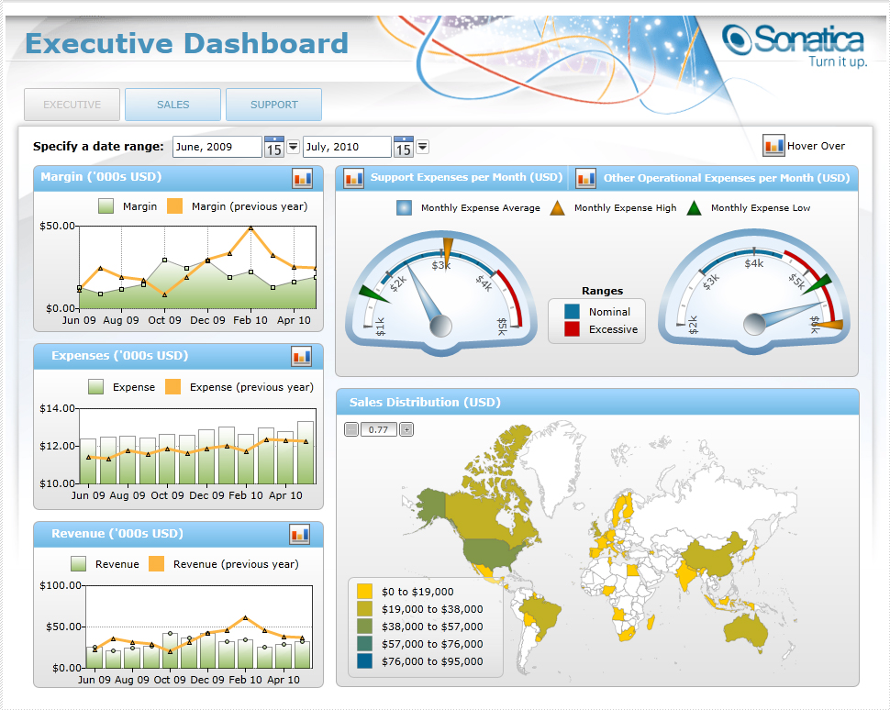
Performance Dashboards

Slide 10
Performance Dashboards
Dashboard design
The fundamental challenge of dashboard design is to display all the required information on a single screen, clearly and without distraction, in a manner that can be assimilated quickly
Three layer of information
Monitoring
Analysis
Management

Slide 11
Performance Dashboards
Three types of performance dashboards:
Operational dashboards
Tactical dashboards
Strategic dashboards
Notes:
There are three common types of dashboards - where the differences between them concern the area of use
operational dashboards are being used mostly on operational level . For example, operational dashboards might be used to monitor production quality.The most meaningful advantage of operational dashboards is a possibility to investigate the same data from diverse perspectives. In case of sales department, we might therefore check the actual sales, then compare it with the one from before a month, and – finally – state whether the goal was achieved. That's not the end yet. We might group sales data by person or prepare a list of best customers, as well. services department, whole thing goes around customers' complaints. And this is what operational dashboards help with. employees and managers might check the number of support calls or complaints per month. These are stats, but important while trying to improve services' efficiency and – therefore – company's appearance.
Tactical dashboards seem to be the best for measuring a progression of most important projects. used for tracing the trends in relation to company's goals and initiatives. managers get a possibility to control how market reacts on company's actions. Managers and staff use tactical dashboards to monitor tactical initiatives, e.g. tactical dashboards might be used to monitor a marketing campaign or sales performance. tactical dashboards we might see not only the totals (which is common with strategic dashboards), but also information about a given product's sale. We might check the value of company shoes sale in Paris on January. services department tactical dashboards provide broadened training abilities what's important whilst implementing a new helpdesk software
strategic dashboards are being commonly used whilst aligning company's strategic goals. strategic dashboards are often connected directly with the balanced scorecard methodology. Dashboards used by a sales department are mainly focused on sales results and their trends and changes. Service: strategic dashboards it is possible to measure the number of complaints. HR - Employees retention rate is one of the examples.

Slide 12
Performance Dashboards
What to look for in a dashboard
Use of visual components (e.g., charts, performance bars, sparklines, gauges, meters, stoplights) to highlight, at a glance, the data and exceptions that require action
Transparent to the user, meaning that it requires minimal training and is extremely easy to use
Combines data from a variety of systems into a single, summarized, unified view of the business
Enables drill-down or drill-through to underlying data sources or reports
Presents a dynamic, real-world view with timely data updates
Requires little, if any, customized coding to implement, deploy, and maintain

Slide 13
Balanced Scorecards
Monitor and show performance by focusing on certain outcome metrics and comparing them to a target
Monitor tactical and strategic goals
Balanced Scorecard
Focuses on four organizational perspectives:
Financial
Customer
Internal business process
Learning and growth
Notes:
(1) How do we look to our shareholders (financial perspective)?
(2) What must we excel at (internal business perspective)?
(3) How do our customers see us (the customer perspective)?
(4) How can we continue to improve and create value (innovation and learning perspective)?

Slide 14
Balanced Scorecards
Approach for organizational assessment developed by Kaplan and Norton
Firm’s competitiveness
Quantify the intangible assets of an organization
Measure past performance
Internal processes and intangible assets
Measures value creation for the organization
Notes:
Provides comprehensive view of firms competitiveness that goes beyond the traditional financial measurements.
Original purpose was to quanity assets.
Financial and customer metrics are lagging indicators in that they measure past performance.
Leading indticators (drivers) include internal processes and intangible assets.
Internal – efficiencies and effectiveness of their business processes.
Intangible – people technology and org climate combine to support strategy.
Measures value creation eg learning, growth measures

Slide 15
Balanced Scorecards
Organizations can use the balanced scorecard as a means to link their long-term strategic objectives with their short term actions through four management processes.
Translating the vision
Communicating and linking
Business planning
Feedback and learning
Notes:
Bsc help leaders to build consensus around a firms vision and strategy
Bsc lets leaders communicate strategy to all levels or org
Bsc enables coordination of intiatives using common set of strategic obj’s
Bsc allows org identify where it may fall short

Slide 16
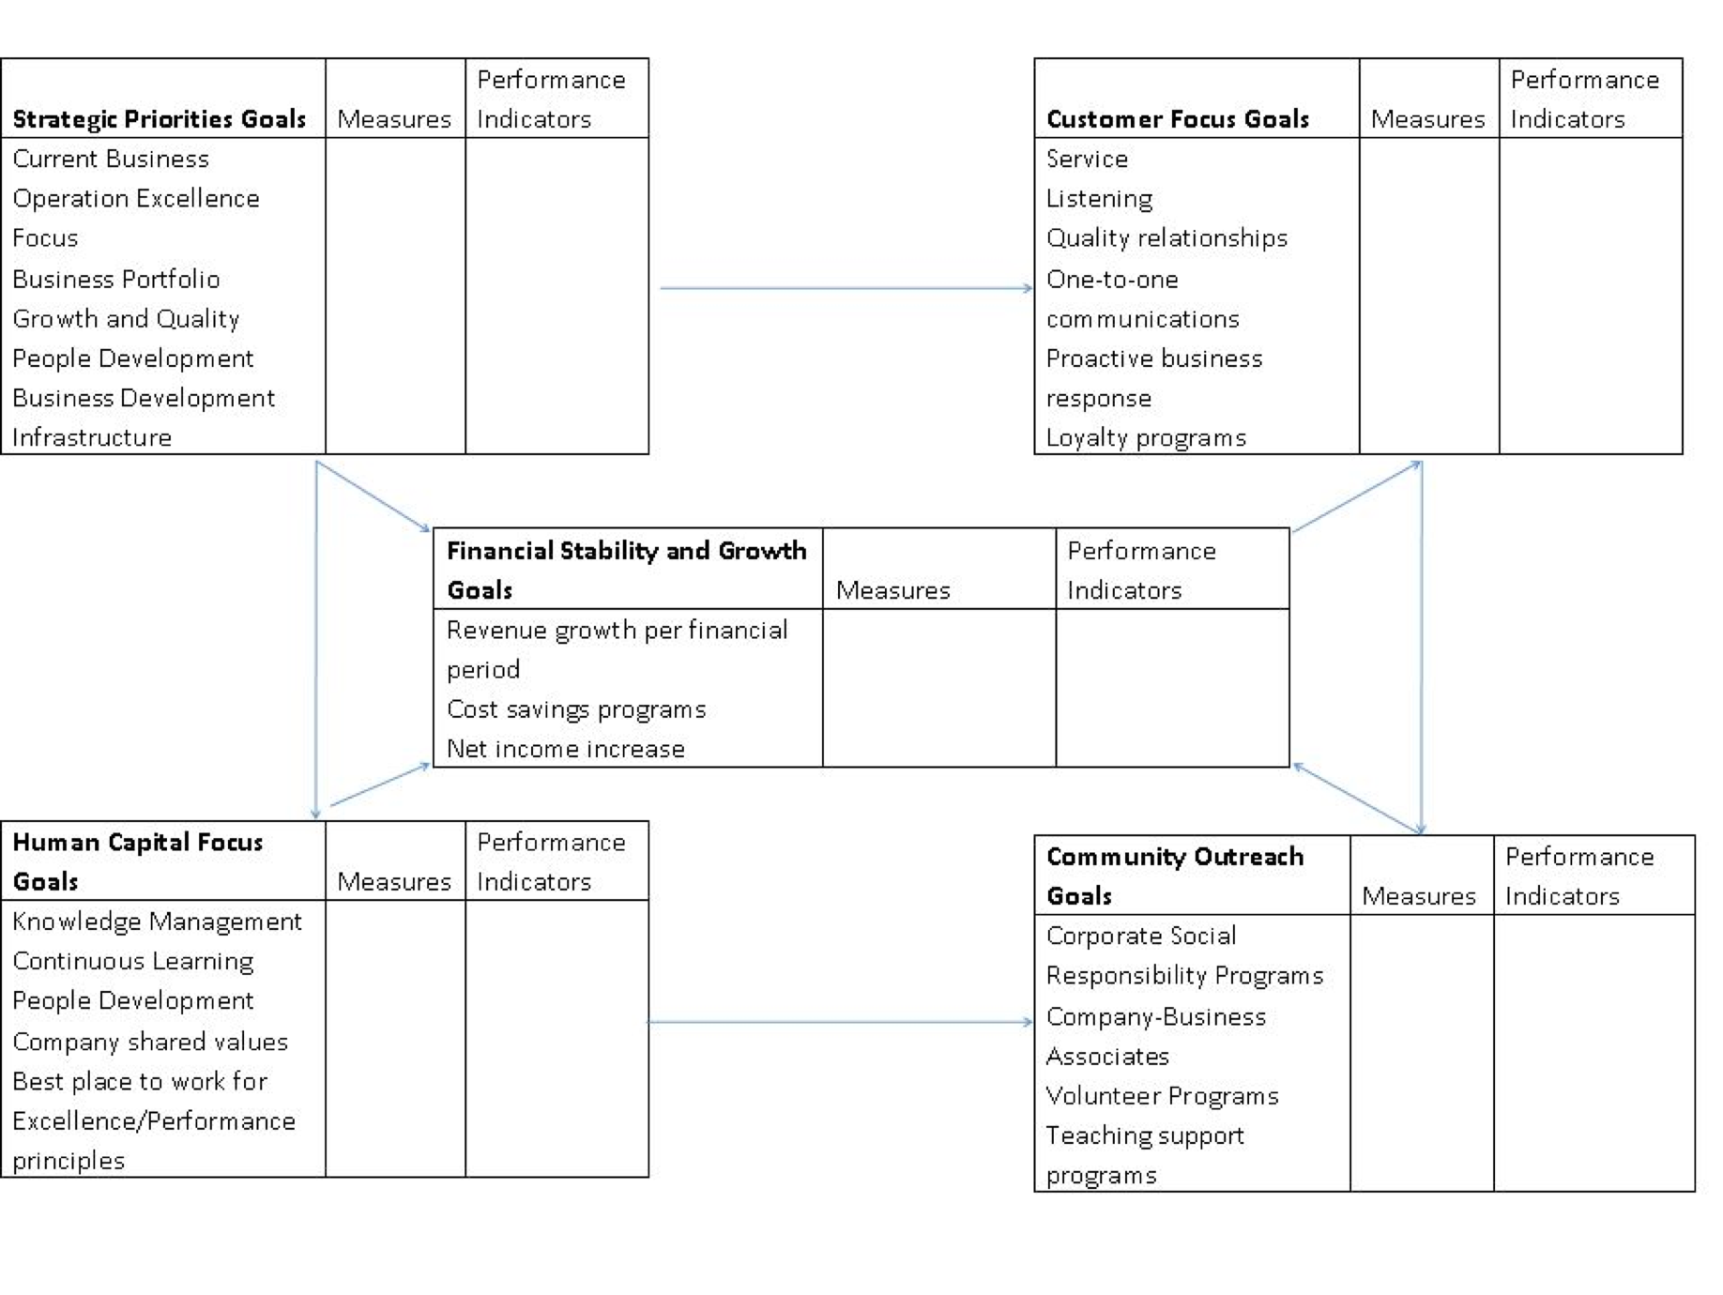
Balanced Scorecards
Notes:
BSc indicators grouped according to the four perspectives, financial, customer, business process and learning/growth.

Slide 17
Vision Statement
Our vision is to be internationally-recognized for providing a high-quality, technology-enabled educational experience rooted in our Miami location and focused on the unique requirements of doing business in a global and interconnected market.
Core Values
Excellence: We pursue excellence in all we do and nurture this pursuit in others.
Ethics: We are committed to doing the right thing in both our words and deeds.
Professionalism: We hold ourselves to the highest standards of expertise and of professional conduct.
Innovation: We embrace change, uncommon thinking, creativity, and the entrepreneurial spirit.
Collegiality: In working together, we respect each other and welcome diverse viewpoints.
Mission Statement
Our mission is to create enduring educational value for our students, for our alumni, and for the business, professional, and academic communities we serve:
•For our students-whom we prepare to succeed in a rapidly changing, technology-driven global business environment;
•For our alumni-to whom we provide opportunities for continuing professional development and a legacy that appreciates as our excellence grows;
•For the business and professional communities-to whom we offer knowledgeable graduates, educational programs, research, and collaborative projects;
•For the academic community-to whom we bring new knowledge by creating an environment that nurtures high-quality research and the development of future scholars.
Goals and Objectives
Strategic Priorities
1. Maintenance of Accreditation
2. Focus - Build excellence and international recognition through investments in programs and faculty in the areas of international business, entrepreneurship, and professional services – accounting, finance, real estate, and insurance.
3. Program Portfolio – Continually evaluate portfolios of programs to ensure excellence in teaching and learning and market need.
4. Growth and Quality - Increase quality of undergraduate students while maintaining current enrollment, grow graduate enrollment by 50% over next 5 years while increasing quality of admitted students.
5. Faculty – Recruit, develop and support an outstanding faculty.
6. Funding – Acquire needed funds to support the college’s mission.
7. Space – Complete construction of Phase II of the Business School Complex.
Strategic Initiatives 2008-2009
1.Maintenance of Accreditation: Implement review recommendations.
2.Undergraduate Programs: Continue implementation of Assurance of Learning System and enhanced undergraduate career services.
3.Graduate Programs: Complete scheduled program reviews and implement recommended changes.
4.Faculty: Recruit replacements for faculty members who resign or retire and recruit new incremental faculty members.
5.External Relations: Expand membership on our advisory boards and our community involvement.
6.External Visibility: Maintain rankings.
7.Internal Processes: Maintain technology for new School of Business Complex.
8.Revenue Generation: Secure private funding for faculty support, student support, and the building; grow executive and professional education program; and plan for new value-added programs.
Core Competencies and Definition of Metrics
(L)earning, Instruction, and Student Services - Provide educational programs and learning experiences that prepare individuals to make sustained contributions to organizations and society in a global environment and are recognized for excellence. Deliver outstanding student services.
(R)search and Scholarship - Identify and address important business and economic issues through discovery, application, and dissemination of knowledge.
(S)ervice and Outreach - Offer expertise to government agencies, business and professional organizations, and others, to promote economic development and to provide value-added educational and professional programs.
(E)xternal Relations and Development - Enhance opportunities for mutually beneficial collaboration between the College and its constituents and grow private investments in the College.
(P)eople - Attract, develop, and retain highly qualified faculty and staff.
(I)nternal Operations - Cultivate an efficient and effective operation that enables faculty and staff to achieve the mission of the College.
Key Metrics
Undergraduate Programs
L1. Assurance of Learning Outcomes
L2. Use and Manage Technology Outcome
L3. Quality of Students
L4. Student Recognitions
L5. Head Count - # of Graduates
L6. FTE enrollment - % of Enrollment Targets Met
L7. Placement – Satisfaction and Outcomes
L8. Satisfaction with Advising
L9. Quality of Instruction
L10. Expectations Met
L11. Rankings
Graduate Programs
L12. Assurance of Learning
L13. Quality of Students
L14. FTE enrollment - % Enrollment Target Met
L15. Placement – Satisfaction and Outcomes
L16. Expectations Met
L17. Rankings
_____________________________________________
R1. Publications in Premier Journals
R2. Citations in Social Service Index
R3. Editorial Board Membership
R4. Recognition and Awards
_____________________________________________
S1. Revenues from EPE Programs
S2. Participation on Boards
_____________________________________________
E1. Corporate Community Participating in Advisory
Boards
E2. Membership in Business Alumni Chapter
E3. New Private and Corporate Donations
________________________________________
P1. Adequacy and Quality of Faculty
P2. Professional Development Support of Faculty and Staff
_____________________________________________
I1. Technology Availability and Quality
I2. User Satisfaction and Use of Technology Resources
Notes:
BSC for College of Business Admin at Florida International Universtiy
Includes:
Vision and mission statements, key metrics used to assess past performance, measure value creation such as research, participation on boards, improvements measured on professional dev of staff.

Slide 18
Business Performance Management (BPM) Overview
Business Performance Management (BPM) is…
A real-time integrated system that alert managers to potential opportunities, impending problems, and threats, and then empowers them to react through models and collaboration.
Previously independent of everything else and known as Executive information system (EIS)
Also called, corporate performance management (CPM by Gartner Group), enterprise performance management (EPM by Oracle), strategic enterprise management (SEM by SAP)
Notes:
BPM refers to business processes, methodologies, metrics, and technologies used by enterprises to measure, monitor, and manage business performance.
BPM is an outgrowth of decision support systems (DSS), enterprise information systems (EIS) and BI. It has over 25 years in the making. As with decision support, it is more than technology.
It is an integrated set of processes, methodologies, metrics, and applications designed to drive the overall financial and operational performance of an enterprise.
It helps enterprises translate their strategies and objectives into plans, monitor performance against those plans, analyze variations between actual results and planned results and adjust their objectives and actions in response to this analysis.
This section examines the processes, methodologies, metrics, and systems underlying BPM. Because BPM is distinguished from DSS and BI by its focus on strategy

Slide 19
BPM Definition
“A framework for organising, automating and analysing business methodologies, metrics, processes and systems to drive the overall performance of the enterprise. It helps organisations translate a unified set of objectives into plans, monitor execution and deliver critical insight to improve financial and operational performance.”

Slide 20
Business Performance Management (BPM) Overview
BPM encompasses three key components
A set of integrated, closed-loop management and analytic processes, supported by technology
Tools for businesses to define strategic goals and then measure/manage performance against them
Methods and tools for monitoring key performance indicators (KPIs), linked to organizational strategy
http://www.ap-institute.com/
Notes:
It addresses financial as well as operational activities.
Measure against the goals.
KPI can be defined as providing the most important performance information that enables organizations or their stakeholders to understand whether the organization is on track or not.
KPI examples: customers: customer complaints, customer turnover rate, customer retention rate.
Customer Complaints are indicators of customer dissatisfaction with the goods or services a company provides
Customer Retention Rate is an indicator of customer loyalty (or the extent to which a company is able to keep acquired customers.Customer Retention Rate (CRR) = Number of customers at the beginning of a period / number of those customers that remained customers at the end of a period
http://www.ap-institute.com/

Slide 21
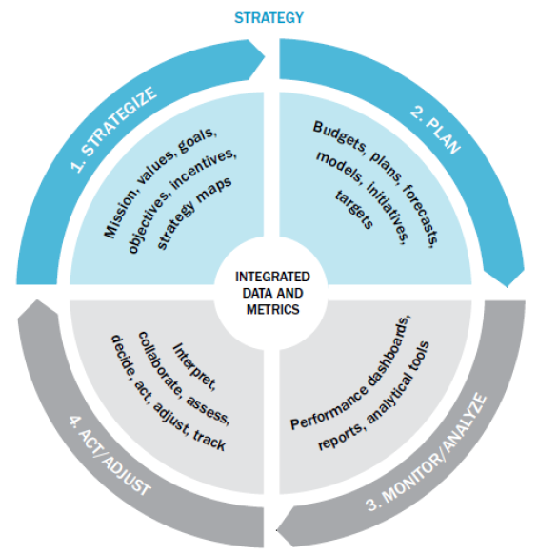
A Closed-loop Process to Optimize Business Performance
Process Steps
Strategize
Plan
Monitor/analyze
Act/adjust
Each with its own process steps…
Notes:
Page 106 -
The primary distinction is that BPM is strategy driven.
It includes a closed-loop set of processes that link strategy to execution in order to optimize business performance.
It is not a one-off project or dept focused. Instead if done correctly it impacts an organization from top to bottom.
Critical to its success is alignment in the organization (achieving performance targets, executing company strategy, and delivering value to stakeholders).
The loop implies that best performance is achieved by setting goals and objectives (strategize), establishing initiatives and plans to achieve those goals (plan), monitoring actual performance against the goals and objectives (monitor) and taking corrective action (act and adjust).
The next slides will look at these major processes in detail.

Slide 22
Strategize: Where Do We Want to Go?
Strategic objective
A broad statement or general course of action prescribing targeted directions for an organization
Strategic goal
A quantified objective with a designated time period
Strategic vision
A picture or mental image of what the organization should look like in the future
Critical success factors (CSF)
Key factors that delineate the things that an organization must excel at to be successful
Notes:
A strategic goal – example: an organization has an objective of improving return on assets (ROA) or increasing overall profitability, these objectives need to turned into quantified targets, e.g. increase of ROA from 10 to 15 % or an increase in profit margin from 5 to 7 % before the org can begin to detail the operation plans needed to achieve these targets.
Vision is a picture, showing the as-is state and the desired state.
CSF is to define what the org excels at, e.g, product based org its product quality and product innovation. Mallwart its distribution capabilities as their goal is low-cost provider.

Slide 23
Strategize: Where Do We Want to Go?
“90 percent of organizations fail to execute their strategies”
The strategy gap
Four sources for the gap between strategy and execution:
Communication (enterprise-wide)
Alignment of rewards and incentives
Focus (concentrating on the core elements)
Resources
Notes:
It’s one thing to create a long term strategy and another to execute it.
Over the past, a number of studies have highlighted that 90% of org fail to execute strategies. The reasons for this strategy gap have been varied.
In many org a very small % of employees understand the org strategy. So its hard on employees to make decisions in accordance with the strategic plan if they have never heard or seen the plan. On the other hand if it is communicated, often it lacks clarity so people are not quite sure are in line with plan or not.
Often rewards or incentives are linked to short term financial results, not to the strategic plan. Again the study found that 70% of org failed to link middle management incentives to their strategy
The study also found that managers spend less than 1 hour per month discussing strategy. Hours are spent on other pressing items such as budgets etc.
Unless SP are properly funded and resources are made avail, failure will occur. The study found that less than 40% of org tied their budgets to their strategic plans.

Slide 24
Plan: How Do We Get There?
Operational planning
Operational plan: plan that translates an organization’s strategic objectives and goals into a set of well-defined tactics and initiatives, resources requirements, and expected results for some future time period (usually a year).
Operational planning can be
Tactic-centric (operationally focused)
Budget-centric (financially focused)
Notes:
When operational managers know and understand the what (org obj and goals), they will be able to come up with the how (detailed operation and financial plans).
Operational and financial plans answer 2 Qs – What tactics and initiatives will be pursued to meet the performance targets established by the strategic plan?
What are the expected financial results of executing the tactics.
Strategy drives tactics, and tactic drive results
The key to successful operational planning is integration – the tactics and initiatives in an op plan need to be directly linked to key obj and targets in the strategic plan. If this is not linked, question it. BPM meth are designed to ensure that these linkages exist.
In tactic-centric planning the focus is on arriving at tactics that will meet the strategic goals. After those have been arrived at, the cost of implementing them is considered. If it exceeds the org’s willingness to spend, the plan can be revised.
In budget-centric the focus is on arriving at tactics that meet financial targets. After these have been arrived at, the results of using them are considered. If they do not meet the org strategic goals, the plan can be revised. Budget-centric is a plan where financial is sums to achieve the targeted financial values.

Slide 25
Monitor: How Are We Doing?
A comprehensive framework for monitoring performance should address two key issues:
What to monitor
Critical success factors – “What”
Strategic goals and targets
How to monitor – if a company plans to introduce a new product every qtr for next 2 years, the org needs to track new prod introduction over this time.
Notes:
A comprehensive framework for monitoring performance should address 2 key issues – what to monitor and how to monitor
Because it is impossible to monitor everything, an org needs to focus on monitoring specific issues.
E.g. if an instrument manufacturer has a specified strategic obj of increasing the overall profit margin of its current product lines by 5% annually over next 3 years, the org needs to monitor the profit margin throughout the year to see whether it is treading toward the targeted annual rate of 5%.

Slide 26
Monitor: How Are We Doing?
Pitfalls of variance analysis
The vast majority of the exception analysis focuses on negative variances when functional groups or departments fail to meet their targets
Rarely are positive variances reviewed for potential opportunities, and rarely does the analysis focus on assumptions underlying the variance patterns
Notes:
The other issue is taking the comparison standard as a given, not considering the possibility that changed circumstances or invalid assumption might make the standard wrong rather than the process being at fault.
When the deviation is larger than expected, this is typically viewed as an operational error that needs to be corrected. At this point, managers usually direct their employees to do whatever it takes to get the plan back on track. If revenues are below plan, they are chided to sell harder. If costs are above plan, they are told to stop spending.

Slide 27
Act and Adjust: What Do We Need to Do Differently?
Success (or mere survival) depends on new projects: creating new products, entering new markets, acquiring new customers (or businesses), or streamlining some process.
Most new projects and ventures fail!
Hollywood movies: 60% chance of failure
Mergers and acquisitions: 60%
IT projects (large-scale): 70%
New food products: 80%
New pharmaceutical products: 90% …
Notes:
Whether a company is interested in growing its business or simply improving its operations, virtually all strategies depend on new projects –
What is the chance of failure? Obviously it depends on the type of product!
Overall the rate of failure of most new projects or ventures runs between 60 and 80 %
A project can fail in a number of different ways, ranging from considering too few options or scenarios, failing to anticipate a competitor’s moves, ignoring changes in the economic or social environment, inaccurately forecasting demand, or underestimating the investment required to succeed, just to name a few!
This is why it is critical for org to continually monitor its results, analyze what has happened, determine why it has happened, and adjust its actions accordingly.

Slide 28
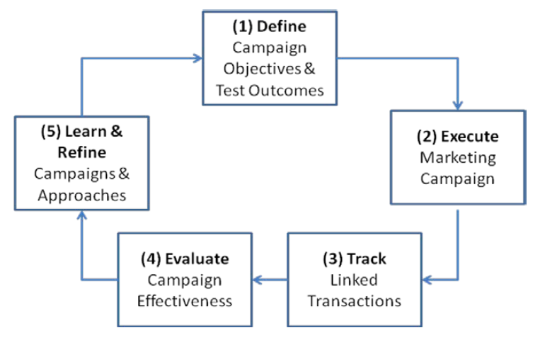
Act and Adjust: What Do We Need to Do Differently?
Harrah’s Closed-Loop Marketing Model
Notes:
Reconsider Harrah’s closed-loop marketing system. As the illustration indicates, the process has 5 basic steps.
The loop begins by defining quantifiable objectives of a marketing campaign or test procedure in the form of expected values or outcomes for customers who are in the experimental test group versus those in the control groups.
The campaign or test is executed. The campaign is designed to provide the right offer and message at the right time. The selection of particular customers and the treatments they receive are based on their prior experiences with Harrah’s.
Each customer’s response of the campaign is tracked. Not only are response rates measured, but other metrics are as well, such as revenues generated by the incentive and whether the incentive induced a positive change in behavior (increased freq of visit, profitability of the visit, or cross-play among the various casinos).
The effectiveness of a campaign is evaluated by determining the net value of the campaign and its profitability relative to other campaigns.
Harrah’s learns which incentives have the most effective influence on customer behavior or provide the best profitability improvement. The knowledge is used to continuously refine its marketing approaches.
Harrah’s has run literally thousands of tests, although all steps are critical. It’s how they continually analyze and adjust its strategy to produce optimal results that sets it apart from its competitors.

Slide 29
BPM Methodologies
An effective performance measurement system should help:
Align top-level strategic objectives and bottom-level initiatives.
Identify opportunities and problems in a timely fashion.
Determine priorities and allocate resources accordingly.
Change measurements when the underlying processes and strategies change.
Delineate responsibilities, understand actual performance relative to responsibilities, and reward and recognize accomplishments.
Take action to improve processes and procedures when the data warrant it.
Plan and forecast in a more reliable and timely fashion.
Notes:
There is more to performance measurement than simply keeping score.
An effective performance measurement system should help the following: (each point)
There are various performance management systems to accommodate those aims, such as activity-based costing (ABC) or activity-based management, are financially focused. Others such as total quality management (TQM) are process oriented.
Next we examine 2 widely used approaches that support the basic processes underlying BPM: the balanced scorecard and six sigma

