Slide 1
Data Analytics
Dr. Brenda Mullally

Slide 2
Modeling and decision trees
Why do we need models?
Approximation of reality
Understand past
Predict future
Separate unpredictable and predictable
A picture, a spreadsheet, a set of mathematical relationships.
What is a decision model?
Is a model that can be used to understand, analyse, or facilitate making a decision.
Notes:
A model is an abstraction or representation of a real system, idea, or object. Models capture the most important features of a problem and present them in a form that is easy to interpret.

Slide 3
Modeling and decision trees
Developing strategies to deal with how to price products, where to locate facilities, how many people to hire, where to allocate advertising budgets and how to schedule production can be a difficult task.
Quantitative decision models can greatly assist in these types of decisions.
Spreadsheets, in particular, provide a convenient means to manage data, construct models, and analyse them for gaining insight and supporting decisions.

Slide 4
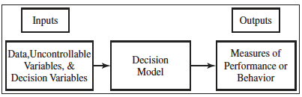
Modeling and decision trees
Three types of inputs:
Data
Uncontrollable variables
Decision variables
Notes:
Data: which are assumed to be constant for purposes of the model. Eg costs, machine capacity, distances
Uncontrollable: quantities that can change but cannot be directly controlled by the decision maker. Eg customer demand, inflation rates, investment returns.
Decision : controllable and can be selected at the discretion of the decision maker. Eg production quantities, staffing levels, investment allocations

Slide 5
Modeling and decision trees
Decision models characterize the relationships between data, uncontrollable variables, and decision variables and the outputs of interest to the decision maker.
A spreadsheet is one way of expressing a decision model through the formulas entered in the cells that reflect the relationships among the model components. For any set of inputs, the spreadsheet calculates some output measures of interest.
Spreadsheets are ideal vehicles for implementing decision models because of their versatility in managing data, evaluating different scenarios, and presenting results in a meaningful fashion.

Slide 6
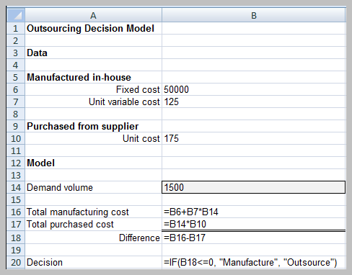
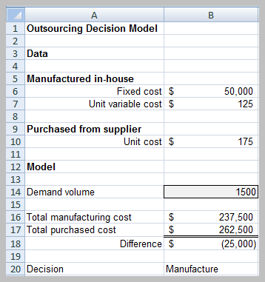
Decision Models – Outsourcing Example
Decision models are models that can be used to understand, analyze, or facilitate making a decision
Notes:
This spreadsheet is for evaluating a simple outsourcing decision.
Manufacturer can produce a part for 125 per unit with a fixed cost of 50,000. The alternative is to outsource production to a supplier at a unit cost of 175.
The decision depends on the anticipated demand, for high volumes the cost to manufacture in house will be lower than outsourcing because the fixed costs can be spread over a larger number of units, for small volumes it would be more economical to outsource.
The key input is the demand volume and the outputs are total manufacturing cost and purchase costs

Slide 7
Outsourcing Model
Model components
F = fixed cost of in-house manufacturing
V = unit variable cost of in-house manufacturing
C = unit cost of outsourcing
D = demand volume
Total Manufacturing Cost = TMC = F + V * D
Total outsourcing cost = TOC = C * D.
Notes:
If you can write a spreadsheet formula you can develop a mathematical model.
Models complement decision maker’s intuition and often provide insights that intuition cannot.
Models are only representations of the real world and cannot capture every nuance that decision makers face

Slide 8
Types of Decision Models
Descriptive - describe relationships and provide information for evaluation
Prescriptive (optimization models) - determine an optimal policy, that is, the best course of action that a decision maker should take to maximize or minimize some objective
Notes:
Descriptive: regression models are examples where they describe the relationship between dependent and independent variables. Outsourcing model is descriptive. Used to explain the behaviour of systems, predict future events as inputs to planning processes and assist decision makers. No decision variable included
Prescriptive: in a competitive environment one percent can mean a difference of hundreds of thousands of dollars, knowing the best can be the difference between success and failure. The airline example on the next slide illustrates this.

Slide 9
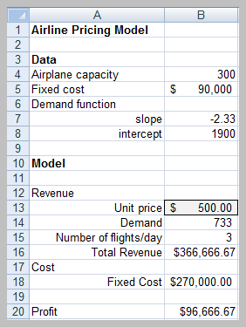
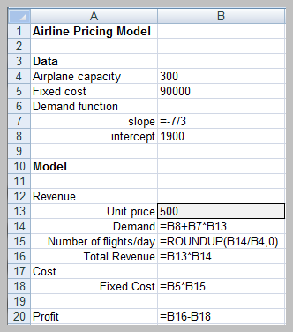
Airline Pricing Model
Notes:
Suppose an airline has studied the price elasticity for the demand for a round trip between chicago and cancun. They discovered that when the price is 600, daily demand is 500 per day, but when the price is 300 demand increases to 1,2000 per day. Airplane capacity is 300 but they can put on more flights if needed. Fixed costs for each flight is 90000.
The decision is to determine the price that maximises profit.
We only have two data points (600,500) and (300,1200) so we assume demand is a linear function of price so we determine the equation of the straight line between them.
Y= mx + b is the basic straight line equation. Y is demand, m is slope, x is the price and b is the y intercept
Slope is the degree of the line, intercept is where the line intercepts with y if x=0, these are calculated using the basic equation of a straight line y=mx+b using this formula you can calculate the demand = slope*price + intercept
Y demand (500 and 1200)
Price (600 and 300)
To calculate the slope you (y2-y1)/(x2-x1)
M = (500 – 1200)/(600-300) = -7/3
To calculate the intercept
B = 500-(-7/3)(600) = 1900
So y or demand = (-7/3 * price )+1900

Slide 10
Model Analysis
What-If Analysis – evaluate how specific combinations of model inputs that reflect key model assumptions affect model outputs (often called sensitivity analysis).
Excel tools
Data tables
Scenario manager
Goal seek
Notes:
A model helps managers gain insight into the nature of the relationships among components of a problem,
We might be interested in:
The impact of changes in assumptions on model outputs
Finding a solution such as a breakeven value
Determining the best solution to an optimization model
Evaluating risks associated with decision alternatives.
Spreadsheet models allow you to evaluate what if questions, in the outsourcing model we might be interested in how different levels of fixed and variable costs affect the total manufacturing cost. Changing model inputs to see affect on outputs is sensitivity analysis. This is one of the most important and valuable approaches to gaining the appropriate insights to make good decisions. It is as easy as changing values in a spreadsheet and analysing the changes, but spreadsheets facilitate sensitivity analysis through tools.

Slide 11
Data Tables
Summarizes the impact of one or two inputs on a specified output
Excel tools
One-way data tables
Two-way data tables
Notes:
A one way table evaluates an output variable over a range of values for a single input variable.
Two way does it over a range of values for 2 different input variables.

Slide 12
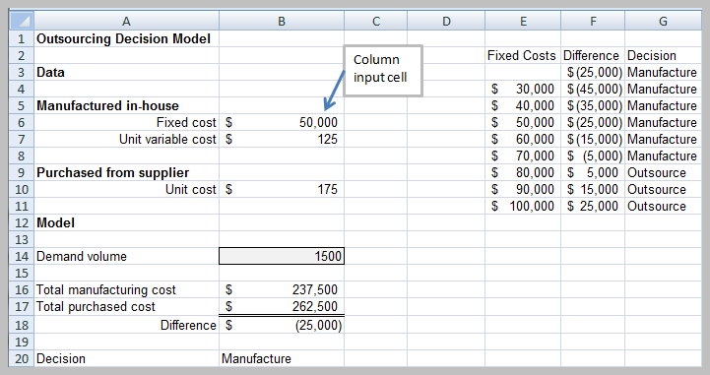
One Way Data Table
Notes:
One way data table.
Suppose we wish to create a one way table to evaluate the difference in manufacturing and outsourcing cost and the best decision for varying levels of fixed costs, E4 to E11 holds the range of these input values in F3 is the difference from B18 and G3 is the decision from B20
Enter the range of fixed costs you want to test, enter the formula for difference and decision and then highlight the full block of fixed costs and decision data, not including heading, then from the Data ribbon you choose the data table option from the what if analysis section and enter B6 as the column input cell. Press ok and the difference column and decision are populated.

Slide 13
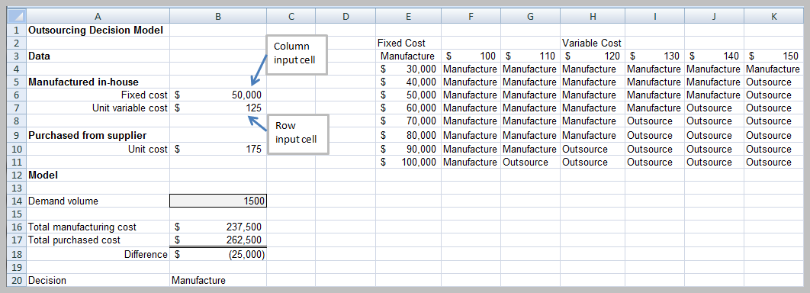
Two Way Data Table
Notes:
A two way data table shows decisions based on two variables fixed costs and variable costs. The column input cell remains as fixed costs and the variable costs as the row input. The result shows the combination of inputs.

Slide 14
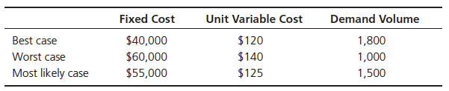
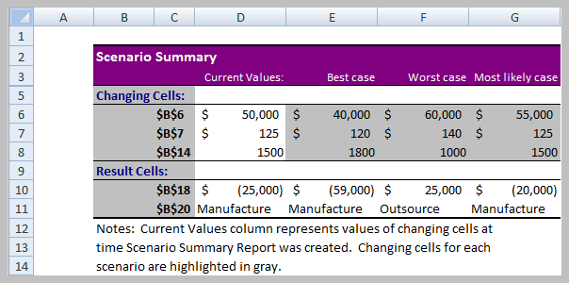
Scenario Manager
Notes:
Scenario manager allows you to create scenarios – they are useful for what if analysis when you have two or more variables (data tables cannot deal with) It can handle up to 32 variables.

Slide 15
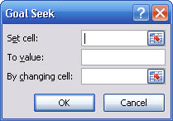
Goal Seek
Find the value of an input that produces a known result within a spreadsheet
Example: find the breakeven point in the outsourcing decision model
Set cell is B18;
To value = 0;
By changing cell is B14
Notes:
If you know the result you want from a formula, but are not sure what input value the formula needs to get that result, use the goal seek feature. It only works with one variable input. If you want to find the breakeven point (difference between the two is zero) so the value you want to find it the level of demand. It determines the demand break even point is 1000

Slide 16
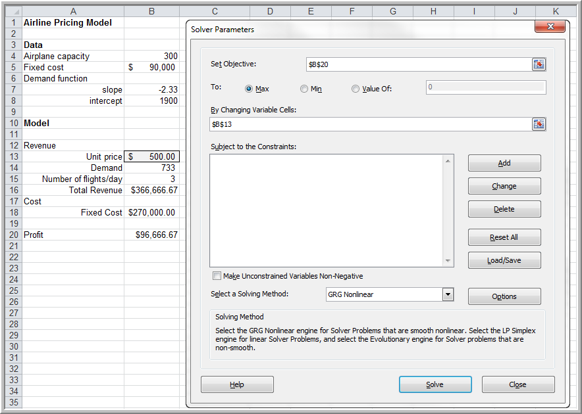
Optimization Models: Excel Solver
Solution:
Price = $428.57;
profit = $115,714.28
Notes:
What ifs are useful for descriptive models, however Optimisation models are different from what if’s, we are looking for the best solution. In most cases an algorithm is needed to provide the solution. An algorithm is a systematic procedure that finds the best solution. Many already exist to solve optimisation problems.
Excel includes solver that allows you to find optimum solutions. It is found in the analysis group on the data tab.
The set objective cell is the one you wish to optimize in this case profit., because we want the largest, we choose max the changing variable cells are another name for decision variables, in this case unit price. Select solving method allows you to choose the algorithm. Click solve and the solution will show as above.
Most will have constraints, limitations, requirements, or other restrictions, such as do not exceed allowable budget, these constraints makes optimisation more challenging.
Sometimes the solution needs to be good but perhaps not optimal, some model’s take too long and are too complex that an optimal solution cannot be guaranteed.

Slide 17
Tools for Model Building
Logic and business principles
Common mathematical functions
Data fitting
Spreadsheet engineering

Slide 18
Logic and Business Principles
Profit = Revenue - Cost
Revenue = (Unit price)(Quantity sold)
Cost = Fixed cost + Unit cost*Quantity produced
Quantity sold = Min(Quantity produced, Demand)
Profit = (Unit price)Min(Quantity produced, Demand) – [Fixed cost + (Unit cost)(Quantity produced)]
Notes:
Business principles in all functional areas, such as accounting, finance, marketing, and operations, knowledge of business practice and research, logical skills.

Slide 19
Modeling Example: Gasoline Consumption
m = miles/day driven
d = days/month
f = miles/gallon
Miles driven/month = md
Gallons consumed/month = md/f
Notes:
Car drives m miles per day and a month has d days in the month then the miles driven in a month is m*d
If a car gets f miles per gallon in fuel economy, then the number of gallons consumed per month is (m*d)/f
You must ensure consistency in dimensions in this case it is miles, days and gallons.

