Slide 1
Data Analytics
Dr. Brenda Mullally

Slide 2
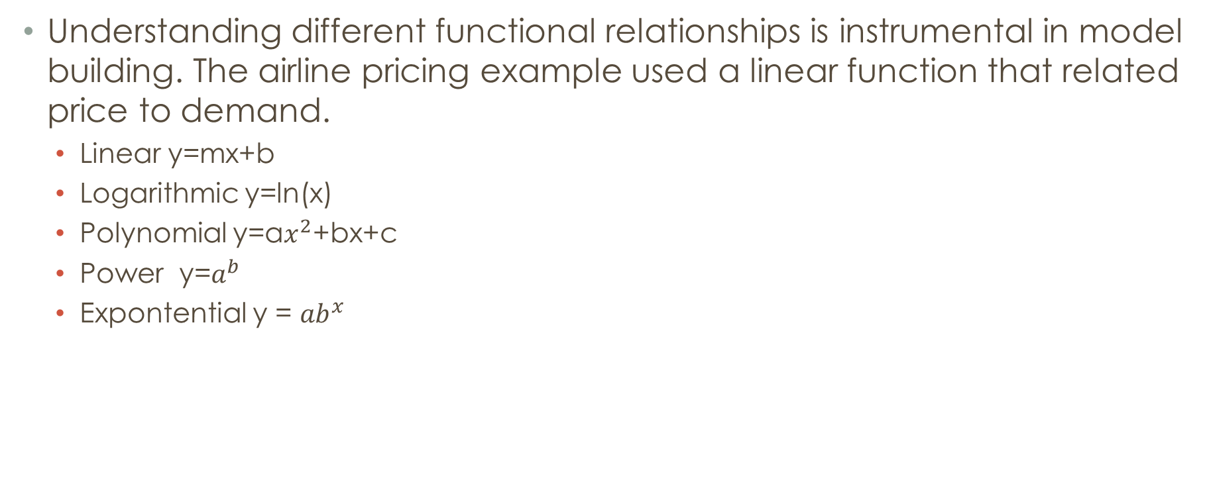
Common mathematical functions
Understanding different functional relationships is instrumental in model building. The airline pricing example used a linear function that related price to demand.
Linear y=mx+b
Logarithmic y=ln(x)
Polynomial y=a$x^{2}$+bx+c
Power y=$a^{b}$
Expontential y = ${ab}^{x}$
Notes:
Common mathematical functions:
Logarithmic for rate of change that is variable (i.e not linear growth)
Polynomial: one hill or valley
Power: increase at a specific rate
Exponential: y rises or falls at constantly increasing rates

Slide 3
Data fitting
For may applications, functional relationships used in decision models are derived from the analysis of the data.
The trendline tool provides a method of determining the best fitting functional relationship. Using the trendline tool you can try fitting each function to the data.
Data fitting is combined with logical approaches in model building.
Notes:
For example crude oil prices on the first Friday of each month for 2 and half years, you can use the trendline tool to fit each different function to the data to see what fits best. In this case it was the third order polynomial.
The proper model to use depends on the scope of the data. E.g. the data might show stability in part of a year and then increase rapidly. By including early data the long term functional relationship might not adequately express the short term trend. You must choose the proper amount of data for analysis. All predictive models are risky. If we omitted some of the early data a different function could yield a more accurate prediction of the price of oil in 6 months after our data ends.

Slide 4
Spreadsheet Engineering
Verification
Improve the design and format of the spreadsheet itself.
Improve the process used to develop a spreadsheet.
Inspect your results carefully and use appropriate tools available in Excel.
Use the Data Validation tool
Inspect and audit formulas
Notes:
Spreadsheets should be accurate. Errors can be disastrous. A large investment company once made a $2.6 billion error. They notified shareholders of a big dividend payout due, luckily they caught the error before sending the cheques.
Industry surveys estimate that more than 90% of spreadsheets with more than 150 rows were incorrect by at least 5%.
Verification is the proces of ensuring that a model is accurate and free from logical errors. How do we do this?
Design: once inputs etc are understood a sketch of model should be designed, separate model inputs from model itself, break complex formulas into smaller parts, easier to read and check results.
Process: work on each part of model and then move on to the next part to ensure it is correct. Check formulas with simple known numbers. Define names for cells, and be careful referencing cells.
Inspect: validation – check for a whole number if that is what the formula should have for an input.

Slide 5
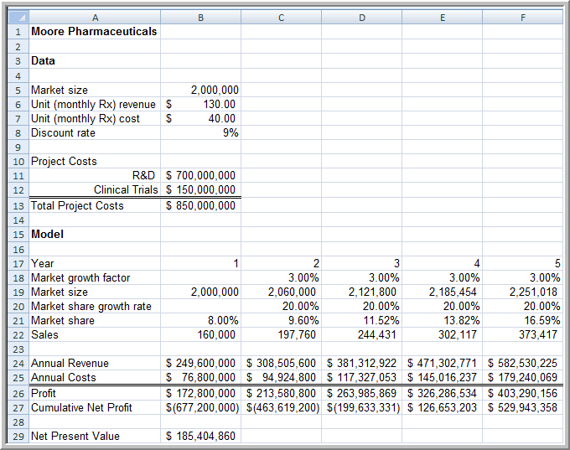
New Product Development Model
Notes:
Many models use basic financial analysis. One example is the decision to launch a new product. Pharmaceutical industry, process of r&d is long and costly. This example is where a potential drug is developed and they need to decide whether to bring it to clinical trials or not. R&d costs $700 million, clinical trials $150 million. Market size estimated to be 2 million people with 3% growth annually. Estimate gaining 8% market share to grow by 20% each year. A monthly prescription is anticipated to generate revenu of $130 with variable costs of $40. Discount of 9% is assumed.

Slide 6
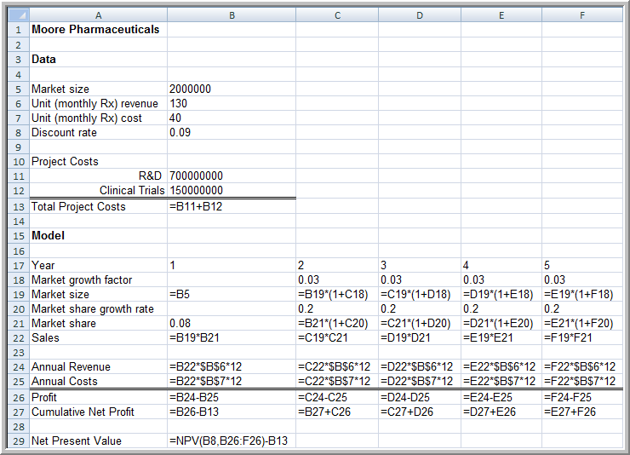
New Product Development Model Formulas
Notes:
The model is based on a variety of known data, estimates and assumptions. Some input are from corporate accounting (discount rate , unit revenue) based on historical data, forecasts or judgmental estimates based on market research or previous expreience . These contain most likely estimates and shows the drug will be profitable in year 4. however the model is based on some rather tenuous assumptions about market size and growth. Much is uncertain and to use just one scenario would be foolish, the real value in a model is in analyzing a variety of scenarios that use ranges of these assumptions.

Slide 7
Single Period Purchase Decisions (Newsvendor Model)
C = purchase cost
R = sale price
S = salvage value
D = demand during a single period
Q = quantity purchased
Net profit = R * Quantity Sold + S * Surplus Quantity - C * Q
Notes:
Newsvendor model is common, purchase with uncertain demand. Dept store buyers must purchase seasonal clothing well in advance of the buying season. Street vendor needs to know how many of something to purchase. Purchasing too few results in lost profit, too many costs you. D is an uncontrollable variable, Q is the decision variable. If demand is known then the optimum quantity is easy Q=D.

Slide 8
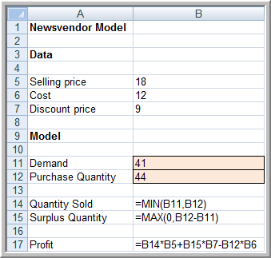
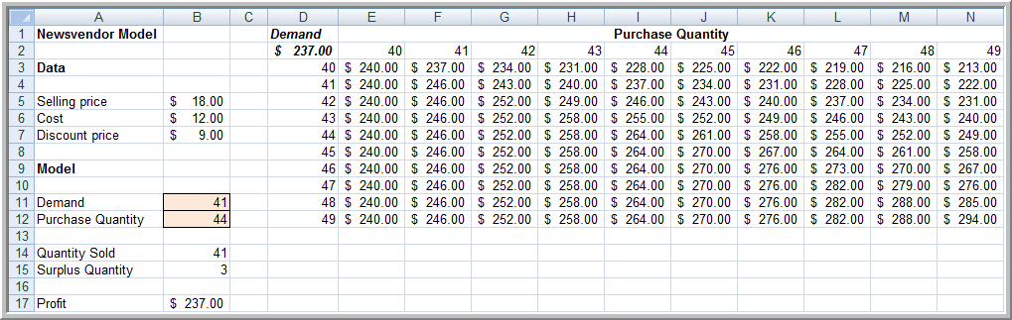
Newsvendor Model Spreadsheet
Notes:
This shows a candy store with a valentines gift for 12 cost, sell at 18, pervious demand shows 40. We can use an excel table to show the options. Higher purchase quantites have potential for high profits but carry higher risk.

Slide 9
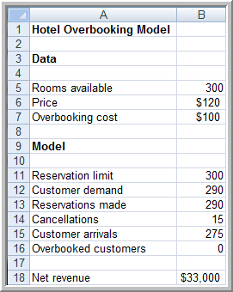
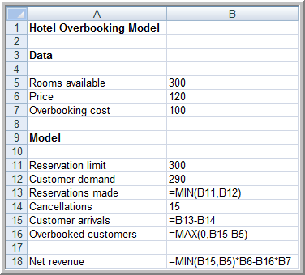
Overbooking Decisions
Notes:
Hotels, arilines, car rental deal with overbooking to effecitivly fill capacity. Decision is by how much to overbook?
B12 is the decision variable of how many reservations to accept B13 is the actual demand. Using data tables you could analyze the effect of changes in revenue etc by changing reservation limit, demand and cancellations.

Slide 10
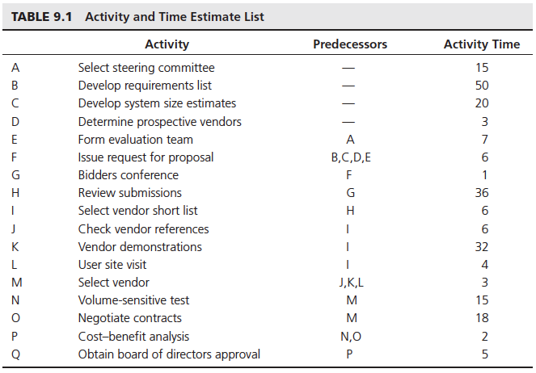
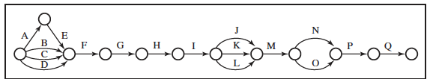
Project Management
Notes:
Scheduling interrelated activities. Expected completion time/date, in this assume activity time is constant,

Slide 11
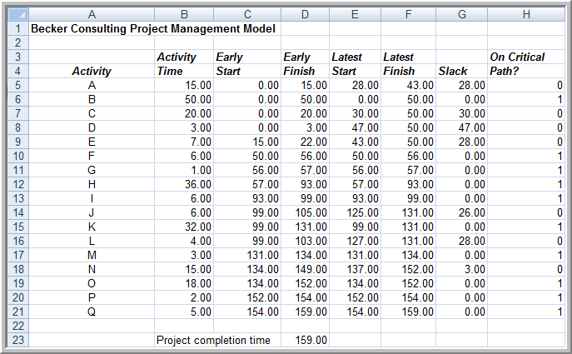
Spreadsheet Model
Notes:
Calculated project completion time. Max, min and if functions used. Depends on time for activity, there is a slack for each activity depending on the activity dependencies.

Slide 12
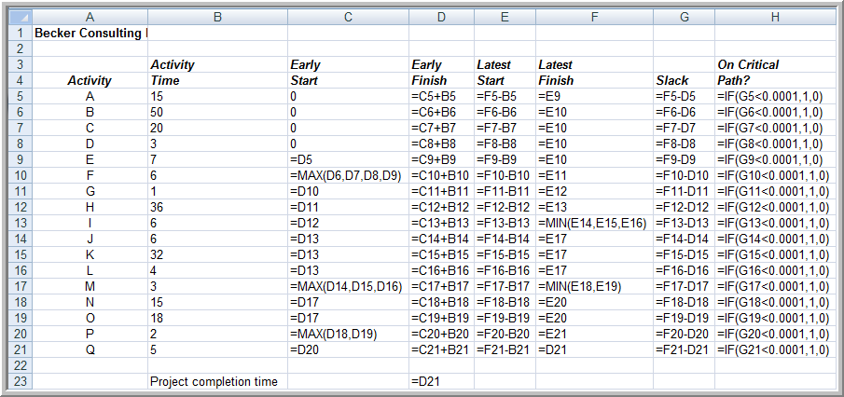
Model Formulas

Slide 13
Model Assumptions, Complexity, and Realism
Validity
All models reflect assumptions used by the modeler.
Assumptions simplify models and make them easier to manipulate and solve
Assumptions should be as realistic as necessary to make models useful but not overly complex
Assumptions should be clearly stated and documented
To add more realism to a model generally requires more complexity
Notes:
Models cannot capture every detail of the real problem, and managers must understand the limitations of models and underlying assumptions.
Validity refers to how well a model represents reality. One approach for judging the validity of a model is to identify and examine the assumptions made in a model to see how they agree with one’s perception of the real world. The closer the agreement the higher the validity. A perfect model corresponds to the real world in every respect, unfortunatley no such model ever existed and never will, it is impossible to include every detail of real life in one model.
Analysts must balance realism with complexity.

Slide 14
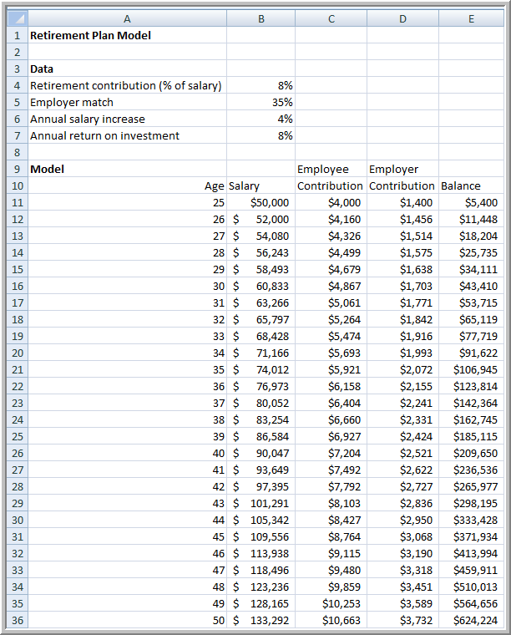
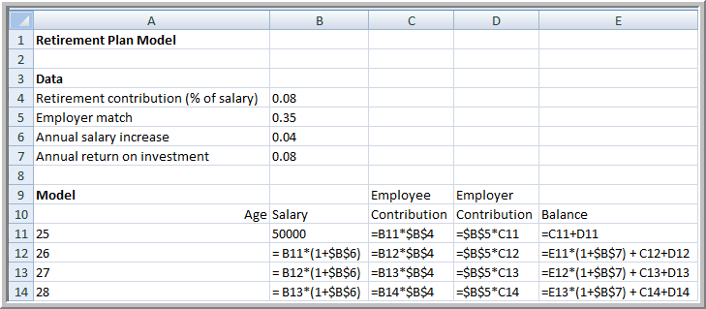
Example: Retirement Planning
Notes:
To illustrate realism, suppose employee stats working at 25 starting salary 50,000, average salary increase of 4% per year, retirement plan requires 8% contribution, employer adds 35%. Annual return of 8% on portfolio. Whether the assumptions for salary increase, return on investment are reasonable and if they should be the same each year is questionable. Them staying the same simplifies the model but detracts from the realism because the variables will clearly vary each year.
Also consider how is the return on investment calculated? Based on the previous year balance and not the current years contributions or on both? Or on a monthly basis which would require a much more complicated model.

