Slide 1




Electricity & Electronics
Merit Badge
Class 1
Name ______________________________
Electricity Merit Badge Class 1
2017 National Scout Jamboree
Notes:
Developed for the Electronics Merit Badge by Tim Hurd, Technical Manager for the Electronics Merit Badge, IEEE emertibadges project. Borrowed with permission and slightly modified by Bruce MacAlister, Technical Manager for the Electricity Merit Badge, IEEE emertibadges project.
The changes are some explanatory notes on volts and amps and the inclusion of a scout-build switch to meet Requirement 11 d. “Build a single-pole, double-throw switch. Show that it works”
See parts needed on next slide notes.

Slide 2
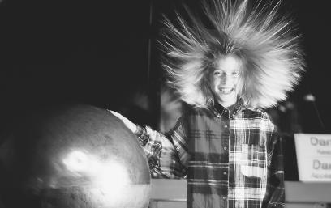
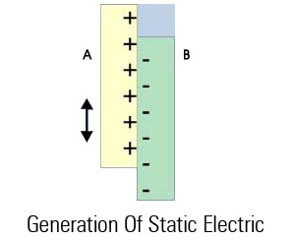
Types of Electricity
Static Electricity
Static electricity is usually created when materials are pulled apart or rubbed together, causing positive (+) charges to collect on one material and negative (−) charges on the other surface.. Sparks may result!
Examples of occurrence of static electricity:
Lightning.
Combing hair.
Walking across carpet and getting shocked.
Pulling out scotch tape.
Electricity Merit Badge Class 1
2017 National Scout Jamboree
Notes:
How to generate static electricity? Every strand of hair is repelling the next strand of hair, as they all have the same electrical charge.
Run comb through hair. The comb will attract paper.
Walk across a carpet and touch a doorknob.
Lightning occurs when a large enough charge accumulates between the bottom of a cloud and the earth, such that an ionization path is created between the two, and electrons flow…

Slide 3
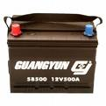

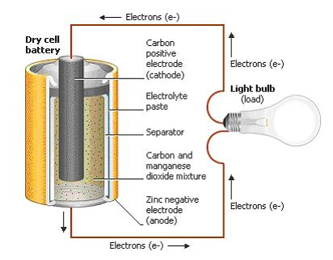
Types of Electricity
Direct Current (DC)
Type of electricity used in most, if not all electronics we have today. Current only flows in one direction (not both directions, like AC).
Examples of DC usage:
MP3 players
Radios
Electricity in cars.
Anywhere you use a battery for power.
Electricity Merit Badge Class 1
2017 National Scout Jamboree
Notes:
We are talking batteries. Through a chemical reaction, batteries provide a flow of electrons --- current flow.

Slide 4
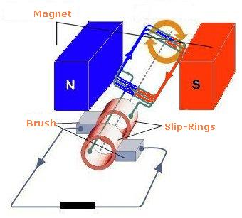
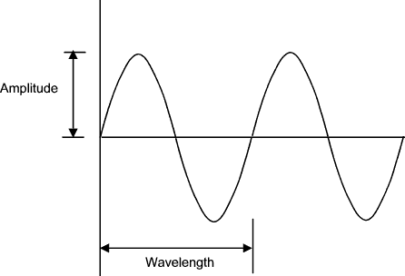
Types of Electricity
Alternating Current (AC)
The common form of electricity from power plant to home/office. Its direction is reversed 60 times per second in the U.S.; 50 times in Europe.
Examples of AC usage:
Kitchens: Stoves, ovens, mixer, etc.
Computer chargers
Lights in house
Home air conditioners.
Electricity Merit Badge Class 1
2017 National Scout Jamboree
Notes:
AC power is present in the home.
Pay attention to safety around AC power.
One idea to illustrate AC power is to get a scout to walk in one direction and then turn around and walk in the other direction. Each time he passes the instructor, he reaches out with his hand and pushes on the instructors hand. Though current flows in 2 directions, it is reasonably easy to see how it can be used to do electrical work.

Slide 5

Voltage
Volts is the electromotive force that causes
electrons (current) to flow.
Voltage can also be thought of as the electrical force that pushes electrons in a wire.
Units for voltage is VOLTS.
The symbol for voltage is E.
The schematic symbol for dc voltage is
generally shown as a battery
GND
Electricity Merit Badge Class 1
2017 National Scout Jamboree

Slide 6
Voltage – Water Analogy
Small height = low voltage
Big height = high voltage
height
height
Gravity provides the force for water (current) to flow.
This illustrates a small voltage, so current flow is small.
You can increase water (current) flow by making the pipe larger as well.
Gravity provides the force for water (current) to flow.
This illustrates a larger voltage, so current flow is larger.
You can increase water (current) flow by making the pipe larger as well.
Electricity Merit Badge Class 1
2017 National Scout Jamboree
Notes:
This is a very important concept to get across. Voltage, current and resistance are the basis for this class.

Slide 7
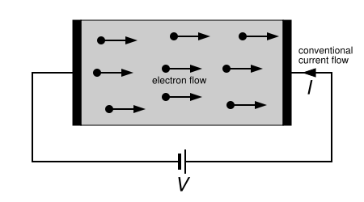
Current
Current: Defined as “flow(time rate of change) of electrons”.
Current: Units of current is AMPS.
Current: Electrical symbol for current is I (eye).
Electricity Merit Badge Class 1
2017 National Scout Jamboree
Notes:
We will use positive flow, not electron flow when we talk about current.

Slide 8
Current Flow – Water Analogy
Water flows in the hose, entering at the top and exiting the bottom.
The water is the “current” ; the flow of electrons.
The more water flowing in the pipe, the more current is flowing in the wire.
Different pipe diameters illustrates different resistance to water flow, which correlates to different resistor values.
Electricity Merit Badge Class 1
2017 National Scout Jamboree
Notes:
Get 1 scout to walk across the room. Now, get 2 scouts to walk across the room.
The scout is an electron, and by walking, is equal to current flow. Two scouts walking are two electrons, and are doubling current flow. I know this is hokey, but can be used when it makes sense during the class.

Slide 9
Resistance
  Resistance is the electrical property of a substance to resist the flow of electrons.
  The units of resistance is OHMS (Ω).
  The symbol for resistance is R.
  The schematic symbol is
  The larger the resistance, the more resistance to current flow.
Electricity Merit Badge Class 1
2017 National Scout Jamboree
Notes:
The larger the resistance, the less current, given the same voltage in the circuit.

Slide 10
Resistance – Water Analogy
10000Ω
Different pipe diameters represents different resistor values.
The smaller the diameter of the pipe, the larger the resistance.
1000Ω
100Ω
10Ω
1Ω
Electricity Merit Badge Class 1
2017 National Scout Jamboree

Slide 11
Electrical Terms
Circuit-A conductor or system path of electrical elements through which current will flow.
Potential Difference-The Voltage between two points in a circuit.
Impedance-The term used in AC Circuits for the resistance to the flow of current.
Short Circuit-An abnormal connection of low impedance (resistance) between two points of different potential.
Ground-A point of common connection of zero volts often the earth
Electricity Merit Badge Class 1
2017 National Scout Jamboree

Slide 12
Other Electrical Terms
Watt- Power to do work at 1 joule/sec or W=VxI
Rectifier-Electronic or Mechanical means to convert AC to DC.
Rheostat-An adjustable resistance such that resistance can be changed without breaking the circuit(example light dimmer).
Conductor-Material that will allow current to pass continuously along it (wire).
Electricity Merit Badge Class 1
2017 National Scout Jamboree

Slide 13
Other Electrical Terms
Switch-Electronic or Mechanical means for opening and closing a circuit.
Fuse-A device that protects a circuit from over-current by melting a link in the device.
Circuit Breaker-A device that protects a circuit for over-current by opening the circuit with a switch.
Cycle-One complete reversal of alternating current or voltage.
Hertz-One cycle per second
Electricity Merit Badge Class 1
2017 National Scout Jamboree

Slide 14
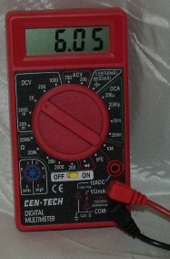
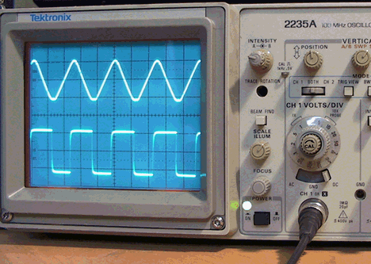
Equipment Used To Measure Electrical Quantities and Qualities
Volt/Ohm/Amp Meter
Usually referred to as a multi-meter.
With this we can measure current A, voltage V and resistance R.
Oscilloscope
Usually referred to as a Scope or O-Scope
With this we can ‘see’ voltage wave forms. This is very useful when voltage is changing, as a meter is no good to us when this is happening.
Electricity Merit Badge Class 1
2017 National Scout Jamboree
Notes:
It is helpful to have examples of these 2 instruments in the class.

Slide 15
Ohms Law DC Circuits
Volts = Current x Resistance
E = I x R
Units
  E is in Volts
  I the electrical current is in Amps
  R is Resistance is in Ohms
  Example: If the Voltage E stays the SAME and Resistance R goes UP, then the amount of Current I flowing in the circuit goes DOWN
Electricity Merit Badge Class 1
2017 National Scout Jamboree
Notes:
This is really, really important. If you understand ohms law, you have a really good understanding of basic electricity.
Talk about how easy this equation is to remember and to use.

Slide 16




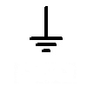


Electricity and Electronic Symbols
Single Pole, Double Throw Switch (SPDT)
Battery
Capacitor
or
Resistor
Light Emitting Diode (LED)
Buzzer
Ground
Fuse
Lamp
Electricity Merit Badge Class 1
2017 National Scout Jamboree
Notes:
These symbols will be used when drawing and wiring up the circuit we are going to do next.

Slide 17
CIRCUIT DIAGRAM (SCHEMATIC)
FLASHLIGHT
Calculate I
LAMP
10 Ohms
SWITCH
V = I x R
V = 9 Volts
R = 10 Ohms
I = ? Amps
9 V = I A x 10 Ohms
9 V / 10 Ohms = I Amps
0.9 Amps = I
+
V = 9 V
I
GROUND
GROUND
TWO GROUND SYMBOLS IS THE SAME AS CONNECTING WITH A WIRE
GROUND = 0 VOLTS
Electricity Merit Badge Class 1
2017 National Scout Jamboree
Notes:
This simple schematic is the circuit of each flashlight. Place emphasis on ground, so that it is fully understood that ground = 0 volts.

Slide 18
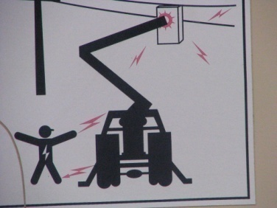
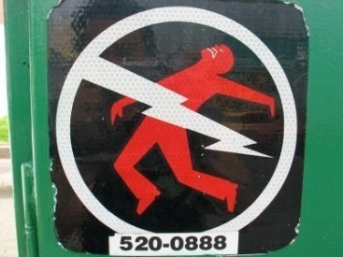

Electricity Safety
High Voltage ( 120V AC or greater) – Safety mainly about not touching the wrong thing.
Current kills – Only 60 volts can kill when current flows through heart or head for a sufficient length of time.
Ventricular fibrillation - Current passing through heart causes knocks heart out of synchronization.
If the shock doesn’t kill you, you can still be badly burned from touching the wrong thing.
Electricity Merit Badge Class 1
2017 National Scout Jamboree
Notes:
Safety for electricity is covered in the electricity merit badge, so I just mention it here.
Don’t fear electricity, learn when and how to handle it.
Next time you see an electric company worker on one of those tall hoists by a pole, notice what they are wearing:
Rubber shoulder pads to insulate from electricity
Thick insulating gloves
Orange insulation blankets draped over the electric lines
Shock can be avoided by being educated about potentially dangerous situations. Stay away from them!!!

Slide 19
Electric Shock
If a person is in contact with an energized (live) circuit do not touch them.
  Turn off the breaker.
  If you do not know where the breaker is located push the circuit off of the person with a dry object like a broom, mop handle or wooden chair.
  Do not use any object that is metal or wet.
  Water like metal can conduct electricity in amounts that can be dangerous.
Electricity Merit Badge Class 1
2017 National Scout Jamboree

Slide 20
Removal of Live Wire
If you cannot remove the wire with a dry object or turn off the breaker then:
  Be sure you are on a dry surface and
  Find a dry shirt, sheet or sweater and loop it around the wire and pull it off
  Or in case you cannot get to the wire try the same method to pull the person off the wire.
  Once you have a person away from the wires check to see if they need artificial respiration.
Electricity Merit Badge Class 1
2017 National Scout Jamboree

Slide 21
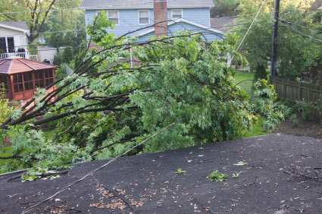
High Power Lines
If a person is in contact with high power lines:
  Do not touch them.
  Stay at least 20 feet away as current can flow through the ground.
  Call 911.
  Let the fire and police manage the situation.

Slide 22
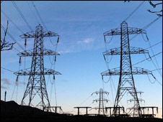
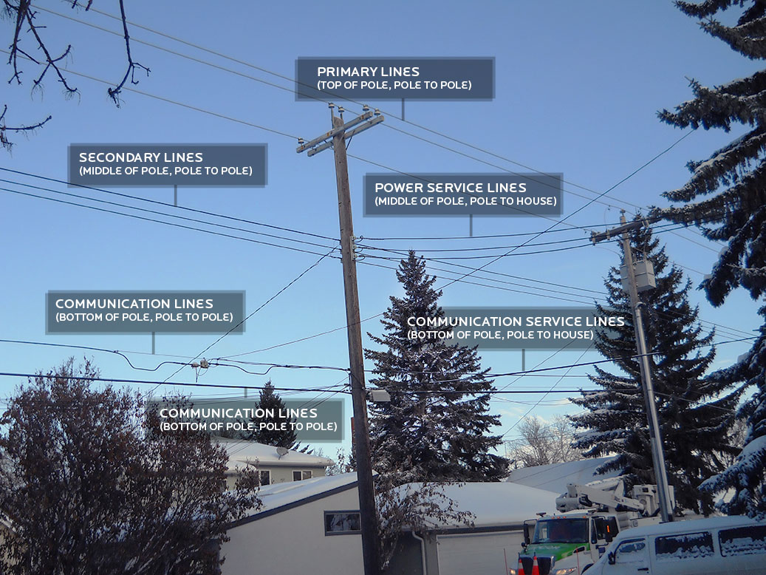
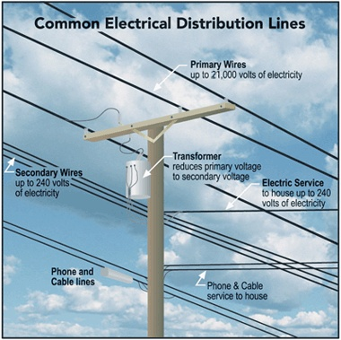
Power Lines
Electricity Merit Badge Class 1
2017 National Scout Jamboree

Slide 23
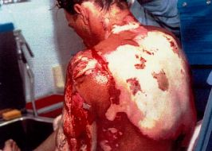
Treating Electrical Burns
When a person has a severe electrical burn:
  Do not apply ice, ointment, water, medication, bandages or dressings
  Do not touch or break boils or blisters
  Do not attempt to remove clothing

Slide 24
Electrical Storms
About 54 people are killed from lightning every year and several hundred are injured.
Numerous forest and house fires are started by lightning.
If outdoors avoid tall solitary trees, towers, water, mountain tops and ridge crests, metal fences and any object like a metal tent pole.
The safest place is a dense forest in a low lying area.
If caught in the open stay low, spread out, crouch with both feet together and soles on the ground
Electricity Merit Badge Class 1
2017 National Scout Jamboree

Slide 25
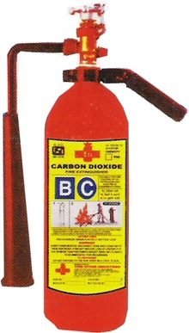
Electrical Fires
They are different from other fires in that trying to put out a fire:
  Never use water.
  Call 911.
  Turn off main breaker
  Use only extinguishers rated for fires. Class C
  fires involve electrical equipment, such as appliances, wiring, circuit breakers and outlets. Never use water - the risk of electrical shock is far too great! The C classification means the extinguishing agent is non-conductive. Geometric symbol (blue circle)
  If fire does not go out leave the building.
Electricity Merit Badge Class 1
2017 National Scout Jamboree

Slide 26
Personal Safety
Be aware of what you are doing, and where you are placing equipment and yourself in an electrical circuit.
Pay attention to energized circuits – Is the power on? Make sure the electricity is turned off especially when working on 120 VAC or higher electrical circuits.
Pay attention to hot soldering irons. Keep a good distance between you those next to you.
Know when you are working with high current and/or high voltage circuits.
THINK before you do something.
Wear safety glasses when soldering.
Electricity Merit Badge Class 1
2017 National Scout Jamboree

Slide 27
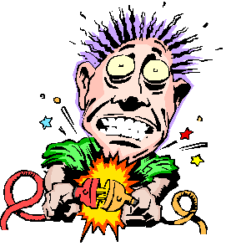
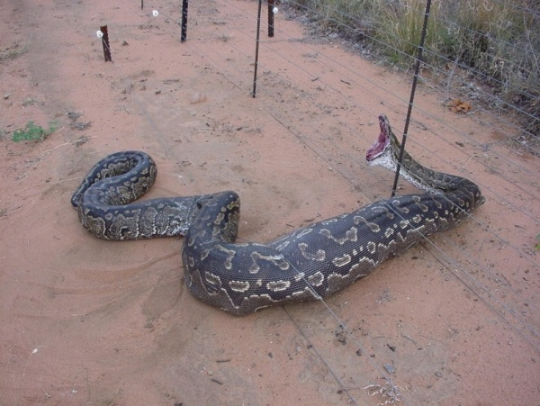
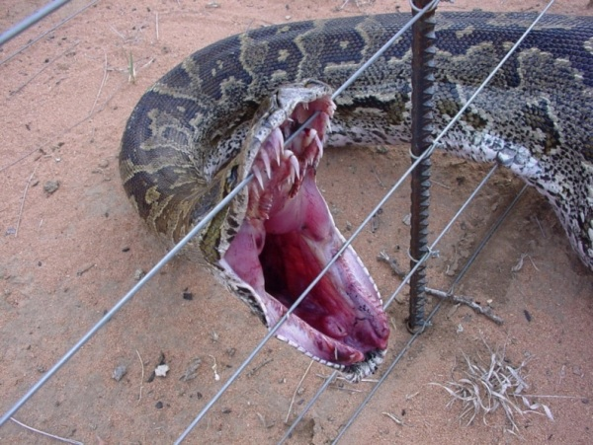
How to avoid shock.
Turn power off before working on equipment.
Don’t touch circuits that could have high voltage on them.
Do not allow current to flow through heart (or maybe mouth, in this case of an electrified fence).
Electricity & Electronics Merit Badges Class 1 – 2013 National Scout Jamboree
Notes:
The snake crawled under the fence. Once through the fence, it felt the shock from the electric fence, and turned to bite the fence.
This passed current through either its brain or heart, and that was it.
Its body made a connection from the fence to ground, and was being shocked.
The snake felt the shock and responded by striking at the source of its pain… the fence.
My guess is that once it bit the fence, it provided a better electrical path from the fence, though its heart, to ground.

Slide 28
Sample Home Electrical Inspection Checklist
Outlets
 Check for outlets that have loose-fitting plugs, which can overheat and lead to fire.
 Replace any missing or broken wall plates.
 Make sure there are safety covers on all unused outlets that are accessible to children.
Line Cords
 Make sure cords are in good condition-not frayed or cracked.
 Make sure they are placed out of traffic areas.
 Make sure that cords are not nailed or stapled to the wall, baseboard or to another object.
 Make sure that cords are not under carpets or rugs or any furniture rests on them.
Extension Cords
 Check to see that extension cords are not overloaded & only be used on a temporary basis, not as permanent wiring.
 Make sure extension cords have safety closures to help protect children from shock hazards and mouth burns.
Plugs
 Make sure your plugs fit securely into your outlets.
 Make sure no plugs have had the ground pin (the third prong) removed in order to make a three-prong fit a two-conductor
outlet; this could lead to an electrical shock.
 Never force a plug into an outlet if it doesn't fit.
 Avoid overloading outlets with too many appliances.
Ground Fault Circuit Interrupters (GFCIs)
GFCIs can help prevent electrocution. When a GFCI senses current leakage in an electrical circuit, it assumes a ground fault has
occurred. It then interrupts power fast enough to help prevent serious injury from electrical shock. GFCIs can be installed at the
outlet, or as a replacement for the circuit breaker for an entire circuit at the fuse box.
 Kitchen  Bathrooms  Garage  Laundry room  Outdoors
 Test GFCIs according to the manufacturer's instructions monthly and after major electrical storms to make sure they are
working properly.
Electricity Merit Badge Class 1
2017 National Scout Jamboree

Slide 29
Sample Home Electrical Inspection Checklist
Light Bulbs
 Check the wattage of all bulbs in light fixtures to make sure they are the correct wattage for the size of the fixture.
 Replace bulbs that have higher wattage than recommended; if you don't know the correct wattage, check with the
manufacturer of the fixture.
 Make sure bulbs are screwed in securely; loose bulbs may overheat.
Circuit Breakers/Fuses
 Make sure circuit breakers and fuses are the correct size current rating for their circuit. If you do not know the correct size,
have an electrician identify and label the size to be used. Always replace a fuse with the correctly specified size fuse.
 Make sure everyone in your home knows where the main breaker is located and how to shut of power to the entire house.
Plug In Appliances
 Make sure there are no plugged-in appliances where they might fall in contact with water. If a plugged-in appliance falls into
water, NEVER reach in to pull it out—even if it's turned off. First turn off the power source at the panel board and then
unplug the appliance. If you have an appliance that has gotten wet, don't use it until it has been checked by a qualified repair
person.
Appliances
 If an appliance repeatedly blows a fuse, trips a circuit breaker or if it has given you a shock, unplug it and have it repaired or
replaced.
Entertainment/Computer Equipment
 Check to see that the equipment is in good condition and working properly. Look for cracks or damage in wiring, plugs and
connectors.
 Use a surge protector bearing the seal of a nationally recognized certification agency.
Electricity Merit Badge Class 1
2017 National Scout Jamboree

Slide 30
Sample Home Electrical Inspection Checklist
Outdoor Safety
 Electric-powered mowers and other electric tools should not be used in the rain, on wet grass or in wet conditions.
 Inspect power tools & electric lawn mowers before each use for frayed power cords, broken plugs & cracked or broken
housings. If any part is damaged, stop using it immediately. Repair it or replace it.
 Always use an extension cord marked for outdoor use and rated for the power needs of your tools.
 Remember to unplug all portable power tools when not in use.
 When using ladders, watch out for overhead wires and power lines. Stay at least 10 feet from all overhead lines.
Lightning
 During an electrical storm, do not use appliances (i.e., hairdryers, toasters and radios) or telephones (except in an
emergency); do not take a bath or shower;
 Keep batteries on hand for flashlights and radios in case of a power outage.
 Use surge protectors on electronic devices, appliances, phones, fax machines and modems.
Space Heaters
 Space heaters are meant to supply supplemental heat. Keep space heaters at least 3 ft. away from any combustible
materials such as bedding, clothing, draperies, furniture and rugs.
 Don't use space heaters in rooms where children are unsupervised and remember to turn off and unplug when not in use.
 Do not use space heaters with extension cords; plug directly into an outlet on a relatively unburdened circuit.
Halogen Floor Lamps
 Halogen floor lamps operate at much higher temperatures than a standard incandescent light bulb. Never place a halogen
floor lamp where it could come in contact with draperies, clothing or other combustible materials.
 Be sure to turn the lamp off whenever you leave the room for an extended period of time.
 Never use torchiere lamps in children's bedrooms or playrooms. Consider using cooler fluorescent floor lamps.
Electricity Merit Badge Class 1
2017 National Scout Jamboree

Slide 31
How can we save energy in our homes, schools and scout areas
Turn off unneeded or unused lights
Unplug chargers when not in use charging
When appliances need to be replaced buy energy star appliances
In the summer set the indoor temperature a degree or two higher and in winter a degree or two lower
Turn off the TV when leaving the room
Electricity Merit Badge Class 1
2017 National Scout Jamboree

Slide 32
How can we save energy in our homes, schools and scout areas
Plan trips to the store so that one trip can complete several errands
Don’t exceed the speed limit
Use a bike for short trips rather than a car
Make sure that the building has adequate insulation
Stop all air leaks in a building use infrared scanner to find leaks
Electricity Merit Badge Class 1
2017 National Scout Jamboree

Slide 33
How can we save energy in our homes, schools and scout areas
Clean or replace air filters regularly
Use energy efficient light bulbs
Keep the doors closed when cooling or heating
Shade your windows in the summer
Use ceiling fans
Close all fireplace flues when not in use
Wash only full loads
Set washers on economy load to save water
Electricity Merit Badge Class 1
2017 National Scout Jamboree

Slide 34
How can we save energy in our homes, schools and scout areas
Set water temperature lower
Take shorter showers
Don’t let the water run while brushing or shaving
Look for energy efficient computers and TVs
Unplug unused appliances and devices as they use power at all times
Electricity Merit Badge Class 1
2017 National Scout Jamboree

