Slide 1
MyMusic360
MM360
Music for me Now on my mood

Slide 2
Mood, Music and Me
“Music touches us emotionally, where words alone can't.” ― Johnny Depp
“When I hear music, I fear no danger. I am invulnerable. I see no foe. I am related to the earliest times, and to the latest.” ― HENRY DAVID THOREAU
“My heart, which is so full to overflowing, has often been solaced and refreshed by music when sick and weary.” ― Martin Luther
“Music is an agreeable harmony for the honor of God and the permissible delights of the soul.” ― Johann Sebastian Bach

Slide 3
MyMusic360 My Music
NOW
Mm360 brings your music to you based on your current mood.
Music selections from Spotify based your likeness and customizations, based on your mood.
Goal is to provide you with a real-time music selection to make you feel comfortable, all the time.
Mm360’s goal is to provide you with the song that will make you comfortable - the song you will "most like" at that moment.

Slide 4
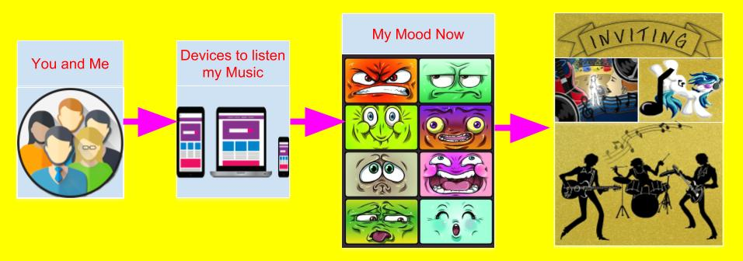
Please relax and enjoy your
MM360

Slide 5
Some Technical Details
Microsoft Azure Face API – for mood detection
Spotipy – Spotify Python API wrapper – for music access
Python Flask – for web access
Plotly – for music breakdown graphs

Slide 6
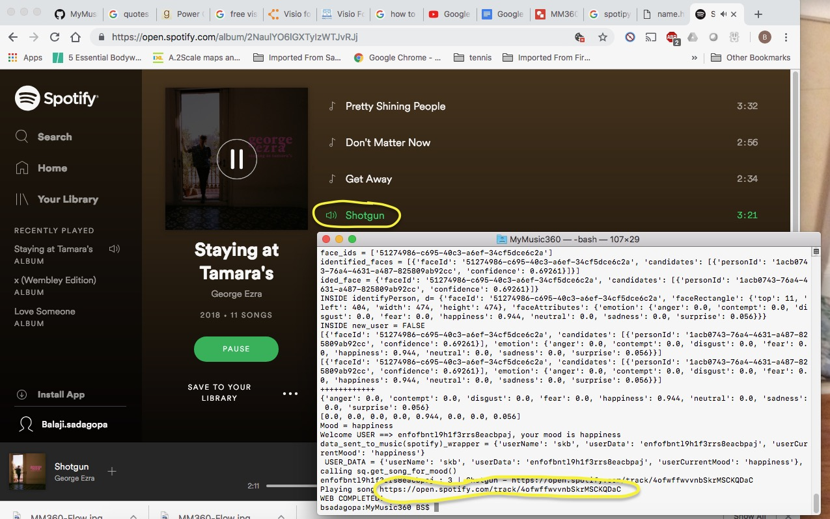
Playing the Mood matched Music from Spotify

Slide 7
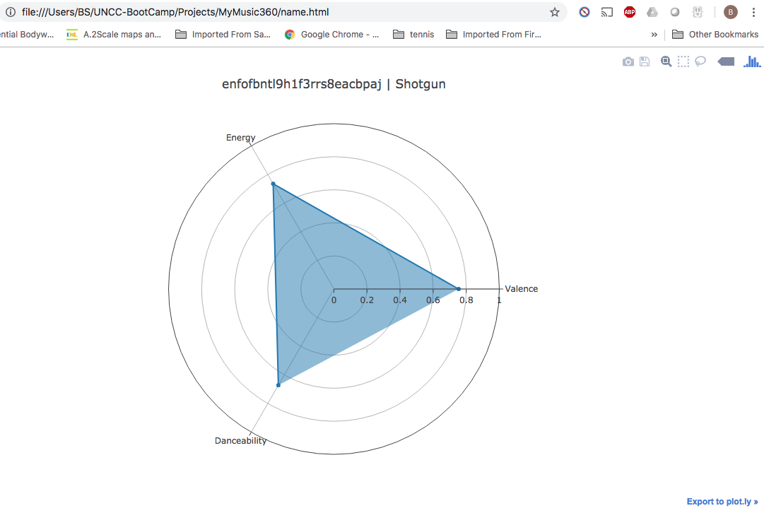
Music Details

Slide 8
This is just the start
Q & A

Slide 9
Appendix
https://en.wikipedia.org/wiki/Music_and_emotion
https://arxiv.org/pdf/1809.07276.pdf
https://pdfs.semanticscholar.org/522f/26b2b4999b619f0b4d48b2ef0fb7fdacd94d.pdf
https://www.ncbi.nlm.nih.gov/pmc/articles/PMC4894878/

