Slide 1
Your News Today
NEWS – North, East, West, South
Where do you think you are today?

Slide 2
What?
What are the top headlines in the world today?
What are the top headlines in US today?

Slide 3
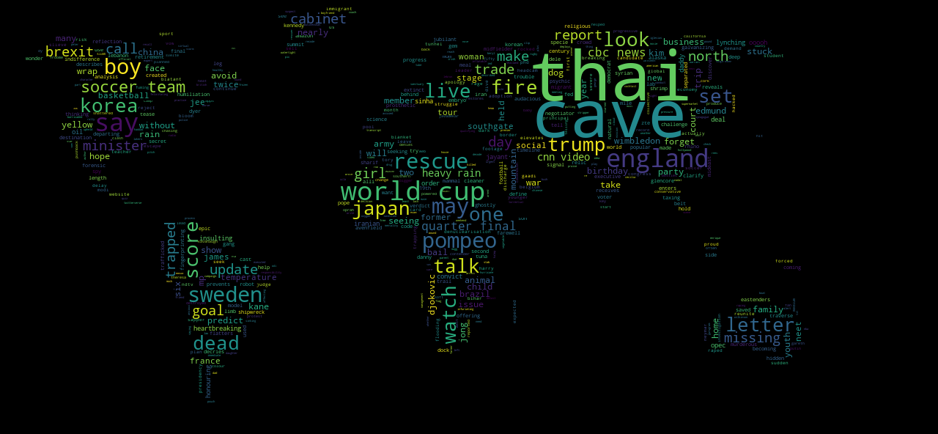
World Media Top WORDS

Slide 4
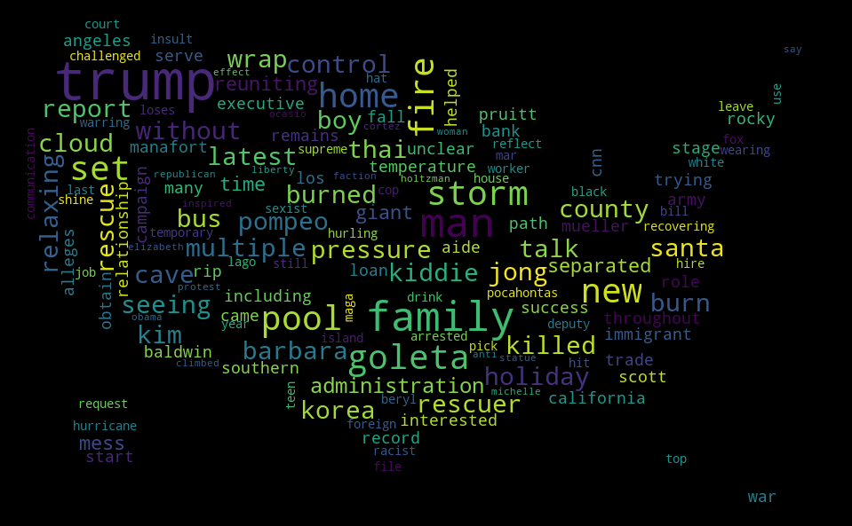
Us media top words

Slide 5
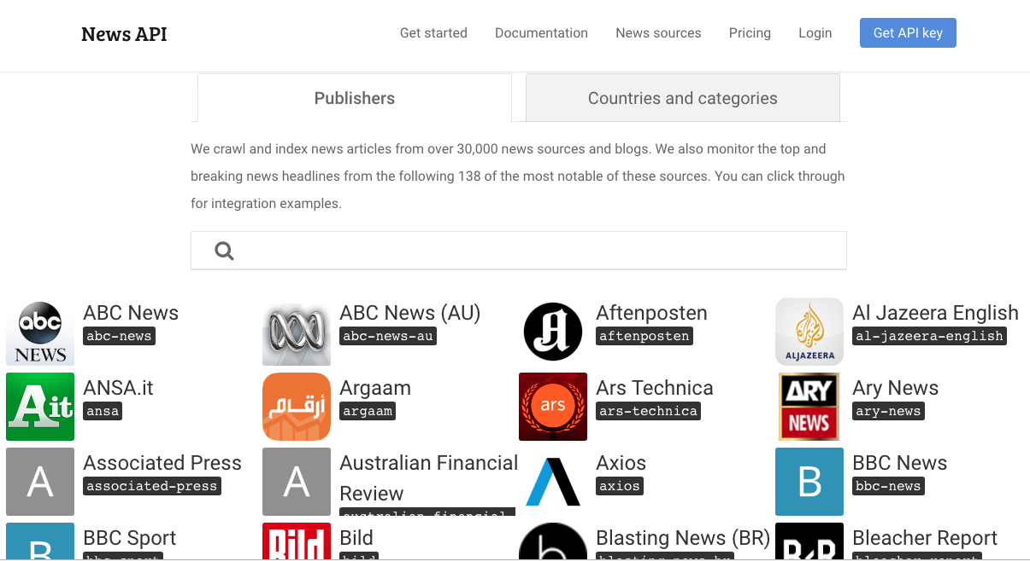
How and from where did the data come from?

Slide 6
So What?
How similar or varied are the news?
How connected are we with the rest of the world?

Slide 7
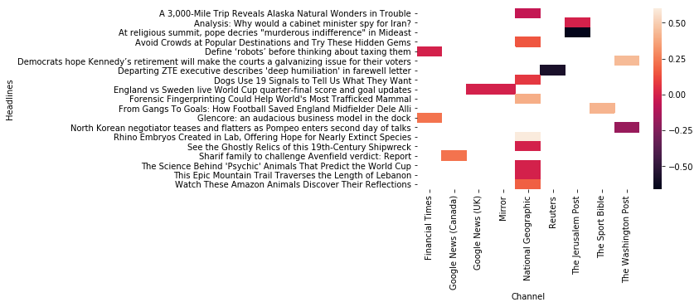
World media sentiment

Slide 8
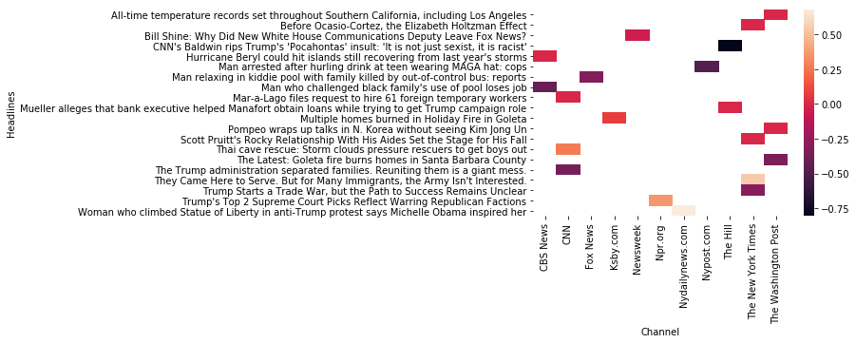
Us media sentiment

Slide 9
Then What? Conclusion
Are we in sync with the rest of the world?
How much of our thinking and decisions are due to our media - influence?
This data is just a start –
More analysis on the topic will shed insights on the current and emerging trends in the fields of finance, medicine, politics, etc. and how they are being given the direction by the media.

Slide 10
Q & A
Thanks!

