Slide 1
Your News Today
NEWS – North, East, West, South
Where do you think you are today?

Slide 2
What?
What are the top headlines in the world today?
What are the top headlines in US today?

Slide 3
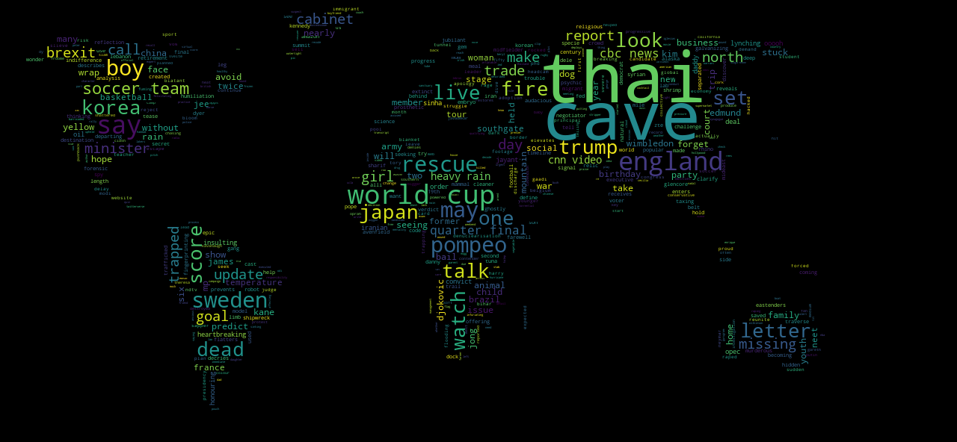
World Media Top WORDS

Slide 4
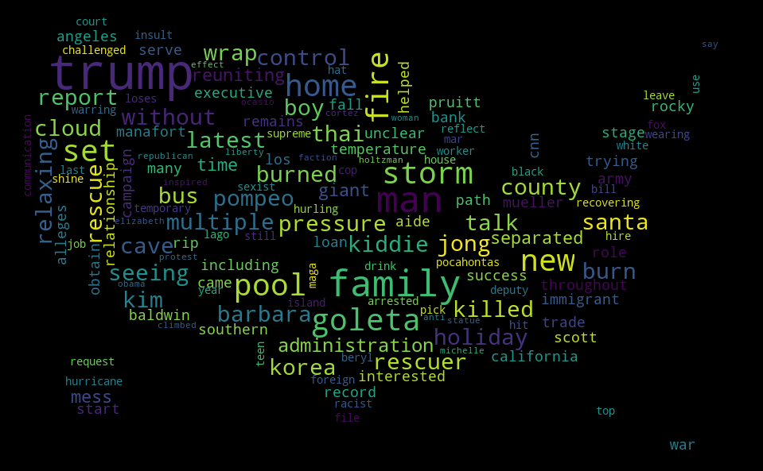
Us media top words

Slide 5
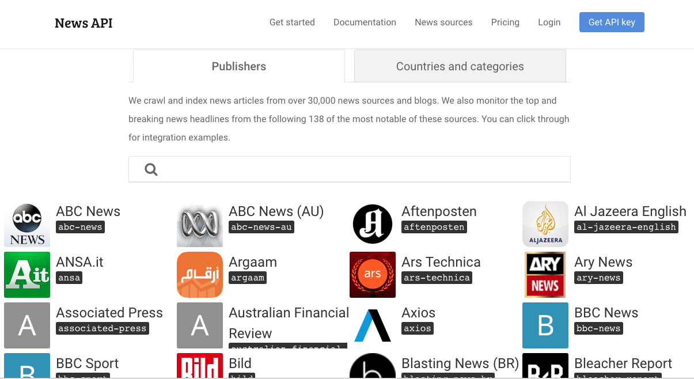
How and from where did the data come from?

Slide 6
So What?
How similar or varied are the news?
How connected are we with the rest of the world?

Slide 7
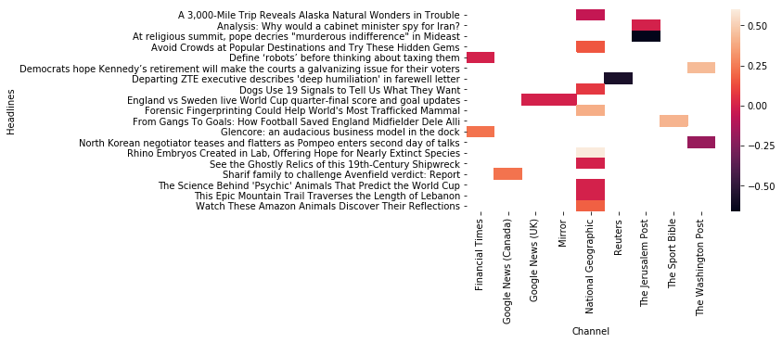
World media sentiment

Slide 8
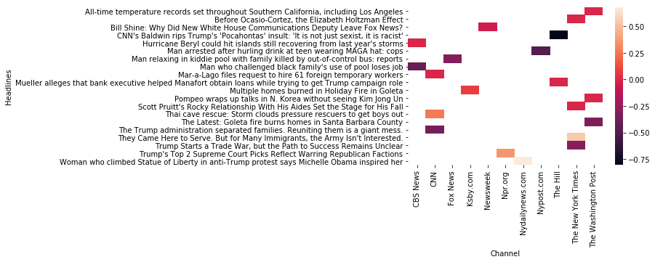
Us media sentiment

Slide 9
Then What? Conclusion
Are we in sync with the rest of the world?
How much of our thinking and decisions are due to our media - influence?
This data is just a start –
More analysis on the topic will shed insights on the current and emerging trends in the fields of finance, medicine, politics, etc. and how they are being given the direction by the media.

Slide 10
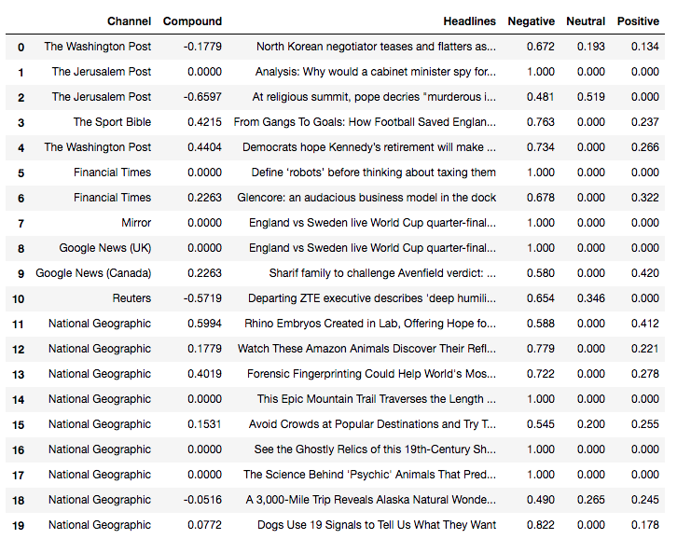
WORLD headlines sentiment dataframe

Slide 11
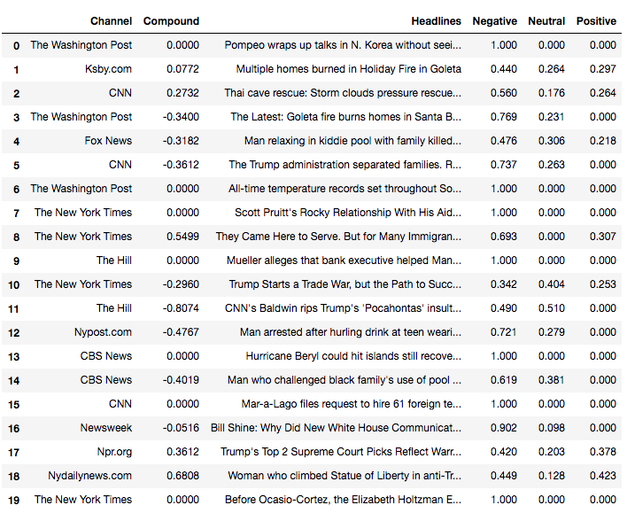
Us headline sentiment dataframe

Slide 12
QUOTE
“I have a foreboding of an America in my children's or grandchildren's time -- when the United States is a service and information economy; when nearly all the manufacturing industries have slipped away to other countries; when awesome technological powers are in the hands of a very few, and no one representing the public interest can even grasp the issues; when the people have lost the ability to set their own agendas or knowledgeably question those in authority; when, clutching our crystals and nervously consulting our horoscopes, our critical faculties in decline, unable to distinguish between what feels good and what's true, we slide, almost without noticing, back into superstition and darkness... The dumbing down of American is most evident in the slow decay of substantive content in the enormously influential media, the 30 second sound bites (now down to 10 seconds or less), lowest common denominator programming, credulous presentations on pseudoscience and superstition, but especially a kind of celebration of ignorance” ― Carl Sagan, The Demon-Haunted World: Science as a Candle in the Dark

Slide 13
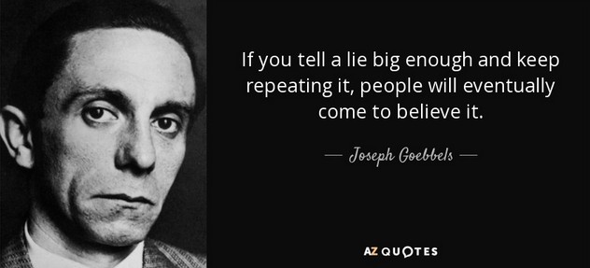
Quote

Slide 14
Issues we faced
The NewsAPI was used to pull the data from the start.
Issues: Result set was limited to only 20 results, using the country and category parameters.
Last minute policy change: The maximum number of articles that can be pulled for non parametrized query was limited to 100.
Heat Map generation and tuning – learning growth ☺.

Slide 15
Q & A
Thanks!

