Slide 1
STOCK MARKET TRACKER
Voice enabled chatbot
By Balaji K. Sadagopa

Slide 2
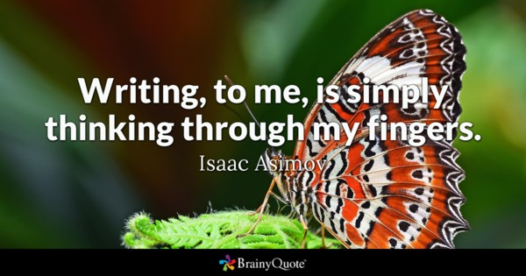

Slide 3
What is Stock market tracker
StockMarketTracker 1.0 is a Machine Learning BOT. That can be accessed by google voice or Slack.
StockMarketTracker 1.0 is a API component model designed application that can be instructed verbally over google voice to get the stock quotes for any publicly traded company. Note, with small modification siri and cortana can also be supported. StockMarketTracker can also be instructed via slack.
StockMarketTracker uses google DialogFlow Machine Learning API to learn the human voice patterns to pull company name, date and price type from the user. It then uses the company name to get the stock ticker from "Yahoo Finance API".
StockMarketTracker then gets the stock ticker price details from "Intrinio Financial Markets Data API". This information is returned back to the google DialogFlow.

Slide 4

Stock Market Tracker - Application flow
Yahoo Finance API
Google
Dialogflow
Webhook
Intrinio Finance API
Human User
Client Interface Layer
Google Machine Learning Service
API Services

Slide 5
Key Components
Google DialogFlow - Machine Learning to recognize and decipher voice and text commands.
Yahoo Finance API - Recognize and translate company name to ticker.
Intrinio Financial Markets Data API - To get the stock details for the stock ticker.

Slide 6
Demo – Q & A
Slack flow
Android voice flow

Slide 7
Special Thanks to
Austin Hagerty
Caleb Martinez
Garrick Stott

