Slide 1
Basic Spring Security Architecture
Http Request
AuthenticationFilter
Security Context
Username/password
AuthenticationManager
UserDetailsService
AuthenticationProvider
PasswordEncoder

Slide 2
Filter Chain
You may add a custom filter in the chain beside
the one provided by spring security
Request
ValidationFilter
BasicAuthenticationFilter
LoggingFilter
Response
ValidationManager
AuthenticationManager

Slide 3
Request
Cors Filter
Order 100
Csrf Filter
Order 200
BasicAuthenticationFilter
Order 300
Response
We add the filter at the position where BasicAuthenticationFilter would have been
Request
Cors Filter
Order 100
Csrf Filter
Order 200
CustomAuthenticationFilter
Order 300
Response

Slide 4
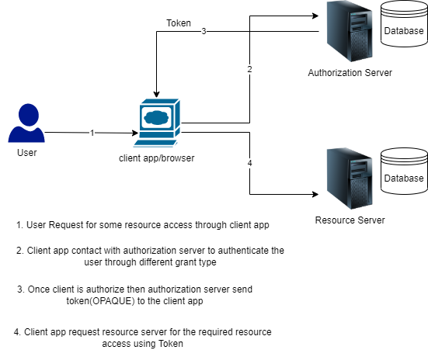
Oauth Flow

Slide 5
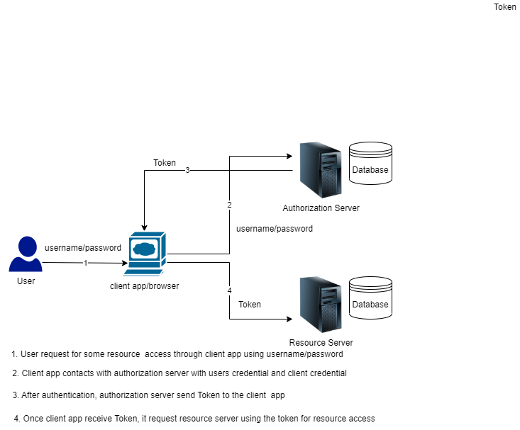
Oauth Flow with Grant Type = Password

Slide 6
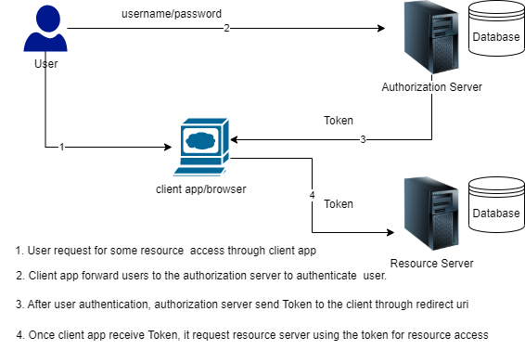
Oauth Flow with Grant Type = implicit

Slide 7
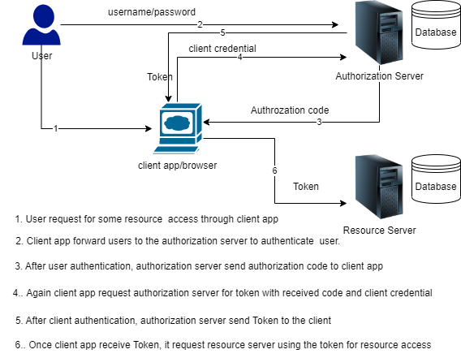
Oauth Flow with Grant Type = authorization code

Slide 8
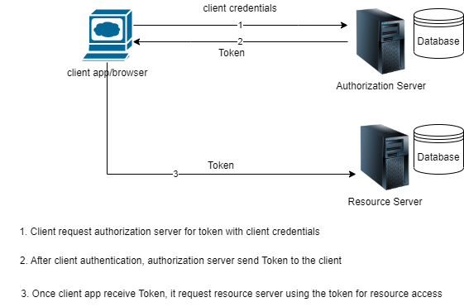
Oauth Flow with Grant Type = client_credentials

