Slide 1
Scratch 101
Coder Dojo Altona NortH

Slide 2
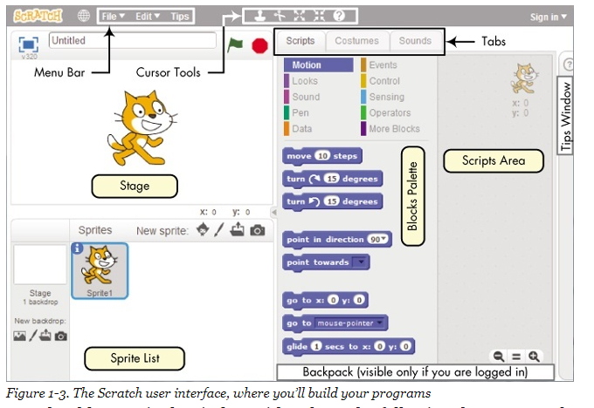
Scratch User Interface

Slide 3
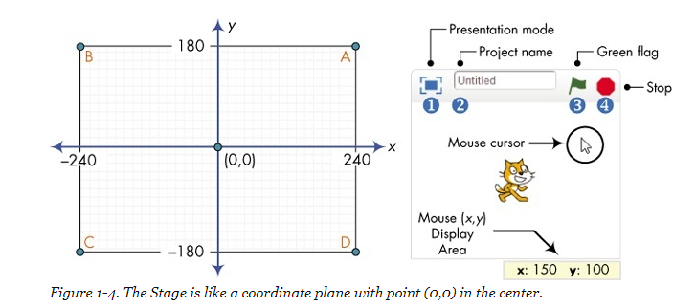
Scratch User Interface - Stage

Slide 4
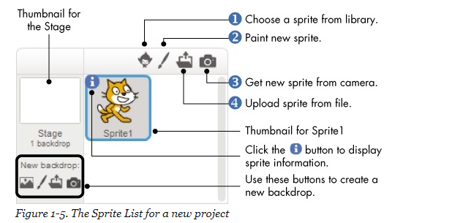
Scratch User Interface - Backdrop

Slide 5
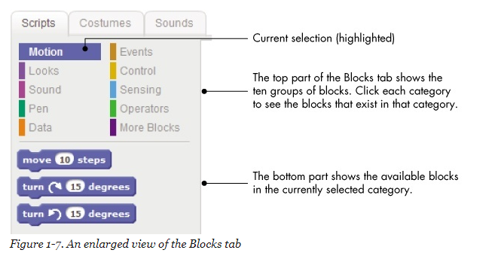
Scratch User Interface – Blocks Tab

Slide 6
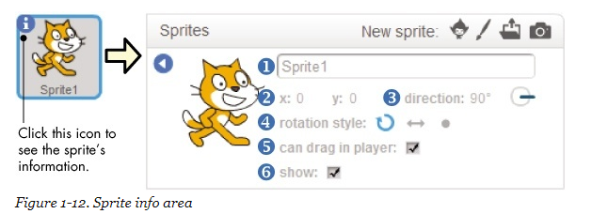
Scratch User Interface - Sprites

Slide 7
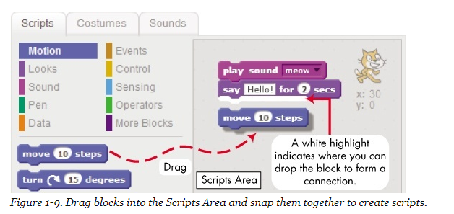
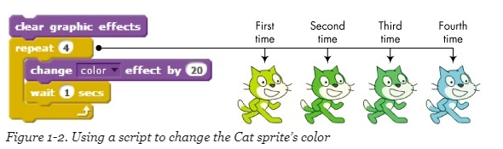
Scratch User Interface – Writing Code

Slide 8
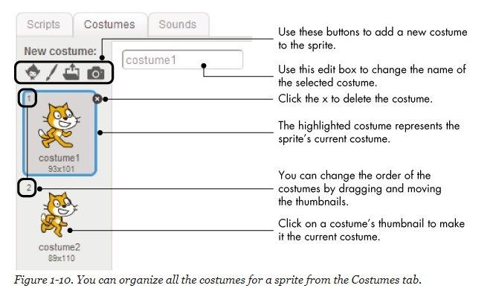
Scratch User Interface – Graphic Effects

Slide 9
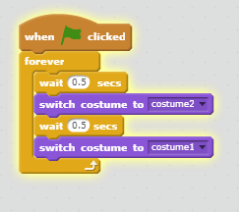
Scratch User Interface – Changing Costume

Slide 10
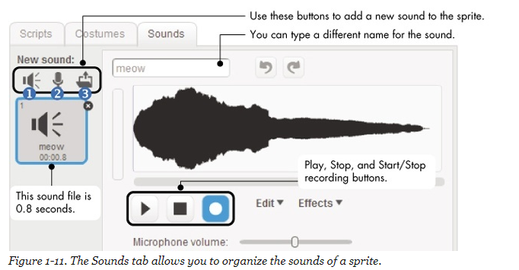
Scratch User Interface – Sound Effects

