Slide 1

Scratch 101
Altona NortH

Slide 2

User Interface

Slide 3
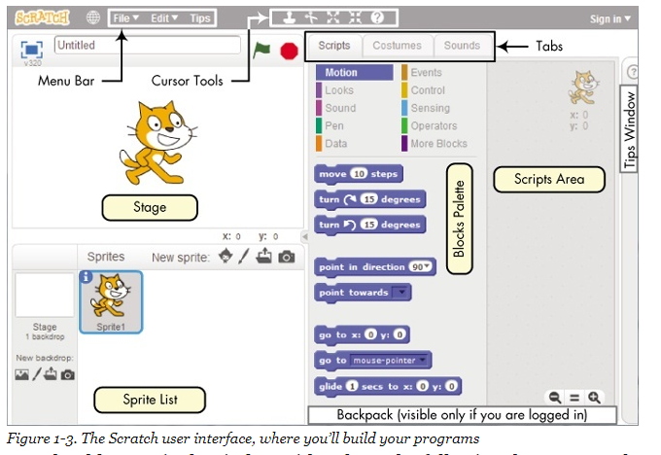
Scratch - User Interface

Slide 4
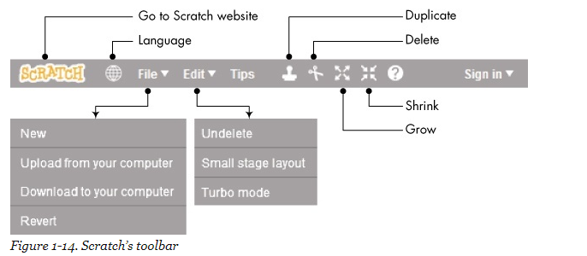
Scratch - Toolbar

Slide 5
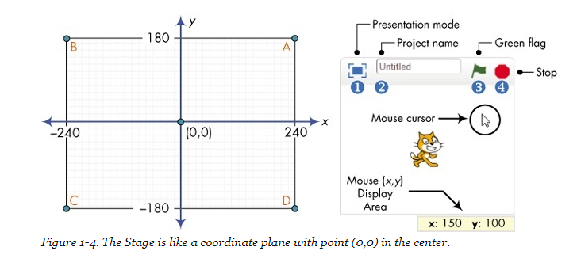
Scratch User Interface - Stage

Slide 6
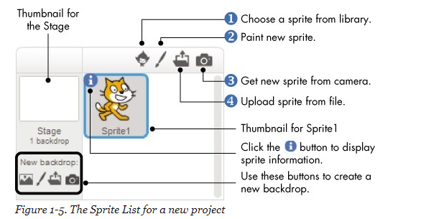
Scratch User Interface - Backdrop

Slide 7

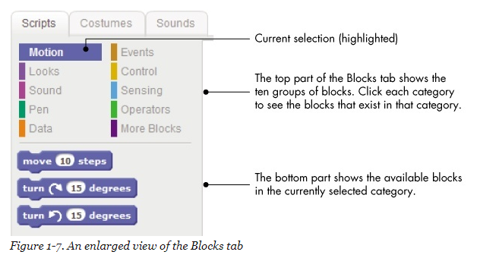
Scratch User Interface – Blocks Tab

Slide 8
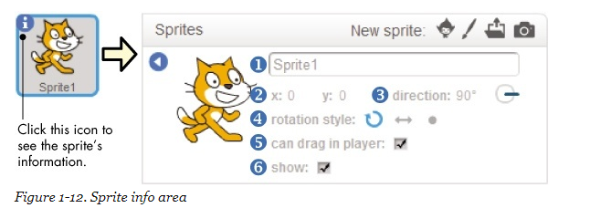
Scratch User Interface - Sprites

Slide 9
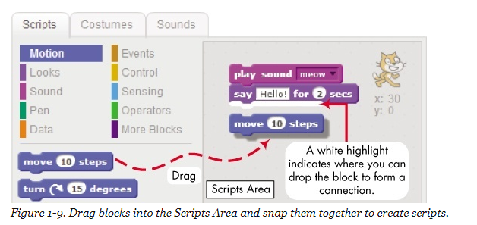

Scratch User Interface – Writing Code

Slide 10
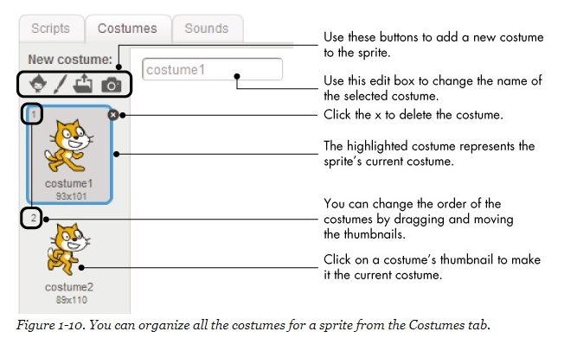
Scratch User Interface – Graphic Effects

Slide 11
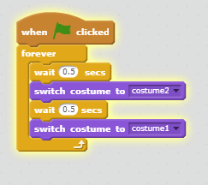
Scratch User Interface – Changing Costume

Slide 12
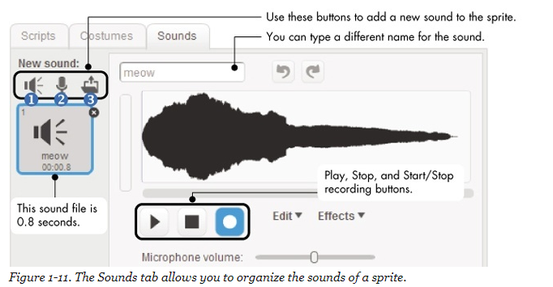
Scratch User Interface – Sound Effects

Slide 13
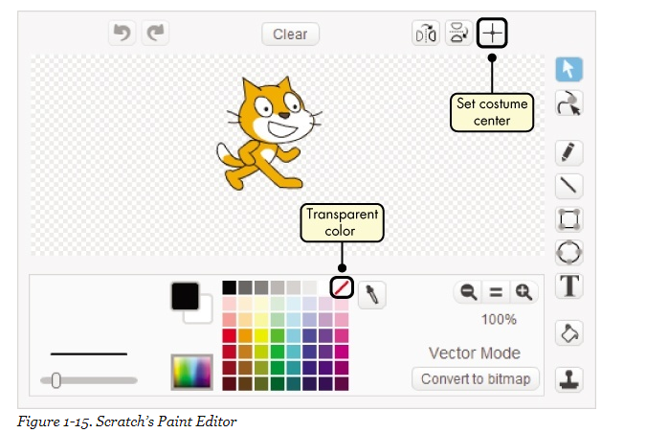
Scratch User Interface – Sprite Paint Editor

Slide 14
Tutorial Getting Started

Slide 15
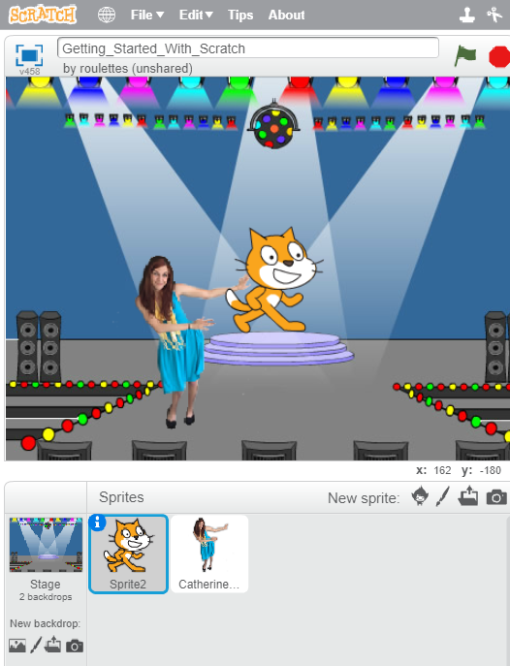
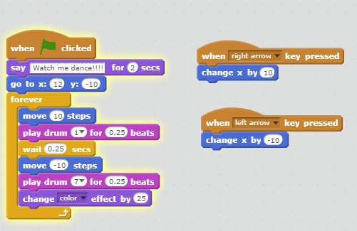
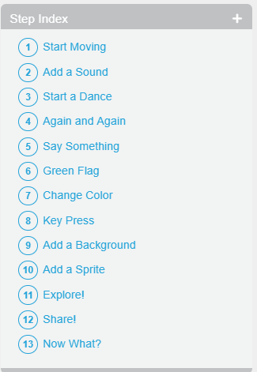
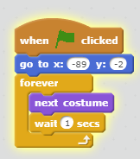
Tutorial – Getting Started
Cat Sprite
Catherine Dance Sprite

Slide 16
Interactive Birthday Card

Slide 17
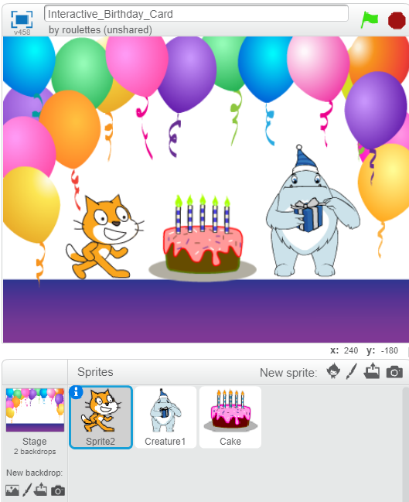
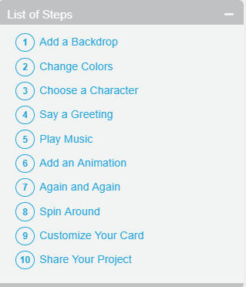
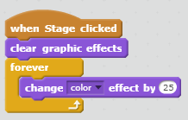
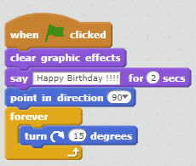
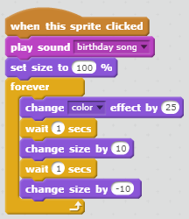
Tutorial – Interactive Birthday Card
Backdrop Sprite
Cat Sprite
Cake Sprite

Slide 18
Tutorial Animate A Name

Slide 19
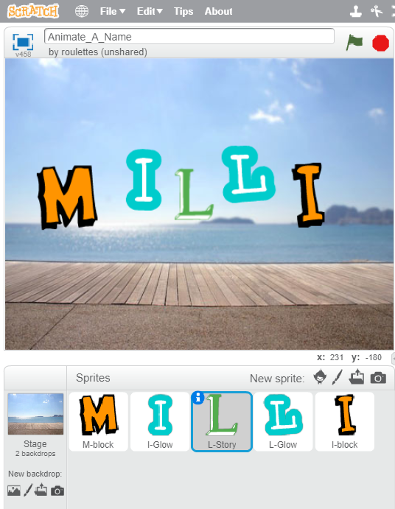
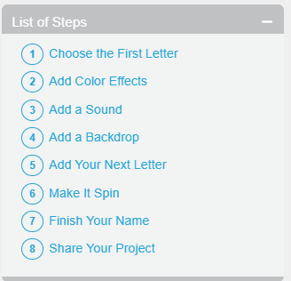
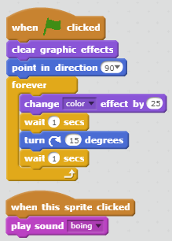
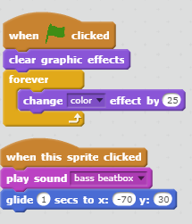
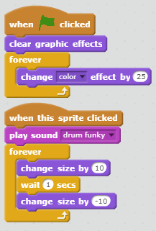
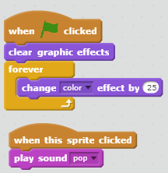
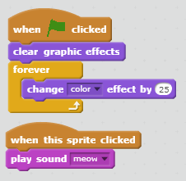
Tutorial – Animate A Name
I Sprite
M Sprite
L Sprite
I Sprite
L Sprite

Slide 20
Tutorial Make IT FLY

Slide 21
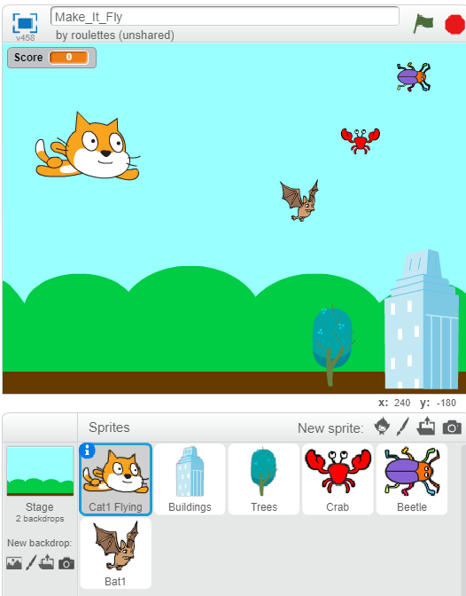
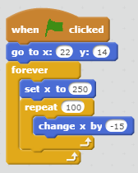
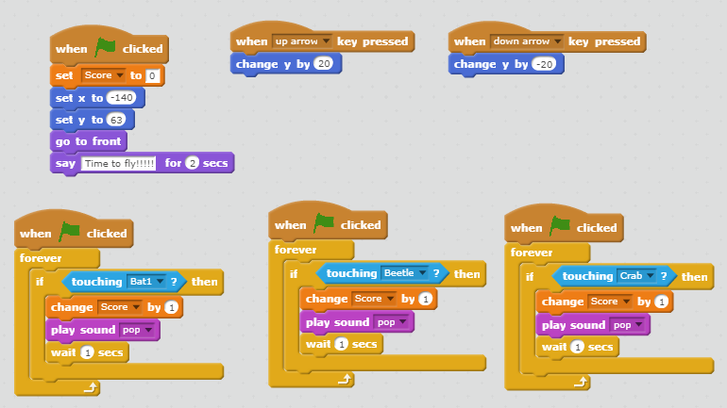
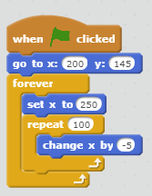
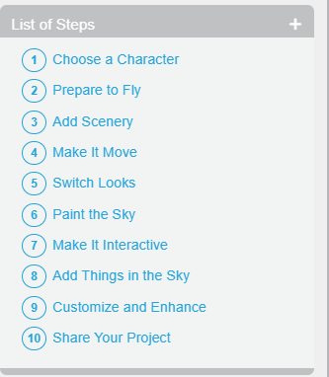
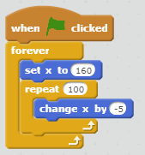
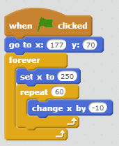
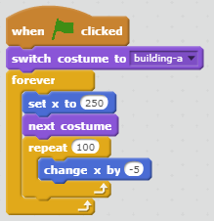
Tutorial – Make It Fly
Cat Sprite
Bat Sprite
Beetle Sprite
Tree Sprite
Crab Sprite
Building Sprite

Slide 22
Tutorial Make Music

Slide 23
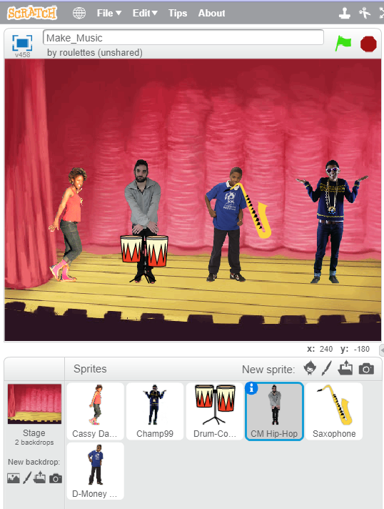
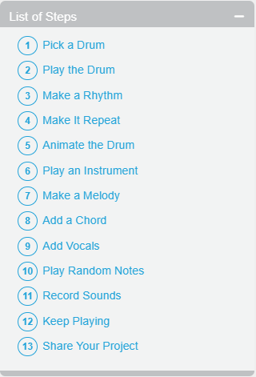
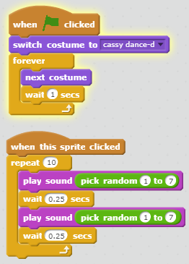
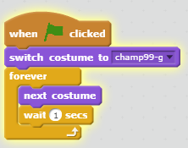
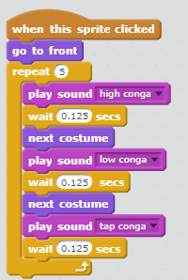
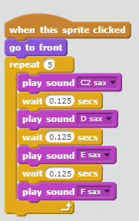
Tutorial – Make Music
Champ99 Sprite
Cassy Sprite
Drum Sprite
Saxophone Sprite

Slide 24
Tutorial Race to the finish

Slide 25
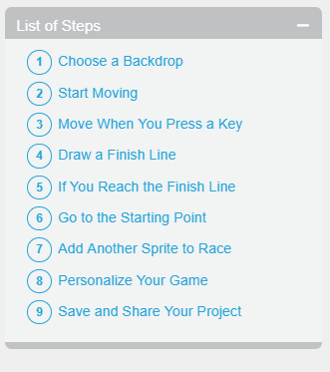
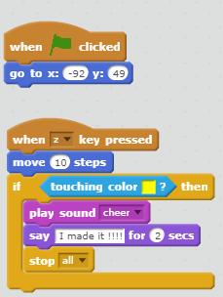
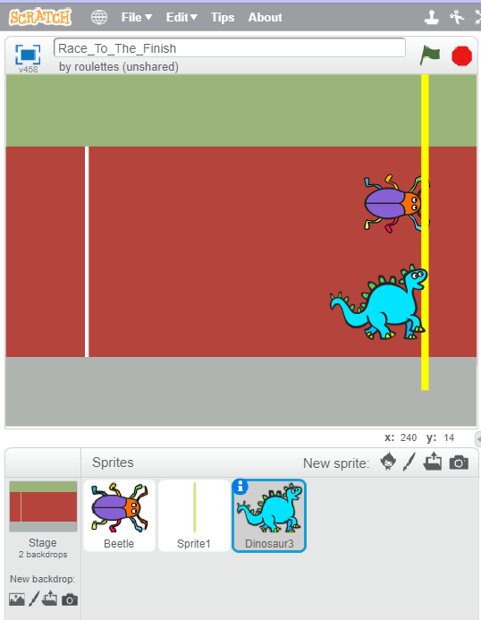
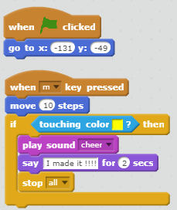

Tutorial – Race to the finish
Beetle Sprite
Finish Line Sprite
Dinosaur Sprite

Slide 26
Tutorial Pong

Slide 27
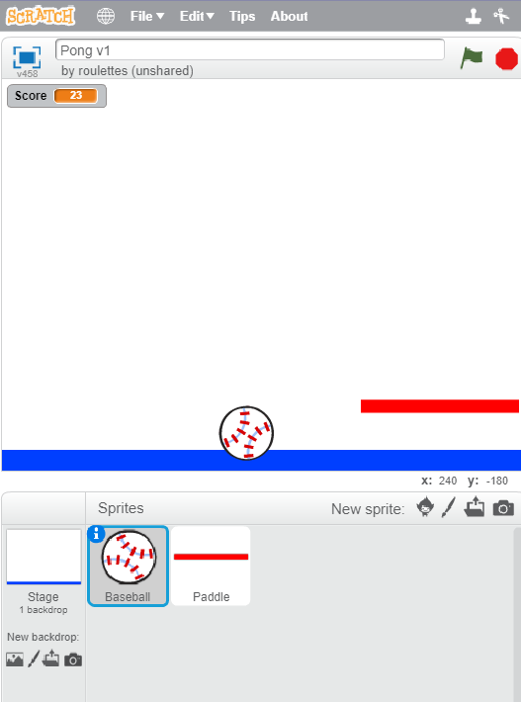
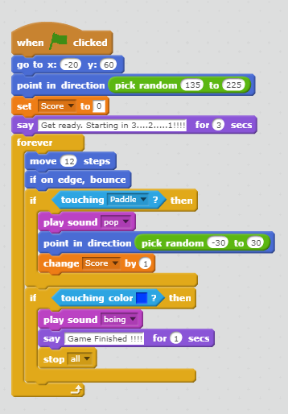
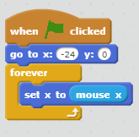
Tutorial - PONG
Paddle Sprite
Ball Sprite

