Slide 1
Superstore Sales Dashboard Insights
Detailed Analysis and Observations

Slide 2
1. Overall Sales Performance
The Superstore has achieved a total sales figure of $2.26 million, representing a significant volume of transactions across multiple regions and product categories. This figure reflects the combined revenue generated from Furniture, Office Supplies, and Technology categories.

Slide 3
2. Sales by Product Category
Among the product categories:
- Furniture leads the chart with $827.46K in sales, accounting for 36.59% of total revenue.
- Office Supplies generated $728.66K (32.22%), showcasing steady demand.
- Technology brought in $705.42K (31.19%), indicating a competitive yet slightly lower performance.

Slide 4
3. Regional Performance Breakdown
Regional sales data reveals that:
- The West region contributed the highest to the overall sales, with nearly $800K.
- The East region closely follows, also showcasing strong performance.
- Central and South regions showed comparatively lower sales, indicating potential areas for marketing or expansion efforts.

Slide 5
4. Sales Trend Over Time
Sales trends reveal a peak in late 2015, particularly around October and November. Following this high point, sales have gradually declined, stabilizing at lower levels over time. This pattern may indicate seasonality in demand or the impact of market dynamics over the years.

Slide 6
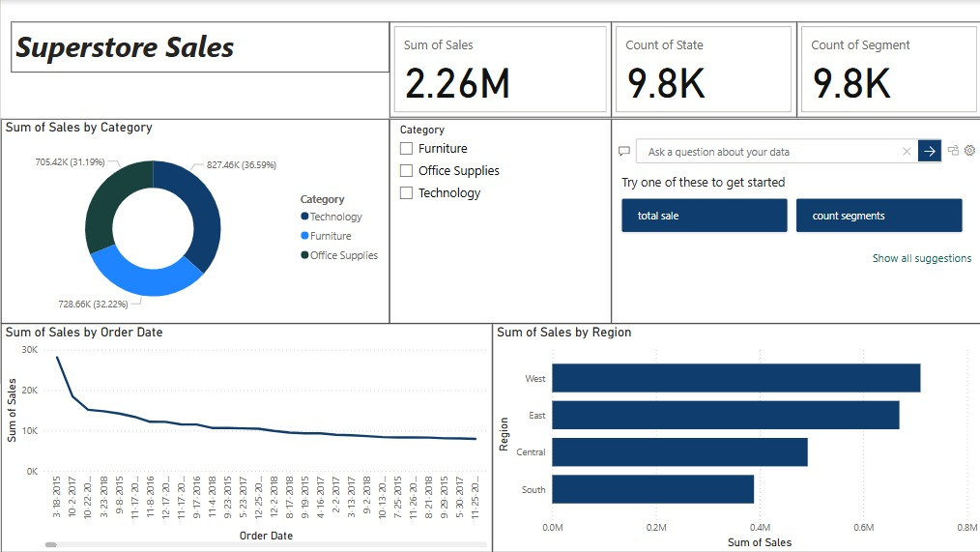
Dashboard Overview

