Slide 1
Ecommerce Shipping Data Analysis
Using SQLite and SQL Queries

Slide 2
Dataset Overview
- Dataset: ecommerce_shipping_data.db (SQLite)
- Table: shipping_data
- Key Columns:
• Mode_of_Shipment, Warehouse_block, Cost_of_the_Product
• Customer_rating, Product_importance, Discount_offered
• Reached.on.Time_Y.N (1=On Time, 0=Delayed)

Slide 3
Project Objectives
- Perform SQL-based data exploration
- Identify key insights from shipping trends
- Evaluate performance based on shipment modes, costs, and delays
- Practice SQL functions like GROUP BY, AVG, CASE, and views

Slide 4
Key SQL Queries Used
- Total Orders by Mode of Shipment
- Average Cost by Warehouse Block
- Delay Analysis by Shipment Mode
- Discount and Product Importance Impact
- Top Costliest Delayed Orders (Subquery)
- View for Shipment Summary

Slide 5
SQL View: shipping_summary
CREATE VIEW shipping_summary AS
SELECT Mode_of_Shipment,
COUNT(*) AS total_orders,
AVG(Cost_of_the_Product) AS avg_cost,
AVG(Discount_offered) AS avg_discount,
SUM(CASE WHEN "Reached.on.Time_Y.N" = 0 THEN 1 ELSE 0 END) AS delayed_orders
FROM shipping_data
GROUP BY Mode_of_Shipment;

Slide 6
Deliverables
- SQLite Database: ecommerce_shipping_data.db
- SQL Query Script: ecommerce_shipping_analysis.sql
- PowerPoint Summary Deck
- (Optional) Screenshots of Query Outputs

Slide 7
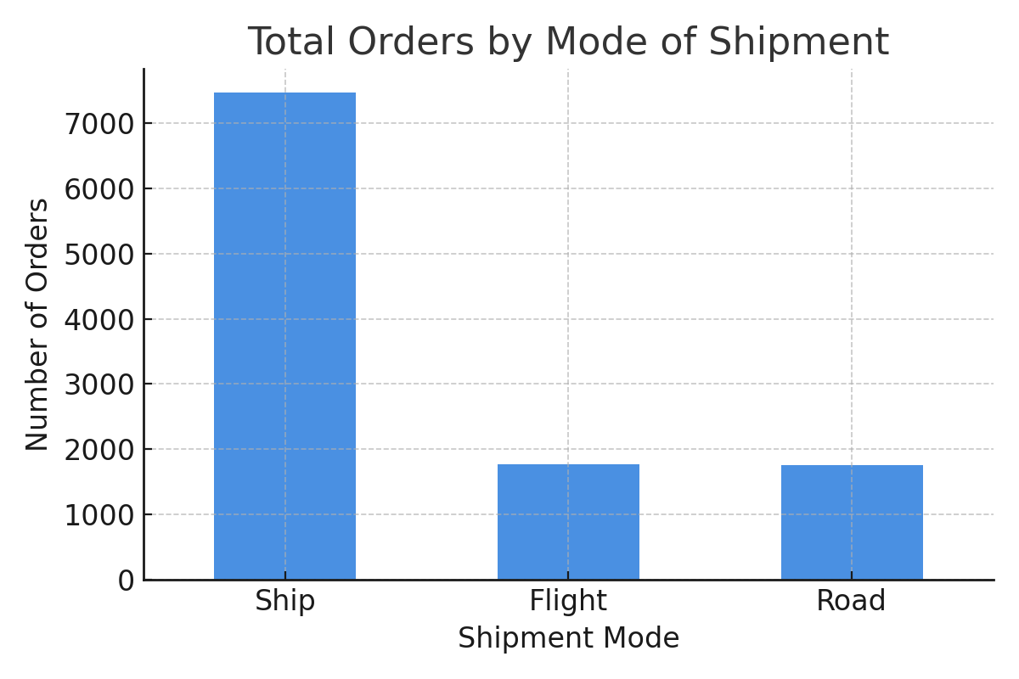
Visualization: Orders by Shipment Mode

Slide 8
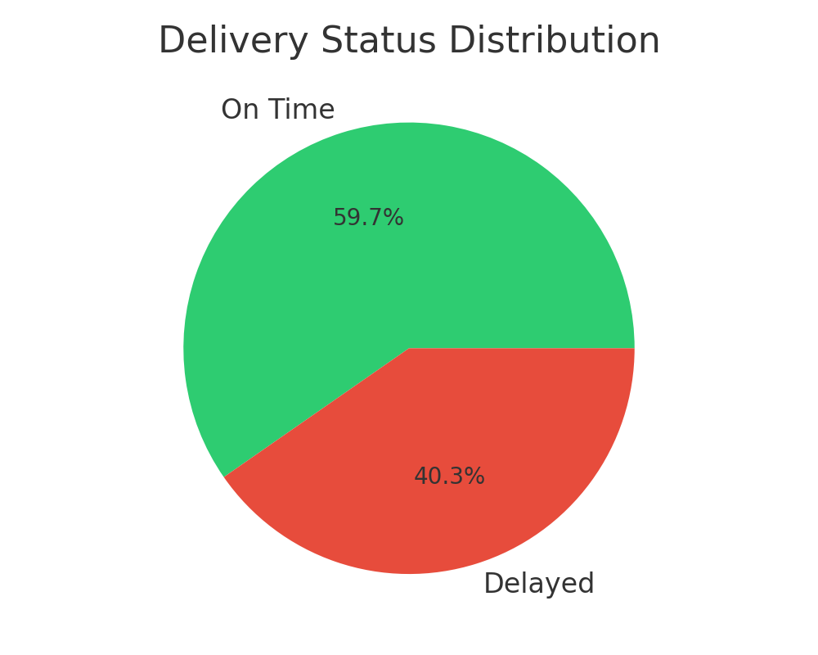
Visualization: Delivery Status Distribution

Slide 9
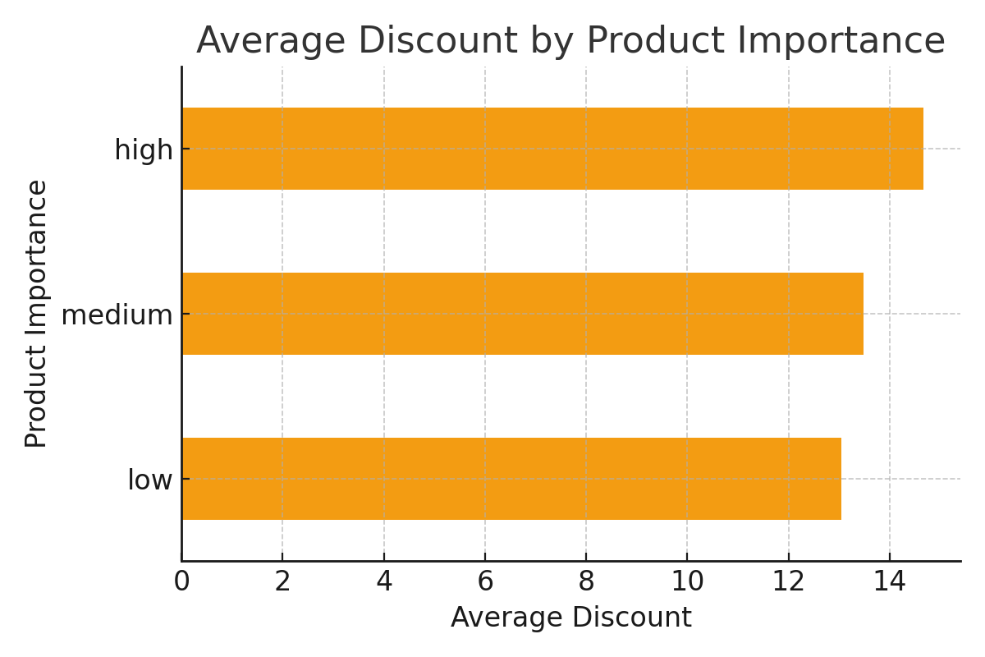
Visualization: Average Discount by Product Importance

