Slide 1
Smart Stocks AI real time Stock Market Analysis
Department of Computer Science & Engineering
B.Tech | Academic Year 2025–26
Presented by:
Sameer Farhad | 2320030239 | CSE
Sai Harshit Dasari | 2320030249 | CSE
Balivada Sai Yashwant | 2310030018 | CSE
Guided by:
Dr. N Sirisha, Associate Professor

Slide 2
Table of Contents
ABSTRACT
INTRODUCTION
OBJECTIVES
LITERATURE SURVEY
TECHNOLOGIES USED
SYSTEM ARCHITECTURE
PROPOSED METHOD
SYSTEM WORKFLOW
DATASET DETAILS
KEY FEATURES
ADVANTAGES & LIMITATIONS
FUTURE ENHANCEMENTS
CONCLUSION & REFERENCES

Slide 3
ABSTRACT
This project develops a Smart Stock Market Analysis System using Big Data technologies. Apache Spark (PySpark) processes and analyzes stock price data efficiently, enabling scalable analytics on large datasets using Spark SQL and Spark DataFrames. A Streamlit-based dashboard provides real-time visualization, AI-based price prediction, and simulated trading with a virtual wallet and transaction history. The system demonstrates how distributed data processing and Machine Learning can combine to support intelligent, data-driven trading decisions. Tech Stack:
Apache Spark | PySpark | Spark SQL | Streamlit | Plotly | Scikit-learn | yfinance | Python | VS Code

Slide 4
INTRODUCTION
The stock market generates massive volumes of real-time financial data including prices, volumes, and market indicators.
Analyzing large-scale, continuously evolving data requires efficient distributed processing beyond traditional single-machine tools.
This project builds a Smart Stock Market Dashboard combining:
• Apache Spark (PySpark) — Distributed Big Data processing and aggregation
• Yahoo Finance API (yfinance) — Near real-time stock data ingestion
• Machine Learning (Linear Regression) — AI-based next price prediction
• Streamlit + Plotly — Interactive visualization and trading simulation
Result: A scalable, intelligent and user-friendly stock trading analytics platform.

Slide 5
LITERATURE SURVEY
Paper | Method | Drawbacks | Future Directions | Link
Stock Price Prediction using LSTM | Deep learning time-series forecasting | Requires large historical datasets | Hybrid deep learning models | https://ieeexplore.ieee.org
Machine Learning in Stock Market Prediction | ML regression & classification models | Limited accuracy during volatile markets | Reinforcement learning trading models | https://arxiv.org
Real-Time Financial Data Analytics using Apache Spark | Distributed data processing | Infrastructure complexity | Spark structured streaming integration | https://spark.apache.org
Financial Market Analysis using Technical Indicators | Distributed data processing | Cannot capture complex market dynamics | AI-driven trading strategies | https://www.sciencedirect.com

Slide 6
PROBLEM STATEMENT
Financial markets generate large volumes of real-time data that are difficult to analyze using traditional tools. Investors often rely on limited indicators or manual analysis, which may lead to inaccurate trading decisions. There is a need for a system that can process large-scale financial data efficiently, generate insights using data analytics and machine learning, and present the results through an interactive dashboard for better decision making.
The goal of this project is to build a Big Data Stock Market Analytics system that uses Apache Spark for large-scale data processing and provides an interactive dashboard with AI-based prediction, trading signals, and simulated trading features.

Slide 7
EXISTING SYSTEM
Currently, investors use platforms such as Angel One, Groww, and Zerodha for stock analysis and trading.
Features of Existing Systems
Provide stock price charts and technical indicators
Enable real trading with brokerage accounts
Provide portfolio management tools
Limitations
Internal analytics algorithms are not transparent
Limited customization for research and experimentation
Do not demonstrate underlying big-data processing pipelines
Educational understanding of data processing and prediction models is limited

Slide 8
OBJECTIVES
• Big Data Stock Analysis Analyze large volumes of historical stock market data using Big Data techniques to identify trends, patterns, and market behavior for better trading insights.
• Scalable Processing with Apache Spark Use Apache Spark (PySpark) to process and aggregate large stock datasets efficiently, enabling fast and scalable data analytics.
• Interactive Trading Dashboard Develop a user-friendly dashboard using Streamlit that displays stock performance through dynamic visualizations such as live candlestick charts.
• Automated Trading Signals Implement the Moving Average Crossover strategy (MA10 vs MA50) to automatically generate Buy, Sell, or Hold signals for traders.
• AI-Based Price Prediction Integrate Machine Learning using Linear Regression to predict future stock price trends based on historical data.
• Virtual Trading Simulation Create a simulated trading environment with a virtual wallet and transaction tracking to test strategies without real financial risk.

Slide 9
PROPOSED solution
The proposed system SmartStocks AI is a big data–based stock market analytics platform designed to analyze financial data efficiently and present insights through an interactive dashboard. The system integrates Apache Spark for large-scale data processing, machine learning for price prediction, and a Streamlit-based visualization interface for user interaction.
Stock market data is collected from the Yahoo Finance API and processed using Apache Spark, which performs analytics such as average price calculation, high–low analysis, and volume aggregation. The processed results are then exported and used by the dashboard for visualization and decision support.
The platform includes an AI-driven prediction module that forecasts future stock prices using machine learning techniques. Additionally, a trading simulation module allows users to perform buy and sell operations using a virtual wallet, track holdings, and analyze profit or loss.

Slide 10
TECHNOLOGIES USED
Big Data Technologies:
• Apache Spark (PySpark) — Distributed data processing engine
• Spark SQL — Large-scale SQL queries on Spark DataFrames
Programming & Frameworks:
• Python 3.x, Streamlit (interactive dashboard), Plotly (candlestick charts)
Machine Learning:
• Scikit-learn — Linear Regression for price prediction
• NumPy — Numerical computation for feature engineering
Data Source & IDE:
• Yahoo Finance API (yfinance) — Live OHLCV stock data feed
• Visual Studio Code (VS Code) — Development environment

Slide 11
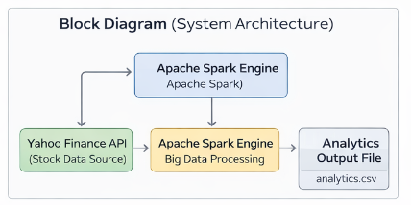
Block diagram

Slide 12
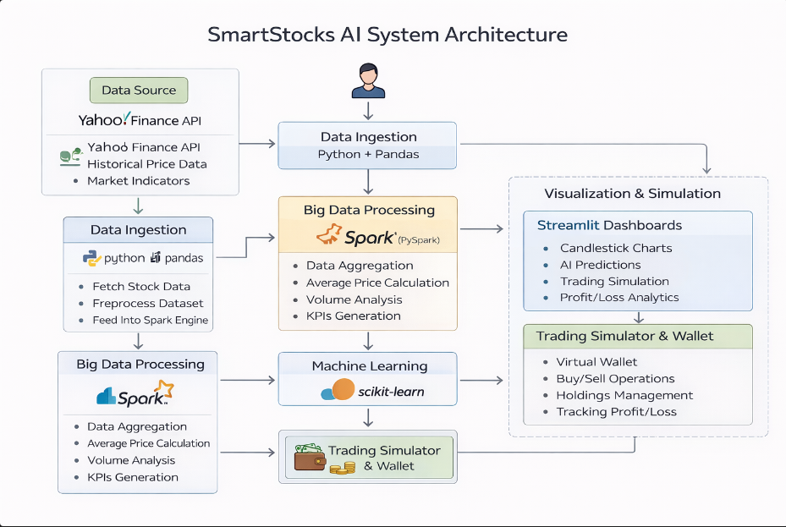
SYSTEM ARCHITECTURE

Slide 13
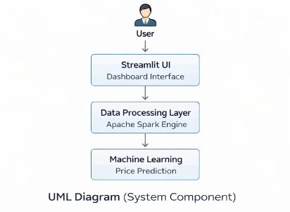
UML DIAGRAM

Slide 14
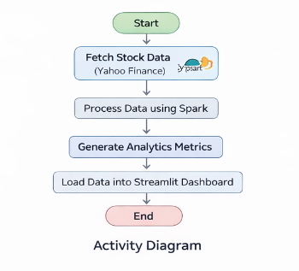
Activity diagram

Slide 15
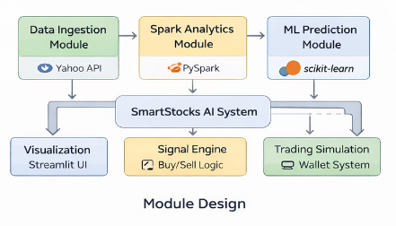
Module design

Slide 16
Expected outcomes
The SmartStocks AI system is expected to:
Demonstrate Big Data analytics using Apache Spark
Provide an interactive stock market dashboard
Generate AI-based price predictions
Simulate a trading environment with wallet and holdings
Enable visual analysis through candlestick charts
Help users understand data-driven trading strategies

Slide 17
Thank you

