Slide 1
Smart Stocks AI real time Stock Market Analysis
Department of Computer Science & Engineering
B.Tech | Academic Year 2025–26
Presented by:
Sameer Farhad | 2320030239 | CSE
Sai Harshit Dasari | 2320030249 | CSE
Balivada Sai Yashwant | 2310030018 | CSE
Guided by:
Dr. N Sirisha, Associate Professor

Slide 2
Table of Contents
REVIEW 2 COMMENTS
MODULE-WISE IMPLEMENTATION
COMPARISON AND DISCUSSION (GRAPHICAL REPRESENTATION)
RESULTS
CONCLUSION
FUTURE DIRECTION
REFERENCES

Slide 3
REVIEW-2 COMMENTS
1. Provide Better Explanation of Trading Signals The explanation of Buy, Sell, and Hold signals generated by the system should be more detailed. The project should clearly describe how the Moving Average Crossover strategy works and how investors can interpret these signals for decision making.
2. Include More Machine Learning Algorithms The current system mainly relies on the Moving Average Crossover technique, which is a rule-based strategy. The panel recommended integrating additional machine learning algorithms to improve prediction accuracy and enhance the analytical capability of the system.
Such Algorithms are:-
Random Forest for stock market movement classification
Support Vector Machine (SVM) for pattern detection

Slide 4
Module wise implementation
1. Data Collection Module
This module collects historical stock market data from available financial datasets or APIs. The collected data includes attributes such as stock symbol, date, open price, close price, high price, low price, and volume.
2. Data Processing Module (Apache Spark)
Apache Spark with PySpark is used to process large stock datasets. Spark enables distributed computing, allowing efficient filtering, transformation, and aggregation of stock market data.
3. Feature Engineering Module
In this module, financial indicators are calculated. The main indicator used is the Moving Average Crossover Strategy, where:
MA10 represents the short-term moving average.
MA50 represents the long-term moving average.
These indicators help identify market trends.
4. Signal Generation Module
This module generates trading signals based on the crossover rule:
• Buy Signal → When MA10 crosses above MA50 • Sell Signal → When MA10 crosses below MA50 • Hold Signal → When there is no crossover
5. Visualization Module (Streamlit Dashboard)
A Streamlit web dashboard is developed to display:
• Stock price trends • Candlestick charts • Generated trading signals

Slide 5
LITERATURE SURVEY
Paper | Method | Drawbacks | Future Directions | Link
Stock Price Prediction using LSTM | Deep learning time-series forecasting | Requires large historical datasets | Hybrid deep learning models | https://ieeexplore.ieee.org
Machine Learning in Stock Market Prediction | ML regression & classification models | Limited accuracy during volatile markets | Reinforcement learning trading models | https://arxiv.org
Real-Time Financial Data Analytics using Apache Spark | Distributed data processing | Infrastructure complexity | Spark structured streaming integration | https://spark.apache.org
Financial Market Analysis using Technical Indicators | Distributed data processing | Cannot capture complex market dynamics | AI-driven trading strategies | https://www.sciencedirect.com

Slide 6
PROBLEM STATEMENT
Financial markets generate large volumes of real-time data that are difficult to analyze using traditional tools. Investors often rely on limited indicators or manual analysis, which may lead to inaccurate trading decisions. There is a need for a system that can process large-scale financial data efficiently, generate insights using data analytics and machine learning, and present the results through an interactive dashboard for better decision making.
The goal of this project is to build a Big Data Stock Market Analytics system that uses Apache Spark for large-scale data processing and provides an interactive dashboard with AI-based prediction, trading signals, and simulated trading features.

Slide 7
EXISTING SYSTEM
Currently, investors use platforms such as Angel One, Groww, and Zerodha for stock analysis and trading.
Features of Existing Systems
Provide stock price charts and technical indicators
Enable real trading with brokerage accounts
Provide portfolio management tools
Limitations
Internal analytics algorithms are not transparent
Limited customization for research and experimentation
Do not demonstrate underlying big-data processing pipelines
Educational understanding of data processing and prediction models is limited

Slide 8
OBJECTIVES
• Big Data Stock Analysis Analyze large volumes of historical stock market data using Big Data techniques to identify trends, patterns, and market behavior for better trading insights.
• Scalable Processing with Apache Spark Use Apache Spark (PySpark) to process and aggregate large stock datasets efficiently, enabling fast and scalable data analytics.
• Interactive Trading Dashboard Develop a user-friendly dashboard using Streamlit that displays stock performance through dynamic visualizations such as live candlestick charts.
• Automated Trading Signals Implement the Moving Average Crossover strategy (MA10 vs MA50) to automatically generate Buy, Sell, or Hold signals for traders.
• AI-Based Price Prediction Integrate Machine Learning using Linear Regression to predict future stock price trends based on historical data.
• Virtual Trading Simulation Create a simulated trading environment with a virtual wallet and transaction tracking to test strategies without real financial risk.

Slide 9
PROPOSED solution
The proposed system SmartStocks AI is a big data–based stock market analytics platform designed to analyze financial data efficiently and present insights through an interactive dashboard. The system integrates Apache Spark for large-scale data processing, machine learning for price prediction, and a Streamlit-based visualization interface for user interaction.
Stock market data is collected from the Yahoo Finance API and processed using Apache Spark, which performs analytics such as average price calculation, high–low analysis, and volume aggregation. The processed results are then exported and used by the dashboard for visualization and decision support.
The platform includes an AI-driven prediction module that forecasts future stock prices using machine learning techniques. Additionally, a trading simulation module allows users to perform buy and sell operations using a virtual wallet, track holdings, and analyze profit or loss.

Slide 10
TECHNOLOGIES USED
Big Data Technologies:
• Apache Spark (PySpark) — Distributed data processing engine
• Spark SQL — Large-scale SQL queries on Spark DataFrames
Programming & Frameworks:
• Python 3.x, Streamlit (interactive dashboard), Plotly (candlestick charts)
Machine Learning:
• Scikit-learn — Linear Regression for price prediction
• NumPy — Numerical computation for feature engineering
Data Source & IDE:
• Yahoo Finance API (yfinance) — Live OHLCV stock data feed
• Visual Studio Code (VS Code) — Development environment

Slide 11
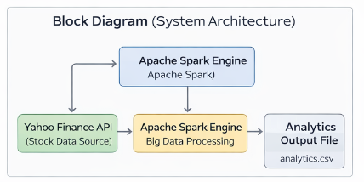
Block diagram

Slide 12
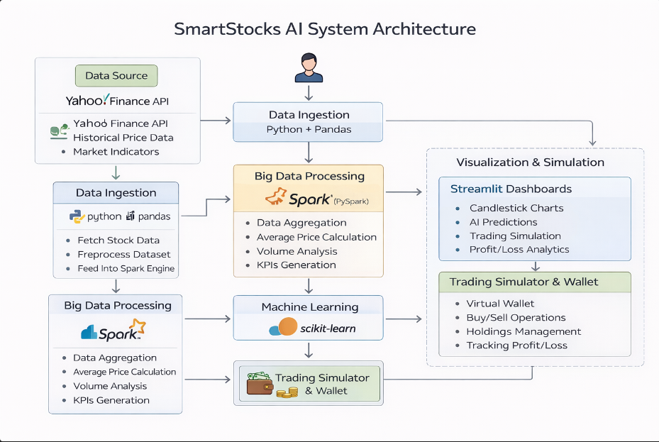
SYSTEM ARCHITECTURE

Slide 13
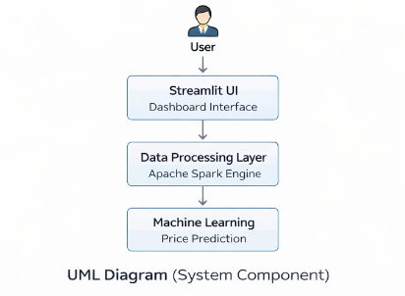
UML DIAGRAM

Slide 14
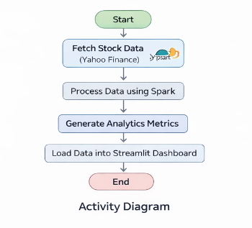
Activity diagram

Slide 15
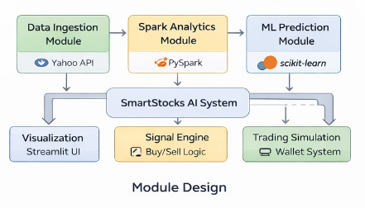
Module design

Slide 16
Expected outcomes
The SmartStocks AI system is expected to:
Demonstrate Big Data analytics using Apache Spark
Provide an interactive stock market dashboard
Generate AI-based price predictions
Simulate a trading environment with wallet and holdings
Enable visual analysis through candlestick charts
Help users understand data-driven trading strategies

Slide 17
Thank you

